Slide 1
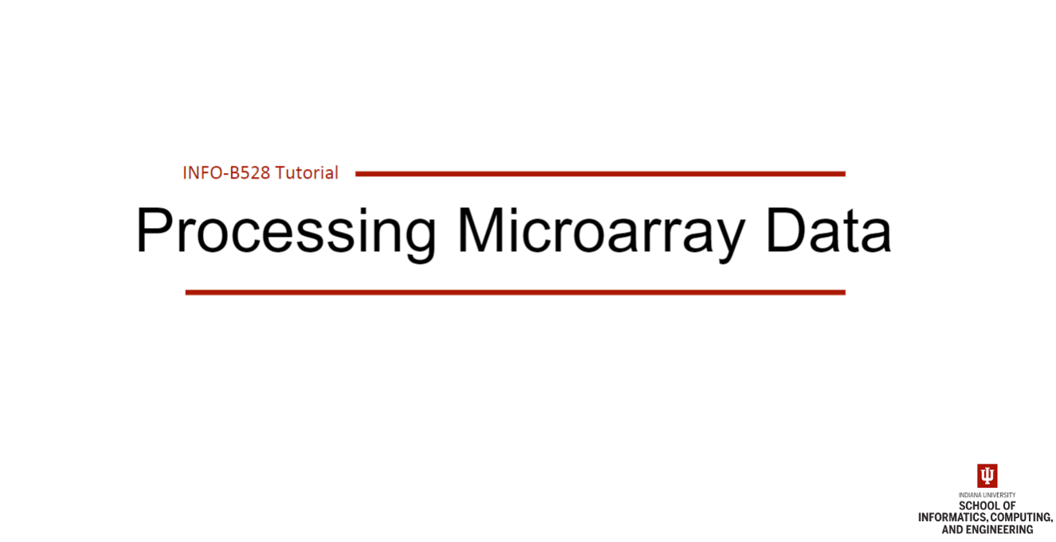

Slide 2
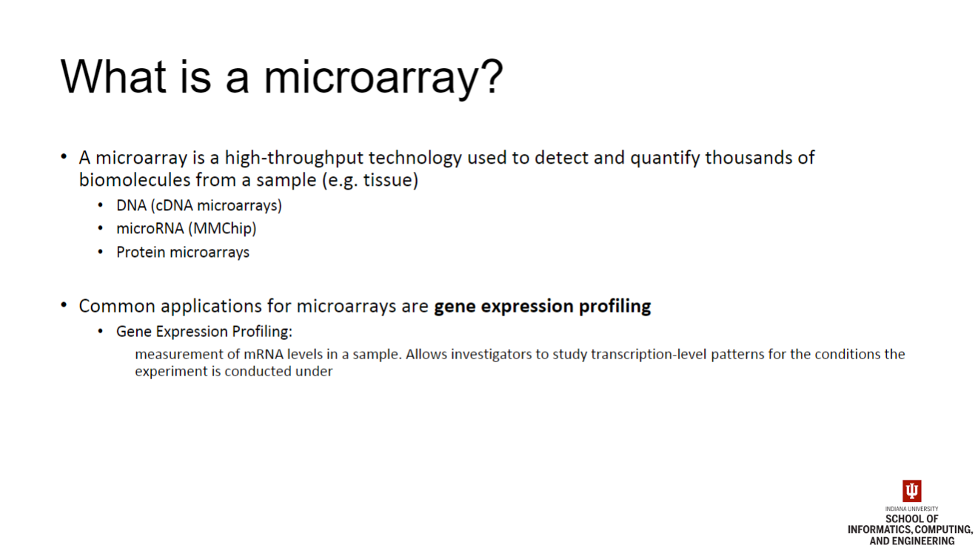

Slide 3
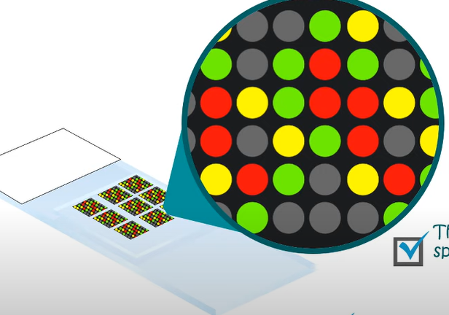
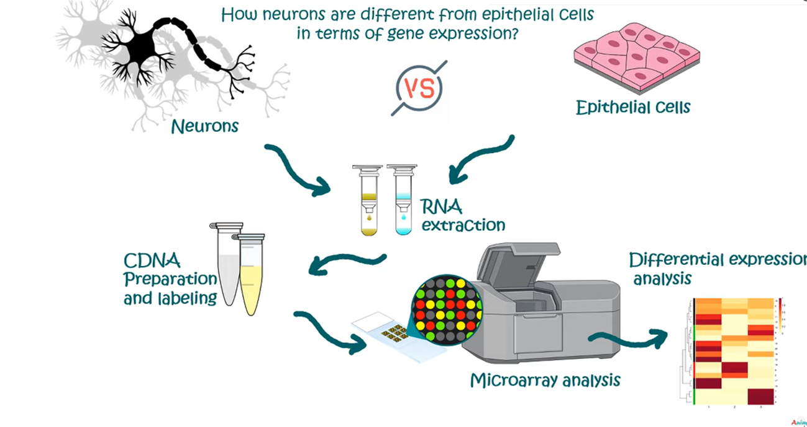

Experimental Principle of Microarray (DNA):
• Begin with two groups (control vs experimental / treatment)
• mRNA is extracted from either sample
• mRNA is converted to cDNA with reverse transcriptase (RT)
• cDNA is labeled with a synthetic dye (Cy3 or Cy5)
• Labeled cDNA from control / experimental are pooled and hybridized with the microarray chip
• Microarray is a glass / silicon slide covered by probes.
• The probes are short DNA fragments (oligonucleotides) that are highly complementary to certain cDNA sequences
• Probes are printed/spotted or synthesized in specific locations on the microarray slide
• Microarray chip is washed to remove unhybridized cDNA
• Microarray chip is exposed to solid-state lasers that operate in certain frequency ranges to excite the fluorescent cDNA labels
• Light emission of cDNA probes is captured with camera
• Microarray fluorescence profiles are interpreted with imaging software

Slide 4
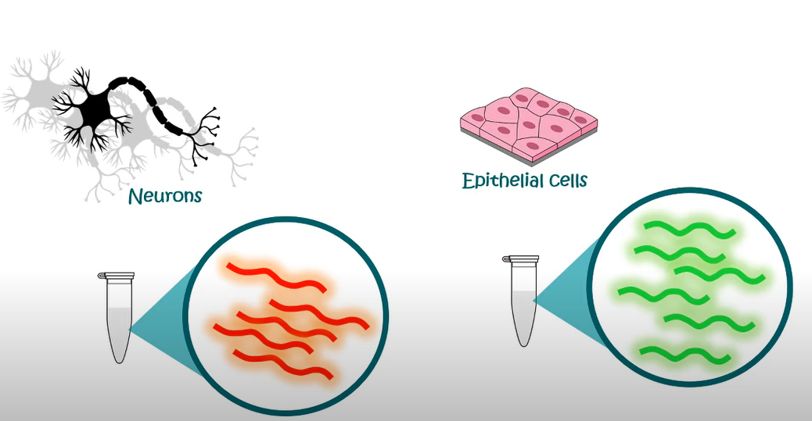

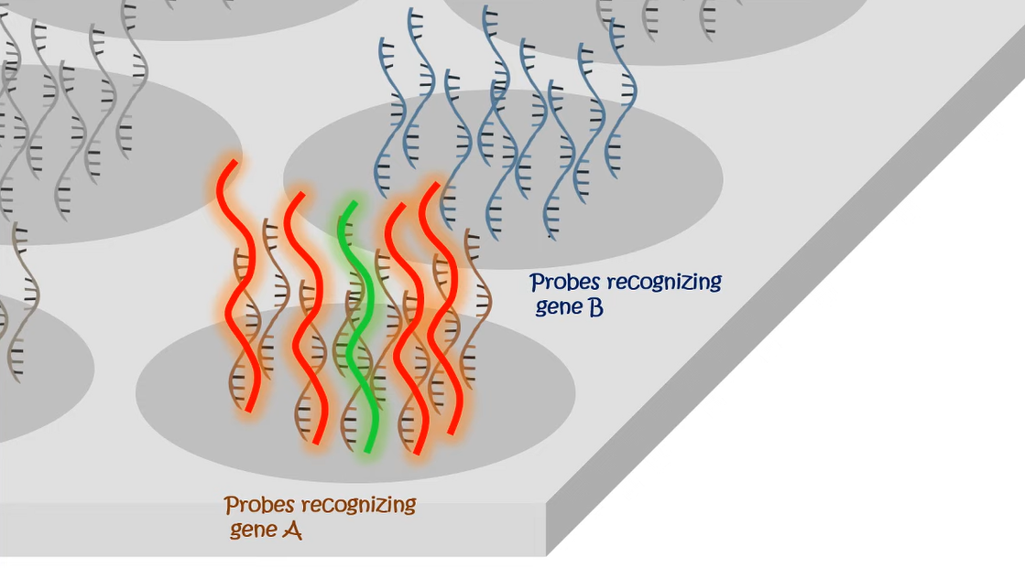
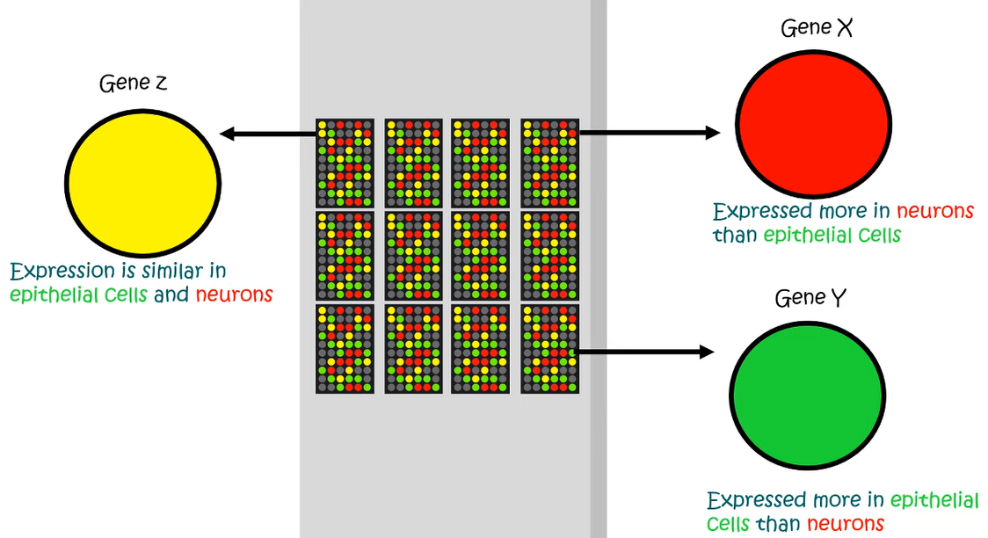

Slide 5
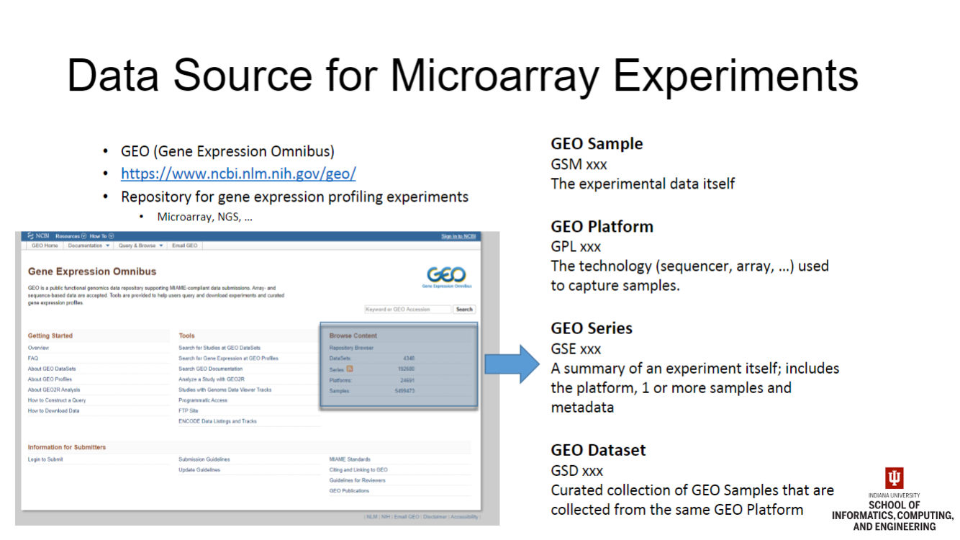

Slide 6
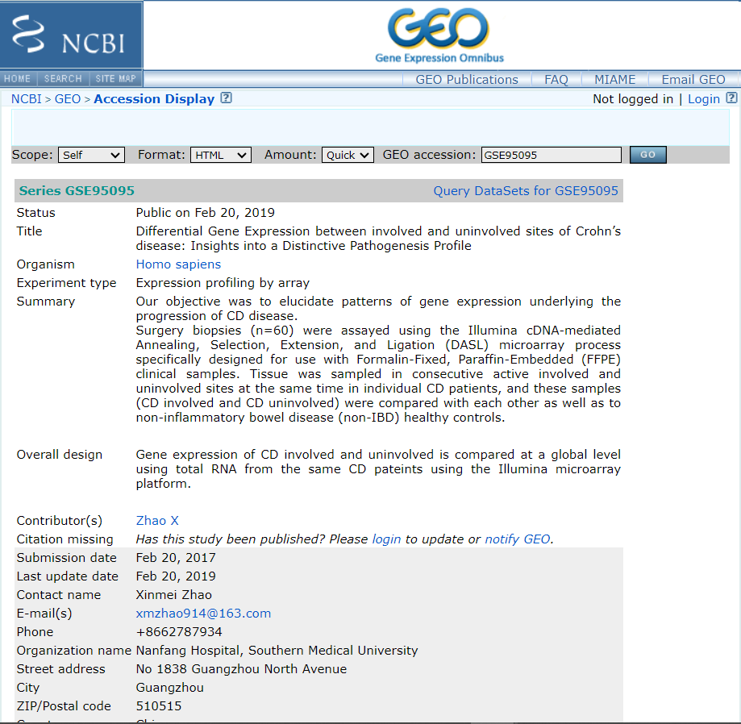

Data for Our Tutorial ...
Our microarray tutorial focuses on data from GSE 95095
https://www.ncbi.nlm.nih.gov/geo/query/acc.cgi?acc=GSE95095
Notes:
24 Samples of Crohn’s Disease Involved
24 Samples of Crohn’s Disease Uninvolved
12 Samples of Healthy

