Slide 1
Tutorial 7
COMP90014 Algorithm for Bioinformatics
Semester 2, 2025

Slide 2
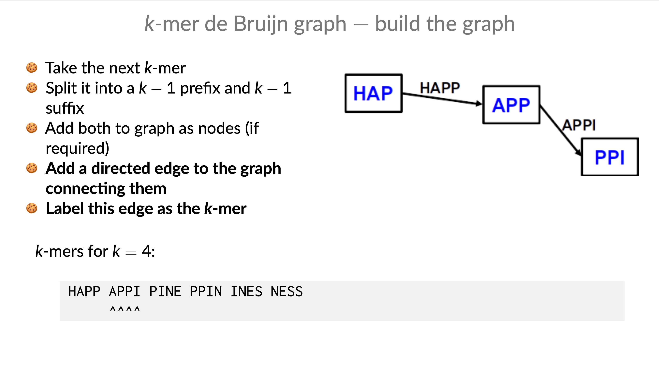

Slide 3
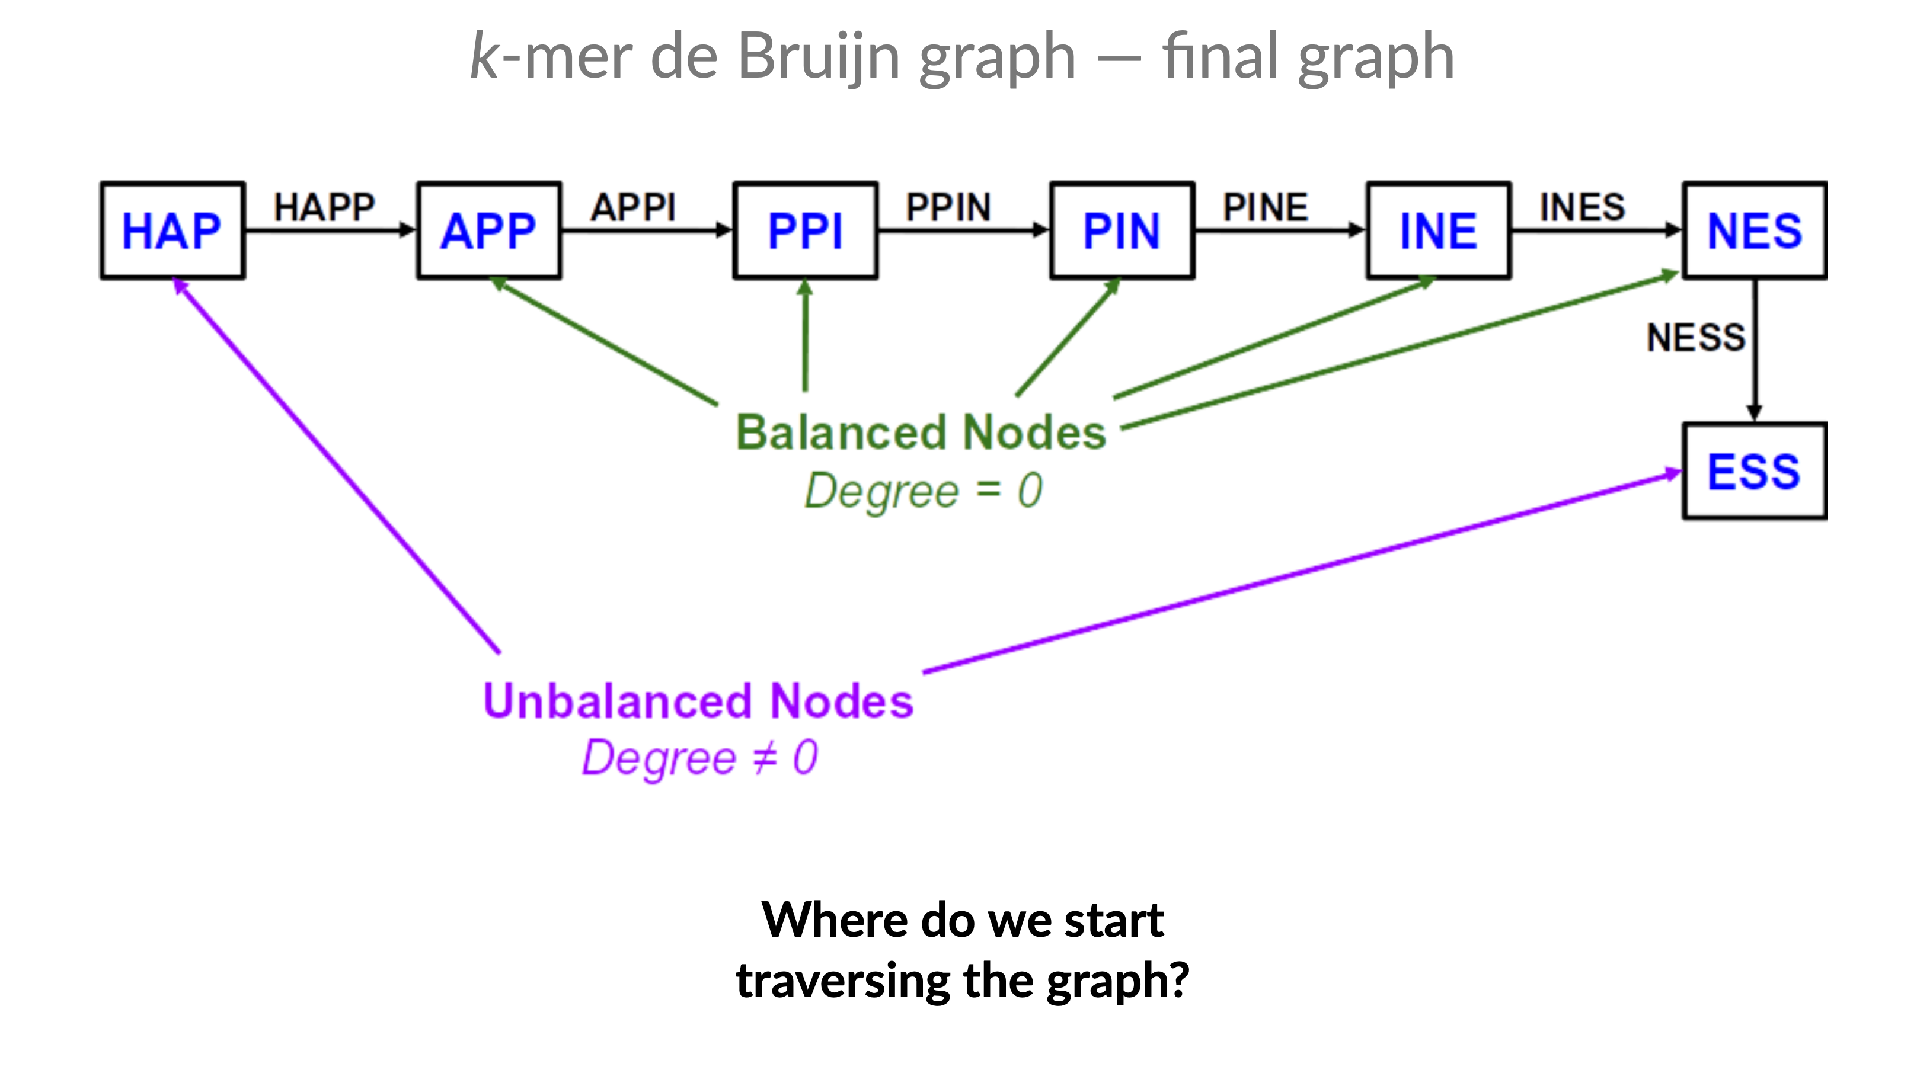

Slide 4
