Slide 1
Project Work
Poisoning the Unlabeled Dataset of Semi-Supervised Learning
Anna Fabris

Slide 2
Recent trends in Machine Learning
Large labeled dataset allowed improvement in model performances
Collecting labeled data is difficult
Semi supervised learning
small amount of labeled data plus large amount of unlabeled data

Slide 3
The problem
Unlabeled samples are obtained by scraping the Internet

Slide 4
Semi-supervised model
Normal training
Attack

Slide 5
Defences
Human supervision
Pay a human to quickly filter out obviously wrong samples
Agglomerative Clustering
Eliminate the largest cluster as poisoned examples are all similar to each and likely located in the same cluster
Training supervision
Eliminate the examples that are influenced by only a few other examples

Slide 6
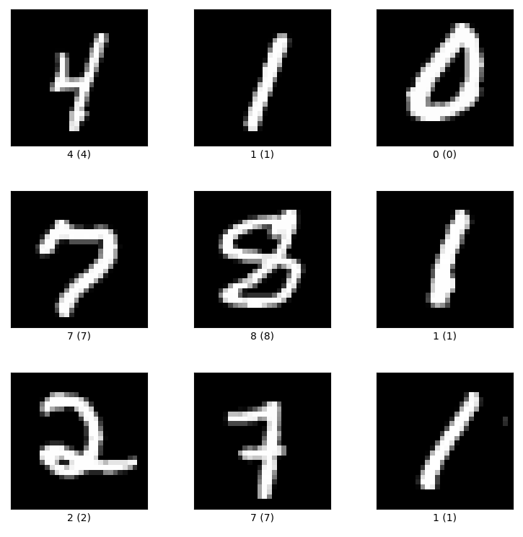
My experiments
MNIST handwritten digit database
Misclassify 4-9
Ladder Network
Just 1 trial
10 epoch of training

Slide 7
Interpolation techniques
Latent space interpolation
Image space interpolation

Slide 8
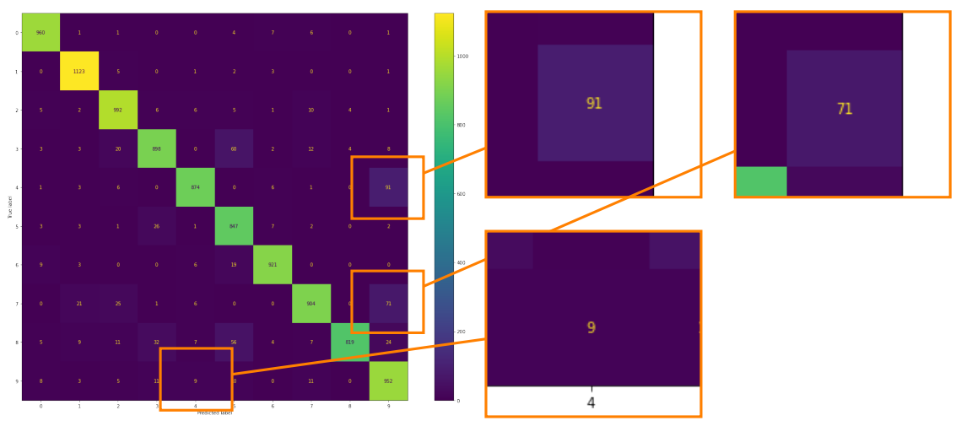
Latent space interpolation, 3%

Slide 9
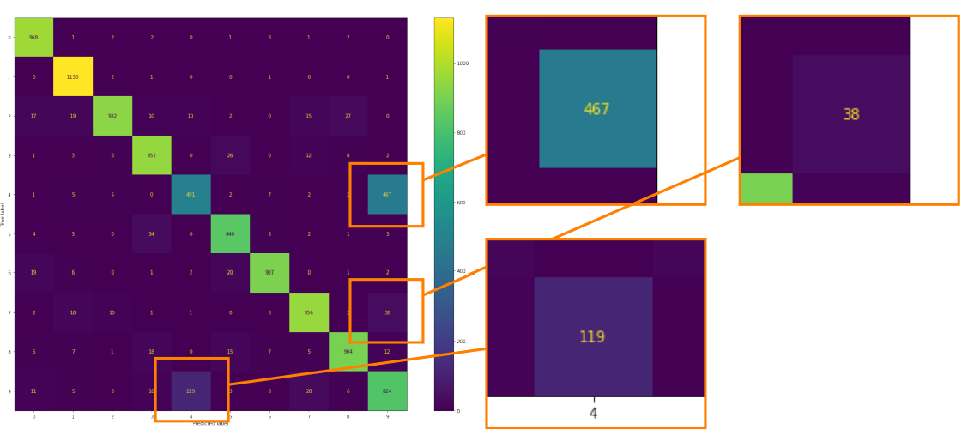
Image space interpolation, 3%

Slide 10
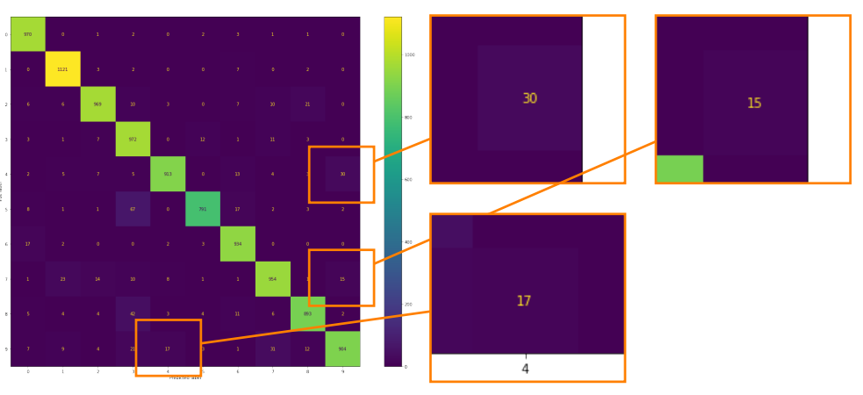
Image space interpolation, 1%

Slide 11
Table of results
 | Test Accuracy | 9s as 4s | 4s as 9s
Non-poisoned model | 95.46 % | 2.3 % | 2.7 %
Latent space model 3% | 92.90 % | 0.9 % | 9.3 %
Image space model 3% | 89.04 % | 11.8 % | 47.6 %
Image space model 1% | 94.21 % | 1.7 % | 3.1 %

Slide 12
Comments
More accurate model are easier to poison
What I think would improve attacks performance
Train the model for more epoch
Better model
Modify the density of poisoning example

Slide 13
Conclusion
Poisoning unlabeled dataset is not too difficult
In the future the problem is only getting worse
Defences against unlabeled dataset poisoning attacks need to be studied

