Slide 1
Financial Sentiment Analyzer
Automated NLP Analysis of SEC 10-K Filings
Anna Geiser, Armir Lecaj, Ray Pinzon, Jan Suter
Semester Project Part 2 - Big Data and Semi-/Unstructured Data

Slide 2
Problem Statement
The Challenge
Big set of SEC 10-K filings (annual financial reports)
Large text corpus with unstructured financial narratives
Manual review is time-consuming and subjective
Need for automated insights to detect risks and inconsistencies
Key Questions
What is the sentiment tone of management's discussion?
Are there inconsistencies between sections?
Which companies show elevated risk indicators?

Slide 3
Stakeholders
Financial Auditors
Detect misstatements
Quarterly/annual audit reviews
Investment Analysts
Identify risk signals in disclosures
Due diligence and portfolio monitoring
Compliance Officers
Monitor regulatory compliance
Pre-filing review processes
Financial Researchers
Large-scale sentiment analysis
Trend analysis across filings

Slide 4
Use Case Context
Triggers
Quarterly Audit Season -> review client filings
Investment Due Diligence -> assess company risk
Compliance Review -> pre-filing verification
Portfolio Monitoring -> track risk changes
Research Projects -> analyse large datasets
Corpus
Management's Discussion & Analysis (MD&A)
Risk Factors sections
Other narrative sections can be added

Slide 5
Analytical Questions
Sentiment Analysis
Q1: What is the overall sentiment of the MD&A section?
Q2: Are there inconsistencies between Risk Factors and MD&A?
Q3: Which companies show high pessimism indicators?
Risk Detection
Q4: Are there signs of excessive optimism (overstatement)?
Q5: Does the filing show mixed signals?
Q6: What passages show strongest negative sentiment?
Batch Analysis
Q7: Which portfolio companies have highest risk scores?
Q8: What are sentiment trends year-over-year?

Slide 6
Expected Results
1. Single File Analysis
Sentiment labels, confidence scores
Risk indicators
Chunk-level details
2. Batch Processing
Comparative metrics
CSV Report
3. Visualizations
Section sentiment comparison
Chunk sentiment distribution
Chunk score distribution (required)
Sentiment confidence matrix
4. Risk Alerts
High Optimism Risk
High Pessimism Risk
Mixed Signals
Low Confidence (with threshold)

Slide 7
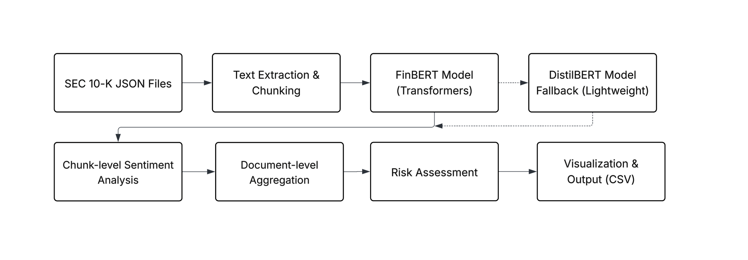
Technical Architecture

Slide 8
Demo
Notes:
Data input: https://www.kaggle.com/datasets/pranjalverma08/sec-edgar-annual-financial-filings-2021

Slide 9
Data input used
https://www.kaggle.com/datasets/pranjalverma08/sec-edgar-annual-financial-filings-2021

