Slide 1
Synthesising Biological Networks through Linear Programming
Anna Kountouri
Dr. Sophia Tsoka

Slide 2
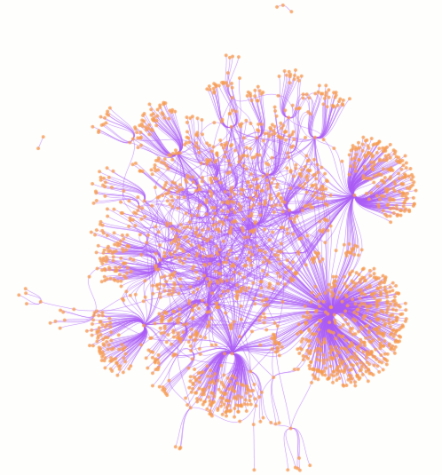
Introduction
Evolutionary affinities modelled by networks.
VGT, LGT
Challenging task:
Accurate models
Appropriate dataset
Notes:
This project is about how evolutionary affinities can be modelled by networks and how these networks can the be analysed.
The evolution of species is shaped by both VGT and LGT events.
VGT is the transmission of genes from parents to their offsprings via reproduction.
LGT is the “non-genealogical transmission of genetic material between organisms that co–habit”.
The framework that was followed in this project for the reconstruction of networks, is capable of recovering both VGT and LGT events.
This is a challenging task because:
appropriate models which capture the evolutionary relationships as accurately as possible must be
devised and
appropriate sequence data ( single gene, set of genes, whole genome) must be chosen in order to
accurately recover the evolutionary information which is encoded in the sequences.
Each of these choices affects the network that is being reconstructed.

Slide 3
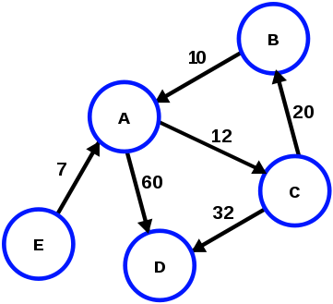
Network Reconstruction
The task of obtaining network structure from a set of data.
Abstract model of complex real life systems.
G=(V,E)
Directed
Weighted
Intergenomic Affinity Network.
Network analysis.
Community detection.
Notes:
Network reconstruction is the task of obtaining network structure from a set of data.
Networks are abstract models of complex real life systems that allow us to get a scientific understanding of the systems they represent
Networks are defined as a set of Vertices V and a set of Edges E.
These networks can be either directed/undirected or weighted/unweighted.
There are many different types of networks that can be used to model evolutionary affinities.
Some of these include Split networks, Reticulate networks and Intergenomic Affinity Networks.
In this project Intergenomic Affinity networks were reconstructed.
The vertices represent fully sequenced genomes which are linked by edges that reflect affinities reconstructed from whole–genome comparisons. The set of vertices V represents the genomes of the organisms being analysed and the set of edges E represents the affinities between genomes which can be either VGT or LGT
Once the networks were reconstructed, network analysis was carried out to understand the system they represent.

Slide 4
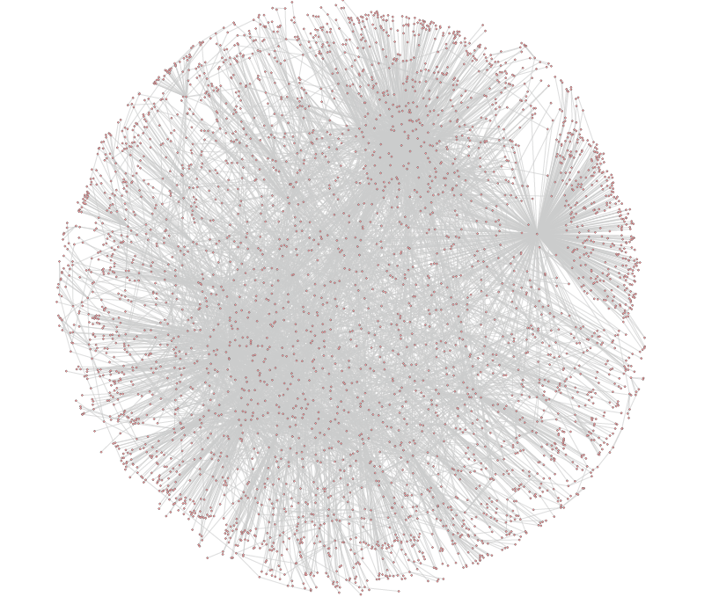
Dataset
BLAST dataset (Beiko et al.)
7.85 GB, 164m rows
144 fully sequenced prokaryotic genomes
15 phyla
All-vs-all BLASTP analysis
PPI dataset (Biogrid)
C. elegans
3624 vertices, 7018 edges, 84 connected components
Notes:
The dataset that was used for this project was generated by Beiko and his colleagues and is publicly available through their server.
This dataset was a 7.85 GB text file composed of 164,571,902 rows and 12 columns.
It represents the sequence similarity scores between 144 fully sequenced prokaryotic genomes.
These 144 genomes were sampled from 15 different prokaryotic phyla (obtained from the NCBI genomes repository) including both bacterial and archaeal species.
The genomes were imported in a database and then all-vs-all BLASTP analysis was carried out on the annotated protein sequences.
The results with similarity score e<0.001 were stored as pairwise comparisons in a database
And this generated file (with each row holding a similarity score between 2 protein coding genes) from 2 genomes is the dataset that was used for this project.
To understand the structure of the genomic network generated from the BLAST file, community detection methods were applied on it
In order to understand what information these methods can reveal they were firstly applied on the PPI dataset of C. elegans downloaded from the Biogrid PPI repository.
This was consisted of 3624 vertices and 7018 and 84 cc.
The largest component was kept for further analysis.

Slide 5
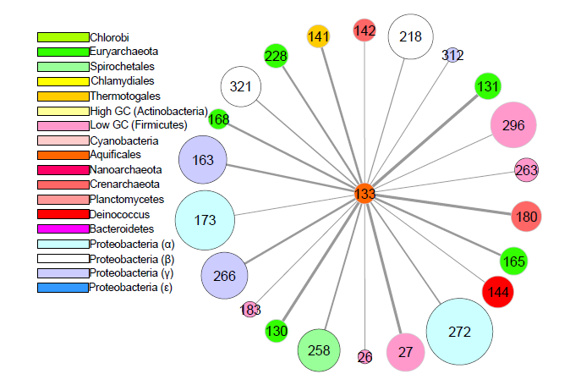
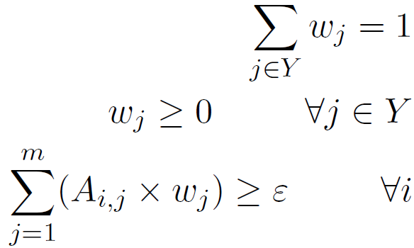
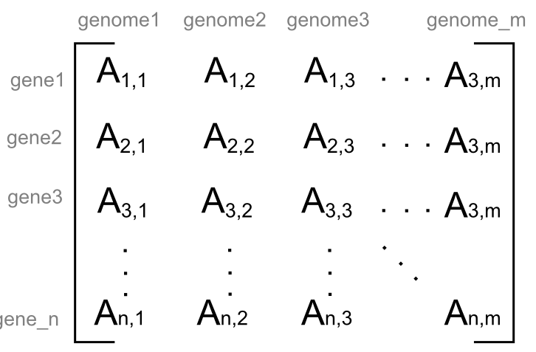
Network Reconstruction - LP Framework
Input: Similarity scores (matrix A)
Output: Genomes affinities (edge weights)
Notes:
The approach adopted was based on the work of Beiko and Holloway.
Beiko and Holloway have used LP to model the evolutionary affinities between a set of taxa.
This framework is performed on each genome one by one in order to find out which genomes contribute to its genetic content (which will be represented in the final network as its incoming edges).
To generate the network for a particular genome X of the 144, its genes are evaluated one by one against all the other genomes to find the
genes that are most similar to its own. (using the similarity scores of the BLAST file)
The input to the LP problem is the nxm matrix A consisting of the similarity scores between the genes of X and all the rest genomes in Y.
The n rows of the matrix correspond to the n genes of the reference genome X and the m columns to the m comparison genomes. Each Aij entry of the matrix represents the similarity between the gene i of the reference genome and the best matching gene gj from the comparison genome
Yj. i=Xgenes, j=Ygenomes.
The LP formulation operates on this matrix and finds the weights between X and the rest genomes that optimise this function subject to these constraints.
The solution of the LP problem gives the genomic affinities between the reference genome X and each of the comparison genomes. It is the weights of its incoming edges as shown in this example network from Aquifex aeolicus.
The edge width represents the weight of the edges which represents the strong of the evolutionary relationship between the two genomes.
These weights must some to one (constraint1) and must be greater or equal to zero (constraint2).

Slide 6
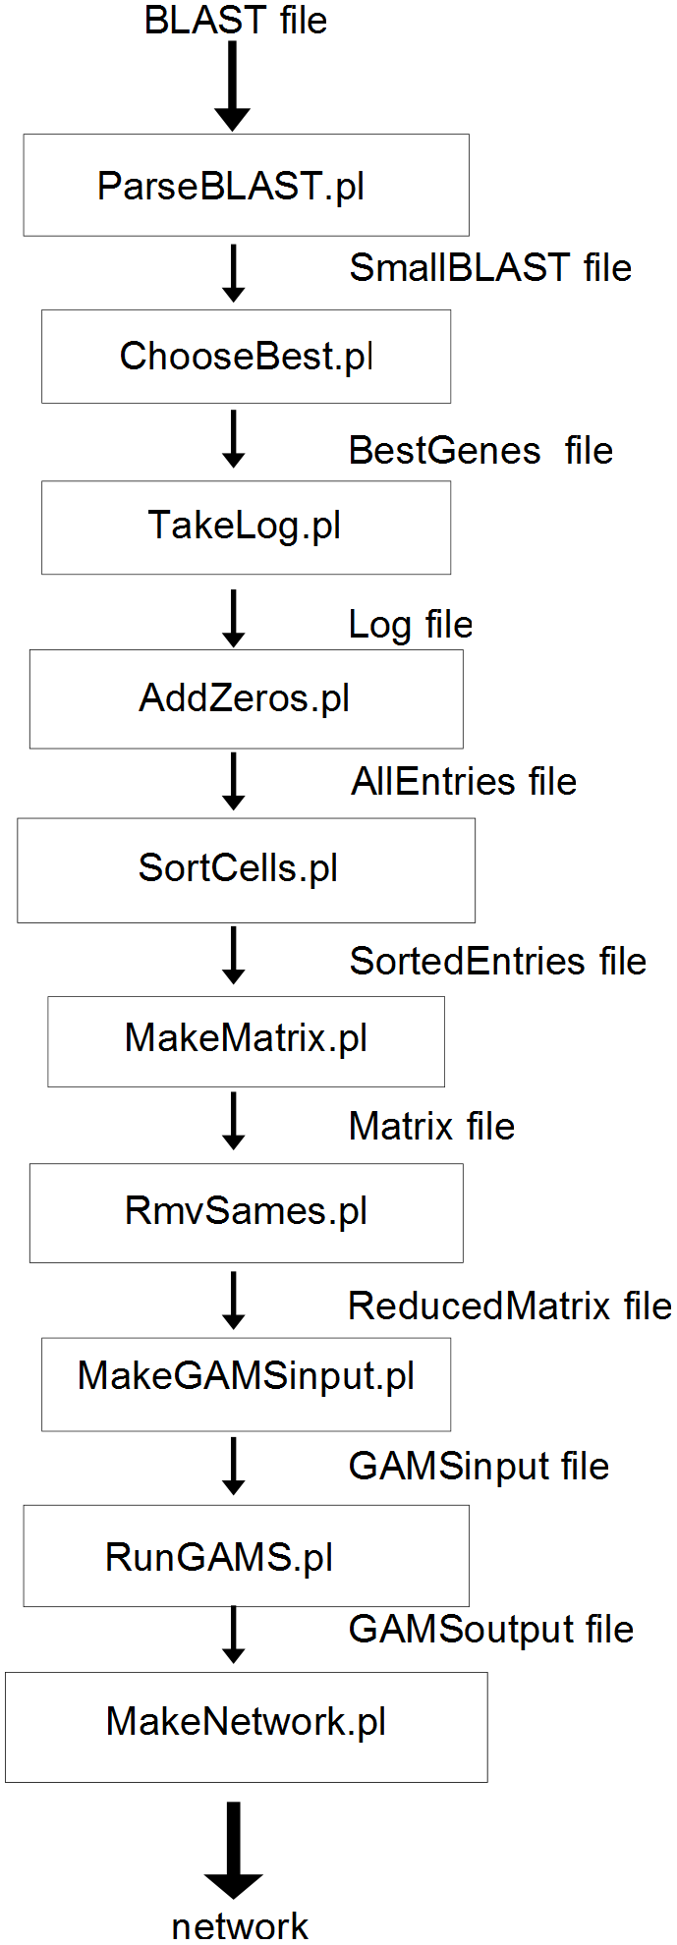
LP Framework steps
Find the relevant similarity scores for each genome from BLAST dataset
Find the best matching genes
Create the A matrix
Pass to GAMS to calculate the weights
Create the network file from the calculated weights
Notes:
So how this framework was implemented: these are the stapes that were followed.
The BLAST file consists of the similarity scores between all the 422; 971 protein coding genes of the 144 organisms. In order to reconstruct the IAN of a particular organism X, firstly the relevant similarity scores involving its own genes must be extracted from the BLAST file.
Next, for each gene in the reference genome X, the best matching gene gj (with the most significant e–value) from each comparison genome Yj is identified. In this way, only the best matching genes from each Yj genome are used.
Then the text file which in tab format is converted to a matrix format in order to create the GAMS input file.
Then the matrix is passed to GAMS, which uses the LP problem described in the previous slide, using the A matrix as its input.
Once the GAMS finds the solution and computes the optimal weights for the incoming edges of X, the network is created by assigning each weight to the appropriate edge between the appropriate two genomes.

Slide 7
ndLP Strategy
Remove dominated proteins
Reduced set of proteins
Best matches to Y
Distinct march profiles not dominated by others
Emphasises the strongest connections
Notes:
This strategy is an extension to the basic framework described previously.
It removes all the dominated proteins from the dataset.
By “dominated proteins” we mean the following: given two proteins p1 and p2 from the reference genome X, p1 is said to dominate p2 if A1;j A2;j for all the target genomes j.
In this way it keeps only the genes of the reference genome that are more informative than the others and therefore generates the network from the strongest signals in the dataset.
By following this strategy to remove the dominated proteins, the reduced dataset is composed only of:
proteins from the reference genome X that have the best matches to each of the genomes in ,
proteins that have distinct match profiles and are dominated by no other protein.

Slide 8
Networks Analysis
Phyla IANs
Whole intergenomic network:
Disjoint community detection
Partitions
Overlapping community detection
Multi-clustered vertices
Notes:
Once the networks were created, analysis was performed on them.
Firstly we look at the 15 networks generated for each phylum and then at the whole network composed of the union of all the 144 IANs.
On the whole network, community detection algorithms were applied, 1 disjoint and three overlapping ones.
Using the output of these methods we observed which species tend to cluster together and which species tend to be more multi-clustered

Slide 9
Results - IANs
Notes:
This an example of the generated networks for Aquifex aeolicus a thermophilic bacterium often found in marine hot springs.
As you can see the solution mainly includes thermophilic species (both bacterial and archaeal) or species with large genomes.
It consists of affinities that have been previously reported in the literature – demonstrating that the LP framework is capable of obtaining accurate results from the dataset.
For example it has been reported that 24% of its genome consists of archael genes – there are 6 archaeal species in the solution.
Also other extremophilic bacteria like T. Maritima(141) and D. Radiodurans(142) found in similar environments with A. Aeolicus have been recovered in the network.
As you can see the strongest connections come from thermophilic species (nodes with grey borders).
142 Crenarchaeota Aeropyrum pernixΒ K1
180 Crenarchaeota Sulfolobus solfataricusΒ P2
168 Euryarchaeota Thermoplasma acidophilumΒ DSM1728
228 Euryarchaeota Pyrococcus furiosusΒ DSM 3638
131 Euryarchaeota Archaeoglobus fulgidusΒ DSM4304
130 Euryarchaeota Methanobacterium thermautotrophicumΒ Ξ”H
165 Euryarchaeota HalobacteriumΒ sp. NRC-1
26 Low G+C Firmicutes Mycoplasma genitaliumΒ G37
27 Low G+C Firmicutes Bacillus subtilisΒ 168
263 Low G+C Firmicutes Streptococcus mutansΒ UA159
183 Low G+C Firmicutes Mycoplasma pulmonisΒ UAB_CTIP
296 Low G+C Firmicutes Bacillus cereusΒ ATCC 14579
173 Proteobacteria(α) Mesorhizobium lotiΒ MAFF303099
272 Proteobacteria(α) Bradyrhizobium japonicumΒ USDA110
321 Proteobacteria(β) Chromobacterium violaceumΒ 12472
218 Proteobacteria(β) Ralstonia solanacearumΒ GMI1000
163 Proteobacteria(γ) Pseudomonas aeruginosaΒ PA01
312 Proteobacteria(γ) Blochmannia floridanusΒ Str.
266 Proteobacteria(γ) Pseudomonas putidaΒ KT2440
258 Spirochaetales Leptospira interrogansΒ lai 56601
141 Thermotogales Thermotoga maritimaΒ MSB8
144 Thermus/Deinococcus group Deinococcus radioduransΒ R1

Slide 10
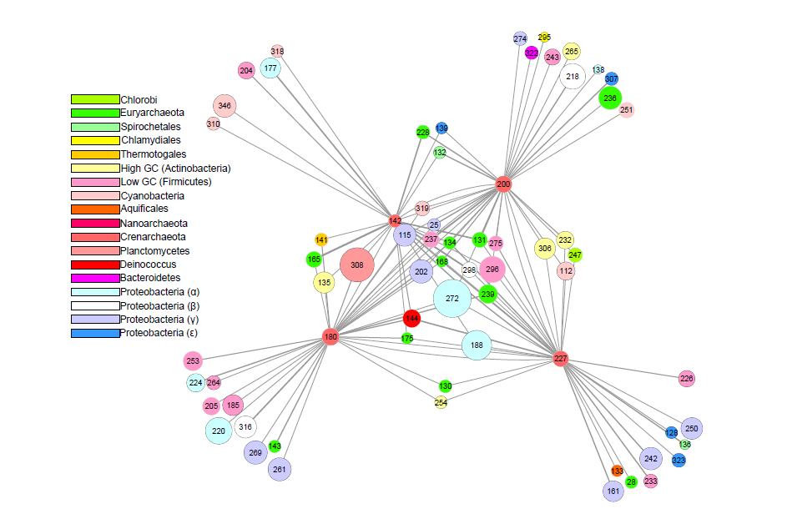
Results - IANs
Notes:
This is another example of the intergenomic network generated for the 4 Crenarchaeota representatives of the dataset.
As you can see from the recovered affinities, the 4 crenarchaeota all have some euryarchaeota as contributors, while each one of them has unique contributors from bacterial species.
The affinities between the archaeal species are possibly due to common ancestry, while the affinities with different bacteria are probably due to VGT events, with species that co-habit in the same environments as each Crenarchaeum in the dataset.
S tokodaii (200) has been previously reported to be prone to LGT and makes extensive use of mobile genetic elements to acquire new genes. In this generated network it has the most genome contributors (31) while the other crenarchaeota have up to 25. This is consistent with previous results.
There were many affinities previoulsy reported in the literature which were recovered from this network:
T. Maritima (141) contributor of A. Pernix (142) S. Solfataricus (180) since all of these three organisms are found in hot aquatic environments like hot marine springs.
Also earlier studies have identified LGT events towards A. Pernix (142) from e. Coli(115), Mycobacterium tuberculosis (135), haemophilus influenze(25), affinities which have been recovered in this solution too.

Slide 11
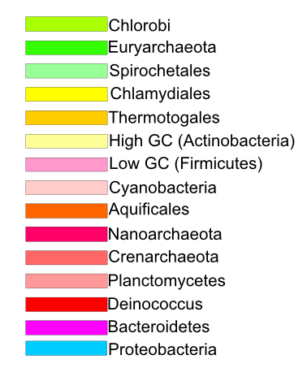
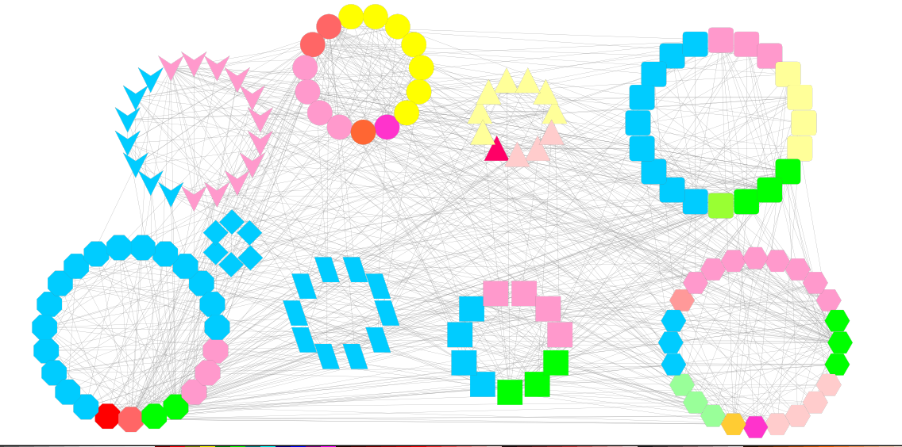
Results - Communities
Notes:
Once the whole network was generated (composed of the 144 networks), community detection methods were applied on it.
Here you can see the detected disjoint communities as calculated by the Louvain algorithm.
As you can see from the partition, species from the same phylum tend to be clusterred in the same partition.
For example chlamydiaels are all clustered in the same partition, g-proteobacteria are all in the same partition, Actinobacteria are divided into two partitions, while Low GC bacteria, Proteobacteria and Euryarchaeota tend to be clustered into many different clusters, possibly because they have many different contributors.
This shows that most of the affinities are between species of the same phylum – due to common ancestry and more frequent LGT events.
Proteobacteria (and especially γ) tend to cluster bytheselves and some firmicutes and crenarchaeota.
Chlamydiales cluster with Firmicutes.
Euryarchaeota are being clustered into many different clusters (including with proteobacteria, Firmicutes, Actinobacteria)
Thermotoga maritima is assigned into the most diversed cluster: includes species from many different pyla. T. Maritima is known to have acquired its genes from many different phyla so that seems to verify that.

Slide 12
Results – Top 10 multi-clustered
 | OCG | CFinder | LinkComm
1 | Archaeoglobus fulgidus | Halobacterium | Mycoplasma pulmonis
2 | Pyrobaculum aerophilum | Methanosarcina mazei | Mycoplasma pneumoniae
3 | Thermoplasma volcanium | Sulfolobus solfataricus | Mycoplasma genitalium
4 | Halobacterium | Thermoanaerobacter tengcongensis | Neisseria meningitidis
5 | Sulfolobus solfataricus | Methanococcus jannaschii | Halobacterium
6 | Thermoanaerobacter tengcongensis | Archaeoglobus fulgidus | Mycoplasma penetrans
7 | Aeropyrum pernix | Methanosarcina acetivorans | Tropheryma whipplei
8 | Methanosarcina mazei | Aeropyrum pernix | Mycoplasma gallisepticum
9 | Methanosarcina acetivorans | Pyrobaculum aerophilum | Nanoarchaeum equitans
10 | Thermotoga maritima | Thermoplasma volcanium | Streptococcus pyogenes
Notes:
Then overlapping community detection methods were applied on the network in order to find which nodes get assinged to more than 1 clusters and are probably more important to the network.
The top multi-clustered nodes as calculated by the three methods are shown into this table.
8 of the 10 top multi clustered genomes found by OCG were also found in the CFinder solution.
This is probably due to the fact that these two methods both follow a node-based approach to cluster their nodes while LinkComm uses a completely different approach which is based on the links and not the nodes.
All of the multi-clustered nodes by these two methods were extremophilic organisms (most of them were thermophilics).
This probably indicates that thermophilic organisms are much more prone to LGT events and acquire foreign genes more frequently.
By calculating the correlation coefficient on the multi-clustered nodes of Cfinder and OCG and their degree and betweeness, there was found out that the number of clusters they are assigned too grows as their degree and betweenness grows.
Also by calculating t-test statistics on the degree and betweenness of the multi-clustered nodes and the mono-clustered ones, it was found out that the multi-clustered ones had significantly higher degrees and higher betweenness. This however was not the case with LinkCommunities.
The most multi-clustered nodes as calculated by LinkComm were all pathogenic bacteria except two arcahea (one of which were recovered by OCG and CFinder too)
This probably indicates as well that pathogenic bacteria are also more prone to LGT due to the fact that by acquiring foreign genes they can become resistant to antibiotics and hence gain their survival.

Slide 13
Overview
Reviewed literature
LP network reconstruction
Networks’ analysis
IANs
Disjoint communities
Overlapping communities
Notes:
So in summary, this project has looked at different methods that are being used for network reconstruction and analysis.
Then it has followed an LP approach to reconstruct the intergenomic networks of 144 fully sequenced prokaryotics genomes.
Then it analysed the generated networks by:
Observing the recovered affinities and comparing them with affinities which have been already reported in the literature.
Applying community detection methods to see which species are clustered together and which genomes are getting assinged to more than one clusters and therefore are important in the network.
And from this analysis some conclusions were drawn regarding the evolutionary affinities of the genomes. Like extremophilic organisms are more prone to LGT and others.

Slide 14
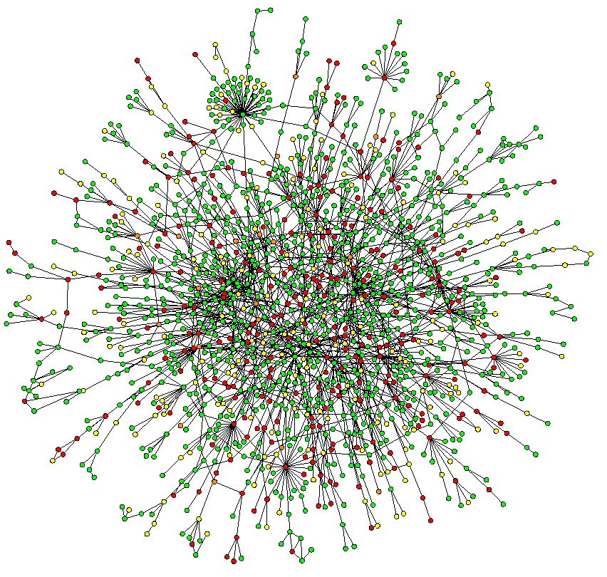
Future Work
Collect larger dataset
More complex model
Notes:
The genomic sequences of the 144 prokaryotic genomes were sampled from 15 phyla. By collecting a larger dataset consisting of more phyla and more species, more accurate genomic networks will be reconstructed.
The problem of reconstructing the evolutionary affinities of the genomes was formulated as a linear optimisation problem. A more complex formulation including quadratic terms could possibly be able to capture accurately more complex affinities between the genomes.

Slide 15
End

