Slide 1

LDBC Linked Data Benchmark Council 2-year status report
Peter Boncz

Slide 2
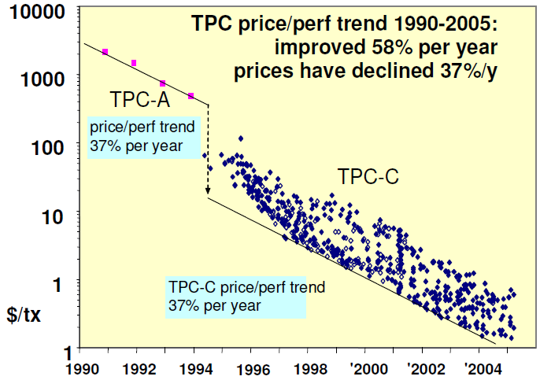
Why Benchmarking?
make competing products comparable
accelerate progress, make technology viable
© Jim Gray, 2005

Slide 3
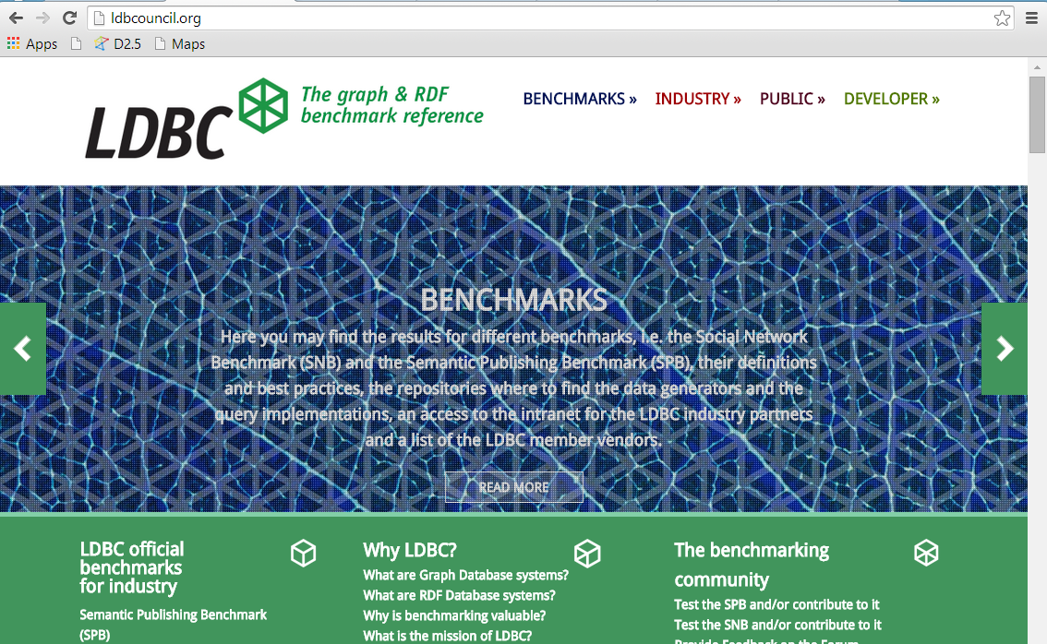
ldbcouncil.org

Slide 4
LDBC: what systems?
Benchmarks for:
Graph Database systems
Neo4j, DEX, InfiniteGraph, …
RDF stores (SPARQL speaking)
Virtuoso, OWLIM, BigData, Allegrograph,…
Graph Programming Frameworks
Giraph, Green Marl, Grappa, GraphLab,…
Relational Database systems

Slide 5








Industry Membership

Slide 6
What is LDBC doing now?
Two main “task forces”:
Semantic Publishing Benchmark (SPB)
BBC use case – RDF oriented
Possible Extensions
Instance matching (SPIMbench)
“Mapping Management” (Open PHACTS)
Reasoning (beyond RDFS)
Social Network Benchmark (SNB)
Interactive workload (ready)
BI workload
Graph algorithms workload
See: github.com/LDBC

Slide 7
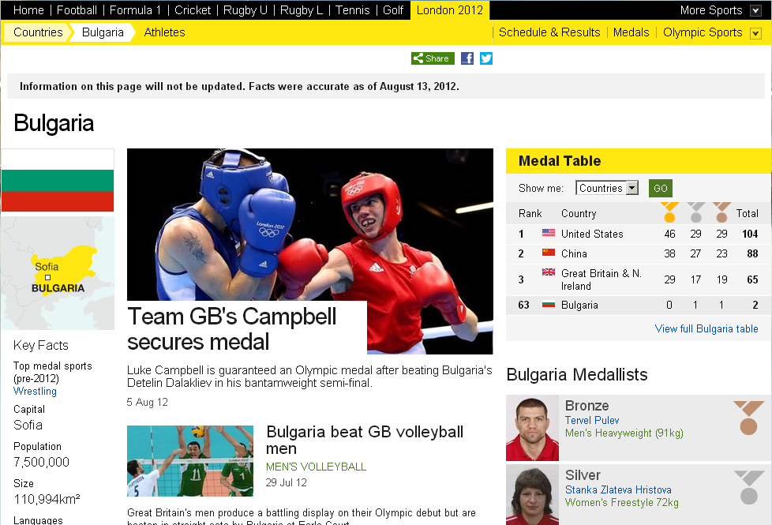
Semantic Publishing Benchmark (SPB)

Slide 8
SNB: Workloads
Interactive: tests a system's throughput with relatively simple queries with concurrent updates
Show all photos posted by my friends that I was tagged in
Business Intelligence: consists of complex structured queries for analyzing online behavior
Influential people the topic of open source development?
Graph Analytics: tests the functionality and scalability on most of the data as a single operation
PageRank, Shortest Path(s), Community Detection

Slide 9
LDBC Roadmap
EU project almost done
5 months left
LDBC non-profit company takes over
5th Technical User Community Meeting
Nov 14, Athens
Probably a 6th TUC in March Barcelona
Focus on Benchmark Results
Officially adopt SNB + SPB
Produce Audited Results

