Slide 1
Project Goals and Status Peter Boncz (CWI & VU Amsterdam)
Amsterdam
April 3, 2014

Slide 2
Motivation
Make RDF and Graph DB technology a credible and more widely adopted technology in IT and Big Data
Stimulate technical advances by making progress visible through benchmarking

Slide 3
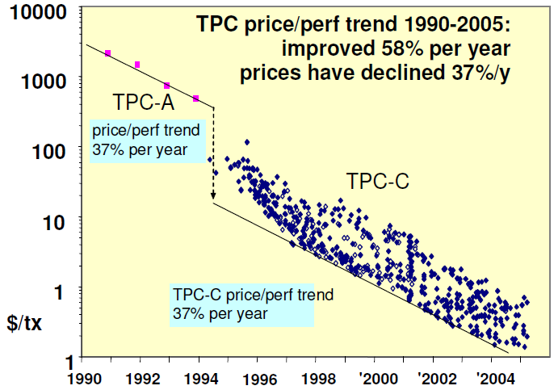
Why Benchmarking?
make competing products comparable
accelerate progress, make technology viable
© Jim Gray, 2005

Slide 4







What is the LDBC?
Linked Data Benchmark Council = a benchmarking organization
Industry entity similar to TPC (www.tpc.org)
Focusing on graph and RDF store benchmarking
An EU project (STREP) in FP7
Runs from sept 2012 – march 2015
8 project partners:

Slide 5
EU Project Goals
Make sure the LDBC becomes a strong entity and will continue to operate after the project
Equip de LDBC with a good initial set of benchmarks, and benchmark results

Slide 6
LDBC Benchmark Design
Developed by so-called “task forces”
Requirements analysis and use case selection.
Technical User Community (TUC)
Benchmark specification.
data generator
query workload
metrics
reporting format
Benchmark implementation.
tools (query drivers, data generation, validation)
test evaluations
Auditing
auditing guide
auditor training

Slide 7
LDBC: what systems?
Benchmarks for:
RDF stores (SPARQL speaking)
Virtuoso, OWLIM, BigData, AllegroGraph,…
Graph Database systems
Neo4j, DEX, InfiniteGraph, …
Graph Programming Frameworks
Giraph, Green Marl, Grappa, GraphLab,…
Relational Database systems

Slide 8
LDBC: functionality
Benchmarks for:
Transactional updates in (RDF) graphs
Business Intelligence queries over graphs
Graph Analytics (e.g. graph clustering)
Complex RDF workload, e.g. including reasoning, or for data integration
Anything relevant for RDF and graph data management systems

Slide 9
LDBC:organization
Board of Directors
Formed by LDBC member organizations
Task Forces
Takes care of a Benchmark or set of benchmarks from beginning to end
Semantic Publishing Benchmark (SPB)
Social Network Benchmark (SNB)
Technical User Community (TUC)
Regular meetings with professional users
End User Community
Initiates activities spring 2014
Draft Benchmark launches SPB & SNB

Slide 10
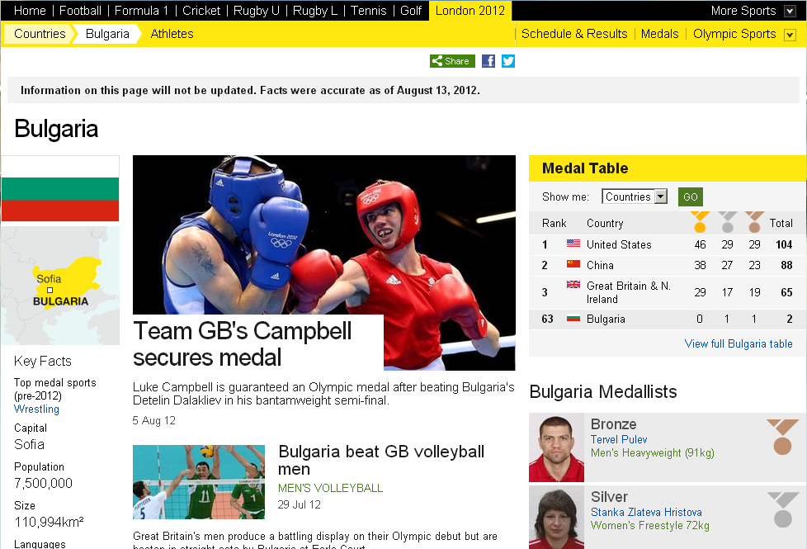
SPB scenario: Semantic Publishing

Slide 11
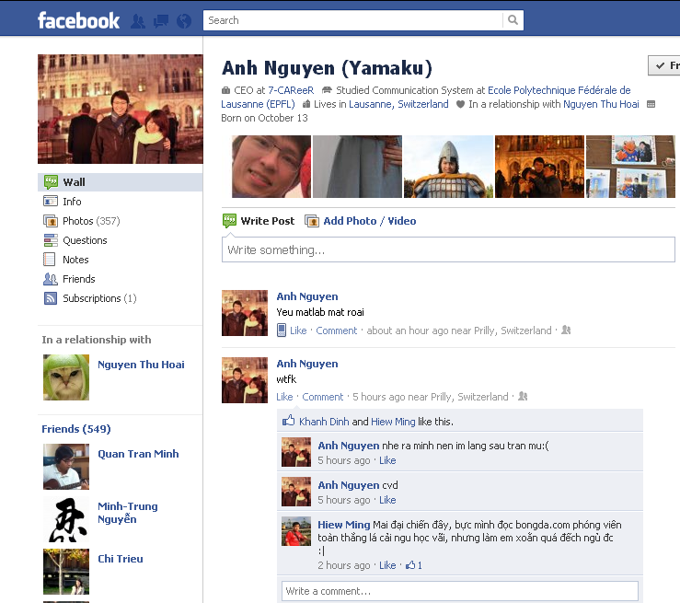
SNB Scenario: Facebook/Twitter
“Switzerland”
“Yamaku”
liveAt
Photo
“EPFL”
hasName
studyAt
Post
upload
create
InRelationShip
User
User
Comment
Comment
knows
create
knows
knows
create
User
like
User
User

Slide 12
Status
LDBC is 1.5year underway from its 2.5year duration
Within one month, LDBC will release draft versions of the SNB and SPB
Purpose: solicit feedback
Activities: finetuning the workloads, produce reference results
➔ Great time to get involved and influence the nature of the benchmarks
Within one month, LDBC will start a publicity campaign
New web site, Technical Blog Series, Community Managers
By fall 2014, the benchmarks should reach official adoption
First official results to be published
LDBC, the EU project, will hand over infrastructure to LDBC, the industry council
Expect more industry members to join
Future activities
Broaden the scope of LDBC: more benchmarks
Include the graph programming framework (Giraph et al) community

Slide 13
Agenda
Today
10:00 Introduction
10:20 Social Network Benchmark + Graph Use Case talks
11:30-11:50 coffee
13:30 Lunch in Restaurant Polder
across the street http://www.cafe-restaurantpolder.nl/
14:30 Semantic Publishing Benchmark + RDF Use Case talks
16:00-16:20 coffee
17:40 Finish
19:00 Social dinner Restaurant Boom
Linnaeusstraat 63 http://www.boom-amsterdam.nl/

