Slide 1
Project Overview for the Technical User Community Peter Boncz (VU Amsterdam)
Barcelona @ UPC
November 19+20, 2012

Slide 2
Motivation
Make RDF and Graph DB technology a credible and more widely adopted technology in IT and Big Data
Stimulate technical advances by making progress visible through benchmarking
Give a set of young and growing EU high tech companies the opportunity to become more prominent in this emerging industry

Slide 3
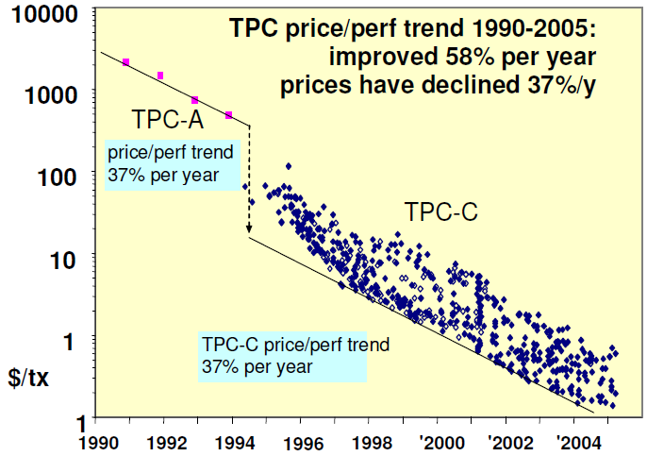
Why Benchmarking?
make competing products comparable
accelerate progress, make technology viable
© Jim Gray, 2005

Slide 4
What is Database Benchmarking?
Standard test to measure and understand how technology performs
Dataset definition
at various scales (100GB, 300GB, 1TB, 3TB, etc)
mimicks a recognizable relevant usage scenario
Database Queries
often between 10-100 queries, with parameters
+ rules/programs that specify how these queries are posed
Result Metrics
a number to understand the result
tps = “transactions/second”
$/QphH@size = “price per query per hour”
Audit Rules
allow results to be checked by independent auditors
prevent/limit cheating

Slide 5







What is the LDBC?
Linked Data Benchmark Council = a benchmarking entity
Industry entity similar to TPC (www.tpc.org)
Focusing on graph and RDF store benchmarking
An EU project (STREP) in FP7
Runs from sept 2012 – march 2015
8 project partners:

Slide 6
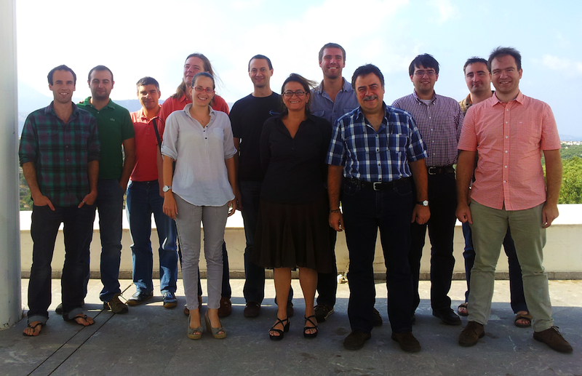
LDBC People
Barry
Bishop
ontotext
Peter
Neubauer
neo
Thomas
Neumann
TUM
Ioan
Toma
IUBK
David
Dominguez Sal
UPC
Orri Erling
Openlink
Miquel
Ferrer
UPC
Peter Boncz
VUA (&CWI)
Alex
Averbuch
neo
Vaggelio
Daskalaki
FORTH
Irini
Fundulaki
FORTH
Larri
UPC

Slide 7
LDBC - Organizations
academia
UPC Barcelona
VU Amsterdam
STI Innsbruck
FORTH (Crete)
Tech Univ Munich
industry
Neo Technologies
Ontotext
Openlink
Sparsity
interested industry
Oracle
IBM
Clark&Parsia
VelocityDB
Bigdata
Objectivity
TSO
Franz
Dydra
OrientDB
Versant

Slide 8
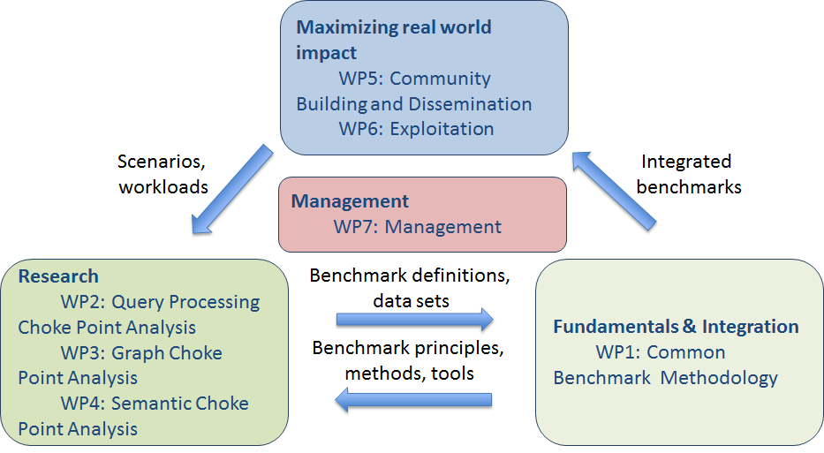
EU project structure

Slide 9
What is happening in the project?
WP5: community building
Technical User Community ⬅ you are here
Includes website, wiki, bug tracker, file sharing
Academic dissemination: workshops
GRADES 2013: Graph Data management Experiences and Systems @ SIGMOD, NY, NY, June 23, 2013
WP6: exploitation
Creating the LDBC entity
Auditor training
WP2,3,4: research
Core query processing, graph databases, RDF
Identifying Choke-points as benchmark ingredients
WP1
Software integration, release management
Public-facing website

Slide 10
Project Goals
Make sure the LDBC becomes a strong entity and will continue to operate after the project
Equip de LDBC with a good initial set of benchmarks, and benchmark results

Slide 11
Goal #1: Strong LDBC
WP1 Internal infrastructure
Methodological setup, Development portal
WP5 Dissemination
Vendors, Users, Academics
WP6 Instilling Procedures
Auditing, Task Forces, Policies (TAB)

Slide 12
Goal #2: Benchmarks
LDBC Benchmark Task Forces
WP2,3,4 Choke Point Analysis
Technical analysis, benchmark design,
data generation, test drivers, benchmark evaluations
WP1 Infrastructure
Software packaging

Slide 13
Choke Point Analysis
Good benchmarks
Embed technical challenges in the workload
Provide opportunities to make progress
Model a relevant user scenario
1,2: Choke Point Analysis ➔research (WP2,3,4)
3: Technical User Community

Slide 14
Choke Points
Choke Points are the pain points in current technology
insights from technology experts
Choosing choke points well
Aim: stimulate innovation in key areas
Setting realistic goals

Slide 15
Benchmark Task Forces
Development Model of LDBC Foundation
Technical Experts + TUC focusing on a use case
Also Used in This project
Matrix organization: experts = WP2,3,4
Benchmark Adoption Process
Proposal, Design, Implementation, Roll-Out
Controlled by LDBC TAB

Slide 16
Matrix Organization
EU project reporting activities (WPs)
LDBC benchmark task force activities (TFs)
WP1 WP2 WP3 WP4
TF1
TF2
(part of) deliverable/
task force artifact
TF3
TF4
TF5

Slide 17
Task Force Activities
Requirements analysis and use case selection.
The output is a requirements document.
Benchmark specification. The output is a design document. It includes
dataset selection (and/or data generator design),
a proposed workload,
proposed metrics, and
a proposed reporting format.
Benchmark implementation.
This includes tool development and
test evaluations (i.e.the running of the preliminary benchmark on a number of systems and an analysis of the results).
Auditing
Creating auditing guide
Training the Auditors
Auditing the first reference results

Slide 18
What we expect from you
Contribute to task forces
By commenting on proposals, specifications
By being an external member
Benchmark scenarios
Data sets or describing datasets
Workloads or describing workloads
Proposing and commenting on metrics
Participate in Workshops
SIGMOD, june 23, 2013, New York: GRADES

Slide 19
What LDBC will provide
Access to TUC wiki with benchmark information
Benchmark development Task force information
Logistics
Benchmark designs
Discussion on benchmark designs
Preliminary benchmark results
6m reports on the progress of the project
..influence the LDBC.. Influence the industry!

Slide 20
LDBC Timeline
M6+M12+M24
development portal
M24+M30
benchmark
software releases
M3+M18
public LDBC
portal
M1-M30
end user
dissemination
M1:
Project fact sheet
M6:
LDBC entity created (4 vendors)
Quality Plan
M12:
2 Task Forces started with initial results
EU report + EU review
IPR plan
M15
2 LDBC council meetings
2 TUC meetings
1-2 scientific workshops
M24:
auditor training start
M27:
4 LDBC council meetings tot.
4 TUC meetings total
2-3 scientific workshops total
M30:
5 LDBC council meetings tot.
5 TUC meetings total
10 vendors in LDBC entity
Auditors audit 8 benchmark results
20 TUC members, 4 workloads described
3 scientific workshops total
standardization report

Slide 21
Goals For Today
Getting to know each other better
Learn how RDF and graph DB technology is used
Discuss topics of possible benchmarks
Benchmark scenarios (data, workload)
Choke points
Provide feedback on Task Force Proposals
Detailed discussion tomorrow
Decision time: soon

Slide 22
Agenda Today
09:00 Welcome
09:30 Project overview
10:30 Coffee break
11:00 Technology User talks
13:00 Lunch
14:00 Technology User talks
15:00 Use case discussions
16:00 Task force proposals
17:00 Finish
20:00 Social dinner

