Slide 1
Semantic Publishing Update
Second TUC meeting
Munich 22/23 April 2013
Barry Bishop, Ontotext

Slide 2
Overview
Semantic publishing
Elements of the benchmark
Next steps

Slide 3
Semantic publishing
Digital content (video, text, photos, audio, etc) stored in appropriate CMS
Content processed using metadata
annotations link content with classes and instances in general and domain specific ontologies
More automation, richer end product
Most significant variable in use-cases is the rate of change of content

Slide 4
Semantic publishing
Content Authoring
RDF DATABASE
Asset metadata
Annotation
Describes
Dynamic aggregation
Delivery
Content store(s)

Slide 5
Semantic publishing
Many ways to generate metadata (outside of scope for the benchmark)
text analytics
image processing
audio analysis
human tagging (Mechanical Turk)
Highest quality metadata is verified by humans
often with suggestions from automatic steps

Slide 6
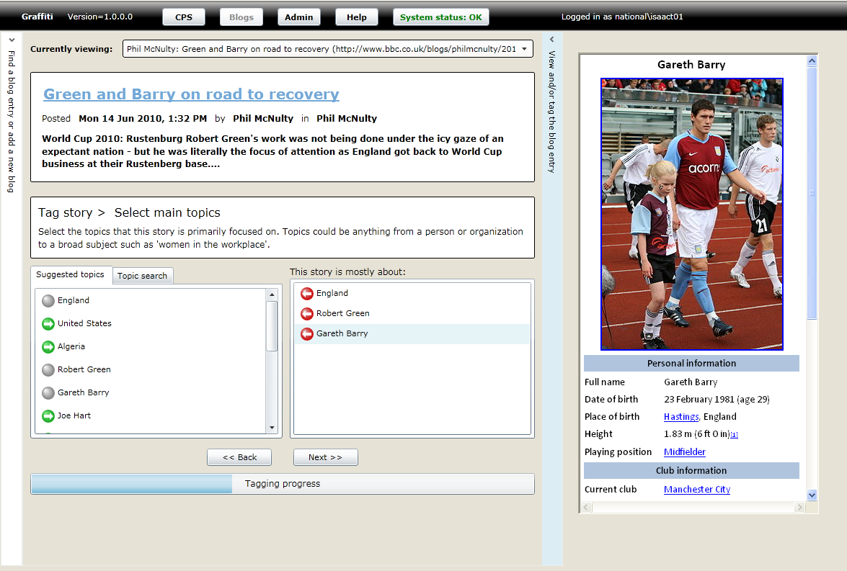
Semantic publishing

Slide 7
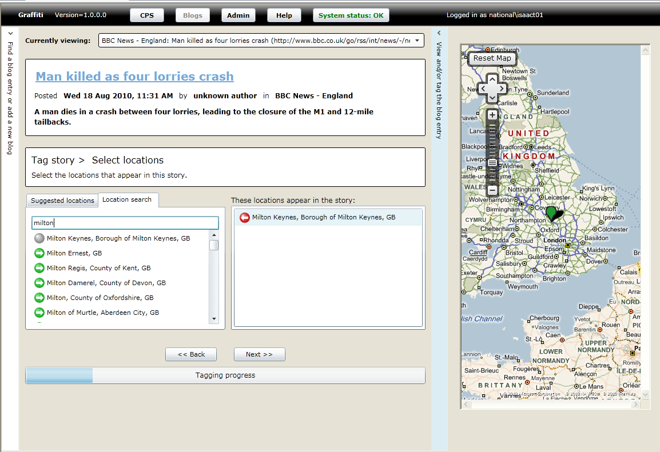
Semantic publishing

Slide 8
Semantic publishing
Journal publisher has different dynamics
a large corpus to annotate
updates are large, but less frequent – offline batch process
nevertheless, rich metadata used to create better products, e.g. virtual journals, services that use metadata only
This benchmark can be informed from this
detail and expressiveness of metadata, inference

Slide 9
Semantic publishing
Why RDF? – several reasons:
Easy data integration format
Many useful datasets to reference, e.g. geonames
Lightweight semantics – ontology driven modelling makes for powerful search
Even more powerful when combined with full-text search and ranking

Slide 10
Overview
Semantic publishing
Elements of the benchmark
Next steps

Slide 11
Elements of the benchmark
Thanks to the BBC, we have:
SPARQL templates for CRUD operations on CreativeWorks
Domain ontologies, e.g. Sports, News
System ontologies, e.g. CreativeWorks, CMS, Provenance, Tagging
See: http://www.ldbc.eu:8090/display/TUC/Semantic+Publishing+Task+Force
(and child pages)

Slide 12
Elements of the benchmark
Too BBC-oriented?
Ontoba have suggested using well-known vocabularies/ontologies where possible, e.g. dcterms, foaf, time, event
Should we anonymise what’s left over?

Slide 13
Elements of the benchmark
Ontotext have created prototype test drivers (Java) that run against a SPARQL endpoint (SPARQL 1.1 Query and Update required)
Recreates the ‘dynamic’ form of semantic publishing, i.e.
constant stream of CreativeWork CRUD operations
simultaneous heavy query load (search)

Slide 14
Elements of the benchmark
Content Authoring
RDF DATABASE
Asset metadata
Annotation
Describes
Dynamic aggregation
Delivery
Content store(s)

Slide 15
Elements of the benchmark
BBC ontologies
Geonames
CreativeWorks
RDF DATABASE
Asset metadata
Annotation
Dynamic aggregation
1 or 2 driver instances
CRUD operations
90% Create
9% Update
1% Delete
30 driver instances
Search queries
Can use the number of drivers to regulate query rate

Slide 16
Elements of the benchmark
Inference – only lightweight is required
RDFS plus owl:sameAs, owl:TransitiveProperty
More expressive inference likely useful for ‘static’ semantic publishing
e.g. where more expressive models can identify deeper relationships in the data
More to do here

Slide 17
Elements of the benchmark
Data generation – work to do here too
Simplest method is to
combine BBC ontologies (domain, system, tagging)
combine useful 3rd party datasets, e.g. geonames
Populate CreativeWorks by generating large number of CREATE operations
Aiming for good distribution across domain and 3rd party instance data

Slide 18
Elements of the benchmark
The first experiments revealed that there are a few inefficiencies in the original queries
Updating an ‘object’ by dropping a named graph that holds the object’s properties/values requires a named graph index

Slide 19
Overview
Semantic publishing
Elements of the benchmark
Next steps

Slide 20
Next steps
Data generation
distribution of CWs (cwork:about, cwork:mentions)
Query generation
skew for hottest topics
Inference
more complex class definitions (input from scientific publishers)
Verification
results of search (retrieving CWs) should be checked

Slide 21
Next steps
Hybrid search
full-text search
ranking
Operational issues
effect of backup on performance
machine failures (cluster mode)
schema updates (curating ontologies)
reference data upgrade

Slide 22
Overview
?

