Slide 1
Project Goals and Status Peter Boncz (VU Amsterdam)
Munich
April 22+23, 2013

Slide 2
Motivation
Make RDF and Graph DB technology a credible and more widely adopted technology in IT and Big Data
Stimulate technical advances by making progress visible through benchmarking

Slide 3
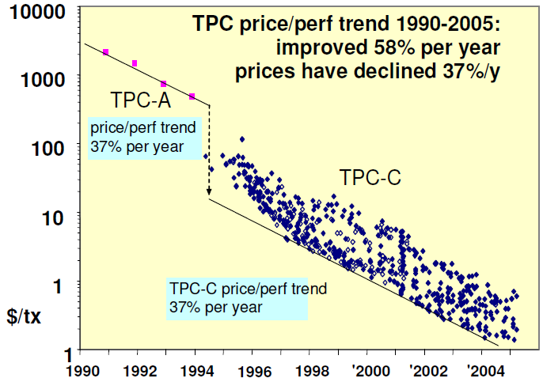
Why Benchmarking?
make competing products comparable
accelerate progress, make technology viable
© Jim Gray, 2005

Slide 4







What is the LDBC?
Linked Data Benchmark Council = a benchmarking organization
Industry entity similar to TPC (www.tpc.org)
Focusing on graph and RDF store benchmarking
An EU project (STREP) in FP7
Runs from sept 2012 – march 2015
8 project partners:

Slide 5
EU Project Goals
Make sure the LDBC becomes a strong entity and will continue to operate after the project
Equip de LDBC with a good initial set of benchmarks, and benchmark results

Slide 6
Benchmark Task Forces
Committee that works on a new benchmark
Technical Experts (choke point analysis)
TUC members (use cases)
Benchmark Development Process
Specification, Implementation, Roll-Out

Slide 7
Task Force Activities
Benchmark Specification
dataset selection (and/or data generator design),
workload
metrics
reporting format
Benchmark Implementation
tool development
test evaluations (i.e.the running of the preliminary benchmark on a number of systems and an analysis of the results).
Benchmark Roll-out
auditing guide + training the Auditors
producing the first reference results

Slide 8
Choke Points
Choke Points are the pain points in current technology
insights from technology experts
ensure these pain points are part of benchmarks
Choosing choke points well
Aim: stimulate innovation in key areas
Setting realistic goals

Slide 9
1st TUC meeting Nov 19/20, Barcelona
Use Cases
BBC - Jem Rayfield
CA Technologies - Victor Muntés
Connected Discovery - Bryn Williams-Jones
Elsevier - Alan Yagoda
ERA7 Bioinformatics - Eduardo Pareja
Press Association - Jarred McGinnis
RJLee - David Neuer
Yale - Lec Maj
Created two Benchmark Task forces:
Semantic Publishing (RDF)
Social Network Analysis (Graph mostly)

Slide 10
Task Force Topics
Better RDF Benchmarks
System Maturity (transactions, online backup)
Need Feature-rich benchmarks (GIS, keyword search)
Reasoning (OWL?)
Defining Graph Benchmarks
Transactional (OLTP)
Analytics (OLAP)
Algorithm frameworks (Bulk Synchronous Processing)
Pregel, Signal/Collect, Giraph, Green Marl, GraphLab

Slide 11
Recent Developments
BigData Top100
http://www.bigdatatop100.org/
Hadoop and Parallel relational database focus
Facebook Linkbench Benchmark (SIGMOD paper)
mimics Facebook MySQL/memcached infrastructure
transactionally oriented
Facebook-like data distributions
BSBM results @ 150 billion triples
First compute-cluster based RDF benchmark runs
750x larger than ever reported
Explore + Business Intelligence workload
Graph workshops, sponsored by LDBC
GRADES, NY, June 23, 2013
GraphLab, SF, July 1, 2013

Slide 12
What we expect from you
Feedback to task forces
By commenting on progress, now.
By becoming an external Task Force member
Provide Input
Provide Data sets or describe datasets
Provide Workloads or describe workloads

Slide 13
What LDBC provides
Access to TUC wiki with benchmark information
Benchmark development Task force information
Logistics
Benchmark designs
Discussion on benchmark designs
Preliminary benchmark results
6m reports on the progress of the project
..influence the LDBC.. Influence the industry!

Slide 14
Goals For Today
Learning about technological challenges
Use case descriptions for graph,RDF systems
Discuss the progress of benchmark task forces
Semantic publishing (RDF)
Social network analysis (Graph-mostly)
New task force proposals?

Slide 15
Agenda
Today
10:00 Introduction
11:00 Social Network Use Cases
12:30 Lunch
13:30 Semantic Publishing Use Cases
15:00 Break
15:30 Projects Related to LDBC
17:30 Finish
19:00 Social dinner (Munich city center)
Tomorrow
10:00 Industry/Hardware Aspects
11:30 Break
12:00 Task Force feedback session
13:00 Finish

