Slide 1
Semantic Publishing Benchmark Task Force
Fourth TUC Meeting,
Amsterdam, 03 April 2014

Slide 2
Use-case
This is an industry-motivated benchmark
The scenario involves a media / publisher organization that maintains semantic metadata about its Journalistic assets (articles, photos, videos, papers, books, etc), called Creative Works
The Semantic Publishing Benchmark simulates:
Consumption of RDF metadata (Creative Works)
Updates of RDF metadata

Slide 3
Benchmark Design - Requirements
Storing and processing RDF data
Loading data in RDF serialization formats :
N-Quads, TRIG, Turtle, etc.
Storing and isolating data in separate RDF graphs

Slide 4
Benchmark Design – Requirements (2)
Supporting following SPARQL standards :
SPARQL 1.1 Protocol, Query, Update
Support for RDFS, in order to return correct results
Optional support for the RL profile of Web Ontology Language (OWL2 RL) in order to pass the conformance test suite

Slide 5
Benchmark Design – operational phases
Initial loading of reference knowledge
Enriched datasets with DBPedia person data and Geonames
Adjustable loading of reference data
Generation of Creative Works
Parallel generation (multi-threaded and multi-process)
Loading of Creative Works
Warm-up
Benchmark
Conformance tests (OWL2 RL)

Slide 6
Benchmark Configuration
Number of editorial / aggregation agents
Size of generated data (triples)
Duration of Warm-up and Benchmark phases
Each operational phase can be enabled or disabled
Parallel data generation

Slide 7
Benchmark Configuration (2)
Distribution of queries in the query-mix
editorial operations
aggregate operations
Data Generator
Allocation of tags in Creative Works
Clustering of Creative Works around major / minor events
Correlations

Slide 8
Data Generation
Produces synthetic data that having the most of the characteristics of real world data provided by The BBC
Input
Ontologies
Reference knowledge datasets
Output: Creative Works datasets
conform to ontologies
refer to entities in the reference datasets
follow the pre-defined modeling and distributions of the Data Generator

Slide 9
Data Generation (2)
correlations
clustering
random distribution
Tagged entities
Jan.2012
Time
Dec.2012

Slide 10
Ontologies
Core Ontologies: describe basic concepts about entities and relationships
Basic Concepts: Creative Works, Places, Persons, Provenance Information, Company Information, etc.
Domain Ontologies: describe concepts and properties related to a specific domain
sports (competitions, events)
politics entities
news (concepts that journalists tag annotations with)

Slide 11
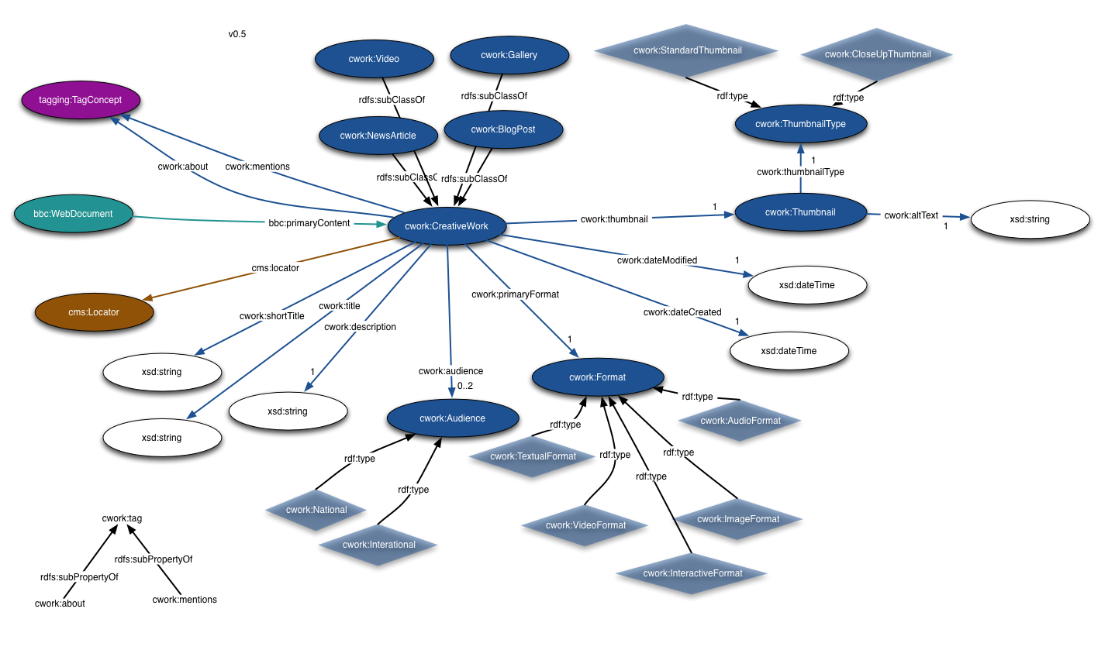
Ontology Sample (Creative Work)

Slide 12
Reference Datasets
Collections of entities describing various domains
Snapshots of the real datasets (BBC)
Football competitions and teams
Formula One competitions and teams
UK Parliament Members
Additional datasets
GeoNames - Places, names and coordinates
DBPedia – Person data

Slide 13
Data Generation Process
Load ontologies and reference knwoledge data to the RDF repository
Data Generator
retrieves instances from Reference Datasets
Generates Creative Works according to pre-defined allocations and models
Writes generated data to disk
SPB Data Generator
(2.d)
Generated CWs
Creative
Works
Generator
Ontology &
Reference
Data Set Loader
(1)
(2.c)
SPARQL Endpoint
data generation parameters
(2.a)
RDF Repository
(1)
(1)
BBC Ontologies
Reference Datasets

Slide 14
Choke Points
“technical challenges that RDF stores need to overcome in order to satisfy the need for a fast and reliable service using real-world data and real-world queries”
test how different constructs affect the performance of the RDF engines : choice of the optimal query plan

Slide 15
Choke Points
Join Ordering :
OPTIONALs & nested OPTIONALs : should be evaluated last (treated as left outer joins)
FILTERs : evaluate as early as possible
Sub-queries : evaluate first
Parallel execution : UNIONs
Elimination of redundant joins : RDFS Constructs
Sorting : OrderBy
Aggregates : GroupBy, Count

Slide 16
The Workloads (Queries)
Simultaneous execution of editorial and aggregation agents
Query mix distributions
Editorial agents – simulate editorial work performed by journalists :
Insert, Update, Delete

Slide 17
The Workloads (Queries 2)
Aggregation agents – simulate retrieval operations performed by end-users :
Base query mix
Aggregation queries
Search queries, Count queries
Geo-spatial , Full-text search queries
Extended query mix
Analytical Drill-down queries (geo-locations, time-range)
Faceted Search Queries
Time-line of Interactions Queries

Slide 18
Query Templates
All queries are saved to template files
Using template parameters in queries
Templates allow to modify each query if necessary

Slide 19
Results Metrics and Logs
Metrics
Editorial operations, Aggregate operations per second
Total QPS
Logs
Brief listing of executed queries
Detailed description of each query and result
Benchmark results summary

Slide 20
Integration
Sources and Datasets are in GitHub reposituries
Adopted SPB as part of the standard release procedure for OWLIM RDF Store
Detect performance deviations for future releases
Both on local hardware and on Amazon’s EC2 Instances

Slide 21
Future Work
End of April - 2014
Validation, execution and query results
Query parameters substitution
Online-replication and Backup

Slide 22
Thank you

