Slide 1

Optimizing Subgraph Queries
With a Mix of
Tradition & Modernity
Semih Salihoglu (joint w/ Amine Mhedhbi)
July 5th, 2019
Optimizing Subgraph Queries With a Mix of Binary & Worst-case Optimal Joins, Mhedbhi & Salihoglu, VLDB, ‘19

Slide 2
Subgraph Queries = Multiway (Self) Join Queries
Query
R1
MATCH (a)->(b)->(c), (a)->(c)
a
b
R2
R3
Query Edge
c
Query Vertex
Input Graph
1
R1
a | b
1 | 2
1 | 3
1 | 4
2 | 4
2 | 5
2 | 6
3 | 4
R2
a | c
1 | 2
1 | 3
1 | 4
2 | 4
2 | 5
2 | 6
3 | 4
R3
b | c
1 | 2
1 | 3
1 | 4
2 | 4
2 | 5
2 | 6
3 | 4
2
3
4
⋈
⋈
5
Edge
6
Vertex

Slide 3
Traditionally: Binary Join Plans
R1
R1
a | b
1 | 2
1 | 3
1 | 4
…
Table(s)/Q-Edge(s)-at-a-time Joins
a
b
R2
R3
c
INT₁
a | b | c
1 | 2 | 2
1 | 2 | 3
1 | 2 | 4
1 | 3 | 2
1 | 3 | 4
…
R2
a | c
1 | 2
1 | 3
1 | 4
…
Output
a | b | c
1 | 2 | 4
1 | 3 | 4
R3
b | c
1 | 2
1 | 3
1 | 4
…

Slide 4
Recent Developments (AGM ‘08, NPRR ’12):
BJ Plans are Not (even) Worst-case Optimal
ś
0
n+1
1
1
a
b
n
2
2
c
…
…
n-1
2n
Any BJ Plan will take O(m²) time.
But max output is: m^{3/2} (AGM Bound of Triangle Query)

Slide 5
Generic Join: A WCO Algorithm (NPRR, 2013)
a | b
1 | 2
1 | 3
1 | 4
2 | 4
2 | 5
2 | 6
3 | 4
Column/Q-Vertex-at-a-time
Order q-vertices: say: a,b,c
a
b
c
∩
INT₁
a
a | c
1 | 2
1 | 3
1 | 4
2 | 4
2 | 5
2 | 6
3 | 4
b | c
1 | 2
1 | 3
1 | 4
2 | 4
2 | 5
2 | 6
3 | 4

Slide 6
Generic Join: A WCO Algorithm (NPRR, 2013)
a | b
1 | 2
1 | 3
1 | 4
2 | 4
2 | 5
2 | 6
3 | 4
Column/Q-Vertex-at-a-time
Order q-vertices: say: a,b,c
a
b
Q =
c
Int₁
a
1
2
3
INT₁
a
INT₂
a | b
a | c
1 | 2
1 | 3
1 | 4
2 | 4
2 | 5
2 | 6
3 | 4
b | c
1 | 2
1 | 3
1 | 4
2 | 4
2 | 5
2 | 6
3 | 4

Slide 7
Generic Join: A WCO Algorithm (NPRR, 2013)
a | b
1 | 2
1 | 3
1 | 4
2 | 4
2 | 5
2 | 6
3 | 4
Column/Q-Vertex-at-a-time
Order q-vertices: say: a,b,c
a
b
Q =
c
INT₁
a
1
2
3
INT₂
a | b
1 | 2
1 | 3
INT₂
a | b
a | c
1 | 2
1 | 3
1 | 4
2 | 4
2 | 5
2 | 6
3 | 4
∩
b | c
1 | 2
1 | 3
1 | 4
2 | 4
2 | 5
2 | 6
3 | 4

Slide 8
Generic Join: A WCO Algorithm (NPRR, 2013)
a | b
1 | 2
1 | 3
1 | 4
2 | 4
2 | 5
2 | 6
3 | 4
Column/Q-Vertex-at-a-time
Order q-vertices: say: a,b,c
a
b
Q =
c
INT₁
a
1
2
3
INT₂
a | b
1 | 2
1 | 3
2 | 4
2 | 5
2 | 6
3 | 4
Output
a | b | c
a | c
1 | 2
1 | 3
1 | 4
2 | 4
2 | 5
2 | 6
3 | 4
∩
b | c
1 | 2
1 | 3
1 | 4
2 | 4
2 | 5
2 | 6
3 | 4

Slide 9
Generic Join: A WCO Algorithm (NPRR, 2013)
a | b
1 | 2
1 | 3
1 | 4
2 | 4
2 | 5
2 | 6
3 | 4
Column/Q-Vertex-at-a-time
Order q-vertices: say: a,b,c
a
b
Q =
c
Output
a | b | c
1 | 2 | 4
1 | 3 | 4
INT₁
a
1
2
3
INT₂
a | b
1 | 2
1 | 3
2 | 4
2 | 5
2 | 6
3 | 4
Output
a | b | c
1 | 2 | 4
a | c
1 | 2
1 | 3
1 | 4
2 | 4
2 | 5
2 | 6
3 | 4
b | c
1 | 2
1 | 3
1 | 4
2 | 4
2 | 5
2 | 6
3 | 4
Theorem (GJ is WCO): Runtime of GJ ≤ AGM
(for any query & any q-vertex ordering)
9

Slide 10

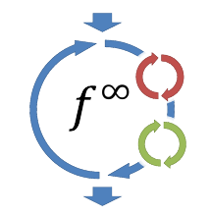
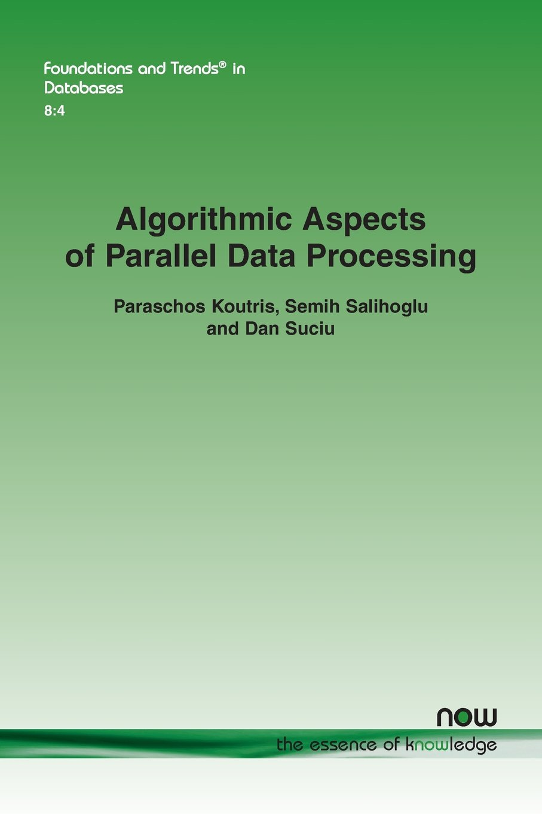
Research Overview on WCO Joins
Serial Setting
Distributed Setting
Prototype GDBMS at UWaterloo
(SIGMOD ‘17 Demo,
VLDB ‘19)
Timely Dataflow
(previously Naiad)
(VLDB ‘18)
Survey on Load Complexity
(F&T, ‘18)
What should the query vertex orderings (QVOs) be?
For which queries to use?
How to mix with traditional joins?
…

Slide 11
Graphflow Logical and Physical Plans for SQs
Storage: 2 adjacency lists per vertex (fw & bw) stored in memory
Logical Plan
(Hybrid) Logical Plan
Physical Plan
(WCO) Logical Plan
QVO: c,d,b,a
b
HashJoin (b,c)
b
a
d
a
d
c
c
b
b
Ext/Int (b)
a→ ∩ c←
Ext/Int (b)
c← ∩ d→
b
a
d
d
c
c
c
a
d
ScanE
a→c
ScanE
c→d
d
c
c
c

Slide 12
Q1: Ordering QVOs: Good Orders
Two main effects of QVOs:
First Effect: # intermediate partial matches.
P1: QVO: c,d,b,a
P2: QVO: c,d,a,b
b
b
a
d
a
d
c
c
 | P1 | P2
Intermediate Matches | 3.5M | 40M
Run time | 9s | 16s
b
a
d
d
c
c
Soc-Epinions
d
d
c
c

Slide 13
Q1: Ordering QVOs: Good Orders
2nd Effect: Directions of adjacency lists intersected.
P1:QVO: a,b,c
P2: QVO: a,c,b
P3: QVO: b,c,a
b
b
b
a
a
a
c
c
c
 | P1 | P2 | P3
Run time | 3s | 15s | 31s
b
b
a
Web-BerkStan
a
c
c
src→ ∩ dst→
src→ ∩ dst←
src← ∩ dst←
Graphflow Optimizer: Minimize estimated intersection cost (i-cost)
I-cost: ∑ (size-of-adj-lists-intersected-throughout-execution)
(estimate # partial matches & avg adj-list sizes w/ subgraph catalogue)

Slide 14
I-cost Estimation Technique: Subgraph Catalogue
S | Adj. Lists | S’ | i-cost | selectivity
… | … | … | … | …
 |  |  | 57 | 4.6
 |  |  | 158 | 4.6
… | … | … | … | …
a
b
a
c
b
a
b
a
b
a
c
b
a
b

Slide 15
Q1: Ordering QVOs: Adaptive Orders
Picking a fixed QVO may be suboptimal.
3
6
3n
…
1
2
4
5
3n-2
3n-1
P1: QVO: b,c,d,a
P2: QVO: b,c,a,d
b
b
a
d
a
d
c
c
 | P1 | P2
 | 2n | 0
 | n | n
 | 0 | 2n
Total | 3n | 3n
b
b
d
a
c
c
b
b
c
c

Slide 16
Q1: Ordering QVOs: Example Adaptive WCO Plan
b
b
a
d
a
d
c
c
b
b
d
a
c
c
b,c,d,a
b,c,a,d
b
c

Slide 17
Q1: Ordering QVOs: Effects of Adaptive WCO Plans
b
b
a
d
a
d
c
c
Soc-Epinions
Web-Google

Slide 18
Q2: How to mix BJs with Intersections?
Cost-based DP optimization algorithm.
b
a
d
c
Optimum Plans for all connected sub-queries with 2 q-vertices:
a
b
a
c
b
c
c
d
d
b
Optimum Plans for all connected sub-queries with 3 q-vertices:
b
b
b
a
d
a
d
a
d
c
c
c
Optimum Plans for all connected sub-queries with 4 q-vertices:
b
a
d
c
Each step: consider plans with both hash joins & intersections.

Slide 19
Graphflow vs Empty-Headed Hybrid Plans
f
f
 | Amzn | Web-G
GF | 6.7s | 328s
EH | 25.2s | >5 hours
b
e
b
e
c
c
a
d
a
d
b
e
f
f
c
b
e
a
d
c
c
a
d
b
e
b
e
c
c
c
c
a
d
a
d
c
c
c
c
a
d
a
d
Graphflow
EmptyHeaded

Slide 20
Q3: For Which Queries are WCO, BJ, Hybrid Plans Good?
Size and cyclicity
b
a
b
c
a
d
c
f
e
d
Soc-Epinions
Amazon

Slide 21
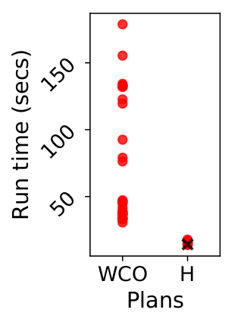
Q3: For Which Queries are WCO, BJ, Hybrid Plans Good?
b
e
b
c
c
a
e
a
d
f
d
Web-Google
Gnutella

Slide 22
Summary
For subgraph queries, Graphflow optimizer:
Adopts the i-cost cost metric
Uses a subgraph catalogue for i-cost estimation
Seamlessly mixes binary joins and WCO-style intersections with a dynamic programming optimizer
Adaptively changes the query vertex orderings during runtime
Similar techniques for cont. subgraph matching (upcoming work)

Slide 23


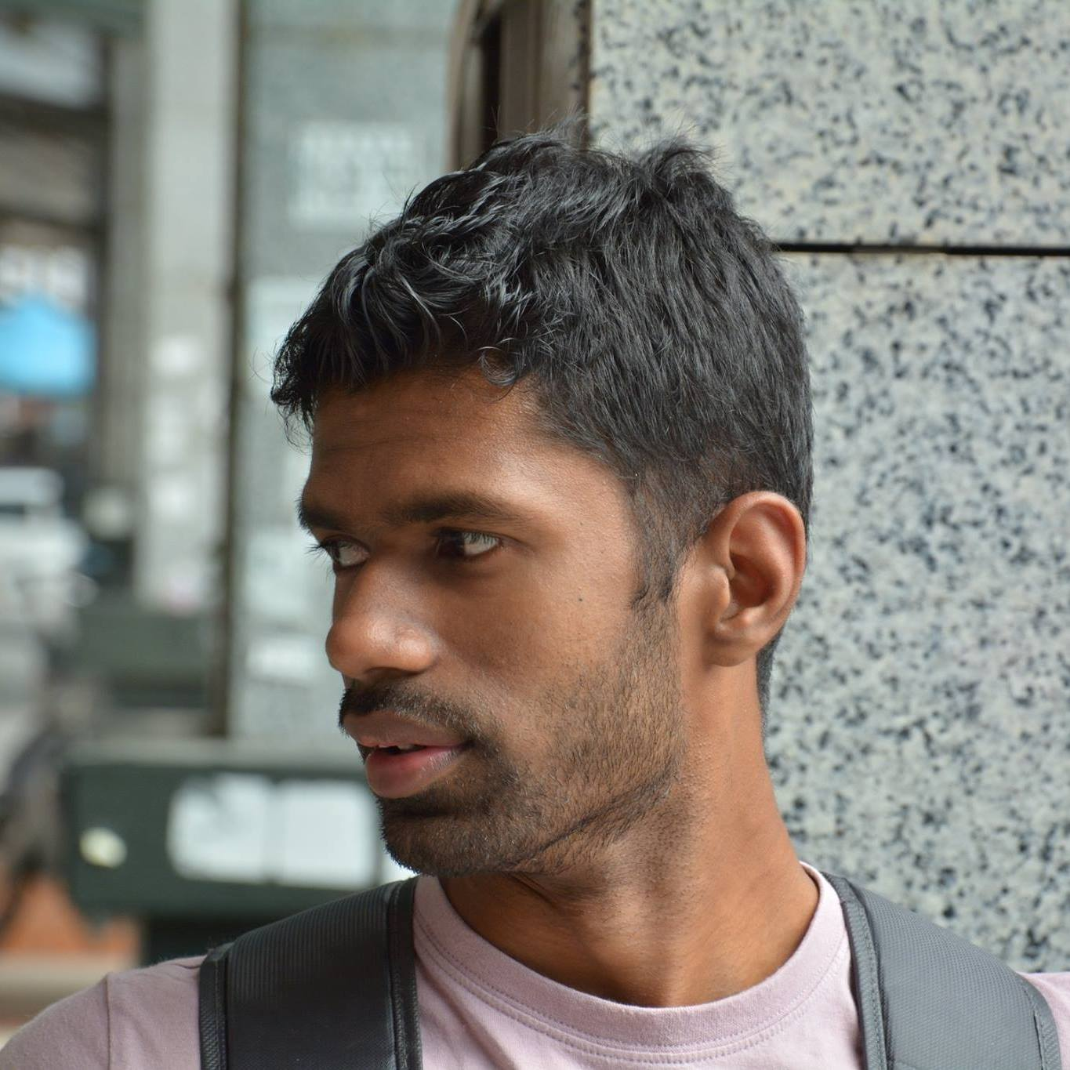
Students
Amine
Mhedhbi
Siddhartha
Sahu
Chathura Kankanamge

Slide 24
References
Efficiently Updating Materialized Views, BLT, SIGMOD Record, 1986
An Efficient Distributed Subgraph Mining Algorithm in Extreme Large Graphs, WB, AICI, 2010
Optimizing Multiway Joins in a Map-Reduce Environment, AU, TKDE, 2011
Leapfrog Triejoin: a worst-case optimal join algorithm, Veldheuizen, arxiv 2012
Tri, Tri Again: Finding Triangles and Small Subgraphs in a Distributed Setting, DLP, DISC, 2012
Worst-case Optimal Join Algorithms, NPRR, PODS 2012
A Distributed Graph Engine for Web Scale RDF Data, ZYWKW, VLDB, 2013
Communication Steps for Parallel Query Processing, BKS, PODS, 2013
Incremental Maintenance for LeapfrogTriejoin, Veldheuizen, arxiv 2013
Naiad: A Timely Dataflow System, MMIIA, SOSP, 2013
PATRIC: A Parallel Algorithm for Counting Triangles in Massive Network, CIKM, 2013
Size Bounds and Query Plans for Relational Joins, AGM, SIAM Journal of Computing, 2013
Upper and Lower Bounds in the Cost of a Map-Reduce Computations, ASSU, VLDB, 2013
Skew Strikes Back: New Developments in the Theory of Join Algorithms, NPRR, SIGMOD Record, 2014
Anchor Points Algorithms for Hamming and Edit Distance, ADRRSU, ICDT 2014
Arabesque: A System for Distributed Graph Mining, SOSP, 2015
Continuous Pattern Detection Over Billion-edge Graph Using Distributed Framework, CHCAF, EDBT, 2015
EmptyHeaded: A Relational Engine for Graph Processing, ATOR, SIGMOD, 2016
PTE: enumerating trillion triangles on distributed systems, PMK, KDD, 2016
Scalable Distributed Subgraph Enumeration, LQLZC, VLDB, 2016
Graphflow: An Active Graph Database, KSMCS, SIGMOD, 2017
GYM: A Multiround Distributed Join Algorithm, AJRSU, 2017
Distributed Evaluation of Subgraph Queries Using Worst-case Optimal Low-Memory Dataflows, AMS, VLDB, 2018
Ubiquity of Large Graphs and Surprising Challenges of Graph Processing, SMSLO, VLDB, 2018
Algorithmic Aspects of Paralllel Data Processing, KSS, F&T, 2018

Slide 25
Thank you

