Slide 1
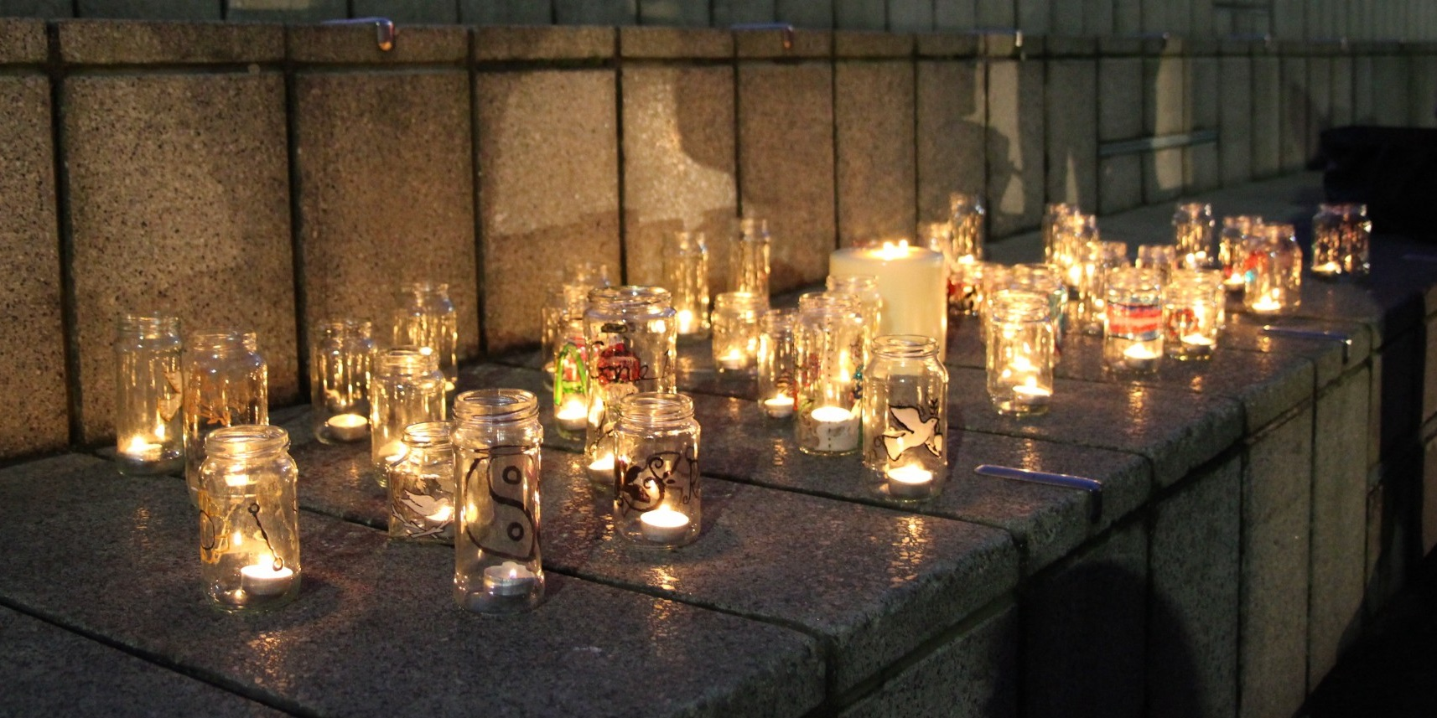
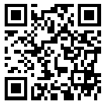
Trans Lives Matter: Remembering Our Dead
https://tdor.translivesmatter.info/

Slide 2
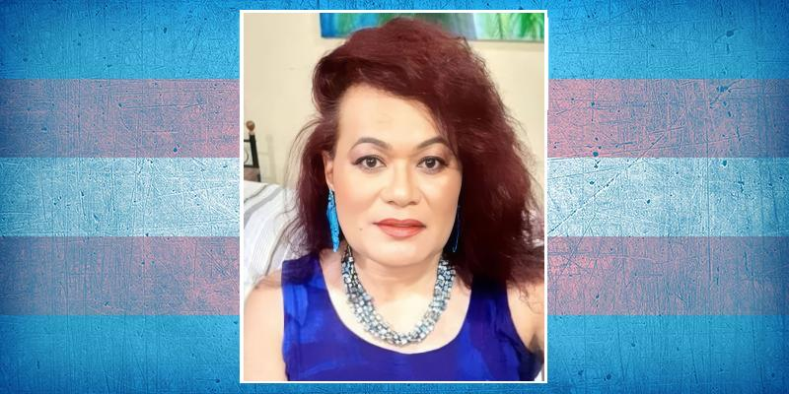
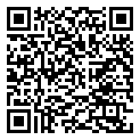
Dr Leighley Leli Darling
Age 52
Nadi, Ba (Fiji)
murdered. 1 Sep 2025

Slide 3
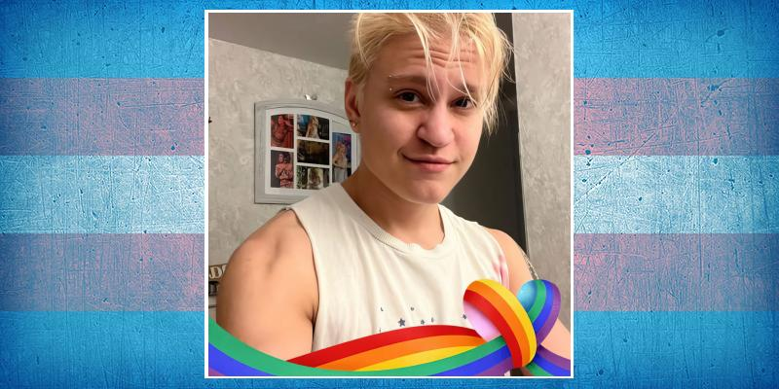
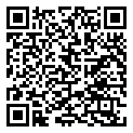
Blake Sturm
Age 25
Roanoke, Virginia (USA)
suicide. 2 Sep 2025

Slide 4
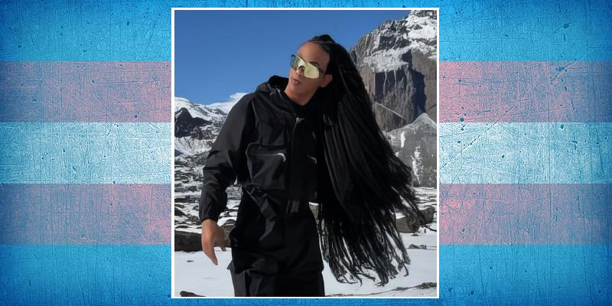
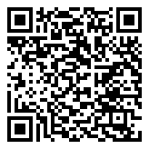
Kakay Britto
Age 26
Salvador, Bahia (Brazil)
shot. 4 Sep 2025

Slide 5
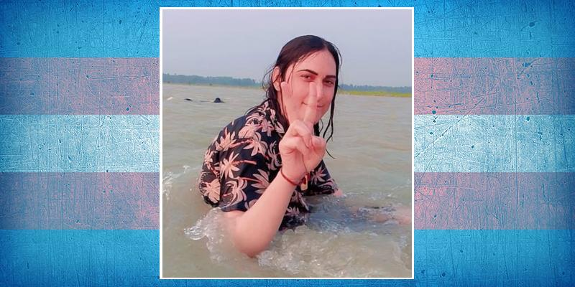
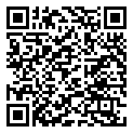
Sabir
Peshawar, Khyber Pakhtunkhwa (Pakistan)
shot. 6 Sep 2025

Slide 6
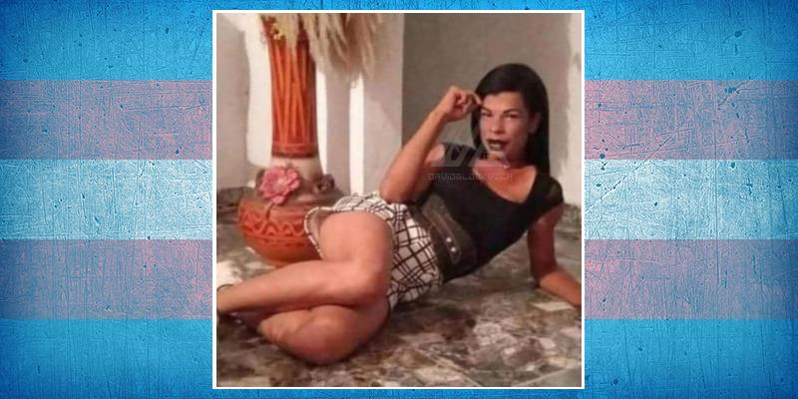
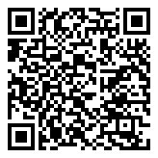
Churris Arasme
Cedeño, Monagas (Venezuela)
7 Sep 2025

Slide 7

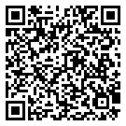
Amanda Falcão Rocha
Age 33
São Luís, Maranhão (Brazil)
8 Sep 2025

Slide 8
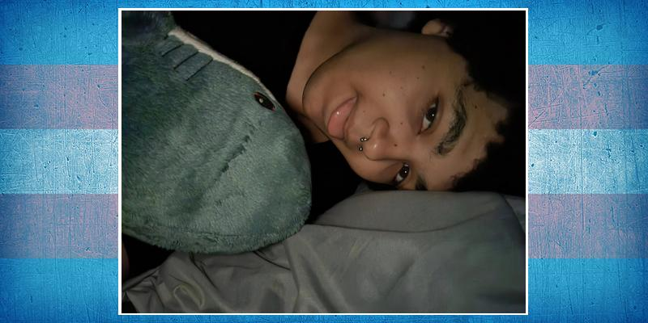
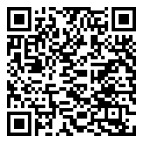
Lillia Holland
Age 19
Portland, Oregon (USA)
suicide. 9 Sep 2025

Slide 9
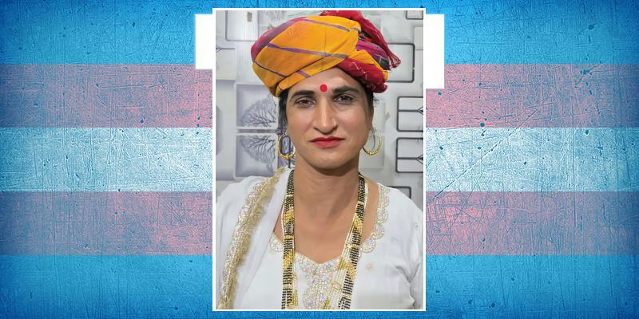
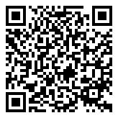
Madhu Sharma
Age 60
Neemrana, Rajasthan (India)
murdered. 10 Sep 2025

Slide 10
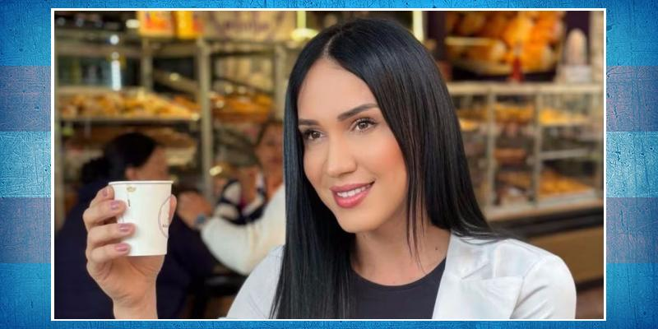
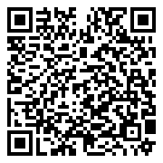
Maria del Mar Perdomo
Santa Marta, Magdalena (Colombia)
10 Sep 2025

Slide 11
Trans Lives Matter
SAY THEIR NAMES

