Slide 3
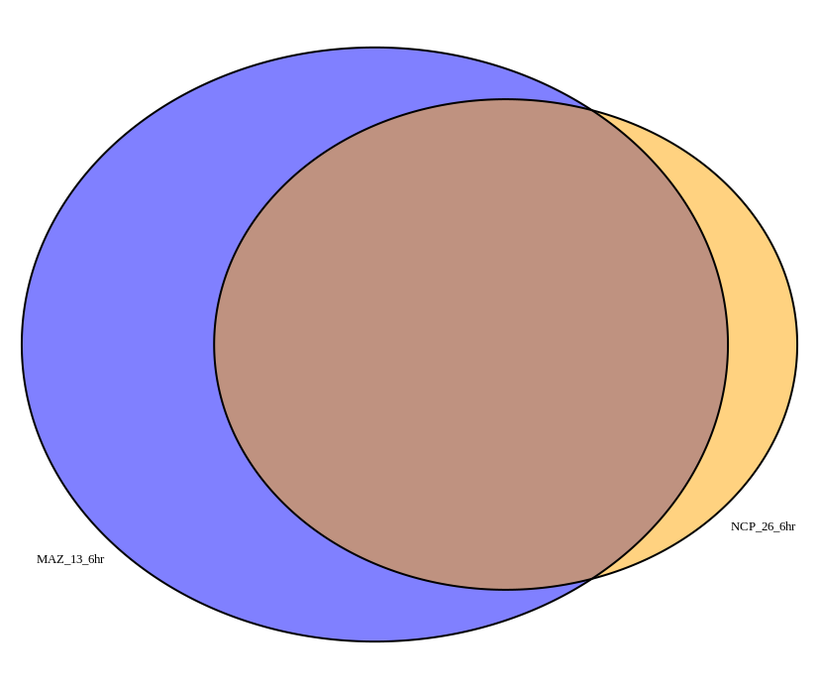
MFAP3L, NCOA7 TUBE1, FAT4, ANKRD28, RASA2 ERBIN, FNDC3A, CREBRF, FGF2, ACTB, PDCD4, ZBTB10, CLIC4, CDC14A, LRP12, JMY, CDK17, GAS2L1, SLC38A2, HSPA1A, COBLL1, INHBC, FAM135A, SUPT5H, CLUH, TMEM267, APOL6, RAB3A, LSP1, WASHC4, METTL4, WDR72, ALKBH8, TRIM36, TRUB1, GRPEL2, TES, KLF3, SKIL, RNF6, NR3C1, JAZF1, RICTOR, ING3, IPMK, TUBA1B, APBB2, KLF12, ZDBF2, NFAT5, CEP120, IGIP, MOSPD2, TUBB4A, CEP126, BACH2, DCUN1D4, ERN1, RNF125, ZMYM5, CREB3L2, ZCCHC8, PLAGL2, PLAG1, HSPA13, PKM, NADK2, IARS, FLNA
INHBE, PSAT1, SLC7A11, SNTB1, SLC6A9, TRIB3, CTH, SESN2, FAM129A, ASNS, PSPH, ATF3, CHAC1, PCK2, GPT2, NFE2L1, ALDH1L2, CEBPB, MTHFD2, RAB39B, PMAIP1, CEBPG, MKX, STC2, GAS7, GARS, BCAT1, FUT1, FASN, SLC1A5, PARP8, EIF4EBP1, PHGDH, HILPDA, WARS, PCGF5, TCEA1, SLC7A5, PFKFB4, DDIT3, SLC7A1, XPOT, TNFRSF10B, RAB33A, SLC43A1, UBE2QL1, ANGPTL4, TRPM8, CCPG1, ZMAT1, TSC22D3, CARS, SLC38A1, TNFRSF8, ITPR1, KIF21B, HSPA8, NR4A3, ALDOC, TARS, RGS16, KRAS, NR1D2, ANK2, LMO4, ARHGAP9, PYROXD1, LONRF1, OSBPL6, CCDC86, SLC3A2, TUBB4B, SEPSECS, TSEN15, CHPF2, BATF2, AARS, LPCAT1, IFRD1, FAM84B, GTPBP2, KRCC1, CYB5R3, PFKFB3, SF3B4, MAP1A, CBR4, CXCR3, AGO4, ADRB2, PLSCR1, BBC3, ADM2, ADM, TBL1X, HMOX1, HOXB9, LRRC8D, SCN4A, IDH1, MIA2, KDM4A, HRK, RNF187, EIF2S2, GADD45A
PIP5KL1 RWDD2B GJA1
BEST1
LDLR
CBS CTNND1 CCDC71L FUT11 SHMT2 ASS1 SF3A2 WDR41 DNAJA1

