Slide 2
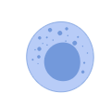

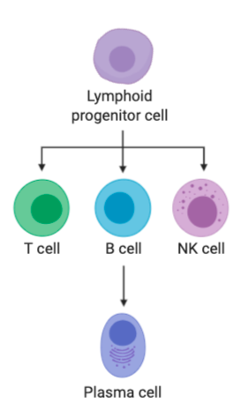
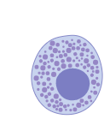



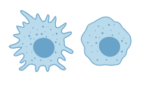




eosinophil
Nk cell
HSC
Mast cell
monocyte
neutrophil
Activated
macrophage
macrophage
megakaryocyte
basophil
thrombocytes

Slide 3
Lymphoid progenitor cell
T cell
B cell
NK cell
Plasma cell
Lymphoid progenitor cell
T cell
B cell
NK cell
Plasma cell

