Slide 1
Score Following:
An Artificially Intelligent Musical Accompanist
Anna Jordanous
Music Informatics,
University of Sussex

Slide 2

This talk will cover:
Accompaniment as an Artificial Intelligence task
Background
  What is score following?
  Previous work in score following
  Using Hidden Markov Models
Producing an artificial accompanist
  Design and Implementation details
  Evaluating the performance of the artificial accompanist
Inspiration for further work
1/ Score Following: An Artificially Intelligent Musical Accompanist

Slide 3
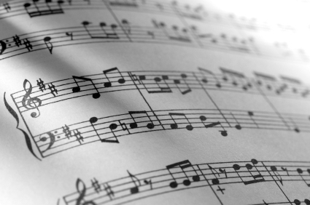
What is score following?
Score
The written music that
a musician reads
when they play music
Score Following
Following a musician’s
performance of a piece
by tracking their playing
through the score
2/ Score Following: An Artificially Intelligent Musical Accompanist

Slide 4
When do we use Score Following?
Imagine you are at a concert.
A flute player is performing a solo piece, with a piano player providing accompaniment.
The pianist listens to what the flute player is playing, to make sure their accompaniment matches the flute player.
The flute player may occasionally not perform the piece exactly as it is written in the score. In these cases the pianist must adjust their accompaniment.
3/ Score Following: An Artificially Intelligent Musical Accompanist

Slide 5
Why might the flute player not perform the piece exactly as written?
The flute player may make mistakes…
Plays the wrong note
Adds extra notes
Skips notes out
Gets lost
Speeds up or slows down
4/ Score Following: An Artificially Intelligent Musical Accompanist

Slide 6
Score Following is a vital part of artificially intelligent accompaniment
5/ Score Following: An Artificially Intelligent Musical Accompanist

Slide 7
Research into score following: a timeline
ICMC conference: Barry Vercoe and Roger Dannenberg both (independently) present computerised accompaniment systems that follow the soloist through the score using dynamic programming *
Vercoe adds learning to his system (to learn the performer’s likely paths through the score)
present
1984
1985
1989
1999
2001
2006
6/ Score Following: An Artificially Intelligent Musical Accompanist

Slide 8
Hidden Markov Models are increasingly being used in score following
Many research efforts are currently focused on using
Hidden Markov Models
Raphael 1999 onwards
Cano, Loscos and Bonada 1999
IRCAM 2001 onwards
Pardo and Birmingham 2006
      What are Hidden Markov Models ?
      How are they useful for artificial accompaniment ?
7/ Score Following: An Artificially Intelligent Musical Accompanist

Slide 9

A Hidden Markov Model is a way of modelling real-world scenarios
e.g. Think of a sequence of coin flips, where the coin being flipped is either a biased or normal coin (but we don’t know which one it is and want to try and find out).
  STATES: ‘biased coin flipped’, ‘normal coin flipped’
  OBSERVATIONS: ‘Head’, ‘Tail’.
By looking at the sequence of results, can we work out
which coin is being used?
… even if we allow the coin to be changed between flips?
A real-life system can be modelled with an HMM if:
  The system can be thought of as being in one of a (finite) number of
    states, at any given time.
  We can determine what state the system is currently in by looking at
    recent outputs from the system (observations).
8/ Score Following: An Artificially Intelligent Musical Accompanist

Slide 10
A Hidden Markov Model is a way of modelling real-world scenarios
A Hidden Markov Model (HMM) uses probabilities relating to these states and observations:
  Probability of the system initially being in a particular state
  Probability of a particular observation happening in each state
  Probability of the system moving from being in one state to being in another
P(initially starting with the biased coin) = 0.5
P(initially starting with the normal coin) = 0.5
P(head | normal coin is being used) = 0.5
P(tail | normal coin is being used) = 0.5
P(head | biased coin is being used) = 0.1
P(tail | biased coin is being used) = 0.9
P(change from using the normal coin to the biased coin) = 0.3
P(change from using the biased coin to the normal coin) = 0.05
9/ Score Following: An Artificially Intelligent Musical Accompanist

Slide 11
Score Following can be done using a Hidden Markov Model
  A music score can be divided into a sequence of events -
    Sequence of notes
    Sequence of beats
    Key points such as cadences/trilled notes
    etc
  A score follower can determine what state the performer is most likely to be in at that time, by:
    Looking at the sequence of events actually being performed by the soloist
    Matching that sequence of events to the Hidden Markov Model of the score
10/ Score Following: An Artificially Intelligent Musical Accompanist

Slide 12
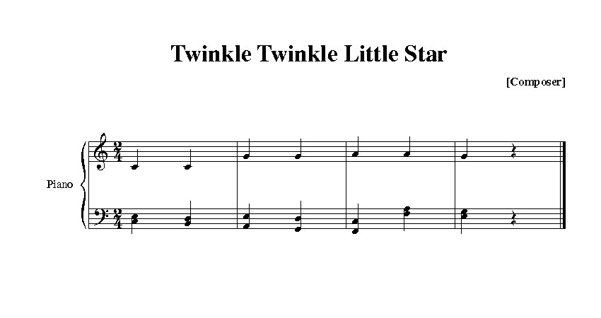
Modelling a score using a Hidden Markov Model: an example
STATES: {Beat1, Beat2, Beat3, Beat4, Beat5, Beat6, Beat7, Beat8}
OBSERVATIONS: The note being played by the soloist at that point in time
11/ Score Following: An Artificially Intelligent Musical Accompanist

Slide 13
Score Following can be done using a Hidden Markov Model
  Problem:
  What about when the performer deviates from the score?
  How can that be represented in a HMM? We can’t possibly come up with a state that represents every possible deviation from the score
  Orio et al. came up with a solution for this problem in their 2003 paper.
  For each event in a score, use two HMM states:
    'Normal' state – for when the performer plays the expected note
    'Ghost' state – for when the performer plays an unexpected note
12/ Score Following: An Artificially Intelligent Musical Accompanist

Slide 14
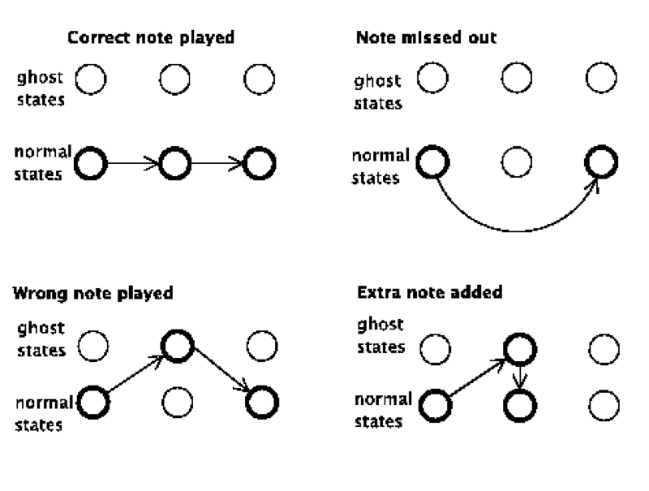
Normal and Ghost states can be used to represent deviations from the score
13/ Score Following: An Artificially Intelligent Musical Accompanist

Slide 15
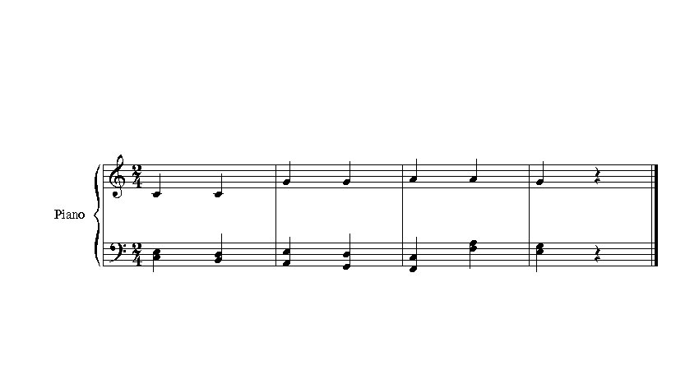
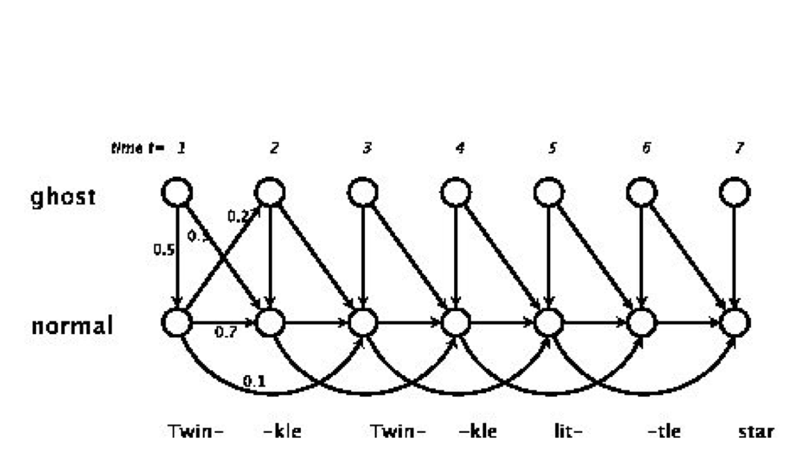
Remember Twinkle Twinkle…
14/ Score Following: An Artificially Intelligent Musical Accompanist

Slide 16
Making an artificially intelligent score follower using HMMs
The hypothesis being tested is:
  Using an HMM to model a musical score is an efficient and practical way to implement score following.
  In particular, it lends well to providing real-time
  accompaniment to a human performer.
To model the scores, I chose to use the HMM states to represent individual beats of the piece:
  A piece of music can be thought of as a sequence of beats, with certain notes expected at each beat (i.e. the note written in the score)
15/ Score Following: An Artificially Intelligent Musical Accompanist

Slide 17
Making an artificially intelligent score follower using HMMs
Written in Max/MSP
  Max/MSP is a real-time, interactive music programming environment
The score follower runs on a Mac or PC computer that is attached to a MIDI keyboard
The MIDI keyboard communicates with the computer using the musical format MIDI
sending and receiving numeric messages about note pitch, volume, etc
16/ Score Following: An Artificially Intelligent Musical Accompanist

Slide 18
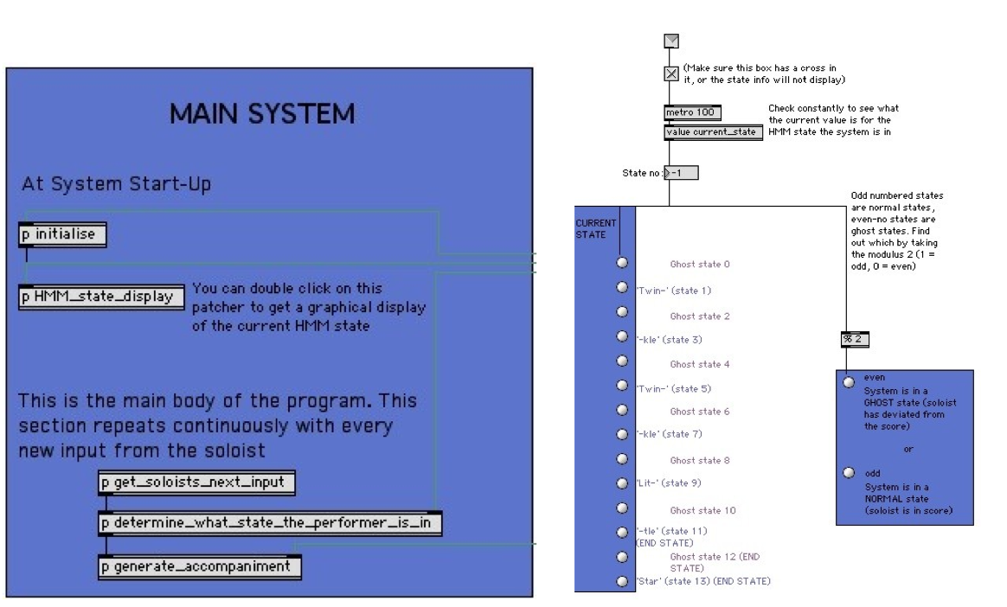
The HMM Score Follower System
17/ Score Following: An Artificially Intelligent Musical Accompanist

Slide 19
The program works by continuously repeating three basic steps
get_soloists_next_input:
  Extracts the new information from MIDI keyboard.
determine_what_state_the_performer_is_in:
  Runs a series of procedures:
  1. Convert the actual pitch of the note into one of 12 possible observations (0 if a ‘C’ has been played, 1 if a ‘C sharp’ has been played, etc).
  2. Adds this observation to the list of observations seen so far and extracts the three most recent observations.
  3. Performs the Viterbi decoding algorithm with these three observations to decode which HMM state the soloist is in (i.e. where they are in the score).
generate_accompaniment:
  Looks up the HMM state in an attribute-value pair, to find which notes to play as accompaniment
  E.g: <1, [48, 52, 55]> - ‘In state 1, play MIDI notes 48, 52, 55’ (C major chord)
18/ Score Following: An Artificially Intelligent Musical Accompanist

Slide 20

Summary: Artificially Intelligent Accompaniment using HMMs
Automated musical accompaniment, or score following, can be implemented using Hidden Markov Models (HMMs) to track what state a performer is in.
In my system, for each note that the performer is expected to play, there are two corresponding states that the soloist could be in: the ‘normal state’ and the ‘ghost state’.
My system determines which HMM state the soloist is currently in, by analysing what they have just played against a specified score. It then plays the appropriate accompaniment for that state.
…
…
…
…
/ Score Following: An Artificially Intelligent Musical Accompanist

