Slide 1
Score Following:
Artificially Intelligent Musical Accompaniment
Anna Jordanous
Music Informatics
University of Sussex

Slide 2

This talk will cover:
Accompaniment as an Artificial Intelligence task
Background
  What is score following?
  Previous work in score following
  Using Hidden Markov Models
Producing an artificial accompanist
  Design and Implementation details
  Evaluating the performance of the artificial accompanist
Inspiration for further work
Score Following: Artificially Intelligent Musical Accompaniment

Slide 3
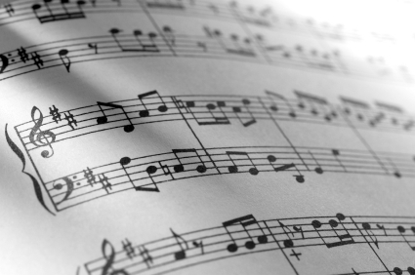
What is score following?
Score
The written music that
a musician reads
when they play music
Score Following
Following a musician’s
performance of a piece
by tracking their playing
through the score
Score Following: Artificially Intelligent Musical Accompaniment

Slide 4
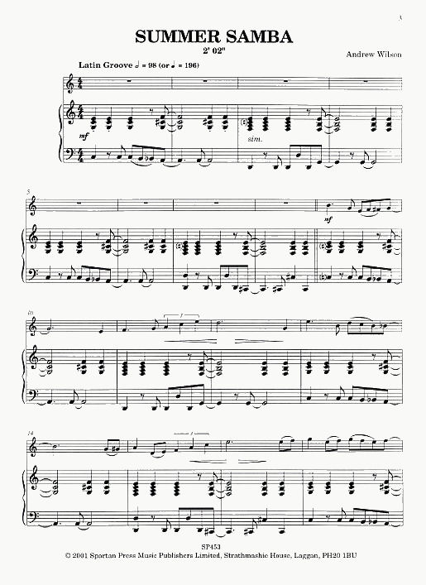
When do we use Score Following?
Imagine you are at a concert. A flute player is performing a solo piece, with a piano player providing accompaniment.
To make sure their accompaniment matches the flute player, the pianist listens to what the flute player is playing, following their playing through the score of the piece.
The flute player may occasionally not perform the piece exactly as it is written in the score. In these cases the pianist must adjust their accompaniment.
Score Following: Artificially Intelligent Musical Accompaniment

Slide 5

Why might the flute player not perform the piece exactly as written?
The flute player may make mistakes…
    Play the wrong note
    Add extra notes
    Skip notes out
    Lose their place in the music
    Speed up or slow down accidentally
… or they may make changes deliberately, to add their own interpretation to the music
    Add embellishments such as trills, to decorate the notes
    Speed up or slow down deliberately, for musical effect
NB. These are not exhaustive lists!
Score Following: Artificially Intelligent Musical Accompaniment

Slide 6
Score Following is vital for artificially intelligent accompaniment
Accompaniment is not just about playing the accompaniment music accurately.
The accompanist must play the right accompaniment at the right time, following the soloist's performance.
Score following allows us:
    to recognise the computer's potential ... as an intelligent and musically informed collaborator in live performance
    Vercoe (1984)
Score Following: Artificially Intelligent Musical Accompaniment

Slide 7
Research into score following: a timeline
Using dynamic programming* to compare the soloist's playing with what they were expected to play (Vercoe; Dannenberg)
(*Dynamic programming = solving problems recursively by continuously breaking the problem down into smaller subproblems)
1984
1985
1989
1998
1999
2001
2005
present
Score Following: Artificially Intelligent Musical Accompaniment

Slide 8
Research into score following: a timeline
Using dynamic programming* to compare the soloist's playing with what they were expected to play (Vercoe; Dannenberg)
(*Dynamic programming = solving problems recursively by continuously breaking the problem down into smaller subproblems)
1984
1985
1989
1998
1999
2001
2005
present
Vercoe adds learning to his system (to learn the performer’s likely paths through the score)
Score Following: Artificially Intelligent Musical Accompaniment

Slide 9
Research into score following: a timeline
Using dynamic programming* to compare the soloist's playing with what they were expected to play (Vercoe; Dannenberg)
(*Dynamic programming = solving problems recursively by continuously breaking the problem down into smaller subproblems)
1984
1985
1989
1998
1999
2001
2005
present
Vercoe adds learning to his system (to learn the performer’s likely paths through the score)
Scheduling (Dannenberg)
Real time (clock) vs Synthetic time (performer's perceived time)
Score Following: Artificially Intelligent Musical Accompaniment

Slide 10
Research into score following: a timeline
Using dynamic programming* to compare the soloist's playing with what they were expected to play (Vercoe; Dannenberg)
(*Dynamic programming = solving problems recursively by continuously breaking the problem down into smaller subproblems)
1984
1985
1989
1998
1999
2001
2005
present
Vercoe adds learning to his system (to learn the performer’s likely paths through the score)
Probability density functions (Grubb & Dannenberg)
Estimating current location in score using probability
Scheduling (Dannenberg)
Real time (clock) vs Synthetic time (performer's perceived time)
Score Following: Artificially Intelligent Musical Accompaniment

Slide 11
Research into score following: a timeline
Using dynamic programming* to compare the soloist's playing with what they were expected to play (Vercoe; Dannenberg)
(*Dynamic programming = solving problems recursively by continuously breaking the problem down into smaller subproblems)
First use of Hidden Markov Models to statistically model the music (Raphael; Cano, Loscos and Bonada)
1984
1985
1989
1998
1999
2001
2005
present
Vercoe adds learning to his system (to learn the performer’s likely paths through the score)
Probability density functions (Grubb & Dannenberg)
Estimating current location in score using probability
Scheduling (Dannenberg)
Real time (clock) vs Synthetic time (performer's perceived time)
Score Following: Artificially Intelligent Musical Accompaniment

Slide 12
Research into score following: a timeline
Using dynamic programming* to compare the soloist's playing with what they were expected to play (Vercoe; Dannenberg)
(*Dynamic programming = solving problems recursively by continuously breaking the problem down into smaller subproblems)
First use of Hidden Markov Models to statistically model the music (Raphael; Cano, Loscos and Bonada)
IRCAM present their initial work on score following, trying different methods before settling on Hidden Markov Models.
Raphael adds Bayesian probability to his score followers (probability of reaching a point in the score given previous play)
1984
1985
1989
1998
1999
2001
2005
present
Vercoe adds learning to his system (to learn the performer’s likely paths through the score)
Probability density functions (Grubb & Dannenberg)
Estimating current location in score using probability
Scheduling (Dannenberg)
Real time (clock) vs Synthetic time (performer's perceived time)
Score Following: Artificially Intelligent Musical Accompaniment

Slide 13
Research into score following: a timeline
Using dynamic programming* to compare the soloist's playing with what they were expected to play (Vercoe; Dannenberg)
(*Dynamic programming = solving problems recursively by continuously breaking the problem down into smaller subproblems)
First use of Hidden Markov Models to statistically model the music (Raphael; Cano, Loscos and Bonada)
IRCAM present their initial work on score following, trying different methods before settling on Hidden Markov Models.
Raphael adds Bayesian probability to his score followers (probability of reaching a point in the score given previous play)
1984
1985
1989
1998
1999
2001
2005
present
Vercoe adds learning to his system (to learn the performer’s likely paths through the score)
Probability density functions (Grubb & Dannenberg)
Estimating current location in score using probability
A comparison of Hidden Markov Models against other methods finds that Hidden Markov Models perform better in jazz accompaniment (Pardo & Birmingham
Scheduling (Dannenberg)
Real time (clock) vs Synthetic time (performer's perceived time)
Score Following: Artificially Intelligent Musical Accompaniment

Slide 14
Hidden Markov Models are increasingly being used in score following
Many research efforts focus on using Hidden Markov Models
    Raphael 1999 onwards
    Cano, Loscos and Bonada 1999
    IRCAM 2001 onwards
    Pardo and Birmingham 2005
      What are Hidden Markov Models ?
      How are they useful for artificial accompaniment ?
Score Following: Artificially Intelligent Musical Accompaniment

Slide 15
A Hidden Markov Model is a way of modelling real-world scenarios
A real-life system can be modelled with an HMM if:
  The system can be thought of as being in one of a (finite) number of
    states, at any given time.
  We can determine what state the system is currently in by looking at
    a sequence of recent outputs from the system (observations).
Score Following: Artificially Intelligent Musical Accompaniment

Slide 16

A Hidden Markov Model is a way of modelling real-world scenarios
e.g. Flipping coins a number of times - where the coin being flipped is either a biased or normal coin (but we don’t know which one it is and want to try and find out).
  STATES: ‘biased coin flipped’, ‘normal coin flipped’
  OBSERVATIONS: ‘H’, ‘T’.
By looking at the sequence of results e.g. H, T, T, T, H, H
Can we work out which coin is being used?
… even if we allow the coin to be changed between flips?
A real-life system can be modelled with an HMM if:
  The system can be thought of as being in one of a (finite) number of
    states, at any given time.
  We can determine what state the system is currently in by looking at
    a sequence of recent outputs from the system (observations).
Score Following: Artificially Intelligent Musical Accompaniment

Slide 17
A Hidden Markov Model is a way of modelling real-world scenarios
A Hidden Markov Model (HMM) uses probabilities relating to these states and observations:
  Probability of the system initially starting in a particular state
  Probability of various observations happening while the system is in a particular state
  Probability of the system moving from being in one state to being in another
Score Following: Artificially Intelligent Musical Accompaniment

Slide 18
A Hidden Markov Model is a way of modelling real-world scenarios
P(initially starting with the biased coin) = 0.5
P(initially starting with the normal coin) = 0.5
P(head | normal coin is being used) = 0.5
P(tail | normal coin is being used) = 0.5
P(head | biased coin is being used) = 0.1
P(tail | biased coin is being used) = 0.9
P(change from using the normal coin to the biased coin) = 0.3
P(change from using the biased coin to the normal coin) = 0.05
Score Following: Artificially Intelligent Musical Accompaniment

Slide 19
Score Following can be done using a Hidden Markov Model
  A music score can be divided into a sequence of events, such as
    Notes
    Beats
    Cadences
    Phrases
    Chords
    etc
Score Following: Artificially Intelligent Musical Accompaniment

Slide 20
Score Following can be done using a Hidden Markov Model
  A music score can be divided into a sequence of events, such as
    Notes
    Beats
    Cadences
    Phrases
    Chords
    etc
  A score follower can determine what state the performer is most likely to be in at that time, by:
    Looking at the sequence of events actually being performed by the soloist
    Matching that sequence of events to the Hidden Markov Model of the score
Score Following: Artificially Intelligent Musical Accompaniment

Slide 21
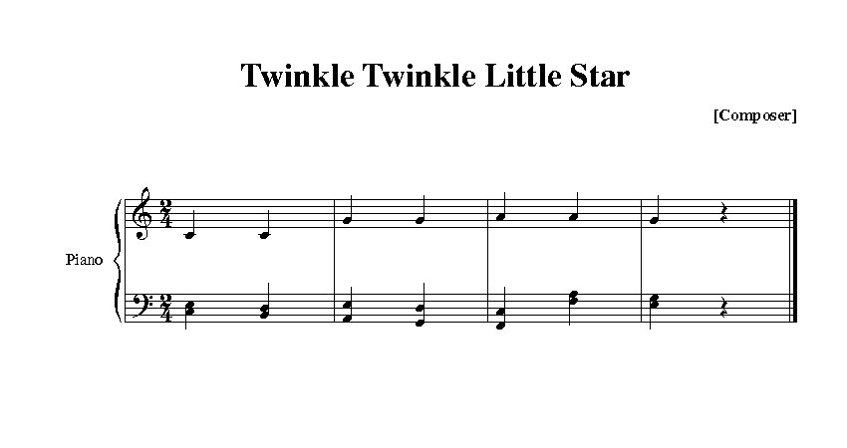
Modelling a score using a Hidden Markov Model: an example
STATES: {Beat1, Beat2, Beat3, Beat4, Beat5, Beat6, Beat7, Beat8}
OBSERVATIONS: The note being played by the soloist at that point in time
How would probabilities be allocated?
Score Following: Artificially Intelligent Musical Accompaniment

Slide 22
Score Following can be done using a Hidden Markov Model
  Problem:
  What about when the performer deviates from the score?
  How can that be represented in a HMM? We can’t possibly come up with a state that represents every possible deviation from the score
Score Following: Artificially Intelligent Musical Accompaniment

Slide 23

Score Following can be done using a Hidden Markov Model
  Problem:
  What about when the performer deviates from the score?
  How can that be represented in a HMM? We can’t possibly come up with a state that represents every possible deviation from the score
  Orio et al. came up with a solution for this problem in their 2003 paper.
  For each event in a score, use two HMM states:
    'Normal' state – for when the performer plays the expected note
    'Ghost' state – for when the performer plays an unexpected note
Score Following: Artificially Intelligent Musical Accompaniment

Slide 24
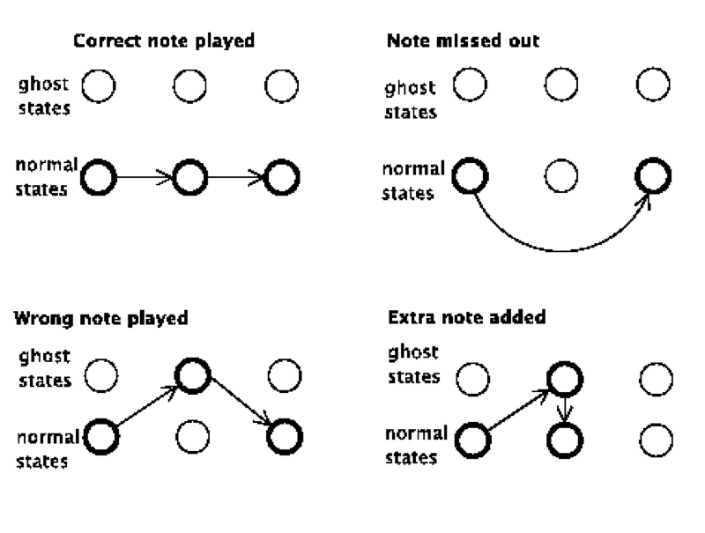
Normal and Ghost states can be used to represent deviations from the score
Score Following: Artificially Intelligent Musical Accompaniment

Slide 25
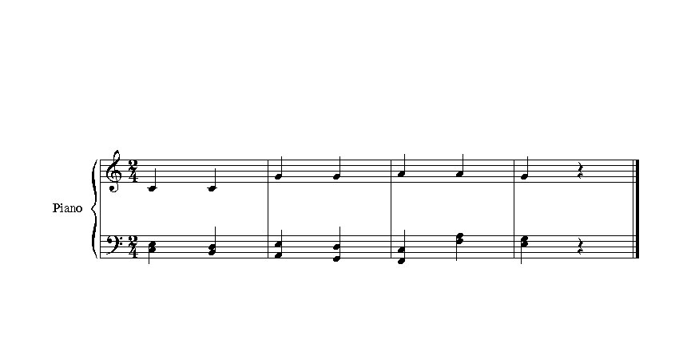
Back to the Twinkle Twinkle example…
Score Following: Artificially Intelligent Musical Accompaniment

Slide 26
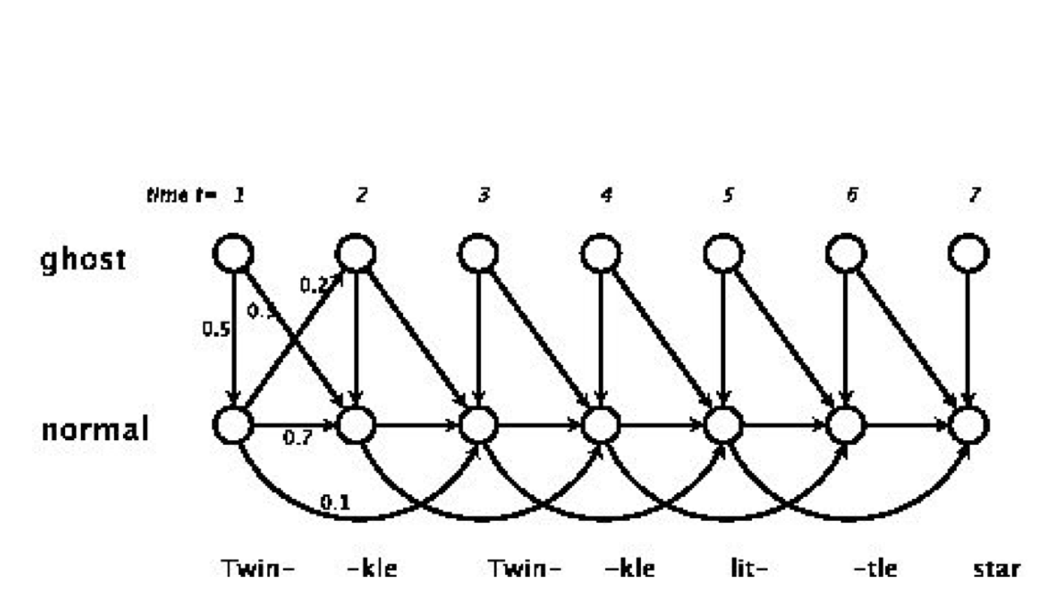
Back to the Twinkle Twinkle example…
Score Following: Artificially Intelligent Musical Accompaniment

Slide 27
Making an artificially intelligent score follower using HMMs
The hypothesis being tested is:
  Using an HMM to model a musical score is an efficient and practical way to implement score following.
  In particular, it lends well to providing real-time
  accompaniment to a human performer.
To model the scores, I chose to use the HMM states to represent individual beats of the piece:
  A piece of music can be thought of as a sequence of beats, with certain notes expected at each beat (i.e. the note written in the score)
Score Following: Artificially Intelligent Musical Accompaniment

Slide 28
Construction of an artificially intelligent score follower using HMMs
Written in Max/MSP
  Max/MSP is a real-time, interactive music programming environment
The score follower runs on a Mac or PC computer that is attached to a MIDI keyboard
The MIDI keyboard communicates with the computer using the musical format MIDI
MIDI messages = coded information about the notes to be played:
pitch, volume, onset time, output channel etc
Score Following: Artificially Intelligent Musical Accompaniment

Slide 29
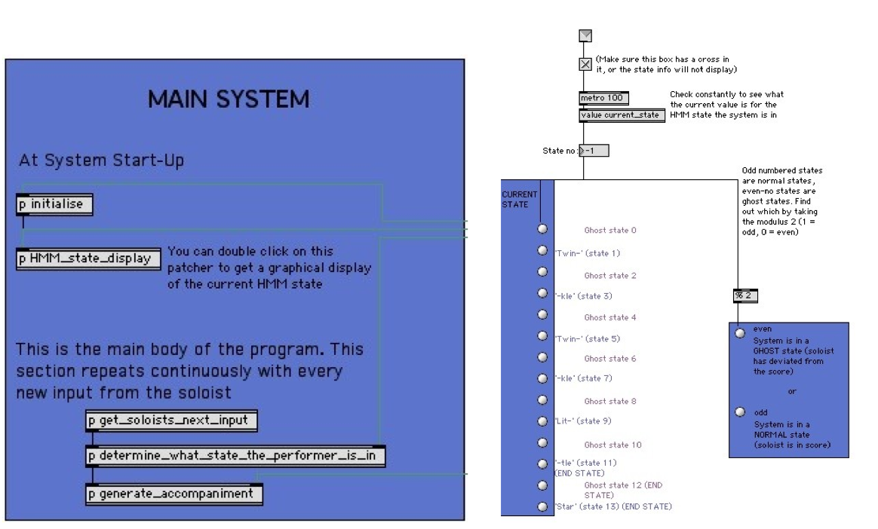
The HMM Score Follower System
Score Following: Artificially Intelligent Musical Accompaniment

Slide 30
The program works by continuously repeating three basic steps
get_soloists_next_input:
  Extracts the new information from MIDI keyboard.
determine_what_state_the_performer_is_in:
  Keeps a list of observations seen so far. Performs the Viterbi decoding algorithm to use the most recent observations to work out which HMM state the soloist is in (i.e. where they are in the score).
generate_accompaniment:
  Looks up the HMM state in an attribute-value pair, to find which notes to play as accompaniment
  E.g: <1, [48, 52, 55]> - ‘In state 1, play MIDI notes 48, 52, 55’ (C major chord)
Score Following: Artificially Intelligent Musical Accompaniment

Slide 31
While performing accompaniment, the system also tracks the performer's tempo
Beat tracking is the process of working out the tempo of a piece of music by analysing what is being heard.
I use very simple methods in comparison to the latest state of the art beat-tracking research! (Gouyon and Dixon, 2006)
    Measure time in between notes played by the soloist and use this to estimate the soloist's tempo
    If the soloist is currently in a ghost state (they have deviated from the score) then ignore the notes they are currently playing, when estimating the tempo
Score Following: Artificially Intelligent Musical Accompaniment

Slide 32
The score follower has been evaluated quantitatively and qualitatively
Evaluated using both objective measurements and subjective judgements of performance, using three melodies of increasing complexity.
Quantitative testing:
    Using criteria devised to test score following systems at Music Information and Retrieval EXchange conference in 2006
    Measure % of correctly played accompaniment and timing issues
Qualitative testing:
    Four testers of varying musical ability were asked to test the system
    Asked to freely experiment with the system as they saw fit
Score Following: Artificially Intelligent Musical Accompaniment

Slide 33
Comparing my score follower to systems tested at MIREX 2006
Total precision: % of correctly detected score notes overall (across all pieces)
Piecewise precision: % of correctly detected notes, averaged across each piece
Cont and Schwarz (MIREX 2006) - Using Hidden Markov Models
  Total precision: 82.90 %
  Piecewise precision: 90.06 %
Miller Puckette (MIREX 2006) - Using Dynamic Programming
  Total precision: 29.75 %
  Piecewise precision: 69.74 %
This score follower - Using Hidden Markov Models
  Total precision: 60.89 %
  Piecewise precision: 54.04 %
Score Following: Artificially Intelligent Musical Accompaniment

Slide 34

Results of testing
Very accurate performance for the simpler melodies reported by both objective measurements and tester feedback
      Accompaniment was played accurately even when the performer deviated extensively from score
      No latency issues (latency = delays in playing)
But: pretty poor performance in the more complex melodies
      The score follower did not locate the performer's position in the score as well, performing with much lower precision
      Latency became a big issue with longer pieces – accompaniment was played with delays of 200-900 ms
Score Following: Artificially Intelligent Musical Accompaniment

Slide 35

Some interesting aspects were noted during evaluation
The most complex piece had a large number of repeated phrases and similar sections, confusing the score follower somewhat.
        Increasing the number of observations used by the score follower increased the level of accuracy
Score Following: Artificially Intelligent Musical Accompaniment

Slide 36
Some interesting aspects were noted during evaluation
The most complex piece had a large number of repeated phrases and similar sections, confusing the score follower somewhat.
        Increasing the number of observations used by the score follower increased the level of accuracy
Delays in accompaniment for the longer pieces was mostly due to high computation load for each note the performer played. Latency was reduced considerably by:
        Calculating HMM-based probabilities in advance for each state, rather than making all calculations while the program was running
        Considering only a sub-set of all the possible locations in the score – those local to the current position
Score Following: Artificially Intelligent Musical Accompaniment

Slide 37
Some interesting aspects were noted during evaluation
The most complex piece had a large number of repeated phrases and similar sections, confusing the score follower somewhat.
        Increasing the number of observations used by the score follower increased the level of accuracy
Delays in accompaniment for the longer pieces was mostly due to high computation load for each note the performer played. Latency was reduced considerably by:
        Calculating HMM-based probabilities in advance for each state, rather than making all calculations while the program was running
        Considering only a sub-set of all the possible locations in the score – those local to the current position
The score follower was too reliant on following the performer and did not have 'confidence' in playing what it perceived to be right
        This is not addressed in score following research to date but Dannenberg has commented on the role of the computer performer in ensemble situations. Also there is interesting related research in entrainement (musical synchonisation).
Score Following: Artificially Intelligent Musical Accompaniment

Slide 38
Summary: Artificially Intelligent Accompaniment using HMMs
Accompaniment is a task which requires musical intelligence
Score Following: Artificially Intelligent Musical Accompaniment

Slide 39
Summary: Artificially Intelligent Accompaniment using HMMs
Accompaniment is a task which requires musical intelligence
Automated musical accompaniment, or score following, can be implemented using Hidden Markov Models (HMMs) to track what state a performer is in
Score Following: Artificially Intelligent Musical Accompaniment

Slide 40
Summary: Artificially Intelligent Accompaniment using HMMs
Accompaniment is a task which requires musical intelligence
Automated musical accompaniment, or score following, can be implemented using Hidden Markov Models (HMMs) to track what state a performer is in
Some useful results were obtained for the accompaniment of simple melodies, however accuracy and latency issues affected performance of longer and more complex/repetitive melodies
Score Following: Artificially Intelligent Musical Accompaniment

Slide 41
Summary: Artificially Intelligent Accompaniment using HMMs
Accompaniment is a task which requires musical intelligence
Automated musical accompaniment, or score following, can be implemented using Hidden Markov Models (HMMs) to track what state a performer is in
Some useful results were obtained for the accompaniment of simple melodies, however accuracy and latency issues affected performance of longer and more complex/repetitive melodies
Problems in initial results could be addressed to some extent, however there is still a high computational cost in using HMMs for score following that needs to be considered
Score Following: Artificially Intelligent Musical Accompaniment

Slide 42
Summary: Artificially Intelligent Accompaniment using HMMs
Accompaniment is a task which requires musical intelligence
Automated musical accompaniment, or score following, can be implemented using Hidden Markov Models (HMMs) to track what state a performer is in
Some useful results were obtained for the accompaniment of simple melodies, however accuracy and latency issues affected performance of longer and more complex/repetitive melodies
Problems in initial results could be addressed to some extent, however there is still a high computational cost in using HMMs for score following that needs to be considered
This research casts interesting questions on the seemingly passive role of the accompanist in a perfomance scenario
Score Following: Artificially Intelligent Musical Accompaniment

Slide 43
Summary: Artificially Intelligent Accompaniment using HMMs
Accompaniment is a task which requires musical intelligence
Automated musical accompaniment, or score following, can be implemented using Hidden Markov Models (HMMs) to track what state a performer is in
Some useful results were obtained for the accompaniment of simple melodies, however accuracy and latency issues affected performance of longer and more complex/repetitive melodies
Problems in initial results could be addressed to some extent, however there is still a high computational cost in using HMMs for score following that needs to be considered
This research casts interesting questions on the seemingly passive role of the accompanist in a perfomance scenario
Lets hear the system in action (warts and all...)
Score Following: Artificially Intelligent Musical Accompaniment

