Slide 1
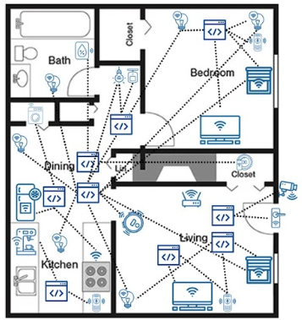
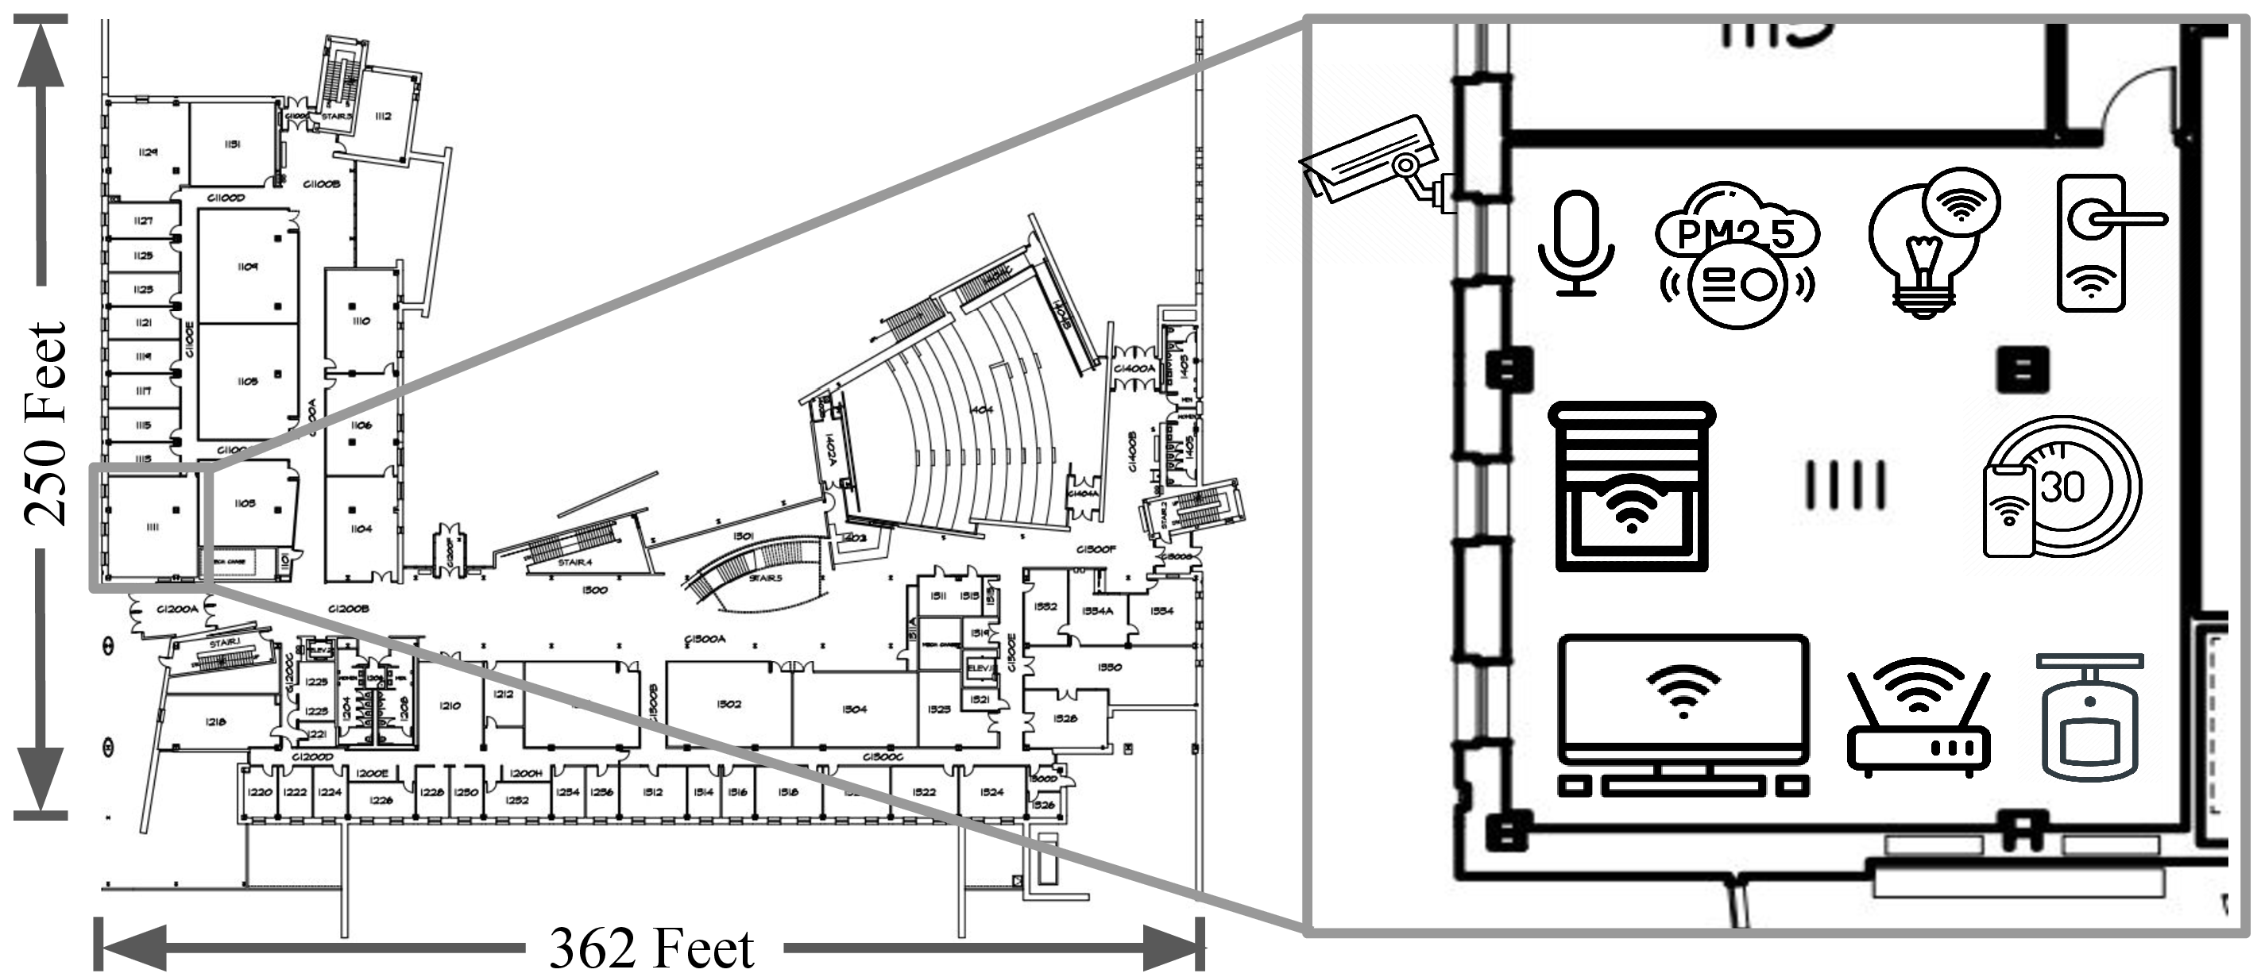
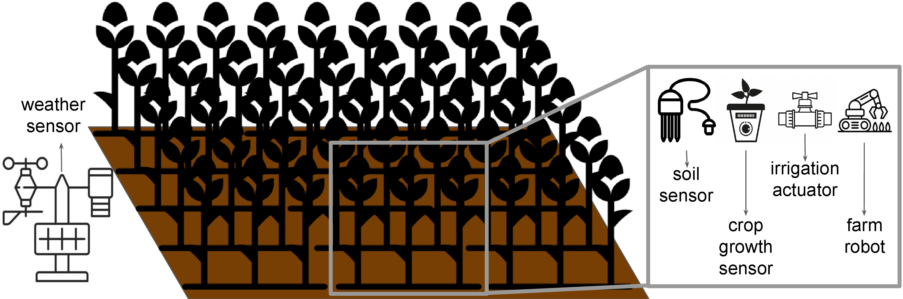
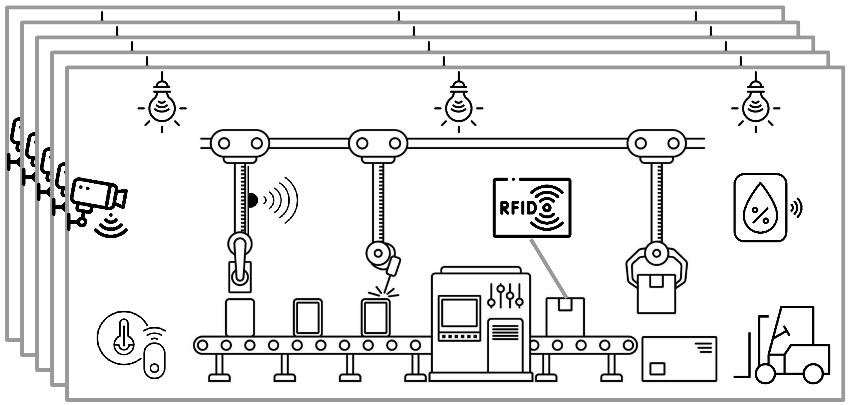
Smart spaces span diverse edge settings
(a) Smart Home
10s of devices
(b) Smart Building
100s–1000s of devices
(c) Smart Farm
distributed, outdoors
(d) Smart Factory
industrial

