Slide 1
Manual for Cleopatra
Ryan Tang (goluckyryan@gmail.com)
Thursday, November 29, 2018

Slide 2
Idea
After the analysis, we have to use DWBA (Ptolemy) to calculate differential cross section (Xsec).
We need to
Prepare the infile for Ptolemy,
Run Ptolemy,
Extract the Xsec from the outfile,
Plot
Simulate Kinematics
Fitting etc…
But step 1, 3, and 4 are boring jobs to do!

Slide 3
Kinematics calculation
Mass Table
Experimental Luminosity
Calibration
Fix energy and sigma
CLEOPATRA
Cleopatra
expData.root
Reaction setting
InFileCreator
Fitting
→ Get the counts
Find the angle
FindThetaCM
PTOLEMY → Xsec
ExpXsecToROOT.C
Convert to Xsec
ExtractXSec
Output as root/txt
Output as root/txt
PlotTGraphTObjArray
Kinematics Calculation
Plot
FitXsec.C
Transfer
Most programs are self-explain.
Output usage when in input argument.
Fitting

Slide 4
Cleopatra.sh
To run step 1, 2, 3, 4, 5
Default X = 0
$./Cleopatra in-file X X X X X angMin angMax angStep
| | | | |
| | | | Kinematics? (1/0)
| | | PlotResult? (1/0)
| | Extract cross-section? (1/0)
| Run Ptolemy? (1/0)
Create infile? (1/0)
In-file : see next slide
Default
angle range is (0, 50) degree,
step = 0.5 degree.

Slide 5
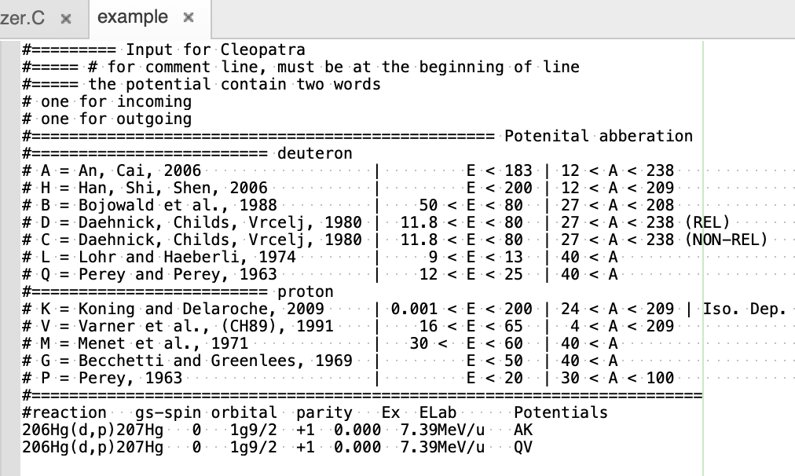
InFileCreator
Create Ptolemy infile
Default
angMin = 0 deg,
angMax = 180 deg
angStep = 1 deg
Usage: ./InfileCreator input_file
Usage: ./InfileCreator input_file angMin angMax
Usage: ./InfileCreator input_file angMin angMax angStep
The input_file (see file “example”)
Output : input_file.in

Slide 6
ExtractXSec
Extract Xsec from Ptolemy outfile
Usage: ./ExtractXSec input_file
Input_file = Ptolemy outfile
The data will be stored in ROOT TGraph
All the TGraph will be collected in TObjArray with name “gList”
The TGraph::Name() is the reaction
To get the TGraph
Root$ TGraph * gr = (TGraph *) gList->At(i)
Output : input_file.Xsec.txt
input_file.root

Slide 7
PlotTGraphTObjArray
Plot the result from input_file.root
Usage: /PlotTGraphTObjArray root_file
root_file = save from ExtractXsec
Output : TCanvas, plot all the TGraph

Slide 8
Cleopatra
Program
Auto Generated Files
User Files
Analysis/working/example
Analysis/Cleopatra/InFileCreator
Analysis/working/example.in
Analysis/working/ reactionConfig.txt
Analysis/working/detectorGeo.txt
Analysis/working /ptolemy
Analysis/working/example.Ex.txt
Analysis/working/example.out
Analysis/Cleopatra /ExtractXsec
Analysis/Cleopatra /Transfer
Analysis/working/example.root
To run:
working/Cleopatra.sh
Analysis/working/ transfer.root

