Slide 1
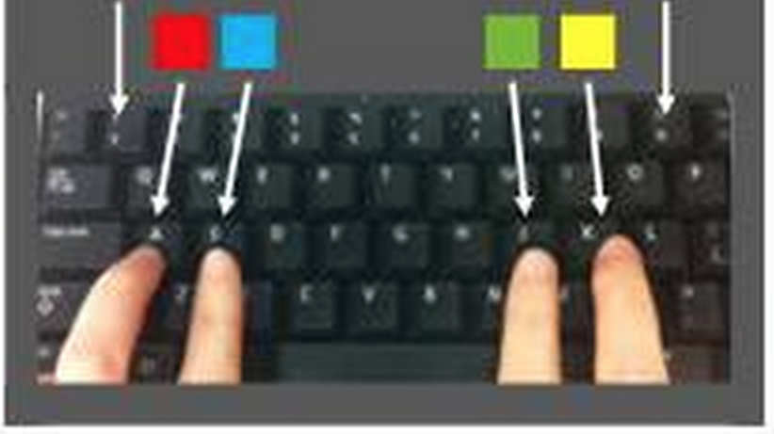
*
Beginning of new trial
Press the button corresponding to the color of this word
(this one is red, press ‘A’)
blue
*
Wait
green
(this one is green, press ‘J’)

