Slide 1
Stories of Data Driving the Business
Data Visualization Portfolio
Anna Kirkland Smith

Slide 2
The following 5 visualizations were connected with actual business cases. In many cases, the original visualization has been cropped to avoid disclosing specific internal information about the company.

Slide 3
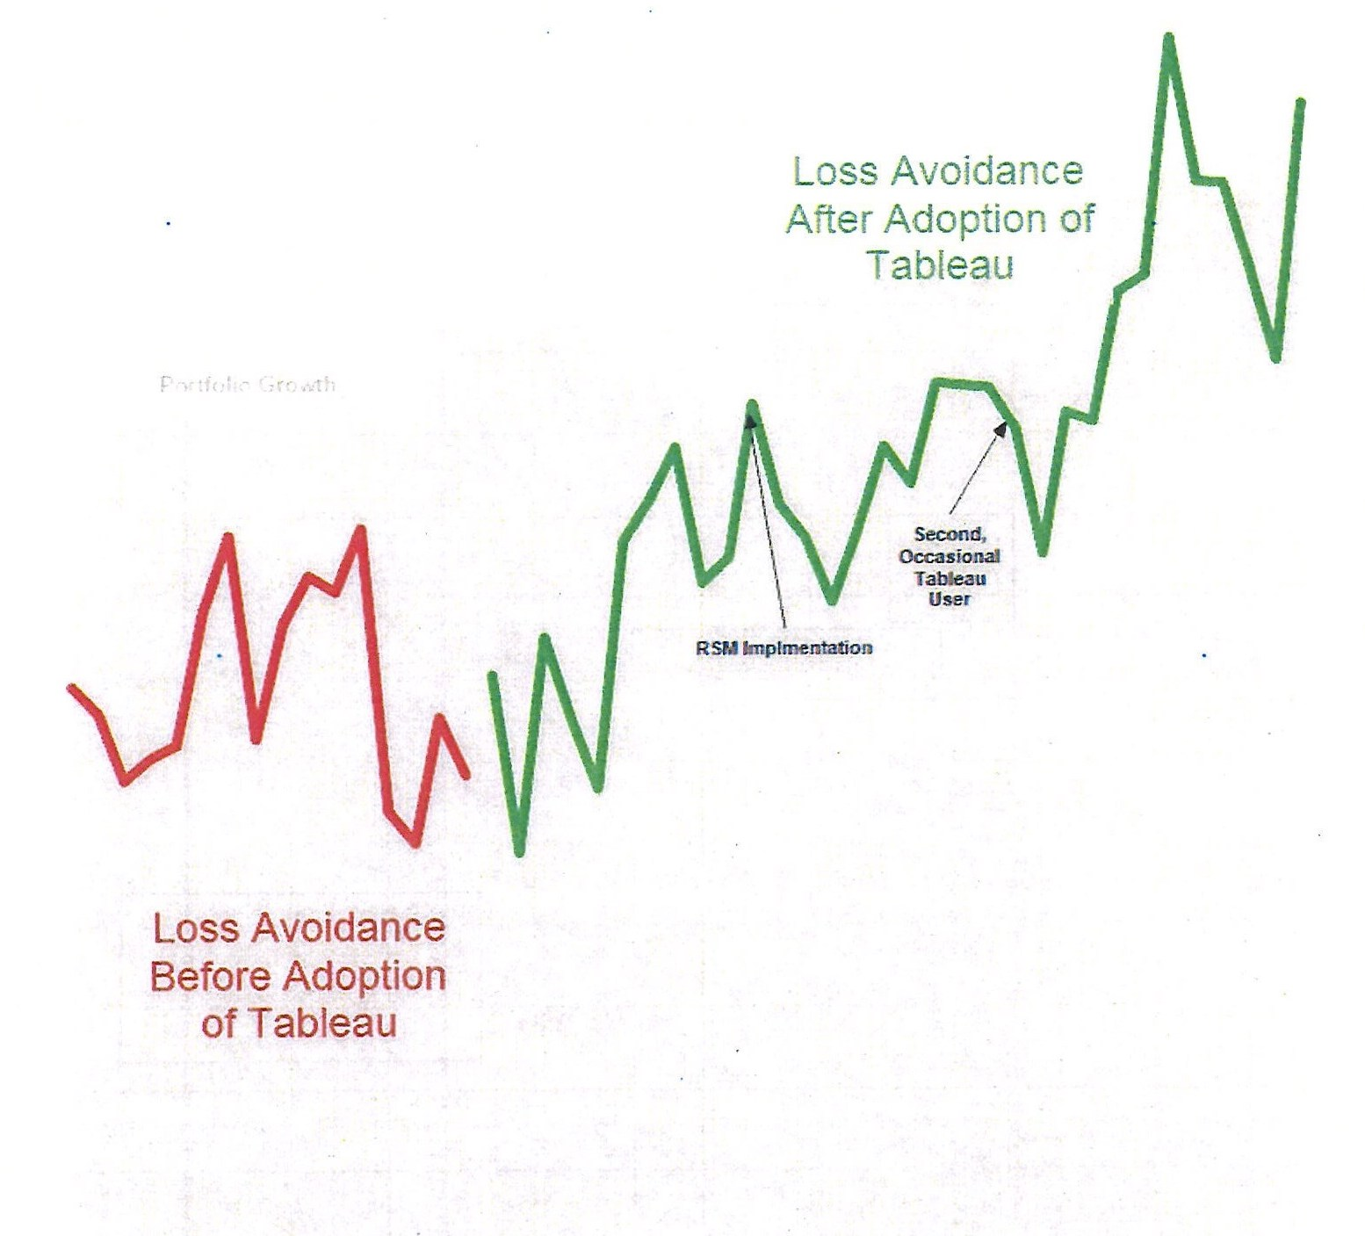
Validate a Purchase
$
A line of business makes purchase decisions based on return of investment, which may not be immediate. Was the promised realized? In this viz, loss avoidance (a revenue stand-in) showed a continuing, dramatically positive trend (green) following a specific purchase, tableau, proving the LOB made a wise decision.
month after month

Slide 4
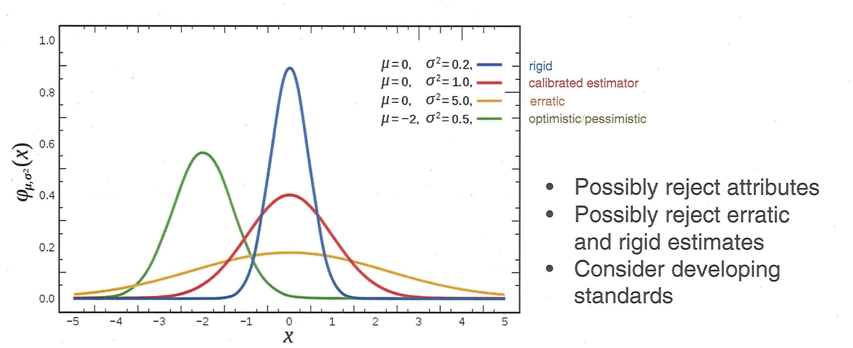
Explore the theoretical
What can a line of business do when there is no data? This viz, from a Wikipedia article, gave the line of business of what survey data would tell if they chose to launch a subjective survey in lieu of objective data: that opinions vary. The Text is a reminder of what can go wrong with a survey. The LOB chose to persevere in leveraging existing data.
hated it
loved it

Slide 5
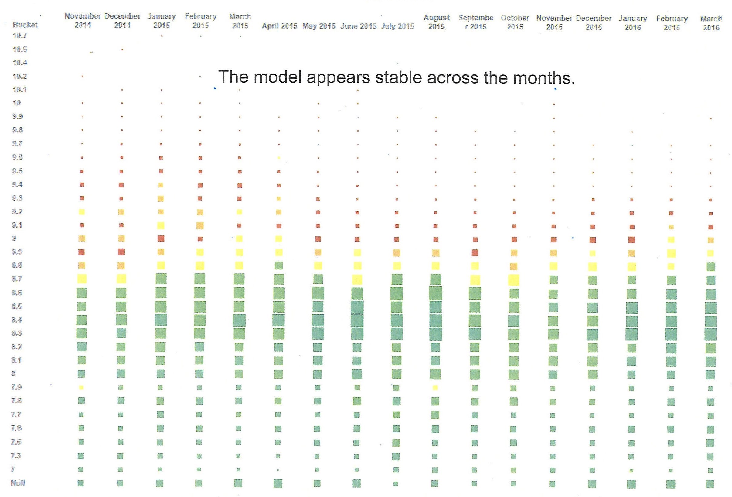
Change a process
likely defective
While the power of prediction is impressive, is a line of business willing to reduce a complex decision into a simple number? In this viz, the scoring system was evaluated across many months. With a stable model, the Line of business was willing to direct 30% of the resources elsewhere.
month after month

Slide 6
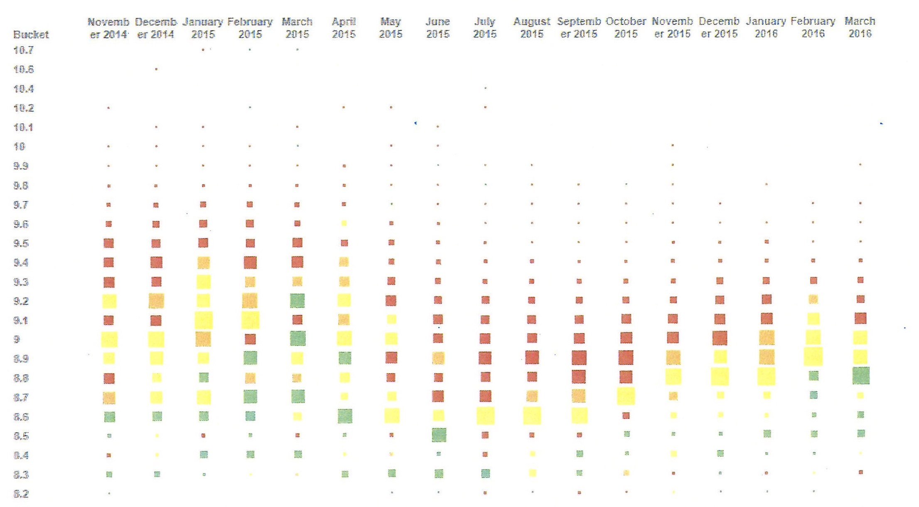
Uncover opportunity
likely defective
Now that the line of business had a model it could trust, what advantages did it have? In this viz, a certain account class had much more unfavorable activity than the other classes. Responsibility is the power to respond to the situation at hand but awareness has to happen first.
month after month

Slide 7
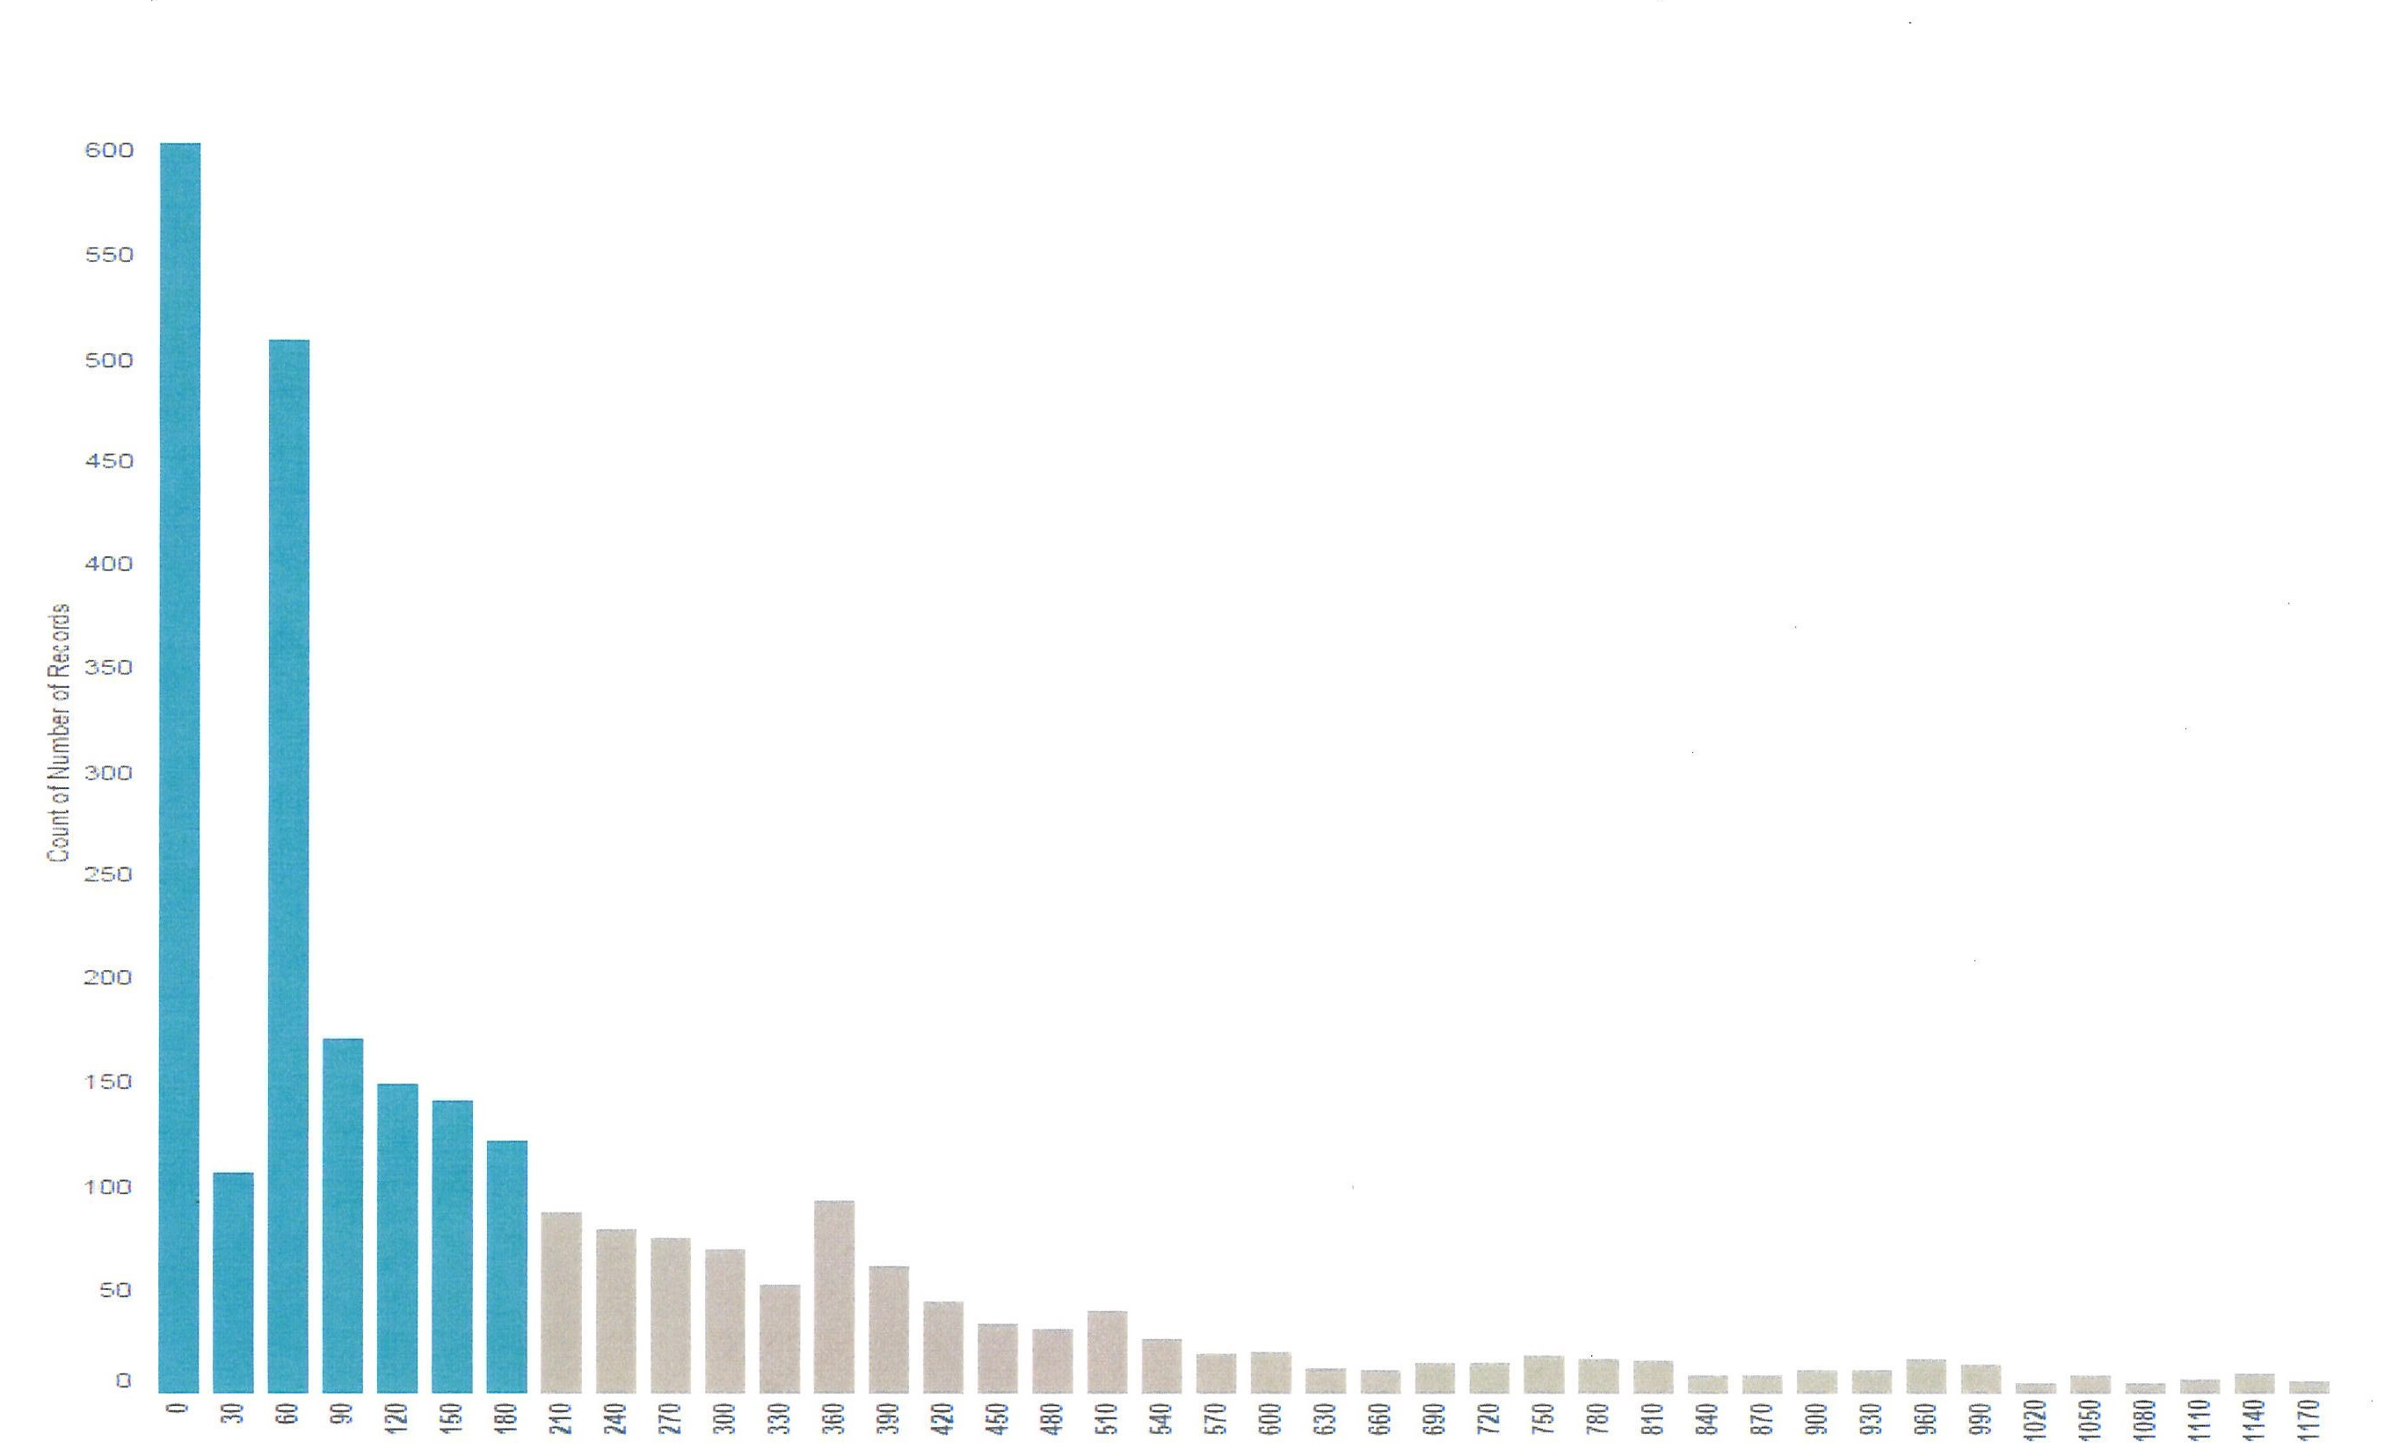
Find hidden value
count of accounts in this bin
It has been said that we learn more from failure than success. In this viz, the line of business bravely look at where an otherwise strong model appeared to be weak. On second look, the false positives were mostly short-lived accounts: a True positive from another perspective. The LOB’s expertise in its domain maintains it as a trusted internal consultant across the enterprise.
length of account life

