Slide 1
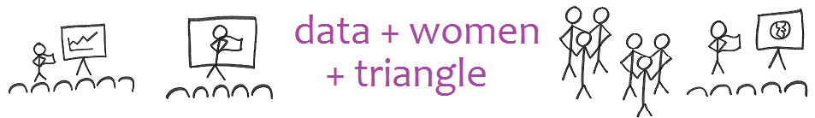
Presentation to Tableau User Group
31 March 2017

Slide 2
2010-2012

Slide 3
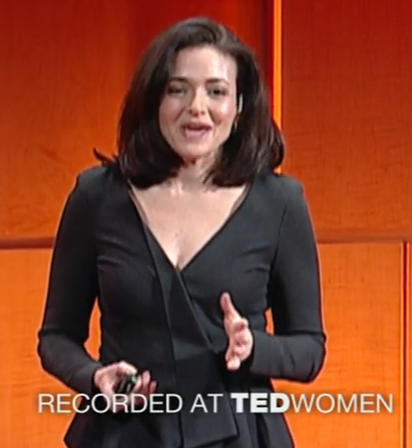
2010
Why do we have too few women leaders?
What will it take for these numbers to change?

Slide 4

2013

Slide 5
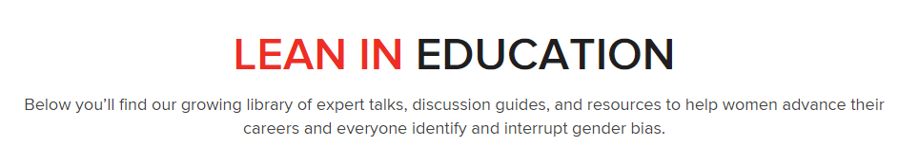
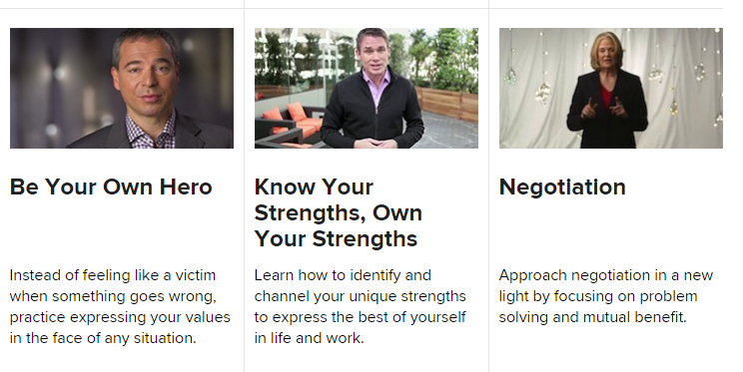
Also, the update sheet

Slide 6

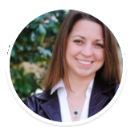
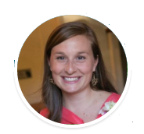
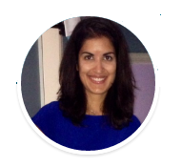
2013
Anna
Dana
Amber

Slide 7


2014-2015
Women’s Information Network
Anna
Dana
What will it take for the numbers to change?

Slide 8


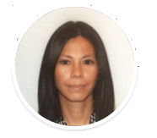
2016
Brooke
Jessica

Slide 10
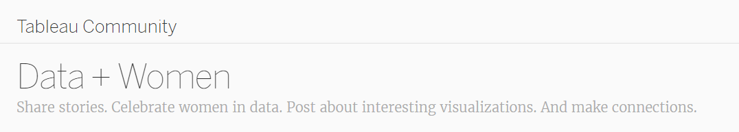
Checklist
Share stories
Celebrate women in data
Share interesting visualizations
Make connections

Slide 11
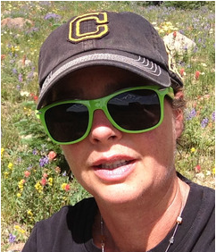
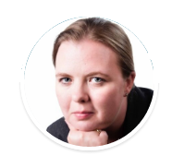
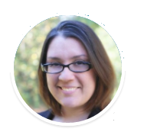
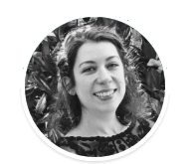
Kickoff May 2016
Rachael
Melinda
Melodie
Tonya
Dana

Slide 12
Staying in STEM is hard because women are I S O L A T E D
The mental act of analysis is dividing, segregating by differences
There is not another women to reach out to for support and comradery in an all-male environment
There’s not a mature, successful example for the role in general
The nature of the job is not conducive to eye contact
This is after a STEM woman gets to the job!

Slide 13
Promise: Our numbers matter!
We build relationships
We attract women to data with the promise of relationships
More women in data science
More women with data in their hands
More women empowered to make decisions
More women able to be leaders
MORE WOMEN LEADERS
We build relationships with one another
We attract women to data with the promise of relationships
We then have more women in data science
Then more women with data in their hands
And then more women empowered to make decisions
So more women we be able to be leaders
And we’ll have more women leaders!

Slide 14
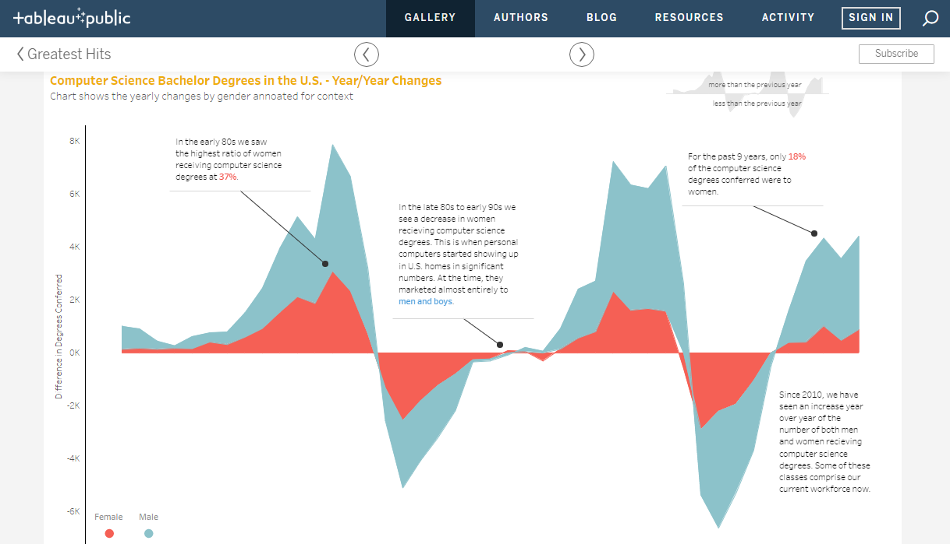
Commercial Break: Tableau

Slide 15
A little different
Partner pairs: Find a women you don’t know, meet with her, and develop a presentation together
Other relationship building activities

Slide 16

November: First Book Club Meetup

Slide 17
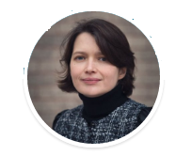
January: First Partner Pair
Julia
Rachael
Technical, but conversant
Melinda

Slide 18
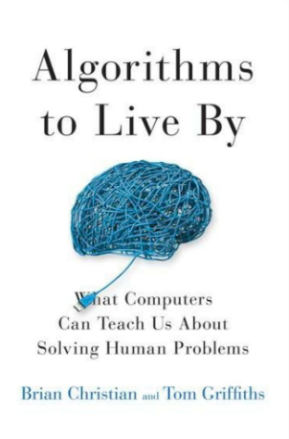
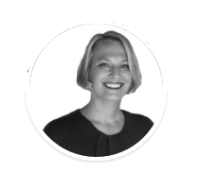
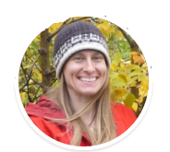
February
Shannon
Ashton

Slide 19

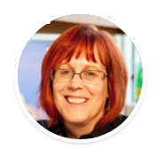
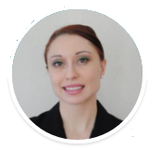
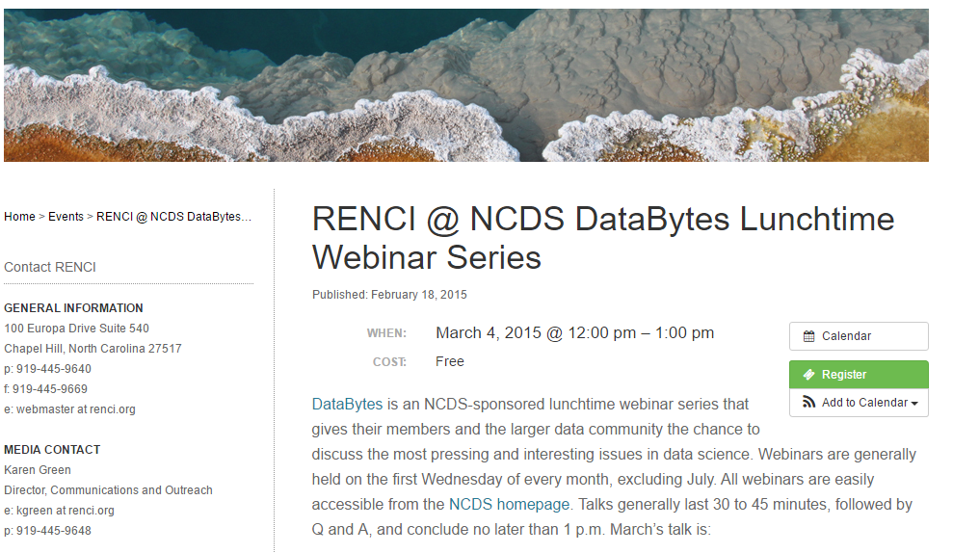
March
Karen
Monica

Slide 20

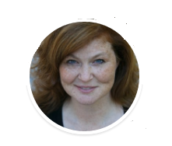
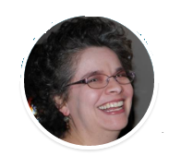
April
Ginny
Renee

Slide 21
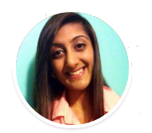
Relationship building through pair-ups and meetups
Technical, but conversant
Book club
LAST MONDAY OF THE MONTH
https://www.meetup.com/DataPlusWomenPlusTriangle/
We have it all!
Harpreet

Slide 22
Thank you, Tableau
Share stories.
Celebrate women in data.
Sharing interesting visualizations.
Make connections

Slide 23
2017
Anna Kirkland Smith
https://www.linkedin.com/in/anna-kirkland-smith-18b40614/

