Slide 1
Data Science and Machine Learning

Slide 2
講machine learning之前講講AI好了
甚麼是智慧
會觀察、了解，並且對於人事物做出反應
可以找到最佳的方法
能夠推論及規劃
能夠學習並調適

Slide 3

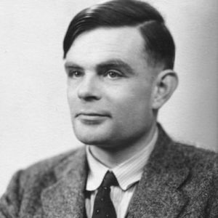
Introduction to AI
1950: Alan Turing
Enigma
Universal calculation machine
Does machine think?
Turing test
1956年達特矛斯第一屆AI會議
http://cdn.worldscreen.com.tw/uploadfile/201410/movie_014407_114559.jpg

Slide 4
Classification of AI
Strong AI
能夠像人類一樣具備心靈
Weak AI
能夠表現出類似人類思考、推論等等智慧的行為

Slide 5
4 school of aspect
 | Human-like | Rational
Thinking | Thinking humanly | Thinking rationally
Acting | Acting humanly | Acting rationally

Slide 6
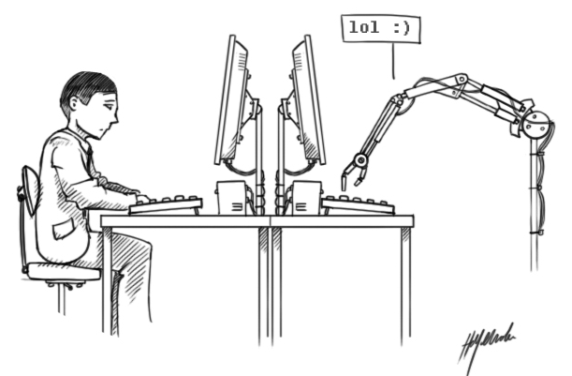
Acting humanly

Slide 7
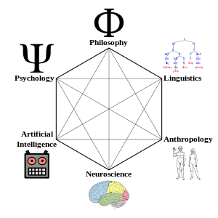
Thinking humanly

Slide 8
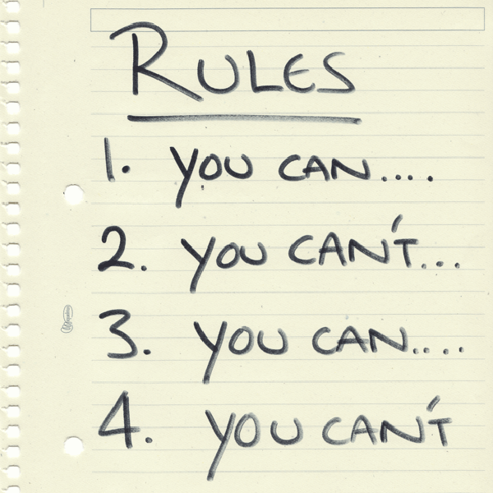
Thinking rationally

Slide 9
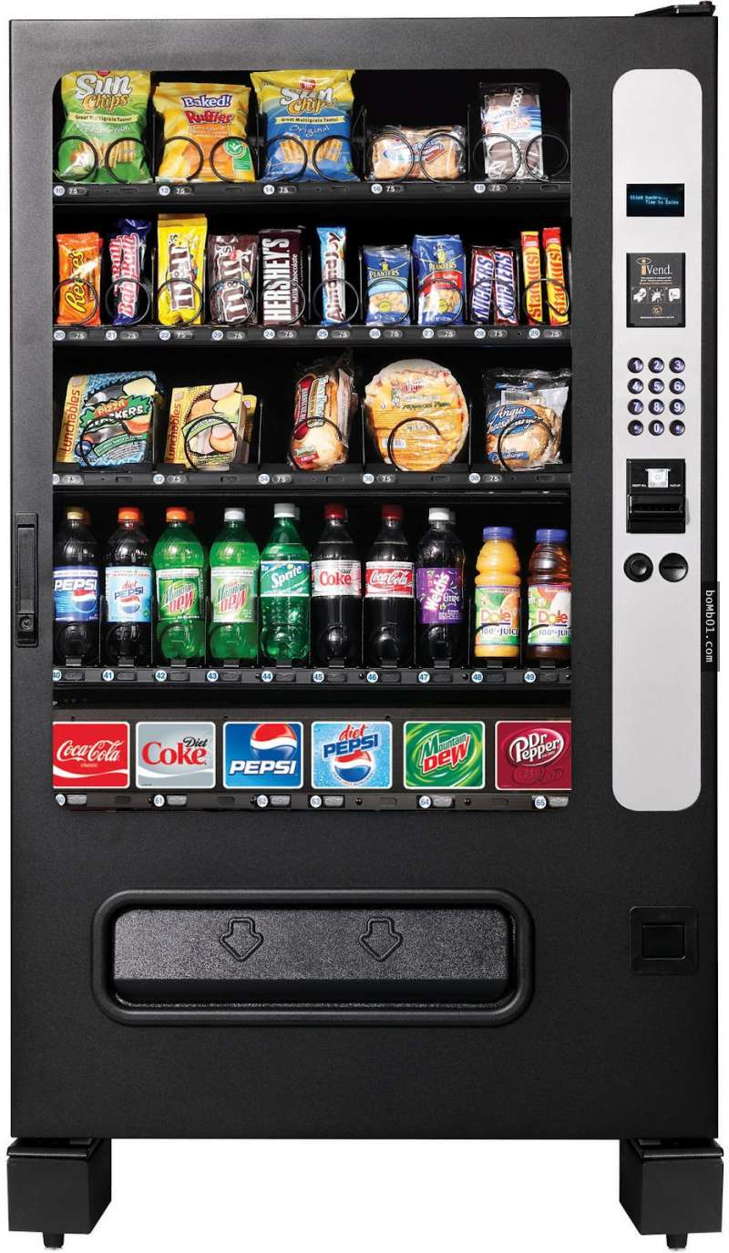
Acting rationally

Slide 10
Dive into machine learning
Start from linear model

Slide 11
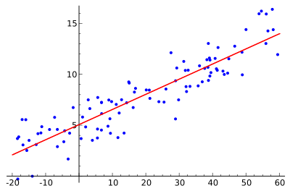
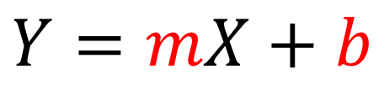
Introduction to linear regression
$$Y=mX+b$$

Slide 12
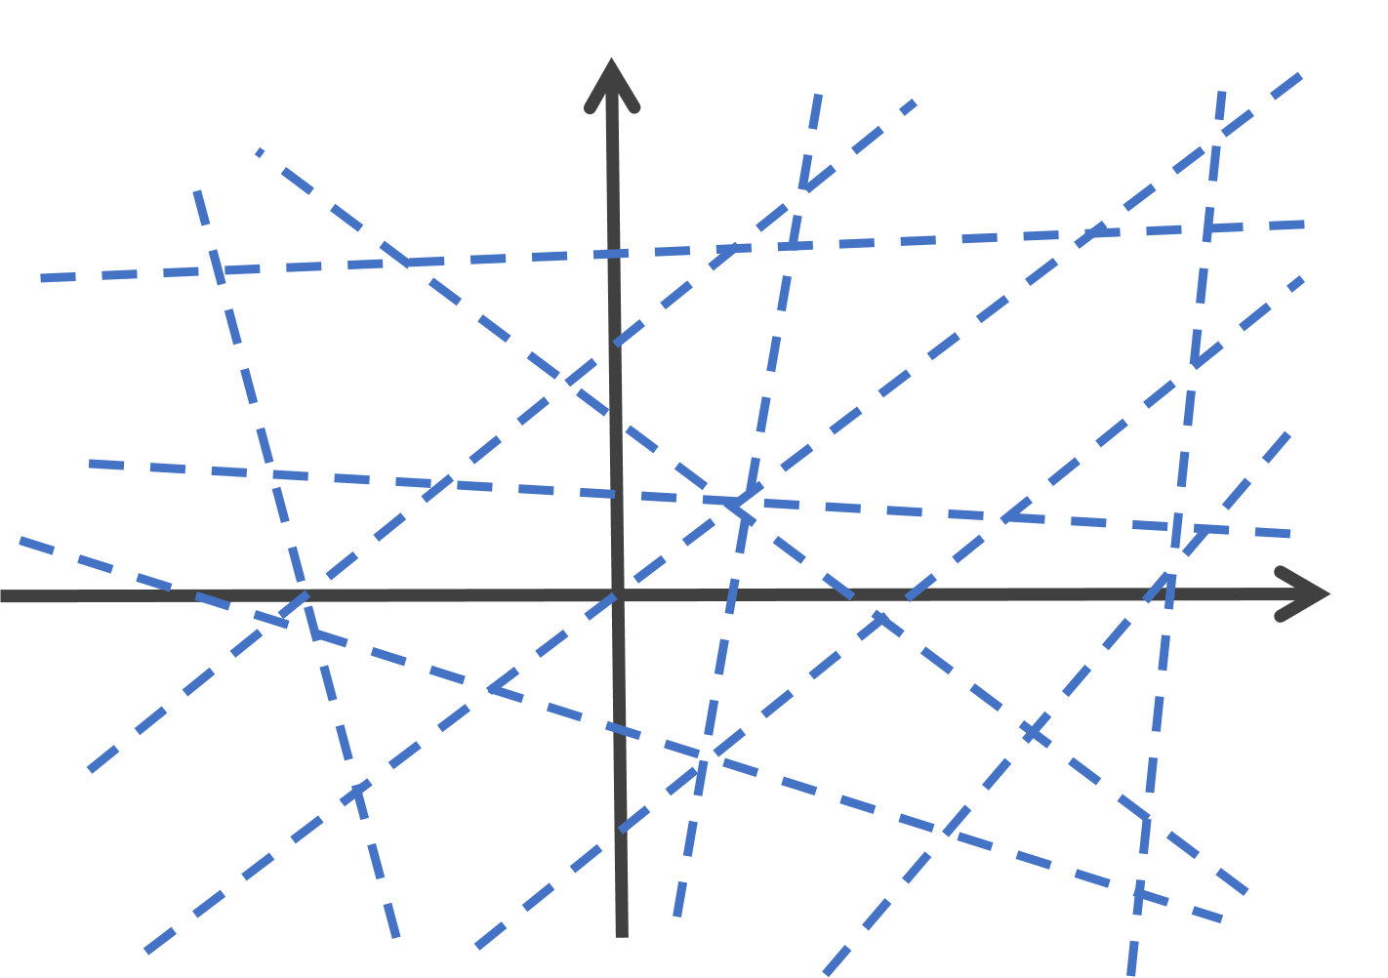
Find the model

Slide 13
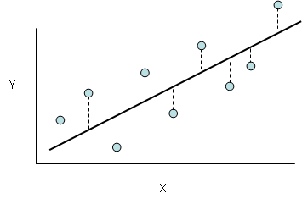
The best fit

Slide 14
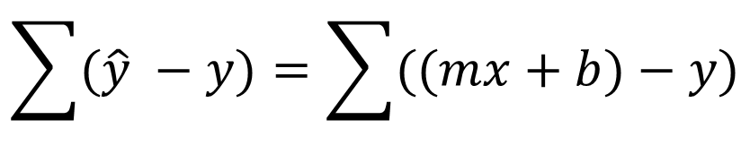
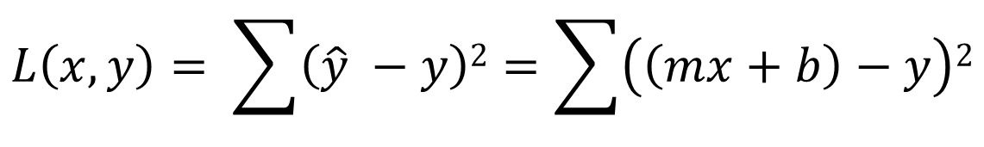
Error measurement
$$\sum{(\hat{y} −y)}=\sum{((mx+b)−y)}$$
$$L\left(x, y\right)= \sum{\left(\hat{y} −y\right)2}=\sum{\left(\left(mx+b\right)−y\right)2}$$

Slide 15
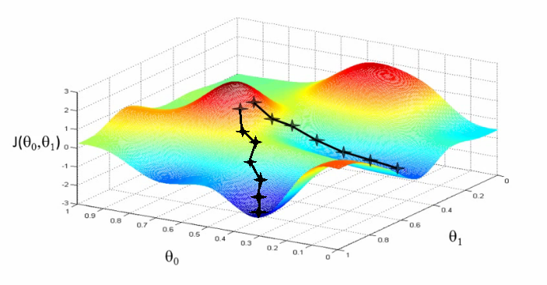

Loss function
$$\min_{m,b} L\left(x, y\right)$$
$$=\min_{m,b}\sum{\left(\hat{y} −y\right)2} \\ =\min_{m,b}\sum{\left(\left(mx+b\right)−y\right)2}$$

Slide 16
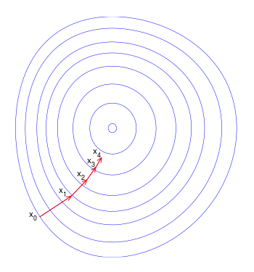
Gradient descent

Slide 17
There are some components
Model
Linear model
Loss function and formulation
Least square method
Optimization algorithm
Gradient descent method

Slide 18
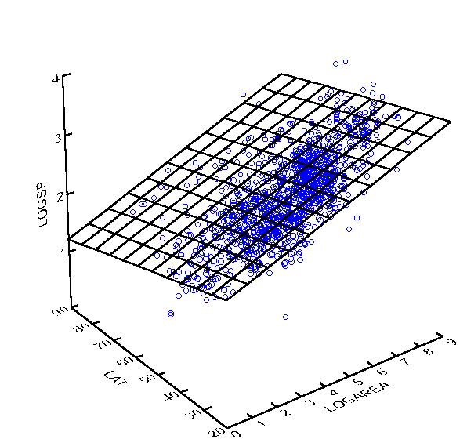
Multivariate regression
$$Y=a0+a1X1+a2X2+ …+anXn$$

Slide 19
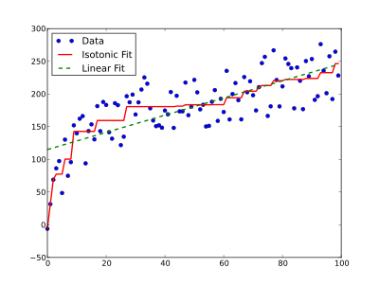
Various kind of regressions
Polynomial regression
Logistic regression
Isotonic regression
Kernel regression
Lasso regression
Ridge regression
SVM (台大林智仁)

Slide 20
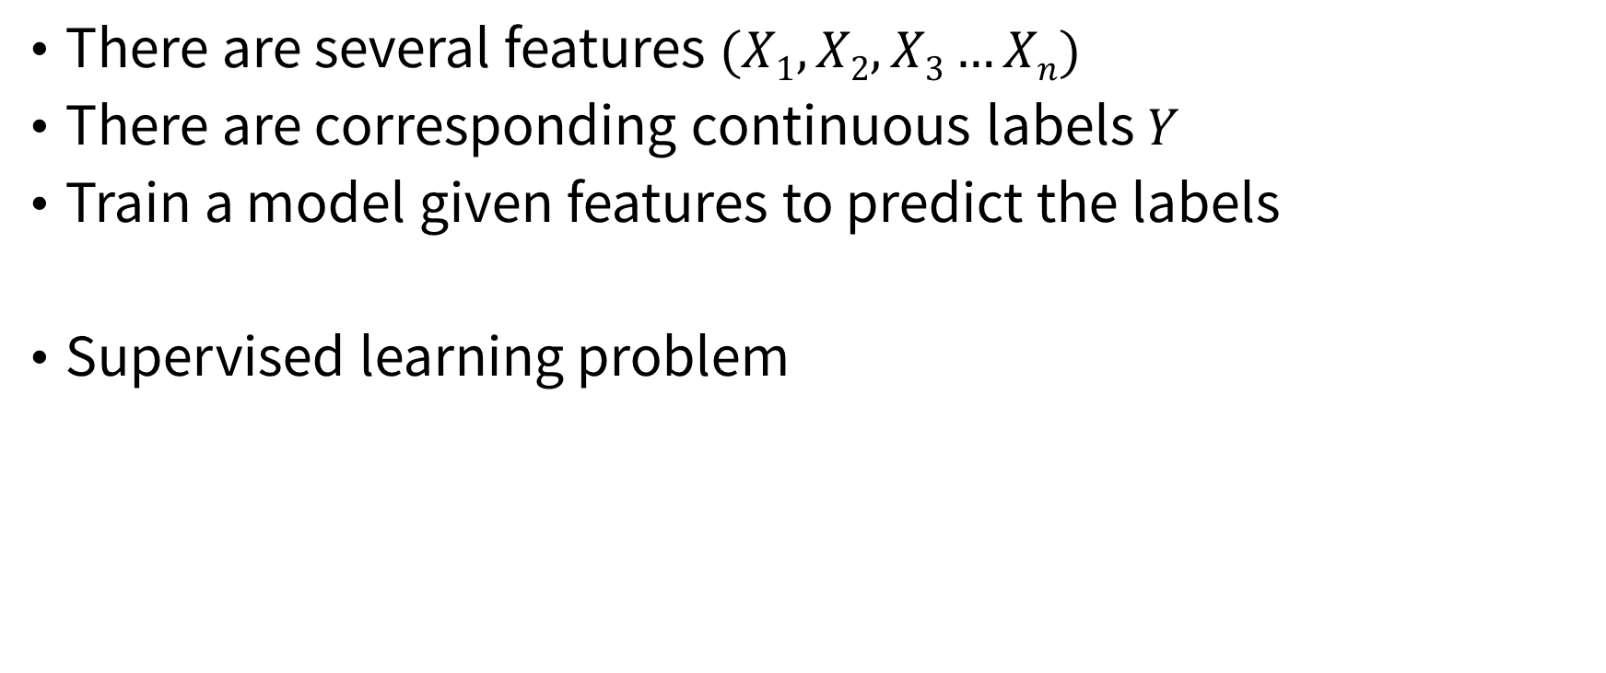
Regression problem
There are several features $(X1, X2, X3…Xn)$
There are corresponding continuous labels $Y$
Train a model given features to predict the labels
Supervised learning problem

Slide 21
Machine Learning
Supervised learning
Training model with labels
Unsupervised learning
Training model with labels
Semi-supervised learning
Training model with partial labels
Reinforced learning
Online learning

Slide 22
Introduction to models
 | Continuous label | Discrete label
Supervised | Regression | Classification
Unsupervised | Density estimation | Clustering

Slide 23
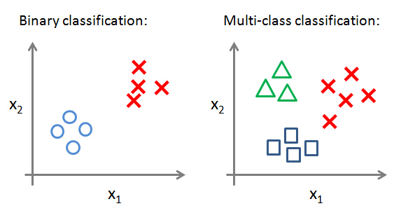
Classification

Slide 24
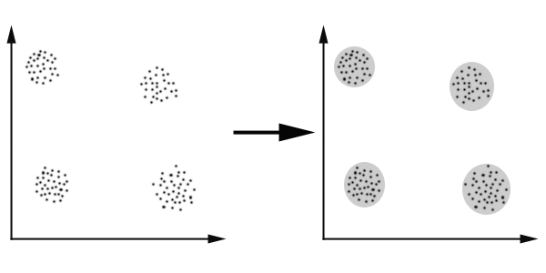
Clustering

Slide 25
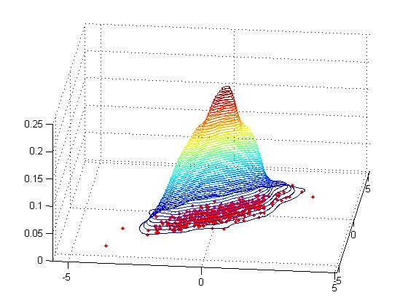
Density estimation

Slide 26
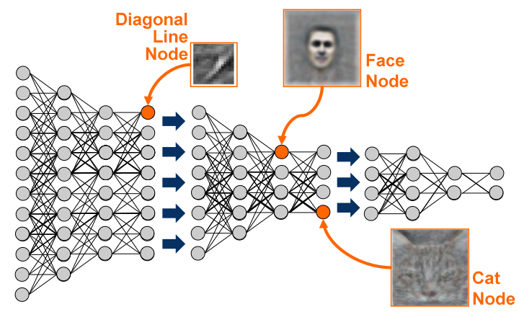
Deep learning

Slide 27
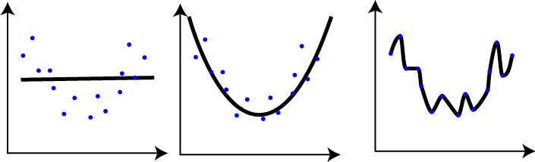
Overfitting

Slide 28
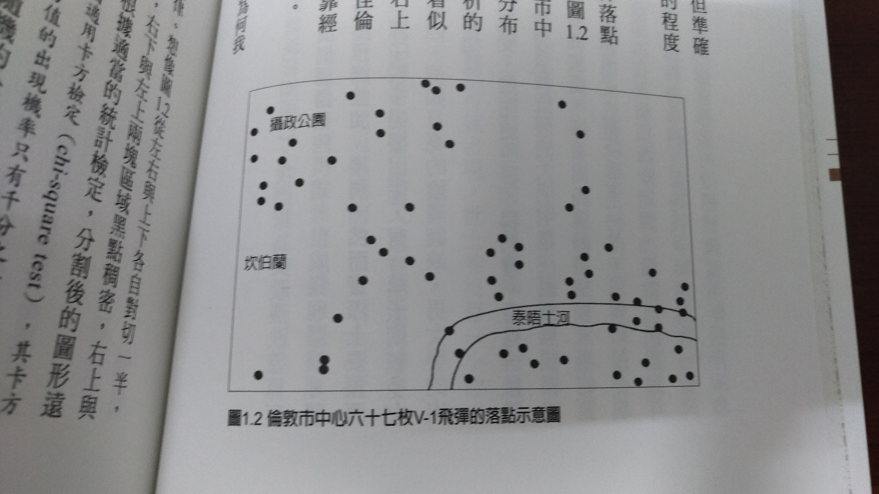
Overfitting

Slide 29
Model complexity
Out-sample error
Model complexity
*
Error
In-sample error
VC dimension

Slide 30
Validation
K-fold cross validation
Training dataset
Dataset
1/K
Testing dataset

Slide 31
Learning flow
Model
Algorithm
Trained Model
Validation
Complexity
Training
dataset
Testing dataset
Features
Dataset
Data size

Slide 32
Dimension
姓名 | 年齡 | 地址
王曉明 | 12 | ……
李小狼 | 13
 | 14
姓名
年齡
14
李小狼
13
王曉明
12
地址

Slide 33
What is data science?

Slide 34
Data-driven science
Data science
收集資料
探索資料
Empirical research
觀察
假設
實驗
分析
收集資料
假設
實驗
分析

Slide 35
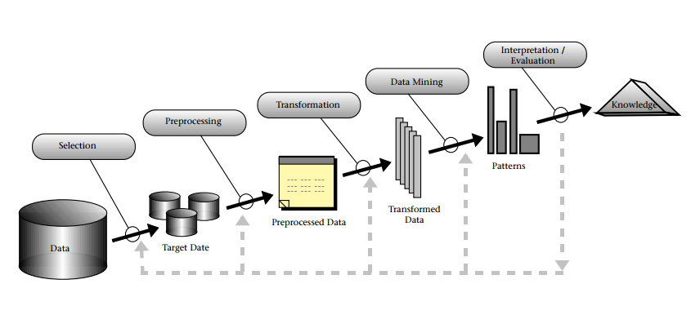
Data processing
Knowledge Discovery in Databases, by Fayyad, Piatetsky-Shapiro, and Smyth

Slide 36
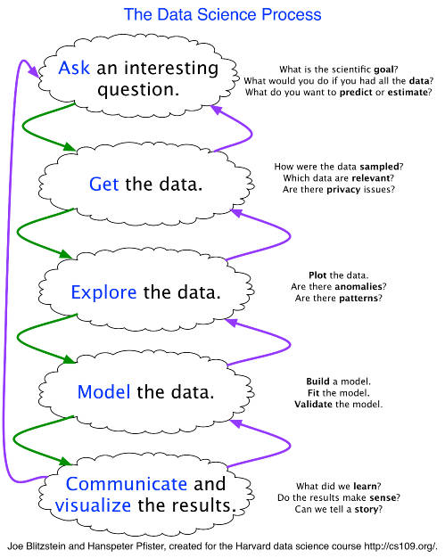
Stage 1: Ask A Question
Skills: science, domain expertise, curiosity
Tools: your brain, talking to experts, experience
Stage 2: Get the Data
Skills: web scraping, data cleaning, querying databases, CS stuff
Tools: python, pandas
Stage 3: Explore the Data
Skills: Get to know data, develop hypotheses, patterns? anomalies?
Tools: matplotlib, numpy, scipy, pandas, mrjob
http://www.kdnuggets.com/2016/03/data-science-process-rediscovered.html
By Matthew Mayo, KDnuggets

Slide 37
Stage 4: Model the Data
Skills: regression, machine learning, validation, big data
Tools: scikits learn, pandas, mrjob, mapreduce
Stage 5: Communicate the Data
Skills: presentation, speaking, visuals, writing
Tools: matplotlib, adobe illustrator, powerpoint/keynote
http://www.kdnuggets.com/2016/03/data-science-process-rediscovered.html
By Matthew Mayo, KDnuggets

Slide 38
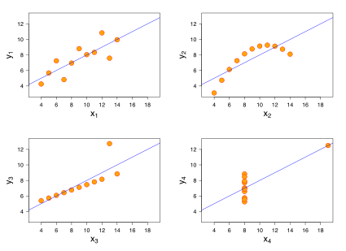
Before analysis you should take a look
Anscombe's quartet, 1973
r = 0.816
y = 3.00 + 0.500x

Slide 39
Data science – case study

Slide 40
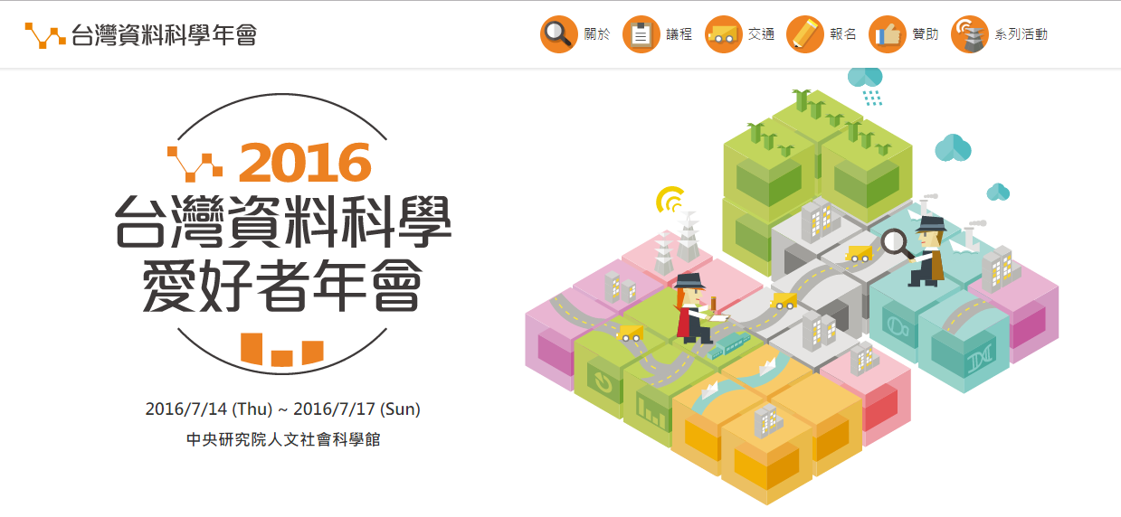
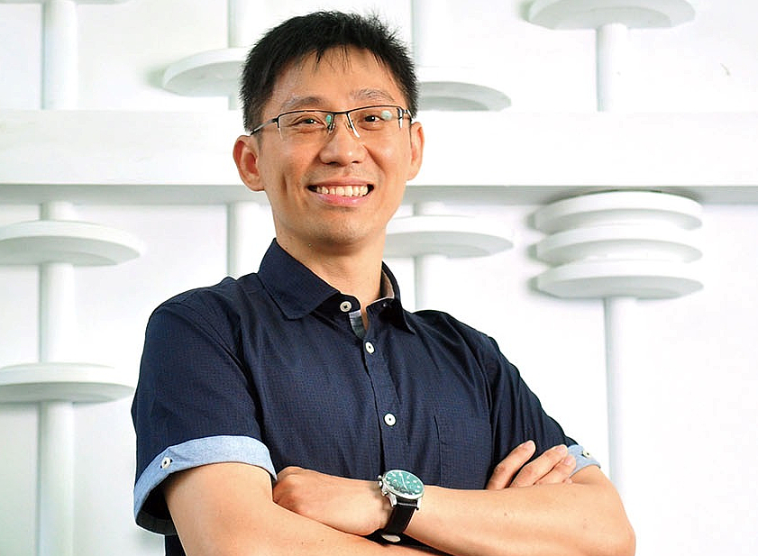
Data science
陳昇瑋

Slide 41
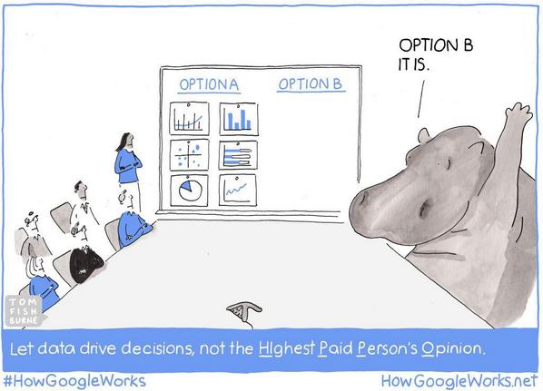
HIPPO
https://pbs.twimg.com/media/B0W2MYdCcAAsUA4.jpg

Slide 42
Open data
其實眾多的資料掌握在大型企業跟政府手上……
從人民身上收集到的資料應該要回饋應用在人民自身……
開放跟透明的資料跟分析流程，讓資料科學不成為專制……
透明的公共政策決策流程

Slide 43
Open data
Availability and Access / 可得性與可讀性
資料必須完整釋出，同時只能依照再製的成本徵收適當的費用。最好能提供網路下載。同時提供的資料格式必須是適用和可被修改的。
Re-use and Redistribution / 重新使用與散播
資料釋出時必須採用允許資料的重新使用和散播的授權聲明。並允許與其他資料混合使用。
Universal Participation/ 分享的普遍性
任何人都可使用，重新使用和散佈這些資料 - 不能限制資料使用的範圍，或是使用者的資格。例如，「非商業使用」將禁止資料在所有「商業性質」的使用，或是限制資料只能使用在某個範圍內 (例如，只能作為教育上使用)。這些限制都是不被允許的。

Slide 44
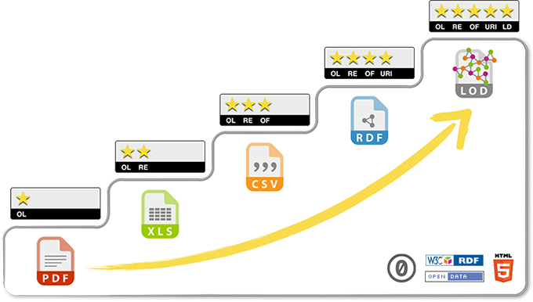
開放資料的格式

Slide 45
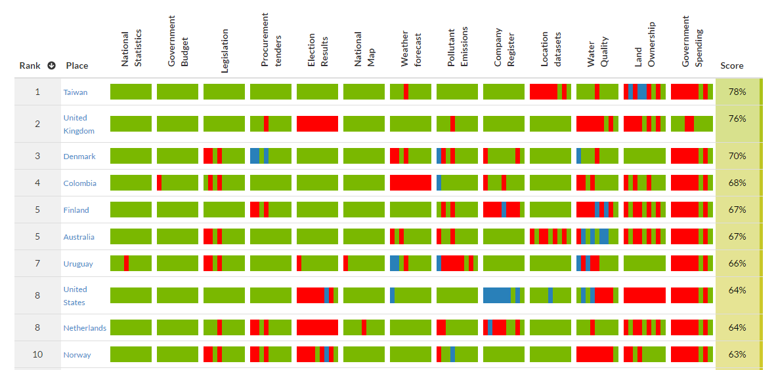
Open data台灣第一
根據英國開放知識基金會（Open Knowledge Foundation）去年底發表的開放資料評比，台灣的資料開放指數在全球149個國家中排名第一，勝過英國、丹麥、美國、日本等國家，也比2014年的第11名和2013年的36名進步許多。

Slide 46
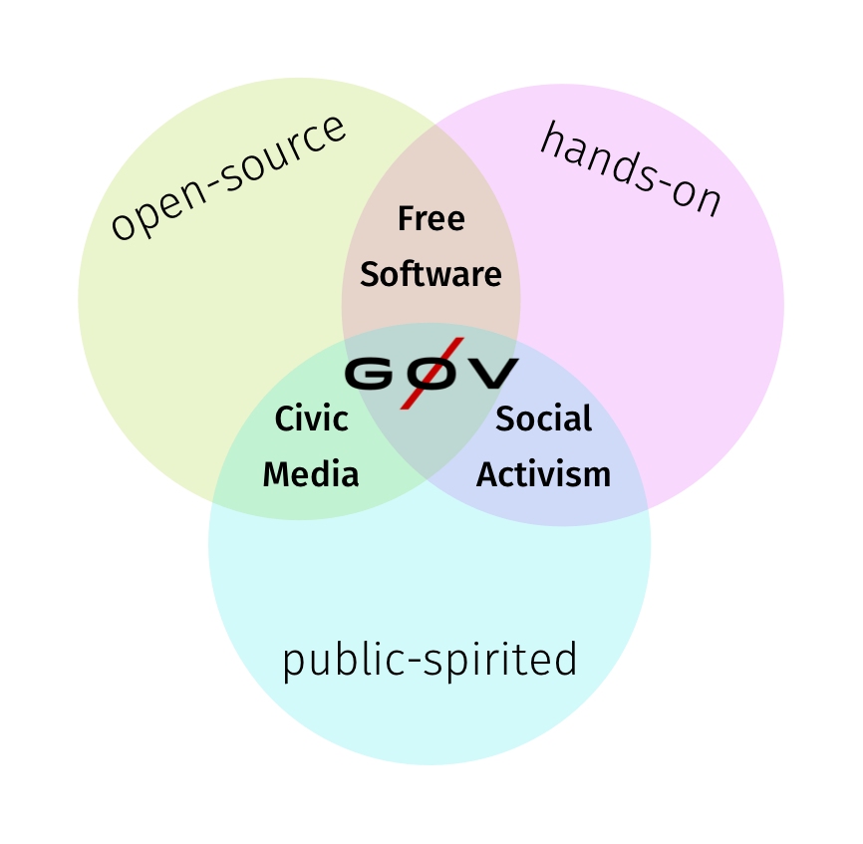

Slide 47
Data Visualization
觀賞影片

