Slide 1
Calendar app
By: Annalise kimura

Slide 2
Approach/ Design
Command line application
Java programming language
Three main components:
Event Model: Represents event data and basic operations
Calendar Manager: Handles calendar operations and business logic
Calendar App: Manages user interface and input/output

Slide 3
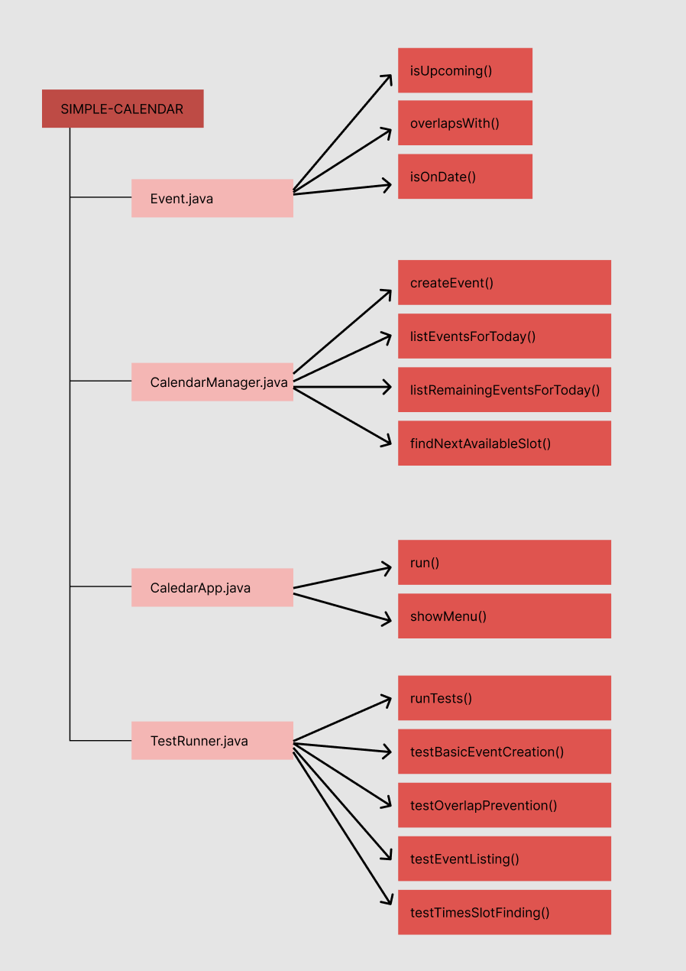
Structure

Slide 4
Run
1. Environment Setup
java --version # ensure Java 8+
git --version # for cloning repository
2. Compilation
git clone https://github.com/annalisekimura/simple-calendar.git
cd simple-calendar
javac *.java
3. Running the Application
java CalendarApp # run the app
java TestRunner # run with test data

Slide 5
Test, Verify
Create tests for: event creation, overlap prevention, listing functions, time slot finding
Use TestRunner.java
Verification
Valid events created successfully, otherwise error
Overlapping events rejected
Today’s events listed correctly, remaining events listed correctly
Available slots identified

Slide 6
Test/Seed data
Event 1- Title: “Really Early Meeting”, StartTime: “00:01”, EndTime: “08:30”
Event 2- Title: “Morning Standup”, StartTime: “09:00”, EndTime: “09:30”
Event 3- Title: “Client Meeting”, StartTime: “10:00”, EndTime: “11:00”
Event 4- Title: “Code Review”, StartTime: “14:00”, EndTime: “15:00”
Event 5- Title: “Team Retrospective”, StartTime: “16:00”, EndTime: “17:00”

