Slide 1

Hackathon by
Anna Manvelyan
Enzo Rougeron
Martin Masson
Ethan Goirand
Paul Ferron
Erwann Lale
Hackathon by Ekimetrics
Group 1
Notes:
Paul

Slide 2
summary
Skyrocket Your Hiring Process With a Fair and Unbiased Algorithm
Detect potential bias in our recruitment model
OUR solution to mitigate biases
A Fair Process for Successful Recruitment
Notes:
Paul

Slide 3

1. Skyrocket Your Hiring Process
With a Fair and Unbiased Algorithm
Mission: Provide a solution to facilitate recruitment within your company
Starting point
You earn €, time and efficiency
Applications are analyzed by our tool, ensuring unbiased selection. Ideal profiles are shortlisted
A position is opened, candidates upload their CV and complete the required fields.
Interviews are launched with the preselected candidates
Recruitment needs are identified
Your hidden gem joins your team
You win !
Our task
Notes:
1) Besoin en recrutement
2) Un poste est ouvert
3) Les candidatures sont analysés par notre outils : on utilise notre algo qui permet un jugemenbt non biaisé
4) Entretiens de candidature
5) Vous avez trouvé votre pépite
Mais quels sont les biais que nous avons repéré ?et pour ça je vais laisser anna

Slide 4
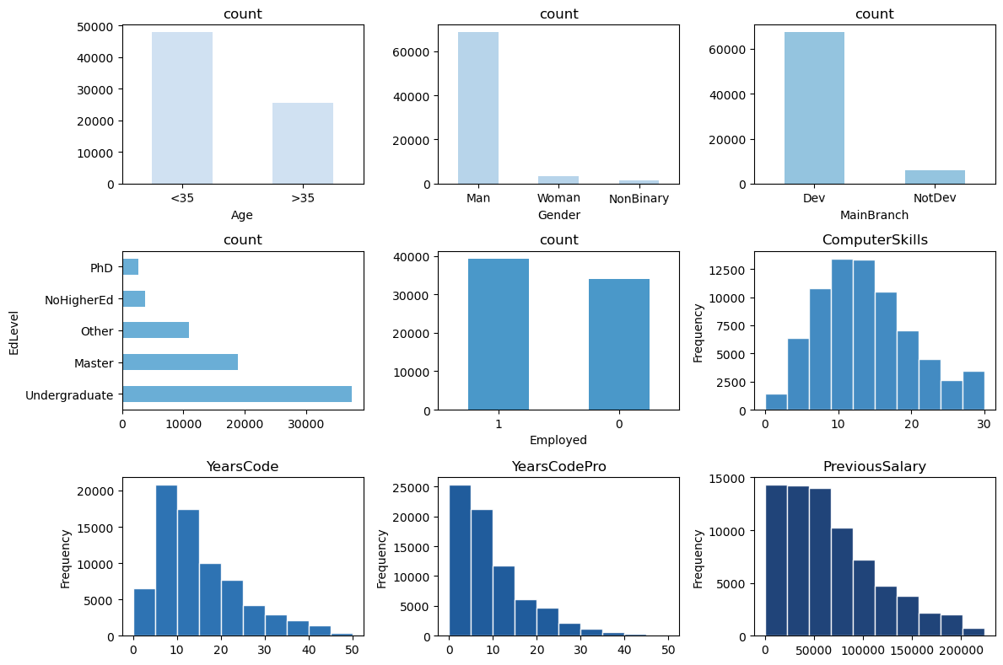
2. Identified biases
Our dataset contains identifiable biases
Many biases : These two biases are the ones we will address in order to solve the data-related issue.
1
Gender
2
Previous Salary

Slide 5
2. Identified biaseS
Women massively underrepresented
Database
Total candidates: 73,463
Initial Outcome
• 93% : Men • 5% : Women • 2% : Non-binary
Hiring outcome :
Men: 54% hired
Women: 55% hired
Gender distribution
Initial Outcome
Hiring outcome :
0-60k
60k+
Previous Salary distribution
• 52% : 0-60k
• 48% : 60k+

Slide 6
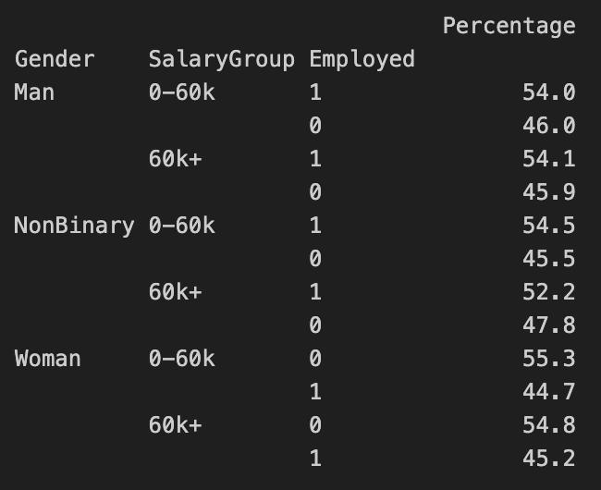
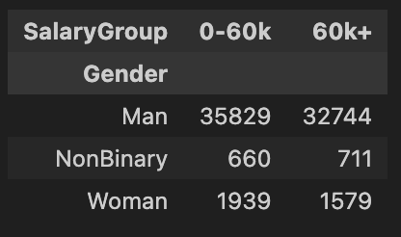
2. Identified biases
Cross-analysis : Gender & Previous Salary
Under represented in volume
Biased from an employment perspective
This confirms a potential bias in data → special attention needed in the modeling phase
Notes:
De nombreux biais sont identifiés, listé ceux qui ont été trouvé,
Mais nous nous focalisons sur deux d’entre eux :

Slide 7
2. Detect potential bias in our recruitment model
What we want to aim
1. Test Objective
1
Equal opportunity ratio
2
Predictive parity ratio
3
Accuracy equality ratio
4
Predictive equality ratio
5
Statistical parity ratio
Notes:
Justifier pq on focus sur ces metrics : ces metrics math vs les impacts

Slide 8
2. Detect potential bias in our recruitment model
Our recruitment model is biased
2. Method used
1
Data splitting
Splitting the dataset into training data (70%) and test data (30%)
2
Assigning “1” to women and “0” to men and non-binary individuals
Concatenation with the previous salary variable [1_60k+, 1_0-60k, 0-60k+]
Attribute creation
3
Definition of the privileged group
Designation of men and non-binary individuals with a 0-60k annual salary
4
Training the model
Testing the model
Model usage
5
Fairness analysis
Analyzing fairness through multiple indicators to compare model performance across different
groups

Slide 9
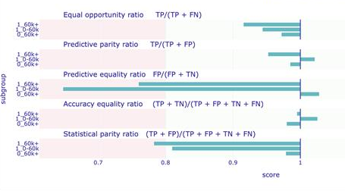
2. Detect potential bias in our recruitment model
Our recruitment model is biased
3. Results analysis
Our model is not fair because two criteria exceed acceptable limits set by epsilon (0.8)
Predictive equality ratio is below 0.8 for [1_0-60k, 1_60k+], which refer to women and high revenues
Systemic bias: Women are less likely to be recruited
Talent loss: Qualified (meaning high salary) candidates excluded
Statistical parity ratio is below 0.8 for [1_60k+], which refer to women with a previous salary range above 60k€ per years
Talent loss: Qualified women are wrongly rejected, missing top candidates
Recruitment inefficiency: More errors → higher costs and lower hire quality

Slide 10
2. Detect potential bias in our recruitment model
What we want to aim
3. Results analysis
Among the fairness metrics, 2 criteria fall outside of the expected ranges :
Statistical Parity Ratio (STP)
Predective equality ratio (FPR)
Our model is not fair because 2 criteria exceed the acceptable limits set by epsilon. Presence of bias
1
Equal opportunity ratio
2
Predictive parity ratio
3
Accuracy equality ratio
4
Predictive equality ratio
5
Statistical parity ratio
Notes:
Justifier pq on focus sur ces metrics : ces metrics math vs les impacts

Slide 11
3. Our SOLUTION to mitigate biases
Identification of different possibilities
Pre-processing
Post-processing
Apply a strategy to rebalance our data set in order to have more homogeneous training data
Using our pre-processed dataset, correcting the results generated by our model to mitigate the biases
Proportion of discrimination​
Pre-processing
Timeline

Slide 12
3. Our SOLUTION to mitigate biases
Smart Candidate Selection Tool
Choice between two Pre-processing methods :
Resampling : Rebalance training data to make protected group equally represented
Removing sensitive data : Drop sensitive features to remove biases, often inefective if biases are connected to proxys (eg. gender and salary)
Resampling → most relevant approach
Rebalancing training data → reduce risk of patterns due to representation

Slide 13
3. Our SOLUTION to mitigate biases
Smart Candidate Selection Tool
Pre-processing process
1
Resampling Fairness
Rebalance the training dataset to have an homogeneous representation of each group
2
Re-fit
Fit of the resampled dataset
3
Data analitics
Comparison of the fairness scores between raw analysis and pre-processed data

Slide 14
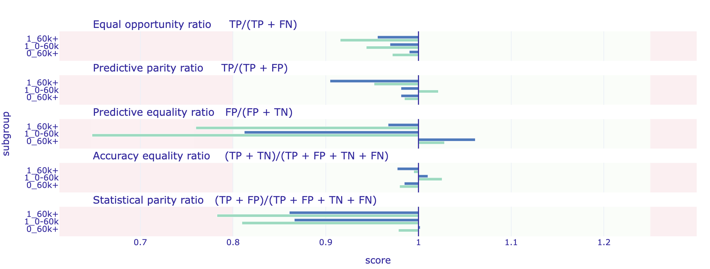
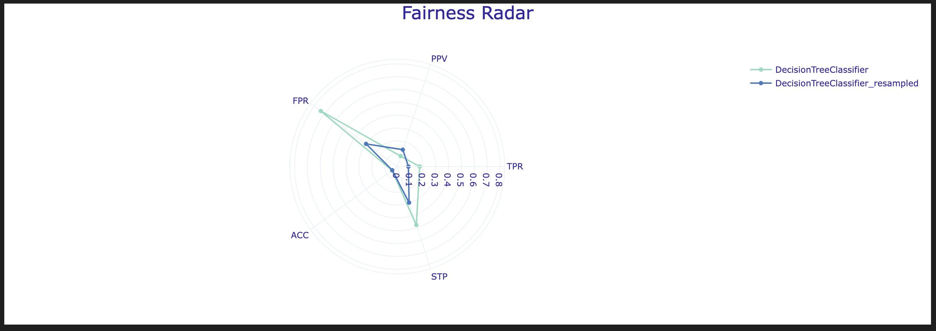
3. Our SOLUTION to mitigate biases
Smart Candidate Selection Tool
Pre-processing results
Raw analysis
Pre-processed analysis

Slide 15
3. Our SOLUTION to mitigate biases
Smart Candidate Selection Tool
Results
Raw analysis
Pre-processed analysis

Slide 16
4. A Fair Process for Successful Recruitment
By adopting an ethical recruitment process…
…Attract more high potential candidates
…Generate more diversity in your team
…Improve your brand image
GROW YOUR BUSINESS

Slide 17
3. Our SOLUTION to mitigate biases
Pre-processing
Apply a strategy to rebalance our data set in order to have more homogeneous training data
Proportion of discrimination​
Pre-processing
Timeline

