Slide 1
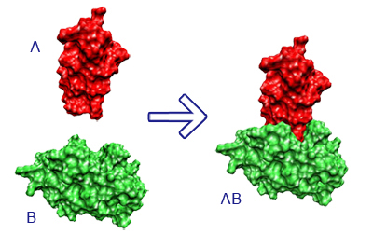
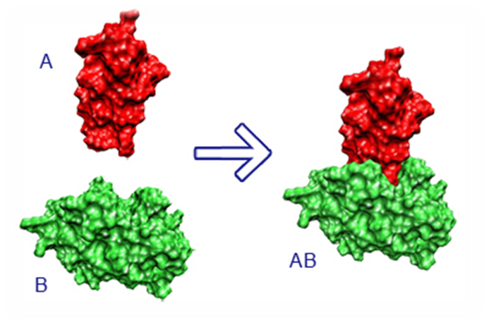
Linking the Language of Life
Ananthan Nambiar
Maeve Heflin
CS Sophomore, UIUC
Simon Liu
CS Freshman, UIUC
Mark Hopkins
Asc. Prof. of CS, Reed College
Anna Ritz
Ast. Prof. of Bio, Reed College

Slide 2
The Language of Life
MKAAVLVFPGSNCDRDLAVAEKI…
▁M KAA VL VF PG SN CDR DLAV AI EKI …
w1 w2 w3 w4 w5 w6 w7 w8 w9 w10 …
$$\overset{⃑}{v}∈ℝ^{d}$$
𝑣 ⃑∈ℝ^𝑑

Slide 3
Sentence embeddings
The cat is brown
The pup is black
My name is Bob

Slide 4



Predicting interactions
$${\overset{⃑}{v}}_{A}$$
Algorithm
TBD
$$1$$
$${\overset{⃑}{v}}_{B}$$

Slide 5
Protein-Protein Docking. (2019). Project Summary. [online] Available at: https://vred.bioinf.uni-sb.de/DFG-protein-protein-docking/DATA/projectsummary.shtml [Accessed 15 Nov. 2019].

Slide 6
Protein-Protein Docking. (2019). Project Summary. [online] Available at: https://vred.bioinf.uni-sb.de/DFG-protein-protein-docking/DATA/projectsummary.shtml [Accessed 15 Nov. 2019].

