Slide 1
EFFICIENT BUSINESS COMMUNICATION
Khrystyna Yablonska

Slide 2

Khrystyna Yablonska
soft skill trainer
ToP facilitator

Slide 3
Learning Objectives
COMMUNICATION PROCESS
COMMUNICATION PLANNING
RELATIONS ESTABLISHING
IDENTIFYING NEEDS AND DEMANDS
PRESENTATION OF YOUR IDEAS
DEALING WITH OBJECTIONS
CONCLUSION

Slide 4
Learning Objectives
COMMUNICATION PROCESS
COMMUNICATION PLANNING
RELATIONS ESTABLISHING
IDENTIFYING NEEDS AND DEMANDS
PRESENTATION OF YOUR IDEAS
DEALING WITH OBJECTIONS
CONCLUSION
STRONG LONG-TERM RELATIONSHIPS

Slide 5
Communication process
COMMUNICATION PLANNING
RELATIONS ESTABLISHING
IDENTIFYING NEEDS AND DEMANDS
PRESENTATION OF YOUR IDEAS
DEALING WITH OBJECTIONS
CONCLUSION
STRONG LONG-TERM RELATIONSHIPS

Slide 6
WHAT IS COMMUNICATION
Communication as a process of informational exchange between two or more people.
The main goal of any communication is to cause reaction

Slide 7
Crucial elements of efficient business communication
POSITIVE
MEASURABLE
ACHIEVABLE
ECOLOGICAL
PERSPECTIVE
The purpose of the communication should be expressed in positive language (without the particles "not“ or without orientation on negative results for other side).
The purpose of the communication should be measurable and verifiable (What? How? When?)
The purpose of the communication should be achievable and its achievement should depend on the people who take part in the communication.
The purpose of communication is to be assertive.
How will this affect on your project and in the long-term relationship with your customer or colleague?
The goal should be with a prospect.

Slide 8
Communication process
COMMUNICATION PLANNING
RELATIONS ESTABLISHING
IDENTIFYING NEEDS AND DEMANDS
PRESENTATION OF YOUR IDEAS
DEALING WITH OBJECTIONS
CONCLUSION
STRONG LONG-TERM RELATIONSHIPS

Slide 9



Rapport
Rapport is a relationship of mutual understanding or trust and agreement between people.

Slide 10
Building rapport
Voice speed and tone
Content of the conversation
Specific words
Non-verbal language
Values
Active listening

Slide 11
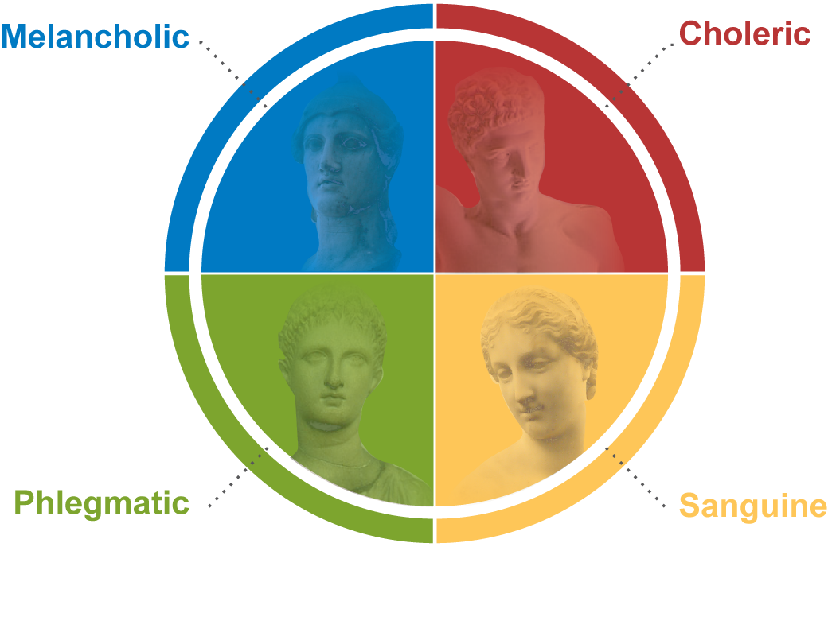
The Four Humours
Hippocrates – Ancient Greece – 500 BC
like orderly lives
prone to mood changes
appear as natural leaders
seen as tough-minded
observe from the sidelines and tend to comply to others' demands
outgoing, optimistic
fun-loving

Slide 12
Representational systems
We use all of them, but we do have a preferred representational system
Visual – SEE
Auditory – HEAR
Kinesthetic – FEEL
Digital - THINK

Slide 13
Types of person
Visual
That looks great…
Auditory
That sounds great…Listen, …I hear what you’re saying. I heard that…
Kinesthetic
That feels great…I feel…My instinct is…It’s comforting that you care about me.
Digital
My view is…
I see what you’re saying…
Picture the situation…
Watch this…
I like the look of it.
My vision is…
I like the sight of that.
Show me…
It rings a bell
It’s good to hear from you.
I’m listening…
I’m all ears.
I am very touched
I feel safe with you.
I’m a hands-on person.
I felt emotional…
How do you feel about…
That works well…I think…I understand what you’re saying…It makes sense…
It’s logical
Figure this out…
Prove it
It stacks up…
I can process it.
I’ll put it on the list…
My plan is…

Slide 14
Communication process
COMMUNICATION PLANNING
RELATIONS ESTABLISHING
IDENTIFYING NEEDS AND DEMANDS
PRESENTATION OF YOUR IDEAS
DEALING WITH OBJECTIONS
CONCLUSION
STRONG LONG-TERM RELATIONSHIPS

Slide 15
Needs, Wants and Demands
Need
Human needs are states of felt deprivation, including physical, social and individual needs.
These needs are not created by marketers: they are basic part of the human
Wants
Wants are the forms that a human need takes, as they are shaped by culture and individual personality
For example: a person needs food, but wants a Hamburger
Demand = Wants + Buying Power
Discover needs
Influence wants
Manage Demands

Slide 16
Questions
Open
Closed
Alternative
2
3

Slide 17
Tools: Questions
Closed
Alternative
„Do you like it?”
„Do you understand?”
„Do you want to participate?”
“So, which solution suits you better:
X or Y?
Open
“W questions”: what, where, who, why, when, how…

Slide 18
How to ask questions?
1. What information do you want to get?
3. What information will I get from the answer?
4. Did I get the information I need?
2. What question do you want to ask?

Slide 19
Open Questions
Who, What, When, Where, Why, How
Is that important for you?
Do you want us to give you weekly reports?
Are you sure it is true?
Have you tried to find another solution?

Slide 20
Open Questions
Who, What, When, Where, Why, How
Is that important for you?
Do you want us to give you weekly reports?
Are you sure it is true?
Have you tried to find another solution?
Why is that important for you?
In your opinion, what would be the best way to organize reporting?
Where does this information come from?
How have you tried so far to solve this problem?

Slide 21
Example
1.Client: I need a warehouse software that can be installed without consultants.
Without consultants means completely – 100% or just 50/50%?
What purpose would you like to solve with a usage of the warehouse software?
Could you tell me more what do you exactly mean by „installed without
consultants”?

Slide 22
SPIN technique
SPIN stands for the four stages of the questioning sequence:
S: Situation
P: Problem
I: Implication
N: Need-Payoff
are used to collect facts.
are used to probe for problems, points of dissatisfaction
general difficulties that the prospect has.
are used to probe for the consequences of a problem, point ofdissatisfaction, or general difficulty.
are used to uncover the core need (i.e., the buying motive) of the prospect.

Slide 23
SPIN questions
Examples
Situation
What equipment are you using now?
Problem
Are you satisfied with your present equipment?
Implication
If a server breaks down in a remote office do you have to send a support person out from the central office to fix it?
How long have you had it?
How many people use it?
What are the disadvantages of the way you’re doing it now?
How difficult is it to process orders with your present system?
Need-Payoff
Is there any other way that our product could help you?
Do you think solving this problem would help achieve your sales goals?
How would it help if all your offices were connected to a centralized database?
How much do you spend on advertising?
What effect does that have on...?
How often does that cause....?

Slide 24
Communication process
COMMUNICATION PLANNING
RELATIONS ESTABLISHING
IDENTIFYING NEEDS AND DEMANDS
PRESENTATION OF YOUR IDEAS
DEALING WITH OBJECTIONS
CONCLUSION
STRONG LONG-TERM RELATIONSHIPS

Slide 25
PRESENTING YOUR IDEAS
«Don’t give me the solution, give me the value of it’s implementation!”
«Don’t give me a project team, give me the pleasure of working with them»
«Don’t give me an information, show me how can we use it»

Slide 26
PRESENTING YOUR IDEAS
People are attracted not by properties of a product or service but by the direct benefits they receive as a result of its use!

Slide 27
Presenting your ideas
New laptop | For designer | For the stakeholder
Feature | Modern processor | Modern processor
Advantage | Work is done faster | Long time no need in upgrade
Benefits | You have more time for travelling | Save your money

Slide 28
Features, advantages and benefits
 | Relation to success
Features Describe some characteristic of a product or service | LOW
Advantages Describe how a product or feature can be used or can help to persuade | MODERATE
Benefits Describe how a product feature or advantage meets an Explicit Need expressed by the persuade | VERY HIGH

Slide 29
Communication process
COMMUNICATION PLANNING
RELATIONS ESTABLISHING
IDENTIFYING NEEDS AND DEMANDS
PRESENTATION OF YOUR IDEAS
DEALING WITH OBJECTIONS
CONCLUSION
STRONG LONG-TERM RELATIONSHIPS

Slide 30
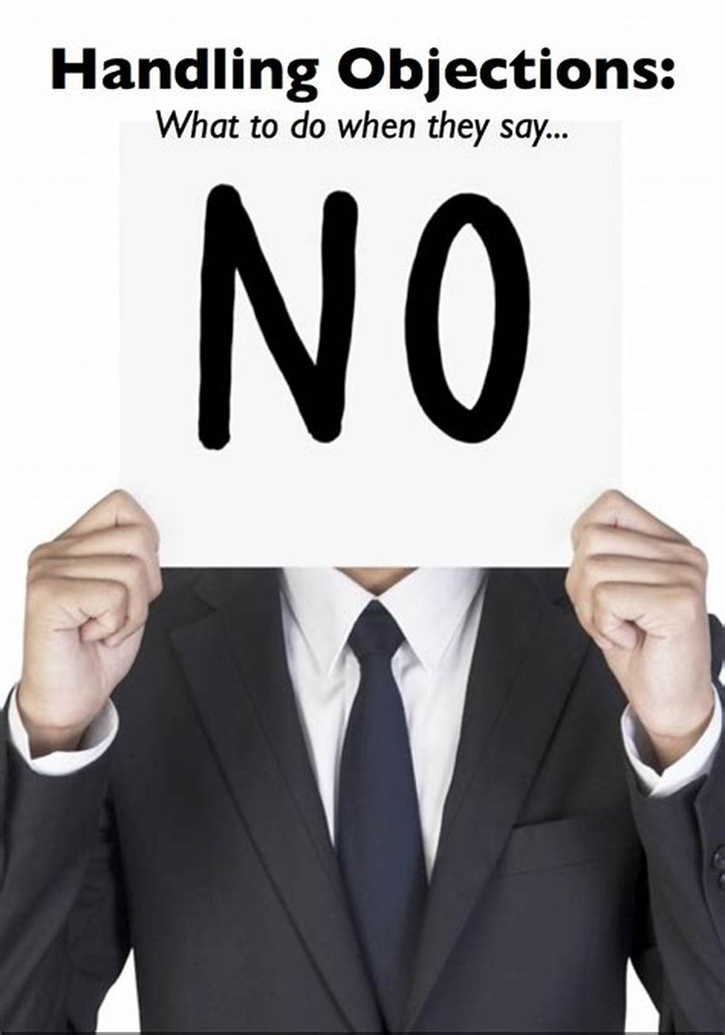
WHAT IS OBJECTION?
Objection –
a reason or argument offered in disagreement, opposition, refusal, or disapproval.
Objections are our helpers, because they help to define original needs and motivation of other person.
Notes:
Yes, must agree with the point on connection between objections and needs. Psychologists say that our objections come from some unsatisfied needs we have at the moment.
So from this point of view how do u think, are customer’s objections are good or not? Just write down the answers into the table u see on the page XX of your handouts, and in 2 minutes we’ll discuss it.

Slide 31
IS IT GOOD WHEN OTHER PERSON OBJECTS?
- | +
It takes some effort to deal with objections; We need to be real professionals to answer on some denials; Sometimes we experience stress while dealing with negative comments | They help to define what other person really expects from our cooperation; Dealing with objection helps to remove tension between you and your colleague/client; Practice with objections is helping to improve our professional and negotiating skills; If we successfully coped with negative, we can improve our products due the needs of a customer; Successful dealing with objections will show our effort on company’s business.

Slide 32
STEPS OF HANDLING OBJECTIONS
1
Hear them out! Don’t interrupt. Use active listening.
2
Question and isolate the objection before you answer it.
3
Answer the objection.
4
Confirm your answer.
5
Talk about resolving the issue. Move forward to the next step of negotiations.

Slide 33

Questions: Paraphrasing
Paraphrasing
Is an effective form of verbal feedback to use when listening, however it is not simply repetition or „parroting”, but restating another persons statement in your own words to gain understanding.
1.Shows that you really listen.
2.Helps to check understanding.
3.Mentally note key points.

Slide 34

Characteristics of paraphrase
Do not repeat the person’s exact words – main point (re-statement). One, two sentences.
Closed question at the end.
Avoid phrases like „I know what you mean”
Don’t be afraid that you misunderstood.

Slide 35
DEALING WITH OBJECTIONS TECHNIQUES
1. VERBAL AIKIDO TECHNIQUE
2. TRANSFERRING OBJECTION TO A POSITIVE QUESTION
3. BOOMERANG
4. EMPATHIZE
5. RENAMING
6. REPRIORITIZE

Slide 36
VERBAL AIKIDO TECHNIQUE
Agree with a statement or with the importance
Continue with your own opinion on this case

Slide 37
VERBAL AIKIDO TECHNIQUE
1. AGREE
2. CONTINUE WITH YOUR OPINION
“Yes, I agree with a fact, that…”
“Yes, it’s really important to be sure in…”
“Yes, this question is really important for us…”
“That’s why let’s discuss some risks we can have…”
“Becides, we had some issues previously…”
“And that’s why let’s look on pluses and minuses…”
NO
YES
BUT
AND

Slide 38

CHECK YOURSELF
WHICH ANSWERS ARE CORRECT DUE TO THE AIKIDO TECHNIQUE:
Yes, we will provide you with a service…
Yes, I agree with you that this option will be useful in this project and I’m ready to discuss it’s risks and advantages…
Yes, I agree with you that these these changes are worth to implement, but it’s necessary to listen to other opinions…
No, our employees cannot make fails…
Sure, this service might be provided, so let’s look on the possibilities of it’s implementation and resources needed for it…

Slide 39
DEALING WITH OBJECTIONS TECHNIQUES
TRANSFERRING OBJECTION TO A POSITIVE QUESTION
Your task is to define original reasons of objection and respond on them.
“We don’t want to raise a budget for this project…”
“As far as I understood you want to know how you can save your money?”
“As I guess you want to know how we can increase our productivity…”
“Your employees work really bad…”

Slide 40
DEALING WITH OBJECTIONS TECHNIQUES
BOOMERANG
Lot’s of call-downs or remarks in despite of a wishes of opponent, somehow can reflect our advantages.
“Sure we are, we really care about the quality of our product, so need to work out all the details to eliminate errors. That’s the reason you are working with our company…”
“Why are you working so long…”

Slide 41
DEALING WITH OBJECTIONS TECHNIQUES
EMPATHIZE
Connect to your opponents emotional condition and show your understanding of the issue.
“I understand your opinion…”
“I realize that this option is very important…”
“Being you in such case I’d be dissatisfied as well…”
Customer’s emotional objection

Slide 42

RENAIMING
Do you suggest that...
If I understand you correctly...
So, you're saying that...
Let me make sure I understand you...
Am I right thinking that you...
So you are positive that...
As i got it, you mean...
I think what you mean to say is...
I understand that...

Slide 43
DEALING WITH OBJECTIONS TECHNIQUES
REPRIORITIZE
When evaluating between different choices, we use different criteria and different weighting of those criteria. We also get fixated on particular solutions and forget about other criteria. If you can change criteria, change weights or remind the other person of forgotten criteria then you can get them to reprioritize.
You are right, price is important. But how much more important is quality to you? A big picture would look nice, but with smaller pictures you can show more of them.

Slide 44
Communication process
COMMUNICATION PLANNING
RELATIONS ESTABLISHING
IDENTIFYING NEEDS AND DEMANDS
PRESENTATION OF YOUR IDEAS
DEALING WITH OBJECTIONS
CONCLUSION
STRONG LONG-TERM RELATIONSHIPS

Slide 45
SUMMARIZING AND ARRANGEMENTS
HOW TO MAKE CONCLUSIONS EFFICIENTLY
Active listening + statement:
generalization
(We discussed ... and we came
to next agreements…)
+
Thank you. Goodbye!
Active listening + a closed question:
generalization
(We discussed ... and did we come
to an agreement that ...)
+
Have we discussed everything?
Alternative question:
Can we finish our meeting
or we have more issues/question for discussion?
Open question:
What issues to be discussed
we still have?

Slide 46
CONCLUSIONS OF THE MEETING
FOLLOW UP ON AGREEMENTS ON:
obligations agreed upon by sides
the timing of their implementation
responsibility for the execution of obligations (who does what)
dates, time and form of a next contact
The results are to be agreed and recorded!

Slide 47
THANK YOU!

