Slide 1

React Hooks
Learn how to use Hooks in React, a powerful feature of function components.
15 July 2021
by Anna Melnyk

Slide 2
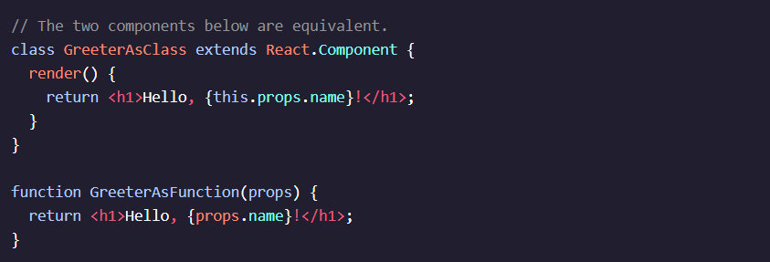
KEY CONCEPTS
Function Components
In React, you can use function as a component instead of a class. Function components
receive props as a parameter.
In the example code, we show two equivalent components: one as a class and one as a
function.

Slide 3

Why Hooks?
Hooks are functions that let us “hook into” state and lifecycle functionality in function components.
Hooks allow us to:
reuse stateful logic between components
simplify and organize our code to separate concerns, rather allowing unrelated data to get tangled up
together
avoid confusion around the behavior of the this
keyword
avoid class constructors, binding methods, and
related advanced JavaScript techniques

Slide 4
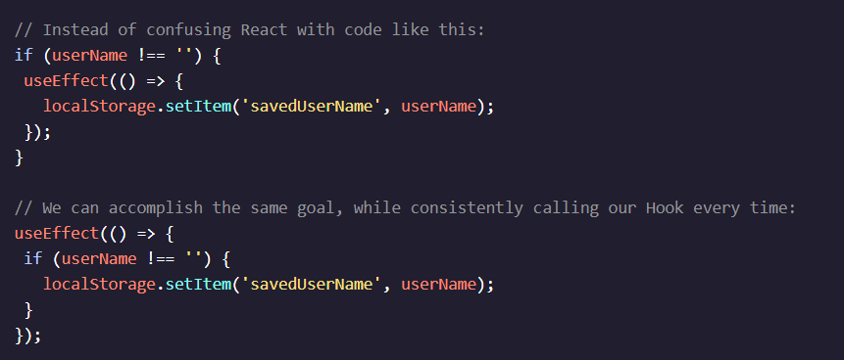
Rules for Using Hooks
There are two main rules to keep in mind when using Hooks:
Only call Hooks from React functions
Only call Hooks at the top level, to be sure that Hooks are called in the same order each time a component renders.
Common mistakes to avoid are calling Hooks inside of loops, conditions, or nested functions.

Slide 5
The State Hook
const [currentState, stateSetter] = useState(initialState);
The useState() Hook lets you add React state to function components. It should be called at the top level of a React function definition to manage its state.
initialState is an optional value that can be used to set the value of currentState for the first render. The stateSetter function is used to update the value of currentState and rerender our component with the next state value.

Slide 6
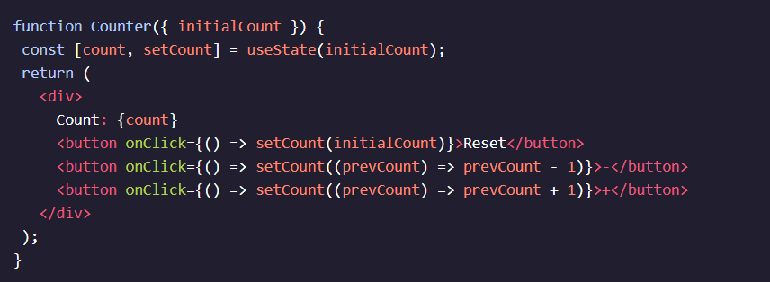
State Setter Callback Function
When the previous state value is used to calculate the next state value, pass a function to the state setter. This function accepts the previous value as an argument and returns an updated value.
If the previous state is not used to compute the next state, just pass the next state value as the argument for the state setter.

Slide 7
Multiple State Hooks
function App() { const [sport, setSport] = useState('basketball’); const [points, setPoints] = useState(31); const [hobbies, setHobbies] = useState([]); }
useState() may be called more than once in a component. This gives us the freedom to separate concerns, simplify our state setter logic, and organize our code in whatever way makes the most sense to us!

Slide 8
Side Effects
The primary purpose of a React component is to return some JSX to be rendered. Often, it is helpful for a component to execute some code that performs side effects in addition to rendering JSX.
In class components, side effects are managed with lifecycle methods. In function components, we manage side effects with the Effect Hook. Some common side effects include: fetching data from a server, subscribing to a data stream, logging values to the console, interval timers, and directly interacting with the DOM.

Slide 9
The Effect Hook
After importing
import React, { useState, useEffect } from 'react'; function TitleCount() { const [count, setCount] = useState(0); useEffect(() => { document.title = `You clicked ${count} times`; }); return <button onClick={(prev) => setCount(prev + 1)}>+</button>; }
After importing useEffect() from the 'react' library, we call this Hook at the top level of a React function definition to perform a side effect.
The callback function that we pass as the first argument of useEffect() is where we write whatever JavaScript code that we’d like React to call after each render.

Slide 10


