Slide 1
A DASHBOARD ANALYSIS
Global Child Survival
Six decades of under-5 mortality, education, and country-level disparities, drawn from the Global Child Survival Tableau dashboard.
Source: Global Child Survival dashboard (child mortality vs. female education, 146 countries)

Slide 2
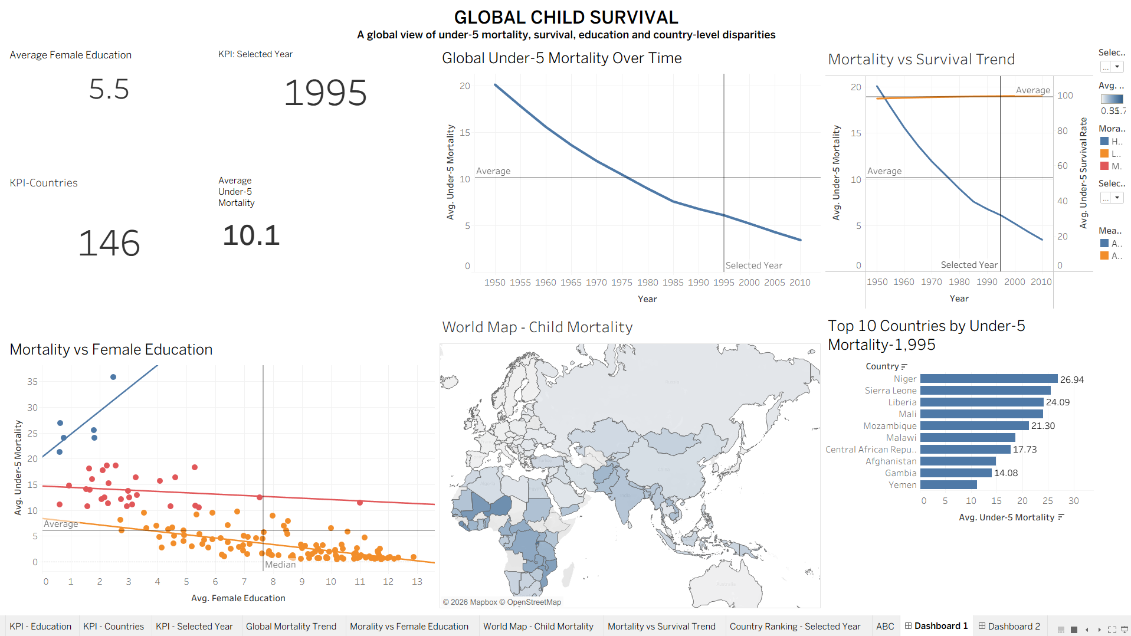
The Full Picture
One dashboard, six views: global trend, survival, education, geography, and country rankings.
Global Child Survival • Tableau Dashboard Analysis
2

Slide 3
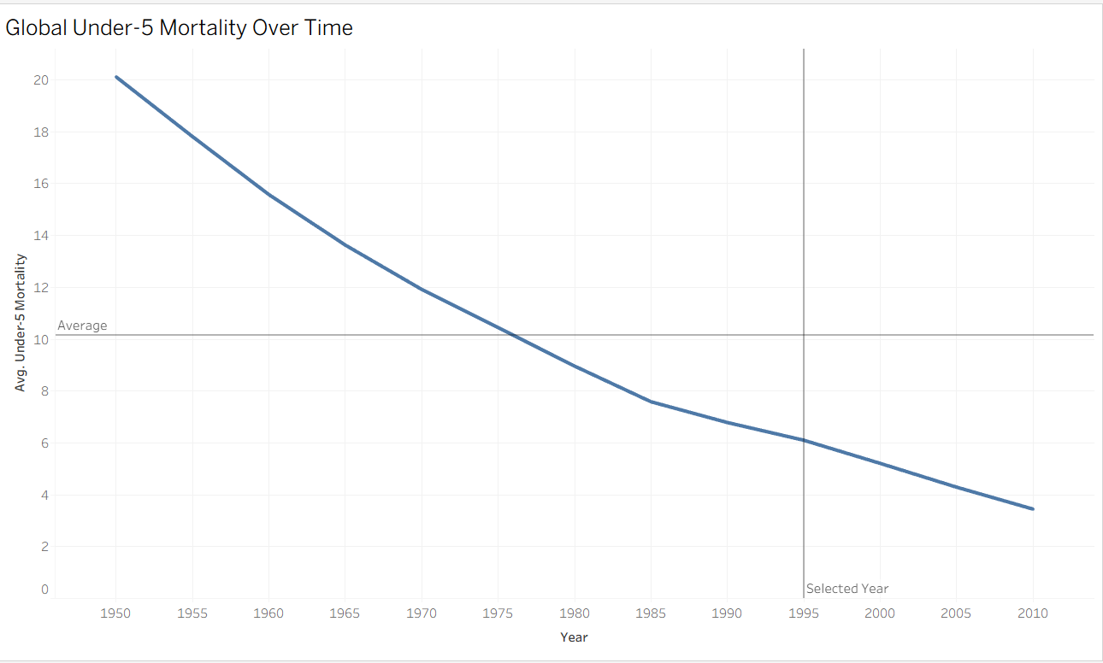
01 — GLOBAL TREND
A Six-Decade Decline
Global average under-5 mortality fell steadily from ~20.2 in 1950 to ~3.4 in 2010 — an ~83% reduction with no plateau across six decades.
The curve crosses the long-run average (10.1) around 1975–76, marking the halfway point of the decline in time, not in magnitude.
The decline is a smooth, consistent curve with no sudden jumps — this reflects a sustained, structural global improvement rather than a one-off gain.
Global Child Survival • Tableau Dashboard Analysis
3

Slide 4
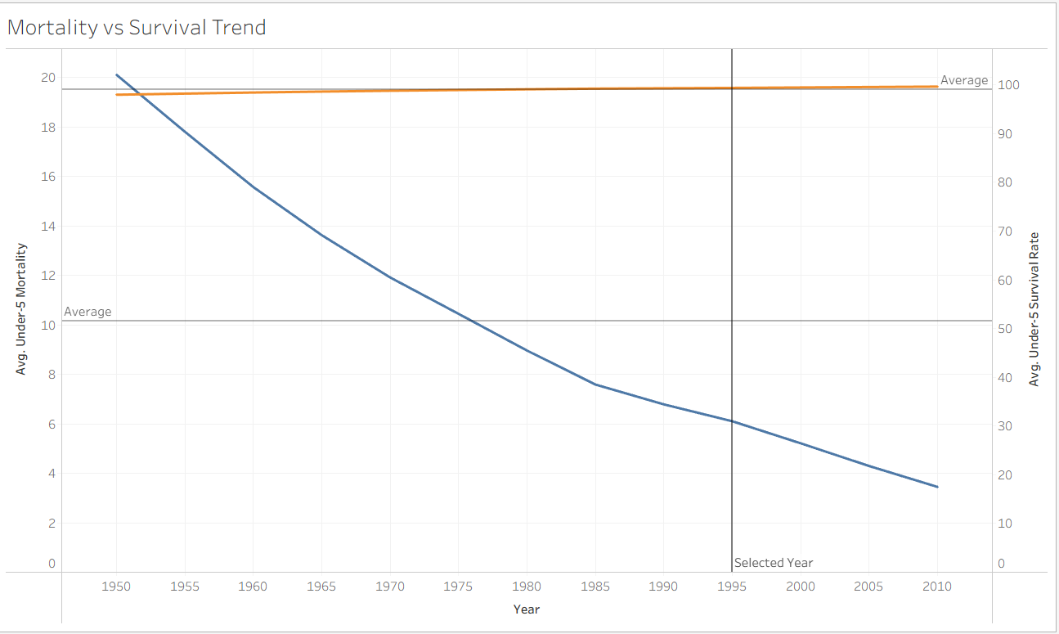
02 — SURVIVAL
Survival Has Been Near-Ceiling All Along
The under-5 survival rate (orange) has stayed close to 97–98% for the entire 1950–2010 window — it was already near its ceiling even in 1950.
Meanwhile mortality (blue) kept falling steadily, from ~20 to ~3.4 — on this compressed scale, a shrinking mortality rate barely moves an already-high survival rate.
Practical takeaway: survival rate is the wrong metric to watch for progress here — the mortality rate is the more sensitive, more informative indicator.
Global Child Survival • Tableau Dashboard Analysis
4

Slide 5
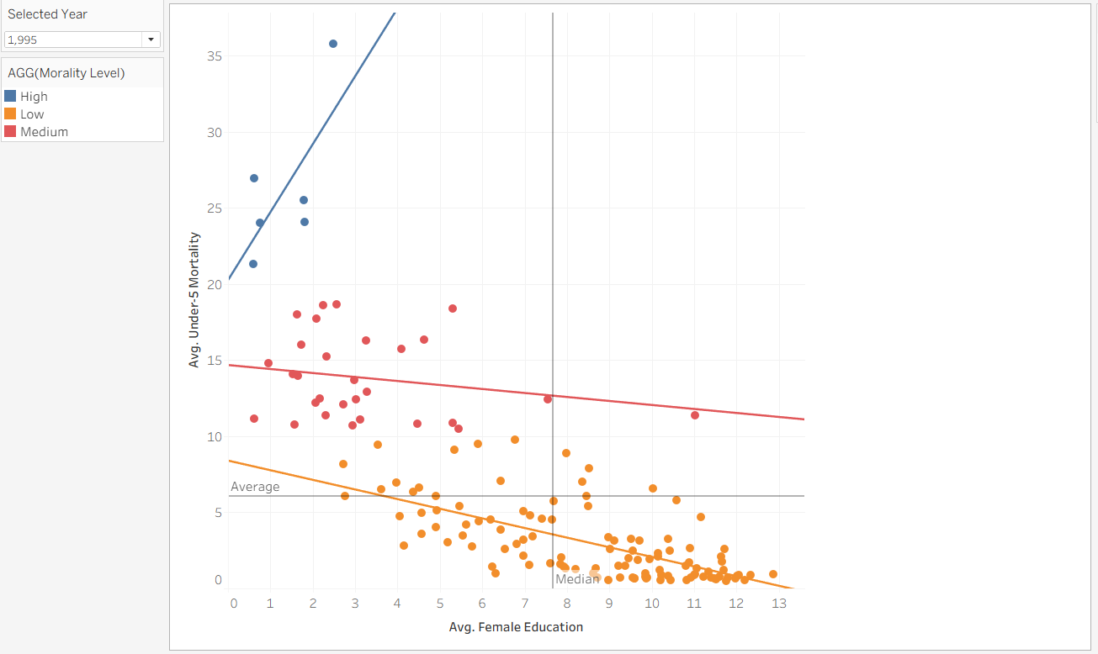
03 — EDUCATION
Education Splits Countries Into Tiers
Countries are grouped into three mortality tiers — Low (orange), Medium (red), High (blue) — and both Low and Medium tiers show mortality falling as female education rises.
The small High-mortality cluster (4 countries, all under 3 years of education) sits far above everyone else, 20–36 on the mortality scale — a distinct, extreme-risk group rather than the tail of a smooth trend.
Past the median of ~7.5 years of education, mortality compresses tightly toward single digits — a visible “floor effect.”
Global Child Survival • Tableau Dashboard Analysis
5

Slide 6
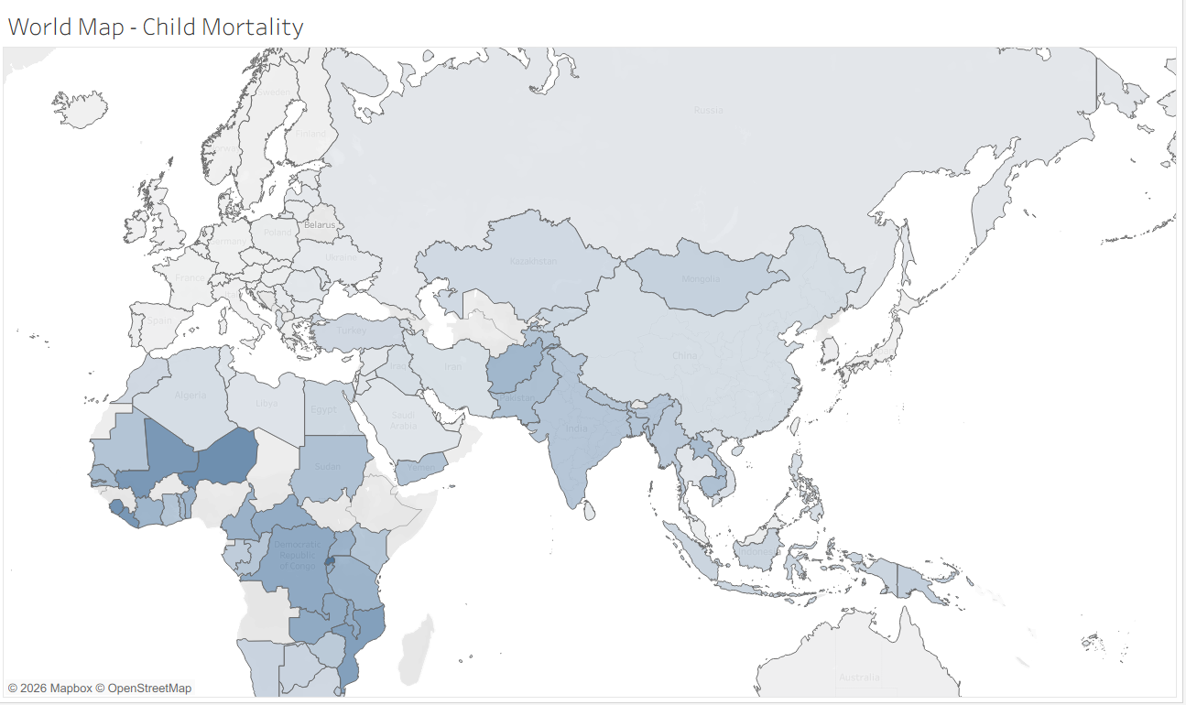
04 — GEOGRAPHY
The Burden Is Concentrated
Country values on the map range from 0.51 to 35.78; the darkest shading — the highest mortality — sits almost entirely across West & Central Africa (Mali, Niger, DRC) with a secondary band through Afghanistan/Pakistan and parts of India.
Most of the map is light gray to pale blue, meaning the majority of the 146 countries sit well below the global average of 10.1.
This is a geographically concentrated problem, not a globally distributed one — good news for where targeted investment can have the most impact.
Global Child Survival • Tableau Dashboard Analysis
6

Slide 7
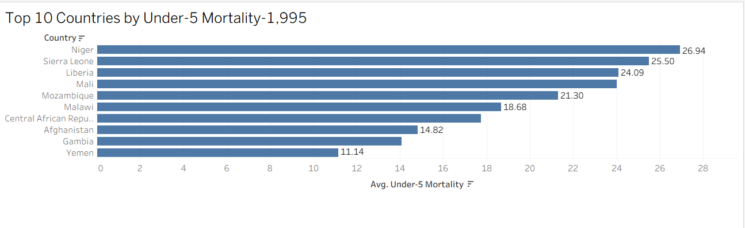
05 — COUNTRY RANKING
Niger Leads the Highest-Risk List
For the selected year (1995), Niger (26.94), Sierra Leone (25.50) and Liberia (24.09) top the list — roughly 2.5x the era's global average of 10.1.
8 of the 10 highest-mortality countries are in Sub-Saharan Africa; only Afghanistan and Yemen fall outside the region.
Even the lowest of this top 10, Yemen (11.14), still sits above the global average — this is a distinct high-risk tier, not a gradual tail.
Global Child Survival • Tableau Dashboard Analysis
7

Slide 8
SNAPSHOT — SELECTED YEAR 1995
The Dashboard at a Glance
146
5.5
10.1
1995
Countries Covered
Avg. Female Education
Avg. Under-5 Mortality
Selected Year
in the dataset
years, global avg.
global avg., all years
dashboard filter
Global Child Survival • Tableau Dashboard Analysis
8

Slide 9
KEY TAKEAWAYS
What the Dashboard Tells Us
1
Sustained progress
Global under-5 mortality has fallen ~83% since 1950 (20.2 → 3.4), with a smooth, uninterrupted decline.
2
Survival was already near-ceiling
The survival rate sat at ~97–98% for the whole 1950–2010 span — mortality, not survival, is the metric that reveals real change.
3
Education is a strong lever with an outlier tier
Low- and Medium-mortality countries show mortality falling as female education rises; a small High-mortality cluster (under 3 yrs education) is a distinct extreme-risk group.
4
Risk is geographically concentrated
The highest-mortality countries cluster in West & Central Africa, led by Niger (26.9), Sierra Leone (25.5), and Liberia (24.1) in 1995.
Global Child Survival • Tableau Dashboard Analysis
9

Slide 10
Global Child Survival
THANK YOU
Source: Global Child Survival dashboard (child mortality vs. female education, 146 countries)

