Slide 1
ADAPTER
Target Market :
IT industry in Machine Learning
Value Propositions:
Solution to a problem when the data set is too large to be processed in a single computing system.
XML<->JSON<->CSV
Team:
Divya Davat
Lakshmi Prasanna
Surya Vamshi Teja Davat
Hashmitha Solipuram
Venkata Sai Teja Annam

Slide 2
Problem Statement
We would be implementing a project to provide a simple solution to the problem arises when a data set is too large to be processed on a single computing system.
The main idea is to process and distribute over multiple datasets and also check for duplicates in that particular dataset.

Slide 3
Approach
The solution is based on the idea of hashing each data instance and assigning it to a particular computing system. If the hash function is properly constructed, we will always assign the same values to the same computing system and therefore we can recognize the duplicates. We can also be sure that the duplicate wasn't assigned to some other computing system, other than the one containing the initial value.
Conversions (XML<->JSON<->CSV)

Slide 4
Conceptuation
The design was created in such manner that we can easily replace, for example, File Handler that handles JSON format with some handler that handles CSV or XML files.
Handle invalid characters in the file during conversions.

Slide 5
Market Research, Offerings and Limitations
Currently we have techniques like compression, Indexing, and chunking to process large data sets.
Our proposal is using duplicates to split the large data sets.
Current websites which are available provide xml <->Json or csv<-> Json or CSV<-> XML in different sites, but we are providing all the additional features altogether in one.

Slide 6
Target Market
https://www.splitcsv.com/
https://www.convertjson.com/xml-to-json.htm
https://www.xml.com/pub/a/2006/05/31/converting-between-xml-and-json.html
Data visualization, data analysis.
Students and software developers.

Slide 7
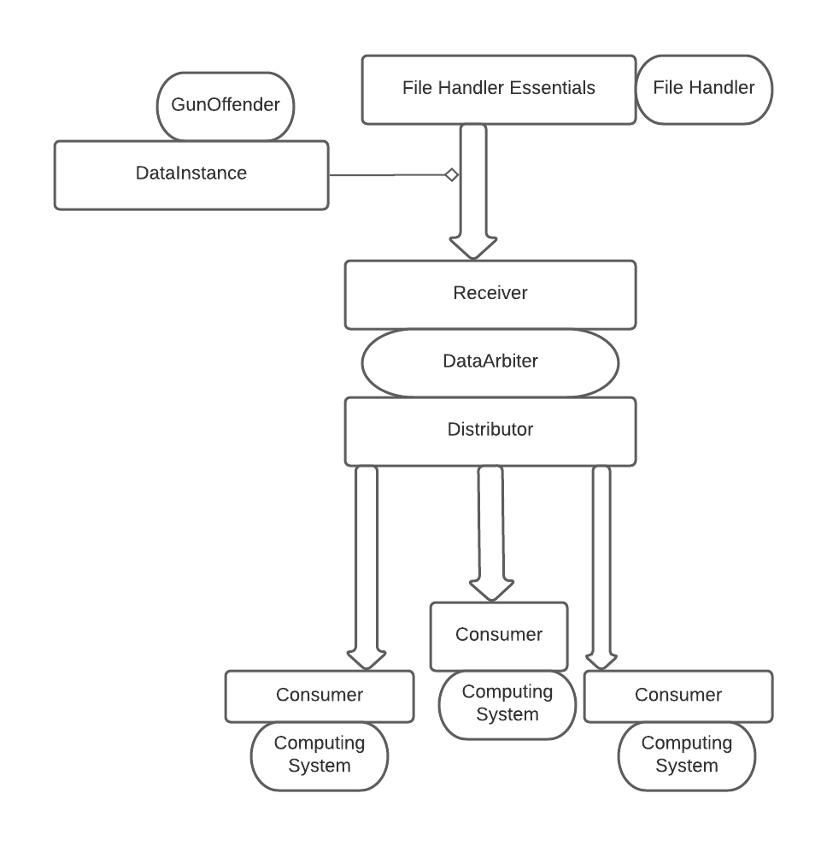
Business Model

Slide 8
Our Team
Divya Davat- hash function computing
Hashmitha Solipuram- Testing unit testing manual testing and management
Lakshmi Prasanna Meduri- conversions
Surya Vamshi Teja Davat- UI using html css and rest api
Venkata Sai Teja Annam- Interfaces controllers and API development

Slide 9
Get Started…
The software we are going to use for the development is cost-free.
IDE used: eclipse
Languages: JAVA
Libraries: Spring Beans, Spring Web,GSON,Rest API
Front end Technologies: HTML,CSS.

Slide 10
Tools
Project management: www.smartsheet.com
Communication: www.github.com, linkedIn.

