Slide 1
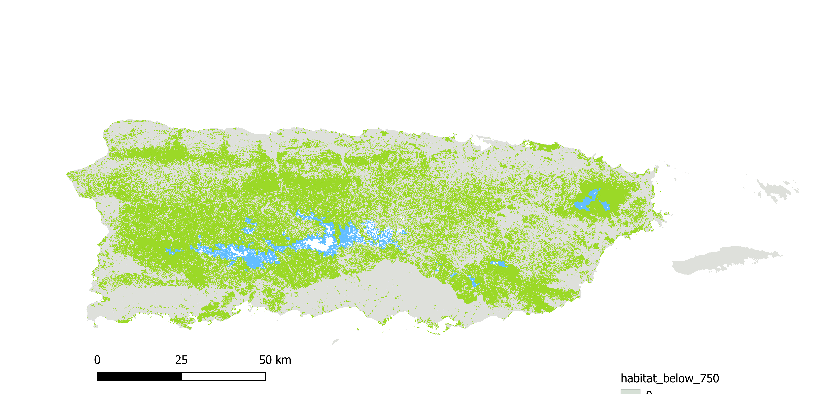
Unsuitable habitat
Suitable habitat below 750m
Potential habitat above 750m

