Slide 1
Source
Inputs
Calculated within each replicate
Outputs
Current habitat area and proportion urban
Gould et al 2008, Martinuzzi et al 2007
Proportion of habitat in urban matrix
Probability of population growth
Castro-Prieto et al 2017
Rate of urbanization
Total habitat area
Mulero 2019
Expert opinion
Range of maximum possible density
Population size in final year
Probability of population decline
Carrying capacity
Mulero 2019
Expert opinion
Range of current density
Starting population size
Quasi-extinction probability
Average demographic rates
Year-specific demographic rates
Expert opinion
Range of effect of urbanization on demographic rates
Reduction in demographic rates in urban areas
Expert opinion

Slide 2
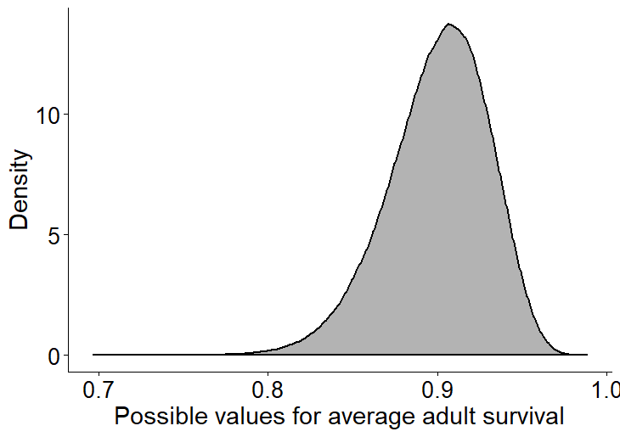

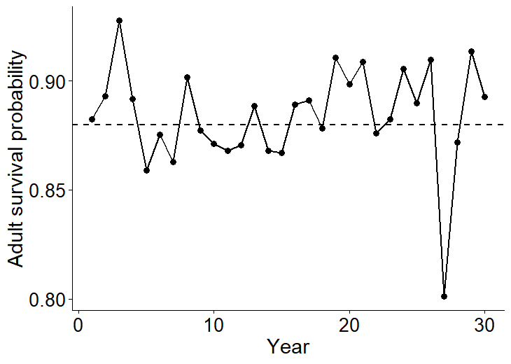
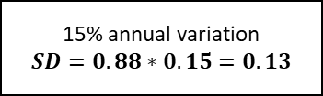

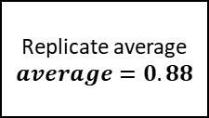
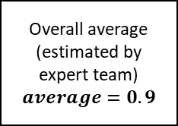
Overall average (estimated by expert team)
$$average=0.9$$
15% uncertainty
$$SD=0.9∗0.15=0.14$$
Replicate average
$$average=0.88$$
15% annual variation
$$SD=0.88∗0.15=0.13$$
Randomly draw one value per replicate
Randomly draw one value per year
Year-specific rates
Replicate average = 0.88

