Slide 1
Puerto Rican boa SSA projection modeling update 8 May 2019 Anna Tucker, Auburn University Conor McGowan, USGS AL Cooperative Fish and Wildlife Research Unit

Slide 2









Life cycle diagram
$$F^{A}$$
$$F^{S}$$
Young
(<60 cm)
Juvenile
(60-90 cm)
Sub-adult
(90-110 cm)
Adult
(>110 cm)
$$T^{YJ}$$
$$T^{JS}$$
$$T^{SA}$$
$$T^{YY}$$
$$T^{JJ}$$
$$T^{SS}$$
$$T^{AA}$$

Slide 3




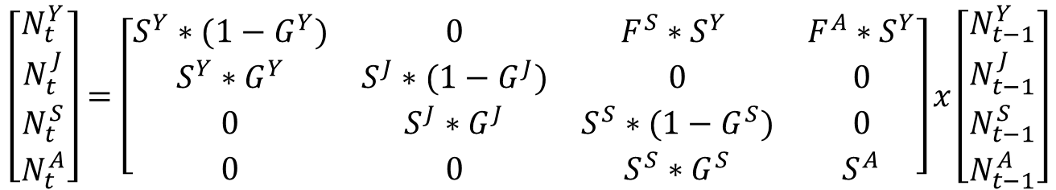





$$F^{A}∗S^{Y}$$
$$F^{S}∗S^{Y}$$
Young
(<60 cm)
Juvenile
(60-90 cm)
Sub-adult
(90-110 cm)
Adult
(>110 cm)
$$S^{Y}∗G^{Y}$$
$$S^{J}∗G^{J}$$
$$S^{S}∗G^{S}$$
$$S^{Y}∗(1−G^{Y})$$
$$S^{J}∗(1−G^{J})$$
$$S^{S}∗(1−G^{S})$$
$$S^{A}$$
$$\left[\begin{matrix}N_{t}^{Y} \\ N_{t}^{J} \\ N_{t}^{S} \\ N_{t}^{A}\end{matrix}\right]=\left[\begin{matrix}S^{Y}∗(1−G^{Y}) & 0 & F^{S}∗S^{Y} & F^{A}∗S^{Y} \\ S^{Y}∗G^{Y} & S^{J}∗(1−G^{J}) & 0 & 0 \\ 0 & S^{J}∗G^{J} & S^{S}∗(1−G^{S}) & 0 \\ 0 & 0 & S^{S}∗G^{S} & S^{A}\end{matrix}\right]x\left[\begin{matrix}N_{t−1}^{Y} \\ N_{t−1}^{J} \\ N_{t−1}^{S} \\ N_{t−1}^{A}\end{matrix}\right]$$

Slide 4







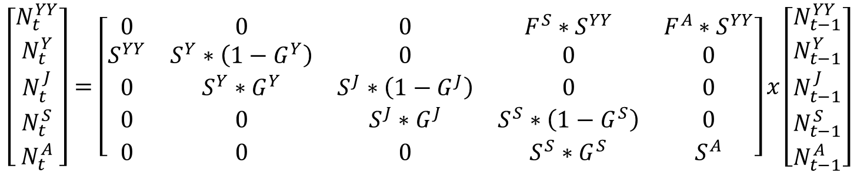



$$F^{A}∗S^{YY}$$
$$F^{S}∗S^{YY}$$
Young of the year
$$S^{YY}$$
Young
(<60 cm)
$$S^{Y}∗G^{Y}$$
Juvenile
(60-90 cm)
$$S^{J}∗G^{J}$$
Sub-adult
(90-110 cm)
$$S^{S}∗G^{S}$$
Adult
(>110 cm)
$$S^{Y}∗(1−G^{Y})$$
$$S^{J}∗(1−G^{J})$$
$$S^{S}∗(1−G^{S})$$
$$S^{A}$$
$$\left[\begin{matrix}N_{t}^{YY} \\ N_{t}^{Y} \\ N_{t}^{J} \\ N_{t}^{S} \\ N_{t}^{A}\end{matrix}\right]=\left[\begin{matrix}0 & 0 & 0 & F^{S}∗S^{YY} & F^{A}∗S^{YY} \\ S^{YY} & S^{Y}∗\left(1−G^{Y}\right) & 0 & 0 & 0 \\ 0 & S^{Y}∗G^{Y} & S^{J}∗\left(1−G^{J}\right) & 0 & 0 \\ 0 & 0 & S^{J}∗G^{J} & S^{S}∗\left(1−G^{S}\right) & 0 \\ 0 & 0 & 0 & S^{S}∗G^{S} & S^{A}\end{matrix}\right]x\left[\begin{matrix}N_{t−1}^{YY} \\ N_{t−1}^{Y} \\ N_{t−1}^{J} \\ N_{t−1}^{S} \\ N_{t−1}^{A}\end{matrix}\right]$$

Slide 5



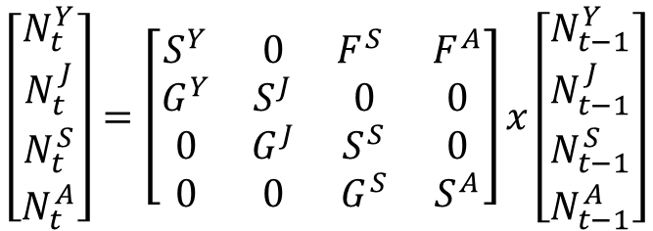





$$F^{A}$$
$$F^{S}$$
Young
(<60 cm)
Juvenile
(60-90 cm)
Sub-adult
(90-110 cm)
Adult
(>110 cm)
$$G^{Y}$$
$$G^{J}$$
$$G^{S}$$
$$S^{Y}$$
$$S^{J}$$
$$S^{S}$$
$$S^{A}$$
$$\left[\begin{matrix}N_{t}^{Y} \\ N_{t}^{J} \\ N_{t}^{S} \\ N_{t}^{A}\end{matrix}\right]=\left[\begin{matrix}S^{Y} & 0 & F^{S} & F^{A} \\ G^{Y} & S^{J} & 0 & 0 \\ 0 & G^{J} & S^{S} & 0 \\ 0 & 0 & G^{S} & S^{A}\end{matrix}\right]x\left[\begin{matrix}N_{t−1}^{Y} \\ N_{t−1}^{J} \\ N_{t−1}^{S} \\ N_{t−1}^{A}\end{matrix}\right]$$

Slide 6
Source
Inputs
Calculated within each replicate
Outputs
Gould et al 2008
Martinuzzi et al 2007
Current habitat area and proportion urban
Proportion of habitat in urban matrix
Rate of urbanization
Total habitat area
Castro-Prieto et al 2017
Probability of population decline
Mulero 2018
Expert opinion
Range of maximum possible density
Carrying capacity
Population size in final year
Probability of population growth
Mulero 2018
Expert opinion
Range of current density
Starting population size
Quasi-extinction probability
(50, 500, 1000, 5000)
Average demographic rates
Year-specific demographic rates
Expert opinion
Range of effect of urbanization on demographic rates
Reduction in demographic rates in urban areas
Expert opinion

Slide 7
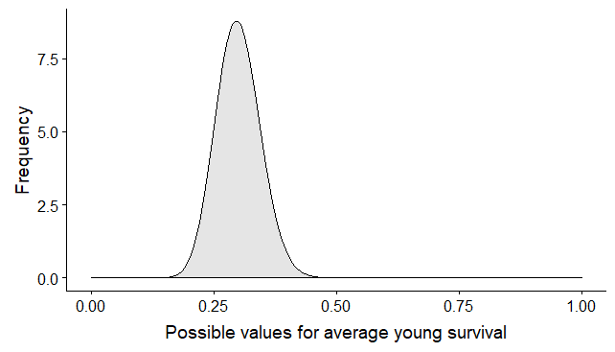
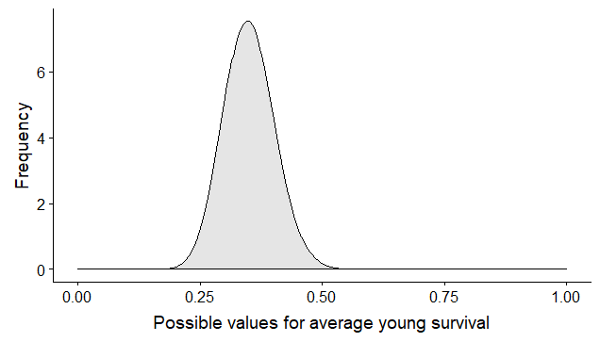
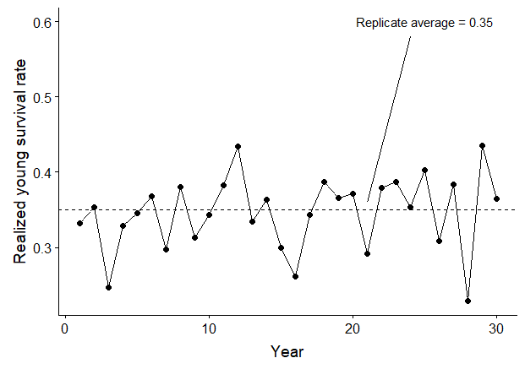
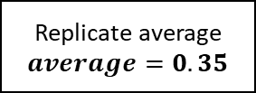
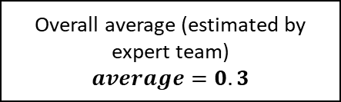
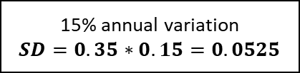
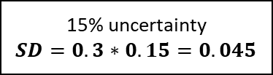
Overall average (estimated by expert team)
$$average=0.3$$
15% uncertainty
$$SD=0.3∗0.15=0.045$$
Replicate average
$$average=0.35$$
15% annual variation
$$SD=0.35∗0.15=0.0525$$
Randomly draw one value per replicate
Year-specific rates
Randomly draw one value per year
Replicate average = 0.35
Possible values for annual young survival

Slide 8
Current habitat area and proportion urban
Rate of urbanization
Range of current density
Range of maximum possible density
Average demographic rates
Range of effect of urbanization on demographic rates
Proportion of habitat in urban matrix
Total habitat area
Starting population size
Carrying capacity
Reduction in demographic rates in urban areas
Population size in final year
Year-specific demographic rates
Probability of population growth
Probability of population decline
Quasi-extinction probability
(50, 500, 1000, 5000)

Slide 9






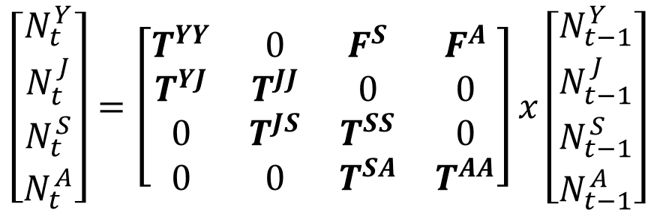




$$F^{A}T^{YY}$$
$$F^{S}T^{YY}$$
$$F^{S}T^{YY}$$
Young
(<60 cm)
Juvenile
(60-90 cm)
Sub-adult
(90-110 cm)
Adult
(>110 cm)
$$T^{YJ}$$
$$T^{JS}$$
$$T^{SA}$$
$$T^{YY}$$
$$T^{JJ}$$
$$T^{SS}$$
$$T^{AA}$$
$$\left[\begin{matrix}N_{t}^{Y} \\ N_{t}^{J} \\ N_{t}^{S} \\ N_{t}^{A}\end{matrix}\right]=\left[\begin{matrix}T^{YY} & 0 & F^{S} & F^{A} \\ T^{YJ} & T^{JJ} & 0 & 0 \\ 0 & T^{JS} & T^{SS} & 0 \\ 0 & 0 & T^{SA} & T^{AA}\end{matrix}\right]x\left[\begin{matrix}N_{t−1}^{Y} \\ N_{t−1}^{J} \\ N_{t−1}^{S} \\ N_{t−1}^{A}\end{matrix}\right]$$

Slide 10
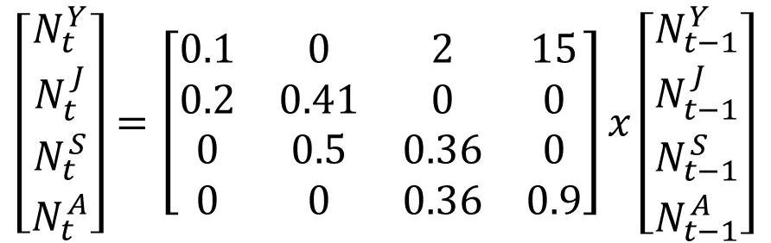
Demographic rates estimated by expert team
15
2
Young
(<60 cm)
Juvenile
(60-90 cm)
Sub-adult
(90-110 cm)
Adult
(>110 cm)
0.2
0.5
0.36
0.1
0.41
0.36
0.9
$$\left[\begin{matrix}N_{t}^{Y} \\ N_{t}^{J} \\ N_{t}^{S} \\ N_{t}^{A}\end{matrix}\right]=\left[\begin{matrix}0.1 & 0 & 2 & 15 \\ 0.2 & 0.41 & 0 & 0 \\ 0 & 0.5 & 0.36 & 0 \\ 0 & 0 & 0.36 & 0.9\end{matrix}\right]x\left[\begin{matrix}N_{t−1}^{Y} \\ N_{t−1}^{J} \\ N_{t−1}^{S} \\ N_{t−1}^{A}\end{matrix}\right]$$

Slide 11
Demographic rates estimated by expert team
Experts did not give estimates of uncertainty (SE or confidence interval) or temporal variation
Assumed ± 15% uncertainty in each parameter estimate
Assumed that demographic rates would vary by ± 15% each year
No estimates of current total population size
We randomly drew an initial population size between 1,000 and 30,000

Slide 12
Differences in habitat types
Included three habitat types: natural (undeveloped), rural (low development), and urban (high development)
Assumed that all demographic rates would be more variable in developed areas than undeveloped areas (due to competing influences of increased mortality and increased prey availability)
Rural: ± 5% of natural habitat rates
Urban: ± 10% of natural habitat rates
For initial projections, assumed that the population was equally distributed among these three habitat types

Slide 13
Projection model
Randomly draw initial population size and average and SD for each demographic rate (100 values)
Draw values for each rate (1000 replicates)
Project population 30 years into the future with annual variation in demographic rates

Slide 14
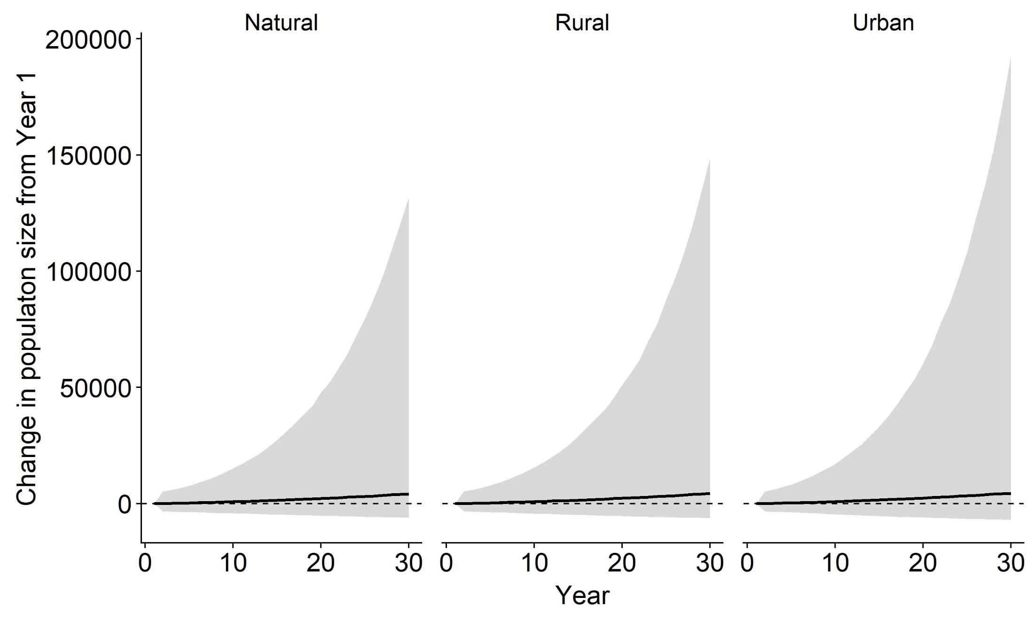
Projected change in total population size in each habitat type. The solid line is the median outcome from all replicates and the shaded region indicates the 95% upper and lower quantiles. Dashed horizontal line at zero indicates no population change.

Slide 15
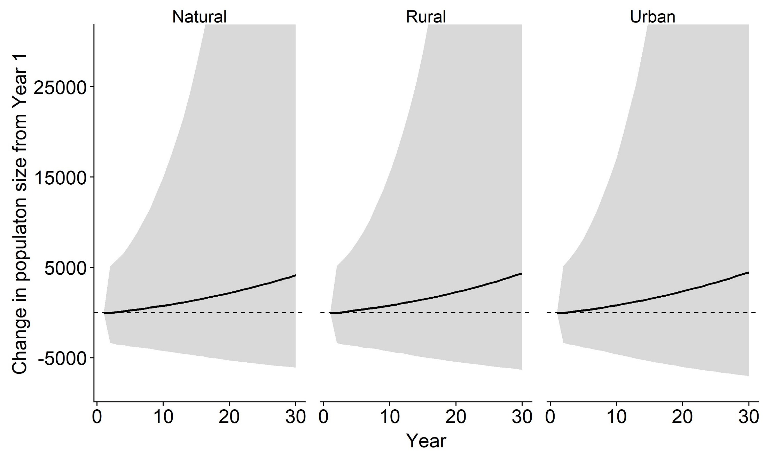
Zoomed in view of previous figure

Slide 16
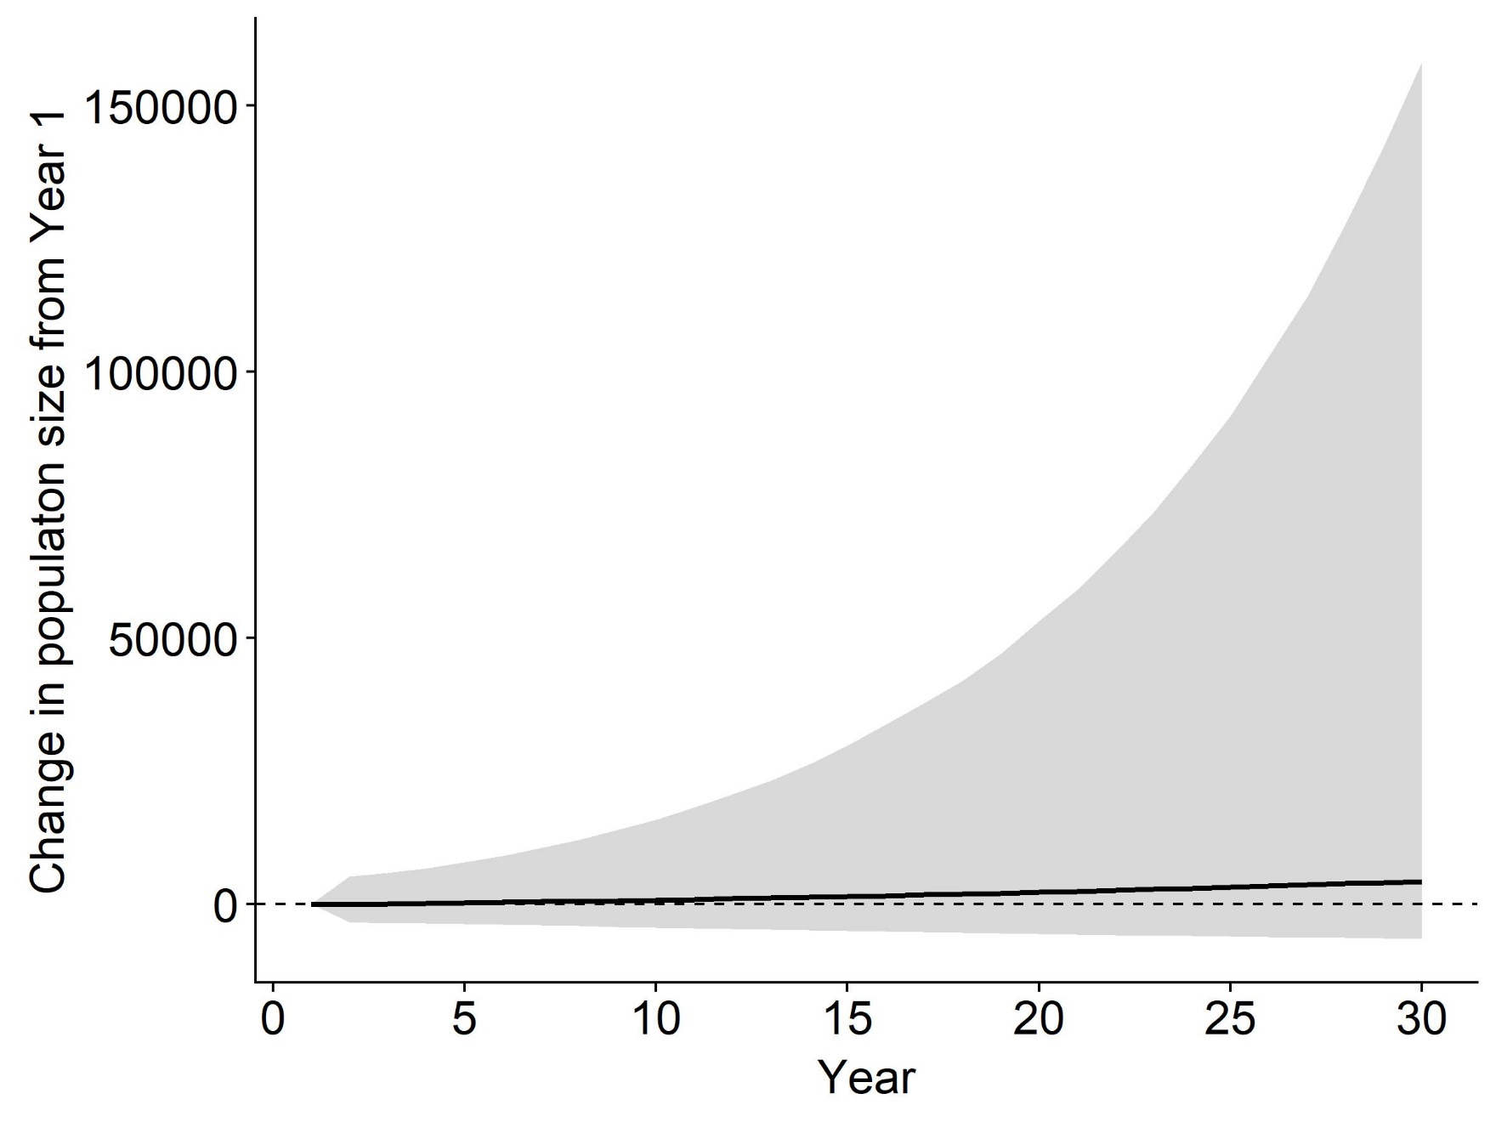
Overall (all habitat types)
Projected change in total population size. The solid line is the median outcome from all replicates and the shaded region indicates the 95% upper and lower quantiles. Dashed horizontal line at zero indicates no population change.

Slide 17
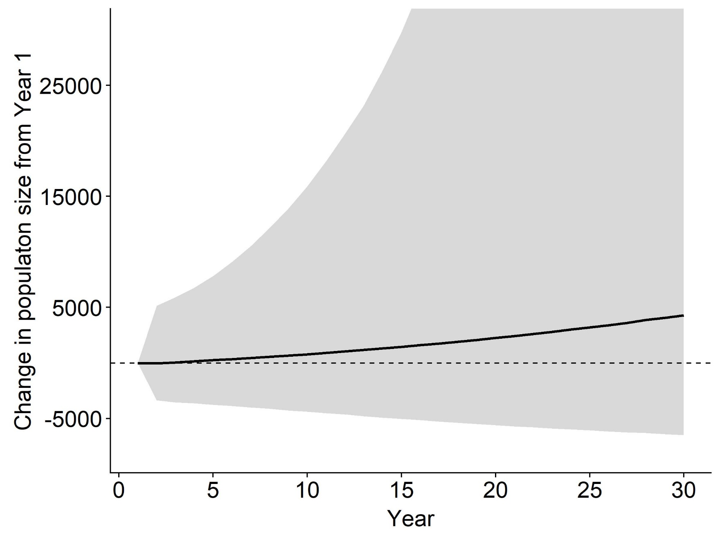
Zoomed in view of previous figure

Slide 18
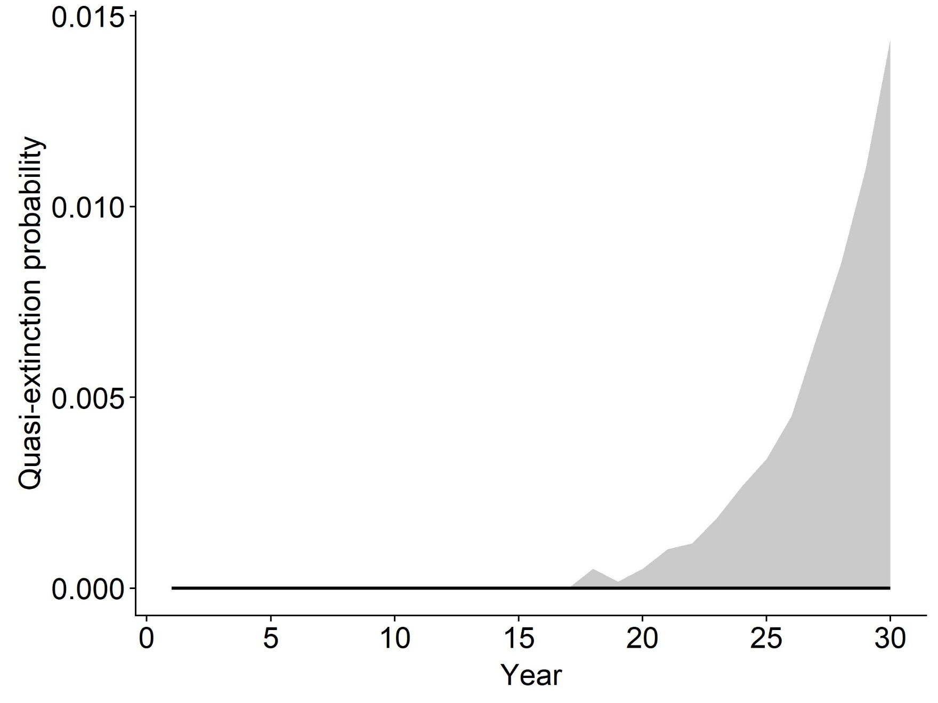
Quasi-extinction threshold = 50

Slide 19
Potential future scenarios
Change in land cover
For example, increase the amount of urban, decrease natural
Use PR GAP land cover raster to determine current relative coverage of each habitat type
Add severe storm events
Specify how severe weather impacts demographic rates (for example, 50% reduction in survival)
Specify frequency of storm events impacting each habitat type
Impacts of invasive predators?
Implemented as an effect on survival probability of young and/or juveniles

Slide 20
Next steps
Population ceiling?
Estimates of current population size and/or occurrence
Decide on future scenarios to implement

