Slide 1
Activity 4

Slide 2

The Turquoise Skipper
Use the information provided to develop an analysis plan for this rare butterfly
Your plan should include:
An assessment of the available data/information
A planned analysis to understand the current conditions for the species and key ecological needs, stressors, and threats
A planned stochastic projection model to predict the future state of the species under one or more scenarios

Slide 3
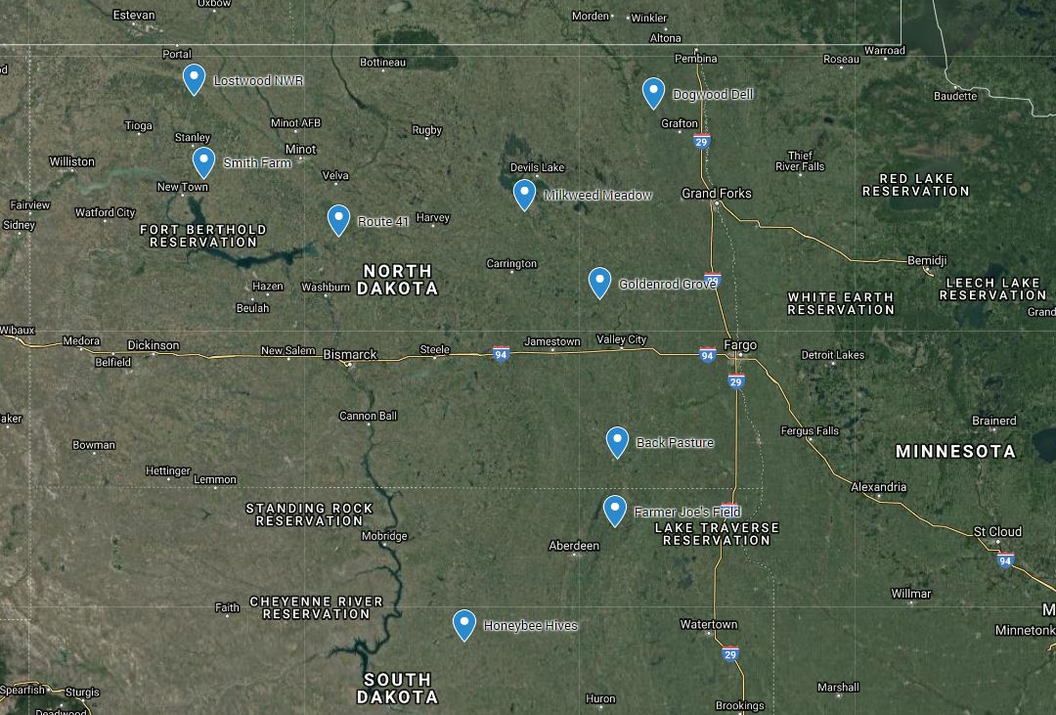
Found in the Prairie Potholes region
Data available from 9 sites

Slide 4
Demographic info in the literature
single generation per year
survive the winter as dormant eggs
overwinter survival of eggs is quite high (>90%) in the absence of early spring fires
females can lay up to 200 eggs in a single season
many caterpillars (>80%) die before pupating into adults
Eggs
Adults

Slide 5
Three data sources available
Lostwood National Wildlife Refuge
presence/absence data at several sites over 6 years
some information on habitat features and weather
Nature Conservancy
Transect surveys 3x per season from 1999-2009
No information about the habitat or other covariates
may be available from National Land Cover Data Base or NOAA weather data archives
BLM
Gathered old field notebooks and iNaturalist records
spanned 2 decades in the 1980s and 90s
several sites throughout the range
Various observers recorded the place, time, date and description of the number of butterflies

Slide 6
