Slide 1



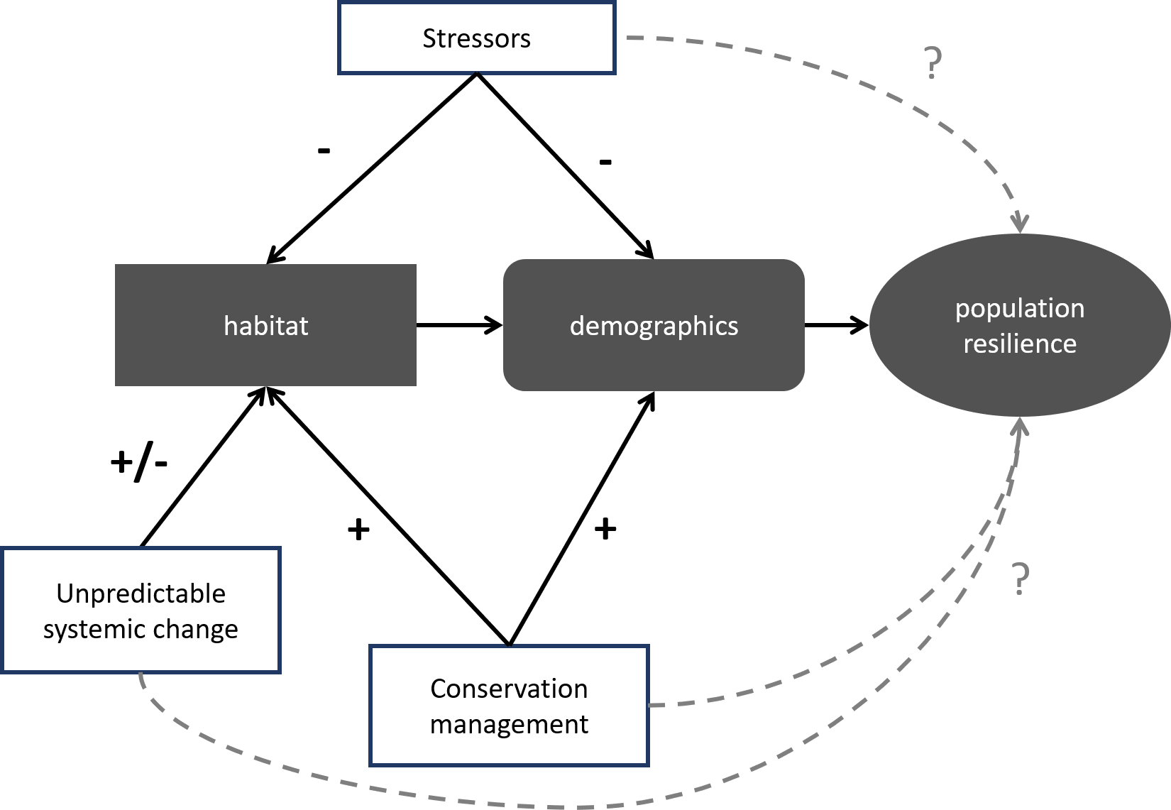
Course Announcement
Species Status Assessment 200 – Strategic use of data: describing population trends for SSAs
Course Description
This is a second course in the Species Status Assessment (SSA) instructional series to understand the basics of models to inform and enhance species status assessments under the Endangered Species Act. The purpose is to help students become comfortable assessing available data, predicting outcomes from mathematical trends, and communicating uncertainty related to those trends to a broader audience.
On day one, we will discuss statistical methods to evaluate the historical and current state of a species, including identifying the data types available and interpreting tables and figures in the scientific literature. On the second day, we will discuss projection models to predict the future population trends of species across alternative scenarios and how to communicate assumptions and outcomes effectively.
Dates & Location
December 3-4, 2019
FWS Region 6 Regional Office
134 Union Blvd.
Lakewood, CO 80228
Local Contact
Craig Hansen craig_hansen@fws.gov
303-236-4749
Who Should Attend
Fish and Wildlife Service biologists involved in conducting SSAs.
Length
2 days, 8 am to 5 pm each day
College Credit
Not applicable.
Tuition
There is no tuition.
To Register
Email the local contact of the class and request a place in the course.
Availability
Limited to 35 participants.
Suggested Accommodations
Fairfield Inn & Suites Denver West/Federal Center
140 South Union Blvd
Lakewood, CO 80228
Course Objectives
Upon completion of this course, you will be able to:
Become familiar with common terminology and approaches used in
population modeling including constraints, weaknesses, and underlying assumptions.
Identify an appropriate analytical approach for assessing the status of a species given the available data.
Communicate/understand relevant analytics and interpret population modeling results pertinent to an SSA.
Communicate population modeling results to decision makers as part of SSA results.

Slide 2
SSA 200 – Questions and Answers
Who is this course for? The material in this class is aimed at SSA practitioners, i.e. biologists who are involved in conducting SSAs for the Fish and Wildlife Service; particularly those who anticipate being involved in SSAs where rule sets and population models are appropriate to develop or where existing frameworks might be incorporated into the SSA.
Who are the instructors? Dr. Conor McGowan, U.S. Geological Survey, Acting Unit Leader, and Dr. Anna Tucker, Post-doctoral Fellow, from the Alabama Cooperative Fish and Wildlife Research Unit, School of Forestry and Wildlife Sciences, Auburn University.
Will I learn how to build population models? No. This is a course to help you know what you don’t know by understanding the different types of population models, their applications and limitations, and the terminology and basic structure of different models in published literature, reports, and conversation. For an introductory course on direct modeling, check out NCTC’s Modeling for Endangered Species Management, CSP2304.
Is this an NCTC-sanctioned training course? No, not yet, but we’re working on it. The course format will be structured and formal, like an NCTC course, but we have not made this an NCTC course. We might do that in the future, but this is the pilot offering, and we want to see how the course is received.
What’s the difference in the SSA 200 course and the Modeling for Endangered Species Management coure? The Modeling for Endangered Species Management course by NCTC is intended to teach biologists how to build population models. Our SSA 200 is an overview of the basics of population modeling so you can communicate better with modelers and better understand when to apply a model. We recommend the Modeling for Endangered Species Management course if you are planning to actually create population models. The SSA 200 course is aimed at everyone else who is involved in SSAs and needs to have a basic knowledge about population models.
Who’s paying for this? There is no tuition for the course. The instructors’ travel have been paid by FWS, Region 6, Ecological Services. Travel costs for students participating in the course will need to be paid by their home office.
Will there be other opportunities to take the course? Presumably yes, but other courses have not yet been scheduled. We are anticipating offering the course for the national Species Assessment Team (RO/HQ Listing people) and SSA Framework Implementation Team. Future course offerings will depend on the interest from other Regions and the availability of qualified instructors to lead the course.
Do I need to have taken the Introduction to Species Status Assessment course from NCTC before taking this course? Yes, it would be best if students had already taken the Intro to SSA course before this course. Exceptions could be made for students who have not taken the Intro to SSA course but have experience in conducting SSAs.

