Slide 1
Analysis of presence-type data
SSA 200

Slide 2
Presence only vs. Presence-absence data
Example 1: A National Park office often gets reports from people who have seen wolverines in the park. They keep track of the locations and dates of these sightings.
Example 2: A researcher conducts point counts for birds in the same forest plot every month from May – July each year. During point counts they make an effort to detect and record every species within the survey window.
Example 3: A natural history museum has plant specimens that contain information about the location and date of collection.
Example 4: iNaturalist has over 29,000 recorded observations of Monarch butterflies from across their range dating back to 2009.
Presence only
Presence-absence
Presence only
Presence only

Slide 3
Do I have true absences in my data?
Presence-absence
Presence only
Replicated surveys?
Number of years?
Yes
No
few
lots
Logistic regression
Site occupancy model
Dynamic occupancy model
Presence type models
Always check specific model assumptions!
Notes:
By the end of the lecture, you should have information to allow you assess presence type models.

Slide 4
Presence only data

Slide 5
Example data sources
Information about where/when a species was detected but NOT where/when it was looked for but not found
Opportunistic reporting by the public
Some eBird checklists (*complete checklists = presence-absence data)
Historical records (e.g. museum specimens, field notes)
Others?

Slide 6
Example questions
Where is this species found? (historic and current condition)
What ecological factors best predict its occurrence? (ecological needs)
Notes:
I thought that we weren’t talking about the future projections until lecture 7? This is confusing

Slide 7
Common analysis approaches
Species Distribution Modeling
Paired points
Notes:
What is this image from? Credit the image. This is a good general conceptual diagram of all of the methods.

Slide 8
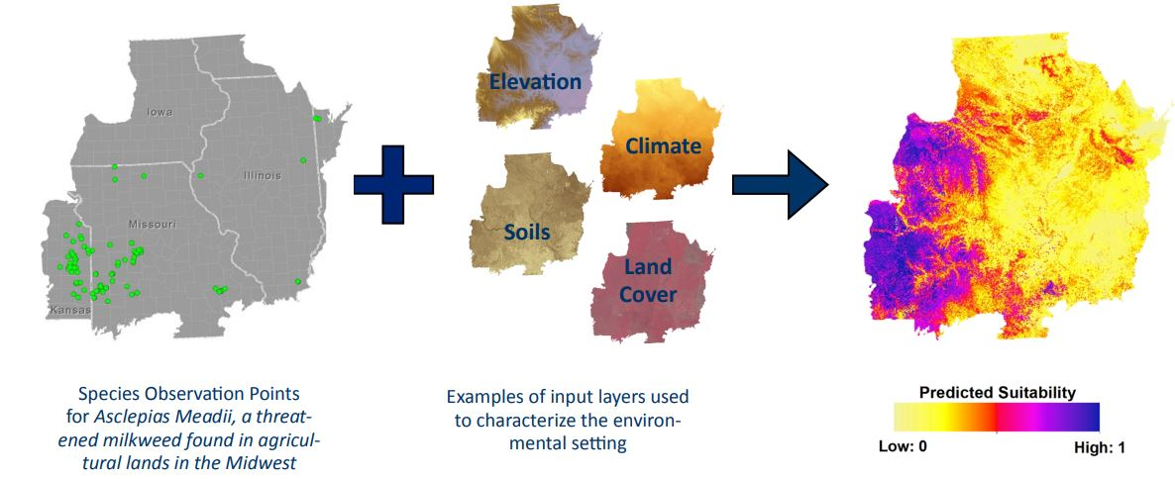
Species distribution modeling
Habitat suitability models
When your data covers a broad spatial scale/most of known range
Inputs
Outputs

Slide 9
Presence data models
Method(s) | Model/software name | Data type
Climatic envelope | BIOCLIM | Presence-only
Gower Metric | DOMAIN | Presence-only
Ecological Niche Factor Analysis (ENFA) | BIOMAPPER | Presence/background
Maximum Entropy | MAXENT | Presence/background
Genetic algorithm | GARP | Presence/pseudo-absence
Regression: Generalized linear model (GLM) and Generalized additive model (GAM) | GRASP | Presence/absence
Artificial Neural Network (ANN) | SPECIES | Presence/absence
Classification and regression trees (CART), GLM, GAM and ANN | BIOMOD | Presence/absence
Boosted decision trees | (implemented in R) | Presence/absence
Multivariate adaptive regression splines (MARS) | (implemented in R) | Presence/absence
Notes:
Here is a giant list of the models you might run into; now, we’ll break it down into a few examples.

Slide 10
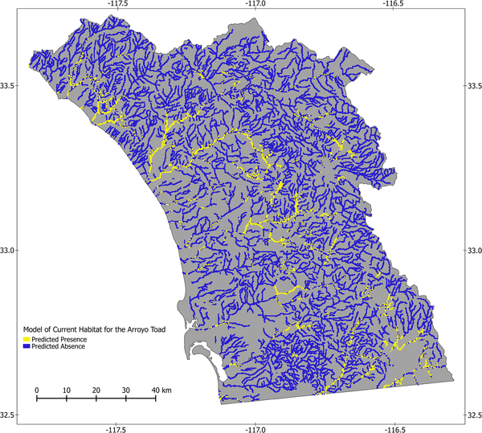
Estimated current distribution of the arroyo toad in southwestern California.
Data sources:
USFWS localities
HerpNet records
Museum records
Treglia ML, Fisher RN, Fitzgerald LA (2015) Integrating Multiple Distribution Models to Guide Conservation Efforts of an Endangered Toad. PLOS ONE 10(6): e0131628. https://doi.org/10.1371/journal.pone.0131628
Notes:
We obtained locality data for arroyo toads from the U.S. Fish and Wildlife Service (http://www.fws.gov/carlsbad/GIS/CFWOGIS.html) and we also used museum records from the following institutions, accessed through the HerpNet data portal (http://herpnet.org/): California Academy of Sciences; Natural History Museum of Los Angeles County; San Diego Natural History Museum; Smithsonian National Museum of Natural History; and University of California, Berkeley, Museum of Vertebrate Zoology. We included data from Cleveland National Forest [43,44], and our own surveys conducted as part of the U.S. Geological Survey (USGS) Amphibian Research and Monitoring Initiative (ARMI; http://armi.usgs.gov/) and the San Diego Monitoring and Management Program (SDMMP; http://sdmmp.com). Datasets were accessed in September 2013.

Slide 11
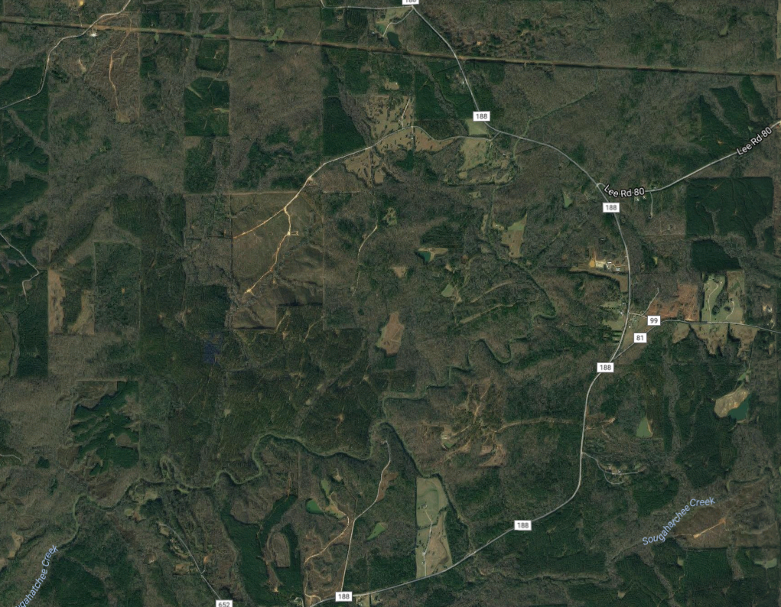
Common analysis approaches
Species Distribution Modeling
Paired points – when you have a more limited spatial coverage of observations
Randomly select nearby points as “pseudo-absences” – places where the species could have been reported, but wasn’t

Slide 12
Generating “pseudo-absences”
Several methods to generate “pseudo-absences”
Entire range/study area
Within some specified distance of each observation
Constrained by environmental variables
Place random points from the background around your observations
Points similar based on the climatic/biological datasets, but where no observation occurred
Different methods of generating background points or pseudo-absences have different assumptions
Generates a dataset of 0s and 1s – use logistic regression to estimate effects of environmental covariates

Slide 13
Logistic regression
A type of generalized linear model where the y variable is drawn from the Binomial distribution
Response variable consists of 1s and 0s (“successes” and “failures”)
Forms the basis for many more complex models
Occupancy analysis
Survival analysis
Resource selection
Assumes perfect detection of the species where it occurs

Slide 14
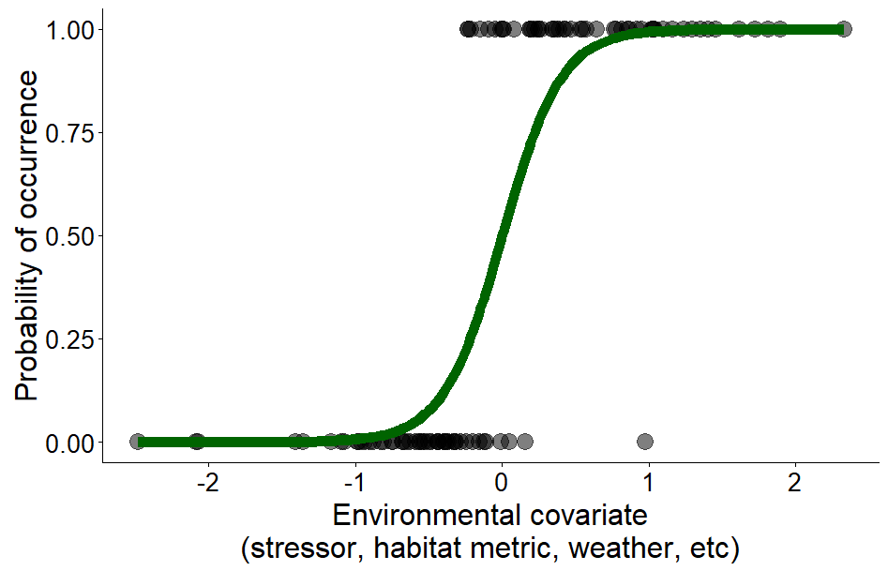
Logistic regression

Slide 15
Some caveats about presence-only models*
Temptation for overfitting
Potential observation bias
Be careful with extrapolation (both spatial and temporal)
Omission & commission errors
*and modeling in general
Notes:
Interpreting outputs using literature example

Slide 16
Some caveats about presence-only models
Temptation for overfitting
The number of terms in the model should not exceed the number of observations
Consider ecologically-relevant environmental variables to include
Notes:
Interpreting outputs using literature example

Slide 17
Overfitting
Simpler
Worse fit
More useful
More complex
Best fit
Less useful
Notes:
Simpler models usually depict more simple trends
The complex yellow model does not account for variation in individuals or measurement error when making predictions.

Slide 18


Slide 19
Some caveats about presence-only models
Temptation for overfitting
Potential observation bias
Notes:
Interpreting outputs using literature example

Slide 20
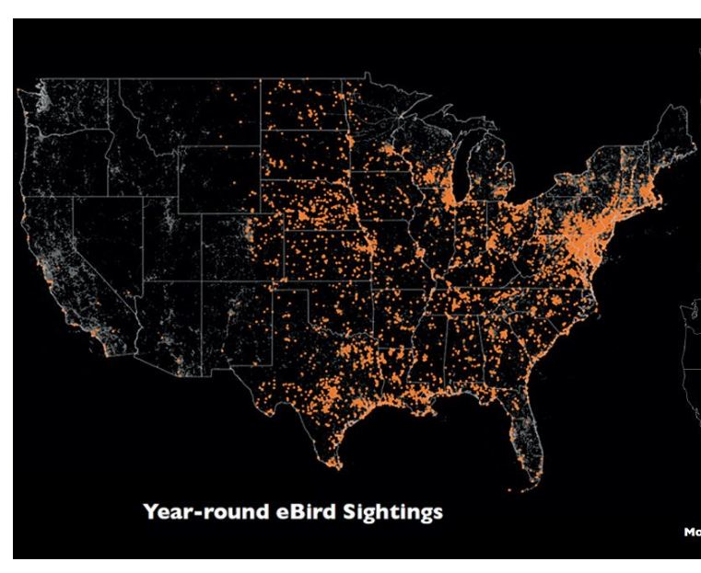
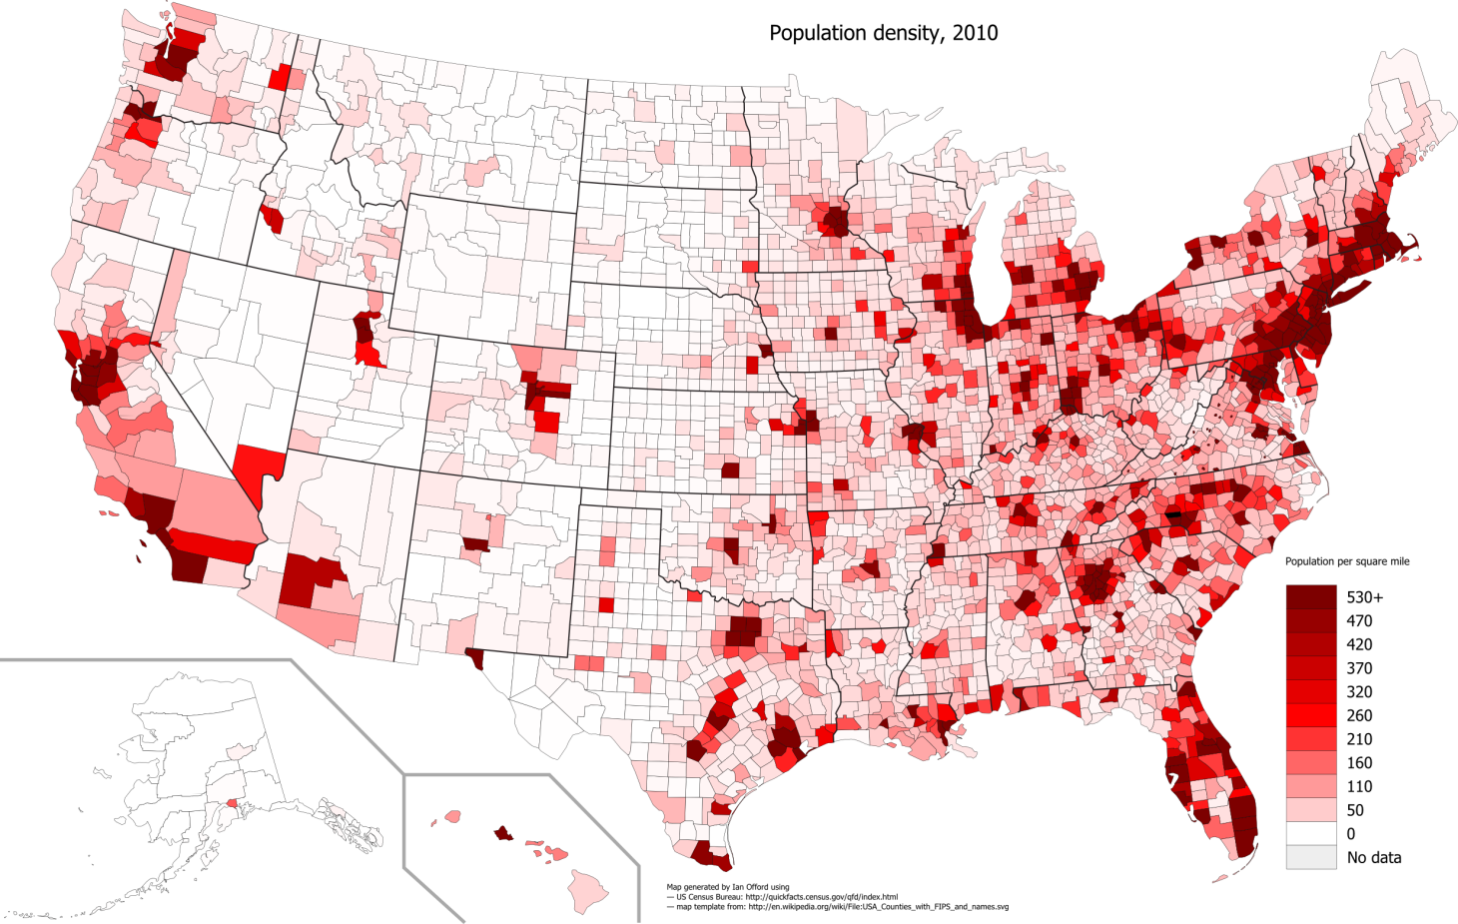
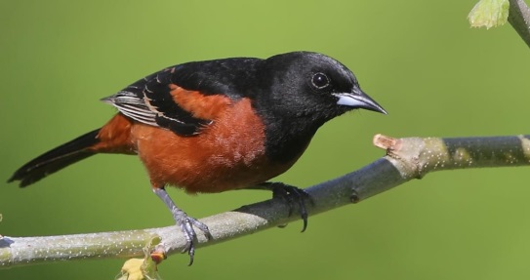
Observation bias
Human population density, 2010 US Census
Notes:
Ebird sightings of orchard oriole

Slide 21
Some caveats about presence-only models
Temptation for overfitting
Potential observation bias
Qualify any extrapolation you make
Potential translocation site, historic records from that area, etc.

Slide 22
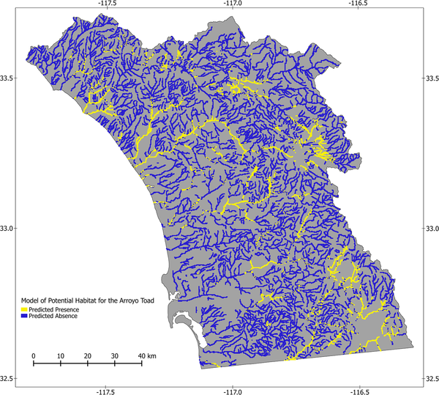
Extrapolation
Notes:
In conservation you might extrapolate to an area where a species was lost – in that case, for eg here for Arroyo Toads, you could then make conservation habitat a part of it.

Slide 23
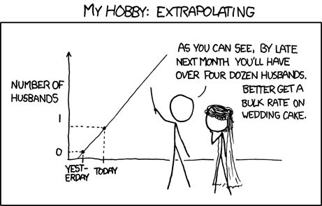
Extrapolation

Slide 24
Some caveats about presence-only models
Temptation for overfitting
Potential observation bias
Qualify extrapolation
Omission & commission errors
Notes:
Interpreting outputs using literature example

Slide 25
Omission and commission errors
Actual geographic distribution
Predicted geographic distribution
Underprediction,
or Omission
Overprediction,
or Commission
Notes:
Threshold statistics you might run into if you use a subset of data to test the models:
true positive (TP) rate (TPR) = TP/P
false positive rate (FPR) =FP/N
accuracy (ACC) = (TP + TN) / (P + N)
Model performance statistics you will run into:
area under the receiver operating curve (AUC): range 0.5–1.0. Models values >0.9 are considered to have high performance

Slide 26
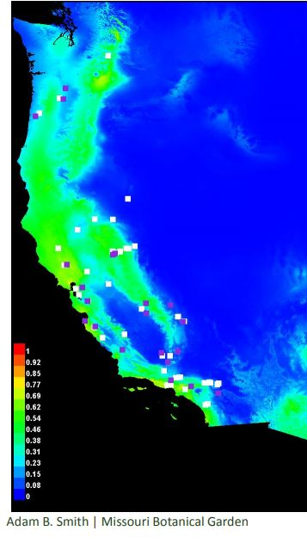
Assessing SDM performance
Purple = training points
White = testing points
Withhold a subset of occurrence records from modeling and use them to test model performance (cross-validation)
Fit model with training points
Test model with test/validation points
Calculate performance metrics:
True positive rate
False positive rate
True negative rate
False negative rate
Depend on user-defined thresholds
Model predicted probability of occurrence
Beechy’s ground squirrel

Slide 27
Assessing SDM performance – AUC
perfect prediction (AUC = 1)
Plot receiver operator curve
AUC = Area Under the Curve
Measure of model performance
1
random guess (AUC = 0.5)
True positive rate
better
worse
0
0
False positive rate
1

Slide 28
Presence-absence data

Slide 29
Example data sources
Information about where/when a species was detected AND where/when it was looked for but not found
Transect surveys
Point counts
Any other systematic survey effort
Complete eBird checklists
Others?

Slide 30
Example research questions
What habitat characteristics are associated with species presence and absence? (ecological needs, stressors)
What is the distribution of a species in a given area? (Representation, Redundancy)
How has that distribution shifted over time? (e.g. due to habitat loss, invasive species, etc.)
What is the extent of the species range?
To what extent does this species co-occur with other species?
Species interactions, exclusion, etc.
How many species are found in this area?
Notes:
Difficult to parse apart observation/detection probability from true occurrence probability

Slide 31
Common analysis approaches
Logistic regression
Assumes perfect detection

Slide 32
Common analysis approaches
Logistic regression
Site-occupancy models

Slide 33
When is occupancy analysis appropriate?
Presence/absence data
Multiple sites (to estimate effects of ecological covariates)
Repeated visits in a closed period (to estimate detection probability)
Assume that true occupancy of a given site does not change between visits
Need to be collected within a short enough time-frame for this to be reasonable—depends on species of interest
Notes:
Multiple sites not necessary for the analysis, but needed to estimate effect of ecological covariates.

Slide 34
Sampling
Replication is key
Spatial – multiple, randomly selected sites or sampling units within the area of interest
Temporal – repeated visits to each site
Visit 1
Visit 2
Visit 3
Notes:
Difficult to parse apart observation/detection probability from true occurrence probability

Slide 35
Example occupancy data set
Site | Date | Species detected?
A | 6/27/2006 | Yes
B | 6/28/2006 | Yes
C | 6/25/2006 | No
A | 7/3/2006 | No
B | 7/5/2006 | Yes
C | 7/2/2006 | No
A | 7/12/2006 | Yes
B | 7/11/2006 | Yes
C | 7/13/2006 | Yes
Site | Visit 1 | Visit 2 | Visit 3
A | 1 | 0 | 1
B
C
Site | Visit 1 | Visit 2 | Visit 3
A | 1 | 0 | 1
B | 1 | 1 | 1
C
Site | Visit 1 | Visit 2 | Visit 3
A | 1 | 0 | 1
B | 1 | 1 | 1
C | 0 | 0 | 1
Site | Visit 1 | Visit 2 | Visit 3
A
B
C
Notes:
Difficult to parse apart observation/detection probability from true occurrence probability

Slide 36
Visit a site
Species is present
Species is not present
Detected
Not detected
Detected
Not detected
Notes:
Potential of underestimating occupancy is this is not taken into account

Slide 37
Site is closed during this time
True presence/absence of the species does not change
Confirmed present
Site | Visit 1 | Visit 2 | Visit 3
A | 1 | 0 | 1
B | 1 | 1 | 0
C | 0 | 1 | 1
D | 0 | 0 | 0
Likely absent?
Notes:
What is the detection probability of this species?

Slide 38
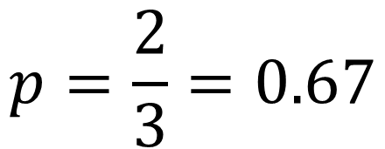


Each site visited three times,
species detected twice at each site
$$p=\frac{2}{3}=0.67$$
Probability the species is not detected if present:
Site | Visit 1 | Visit 2 | Visit 3
A | 1 | 0 | 1
B | 1 | 1 | 0
C | 0 | 1 | 1
D | 0 | 0 | 0
$$1−0.67=0.33$$
Probability the species is not detected three times if present:
$$0.33∗0.33∗0.33=0.04$$
Notes:
What is the detection probability of this species?

Slide 39
Detection probability
Generally considered a “nuisance parameter”, not of ecological interest
Analyses that also estimate detection probability produce estimates of the ecologically-interesting parameter (e.g. occupancy) that are adjusted for detection
Detection process and covariates that could influence detection (e.g. weather, visibility) important to consider in designing an analysis

Slide 40
Assumptions of occupancy models
Sites are closed to changes in occupancy between sampling occasions
Appropriate duration between surveys
Detection process is independent at each site
Appropriate distance between sites
Both detection probability and occupancy probability are constant across all sites OR explained by covariates
For example, if we think rainfall influences our ability to detect the species, then rainfall should be included in the model

Slide 41
Model parameters
ψ_{i} = probability that site i is occupied
p_{i,t} = probability of detecting the species in site i at time t, given that the species is present
β_{k} = effect of covariate k on occupancy (or detection) probability
Positive or negative?
“significant” effect? – does the confidence interval contain 0?
Importance of covariates often assessed by comparing models using AIC
* Check text and captions for notation definitions within each paper – not always consistent!

Slide 42
What influences occupancy probability?
Potential stressors and threats included as covariates
Site characteristics (e.g. land cover, vegetation)
Weather (rainfall, temperature)
Distance to other occupied sites
… etc. …

Slide 43
Parameter(predictor variables)
Relative support for each model (Relative to the model with the lowest AIC)
If ΔAIC > 2 then top model has the most support
Model weight – another way to assess relative support
Model | AIC | ΔAIC | Np | w_{i}
S(time) p(.) | 684 | 0 | 5 | 0.98
S(.) p(.) | 693 | 9 | 2 | 0.01
S(time) p(time) | 698 | 14 | 10 | 0.01
S(time + sex) p(time) | 710 | 26 | 12 | 0
Usually listed in decreasing order
Number of parameters
(sometimes called k)
AIC is a relative measure of support only!
One model will always have the lowest AIC
Doesn’t necessarily mean it is a good model!

Slide 44
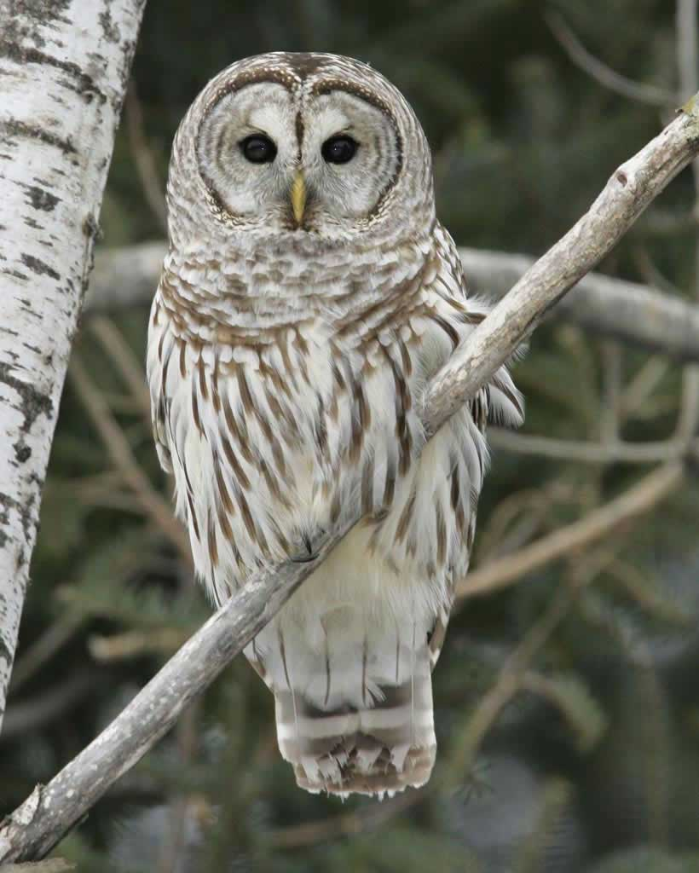
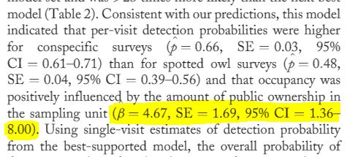
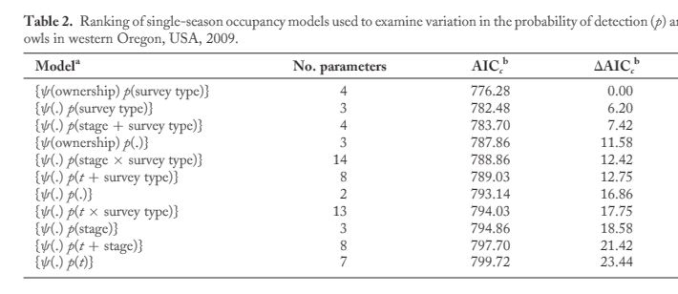
Wiens et al 2011. Barred Owl Occupancy Surveys Within the Range of the Northern Spotted Owl. Journal of Wildlife Management

Slide 45
Common analysis approaches
Logistic regression
Site-occupancy models
Dynamic occupancy models
Notes:
Difficult to parse apart observation/detection probability from true occurrence probability

Slide 46
Dynamic occupancy models
Estimate change in occupancy over time (colonization and extinction)
1
P
1
0
P
E
1
C
E
0
1
1 - C
0
Time 1
Time 2
Time 3

Slide 47
Dynamic occupancy models
closed
closed
closed
 | Year 1 |  |  | Year 2 |  |  | Year 3
Site | Visit 1 | Visit 2 | Visit 3 | Visit 1 | Visit 2 | Visit 3 | Visit 1 | Visit 2 | Visit 3
A | 1 | 0 | 1 | 0 | 0 | 0 | 0 | 1 | 0
B | 1 | 1 | 0 | 0 | 1 | 1 | 1 | 0 | 1
C | 0 | 1 | 1 | 1 | 0 | 1 | 0 | 0 | 0
D | 0 | 0 | 0 | 0 | 1 | 0 | 1 | 1 | 0

Slide 48
Common analysis approaches
Logistic regression – lacking spatial and/or temporal replication
Site-occupancy models – single year, several sites
Dynamic occupancy models – several years, several sites
Account for imperfect detection
Assume detection is perfect
Notes:
Difficult to parse apart observation/detection probability from true occurrence probability

Slide 49
Do I have true absences in my data?
Presence-absence
Presence only
Replicated surveys?
Number of years?
Yes
No
few
lots
Logistic regression
Site occupancy model
Dynamic occupancy model
Presence type models
Always check specific model assumptions!
Notes:
By the end of the lecture, you should have information to allow you assess presence type models.

