Slide 1
Analysis of demographic data
SSA 200

Slide 2
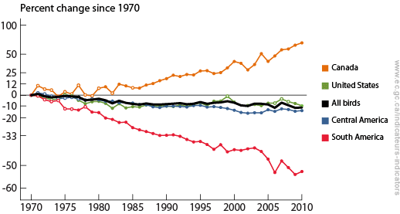
Estimating population vital rates
Can use counts to model change in population size and the effect of covariates
Intrinsic population characteristics govern population dynamics
Stressors and threats often act directly on these rates
This can help guide conservation actions to where it will be the most helpful and examine effects of potential management actions

Slide 3

Change in population size
births
-
=
+
immigration
deaths
emigration
-
$$λ$$
Fecundity/Recruitment
Nest/den monitoring
Reproductive success/failure
Number of offspring produced
Age ratios
Survival
Individual capture-mark-recapture
Radio telemetry
Apparent survival
Individual capture-mark-recapture
Radio telemetry
Notes:
Immigration and especially emigration are often very difficult to estimate. Therefore estimation of survival probability typically cannot distinguish true mortality from permanent emigration, or individuals that have permanently left the study area. Therefore what we

Slide 4
Demographic data types
Many different types, depends on ecology/life history of species of interest
Number of broods/litters per season
Breeding site fidelity
Etc.
Data types
Number of offspring per female
Ratio of young to adults (or size classes)
Nest/den success or failure
Number of young returning next year
Individual mark-recapture/resight
Radio telemetry
Others?
Demographic vital rate
Fecundity
Recruitment probability
Survival probability (seasonal or annual)
Breeding success probability
Notes:
Note that receiving demographic data may be unlikely, but published scientific literature can be a good source of estimated survival, fecundity, etc.

Slide 5
Estimating fecundity
From a population growth perspective, recruitment into breeding population is more important than fecundity
A product of many events: reproductive success, juvenile survival, site fidelity/dispersal
Often easier to collect data on breeding success than recruitment
Can estimate from individual-level data (nest/den success) or population-level data (ratio of young to adults)

Slide 6
GLMs to estimate fecundity
Include ecological covariates to determine important drivers of breeding success
Type of GLM depends on response variable
Number of offspring per female → Poisson GLM
Successful breeding (yes/no) → Binomial GLM

Slide 7
Estimating survival/mortality
Radio telemetry → known fate models
Assume perfect detection of individuals
Individual capture-mark-recapture → Cormack-Jolly-Seber (CJS) models
Data can come from a variety of sampling methods
Physical recapture (trapping array)
Photographic re-encounter (camera traps)
Re-sightings (field-readable tags, individually-identifiable marks)
Noninvasive genetic sampling (hair snares, scat collection)
Assume imperfect detection of individuals
Notes:
What kind of regression is the core of survival analysis?

Slide 8


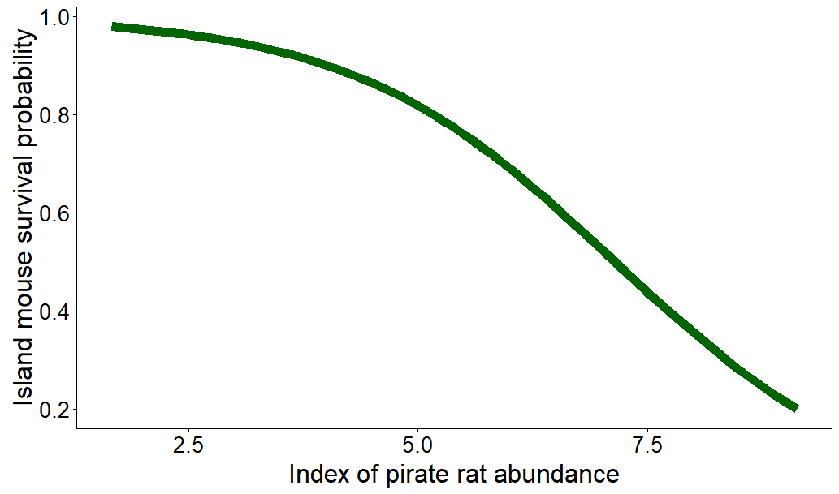

Linking survival probability to covariates
Logistic regression is at the heart of survival estimation
If $β_{1}$ > 0, then pirate rate abundance has a positive effect on survival
If $β_{1}$ < 0, then pirate rate abundance has a negative effect on survival
$$logit\left(S\right)=β_{0}+β_{1}∗Pirate rat abundance$$

Slide 9
Matrix models for age- or stage-structure
When vital rates vary by age or stage (e.g. size), matrix models are used to present and analyze demographics
Individuals always advance linearly through stages (they can’t shrink or become younger)
Young of the year
Juveniles
Adults

Slide 10




In each year, what proportion of the individuals in stage [column number]…
$$\left[\begin{matrix}0 & 0 & F \\ S_{Y} & 0 & 0 \\ 0 & S_{J} & 0\end{matrix}\right]$$
Transition into stage [row number]
$$F_{}$$
Young of the year
$$S_{Y}$$
Juveniles
$$S_{J}$$
Adults

Slide 11
Building a matrix model
Can use combination of methods to fill in vital rates
Published in the literature
Primary analysis of data
Expert opinion

Slide 12
Applications of matrix models
Which vital rate has the strongest effect on changing population growth rate (λ)?
Elasticity/sensitivity analysis
Implications for choosing conservation actions

Slide 13

Loggerhead sea turtle matrix model
“Slow” life history
Sexual maturity at 17-33 years
Lifespan 47-67 years
Key threats:
Predation of eggs and small juveniles
Mortality due to fishing trawls
Loss of nesting habitat
Difficult to study
Worldwide movements
Hard to determine age
Crouse et al 1987
Crowder et al 1994

Slide 14
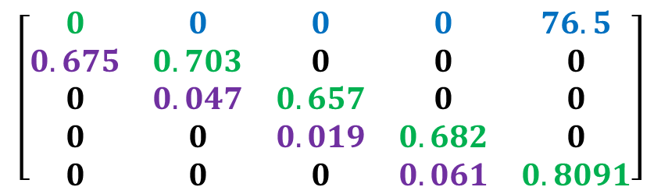
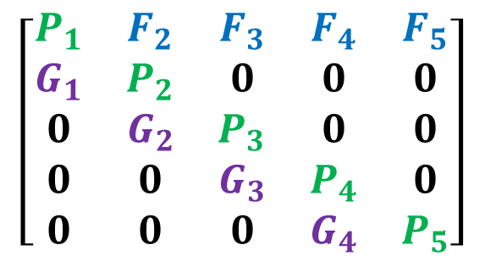
Stage-structured matrix model
$$\left[\begin{matrix}P_{1} & F_{2} & F_{3} & F_{4} & F_{5} \\ G_{1} & P_{2} & 0 & 0 & 0 \\ 0 & G_{2} & P_{3} & 0 & 0 \\ 0 & 0 & G_{3} & P_{4} & 0 \\ 0 & 0 & 0 & G_{4} & P_{5}\end{matrix}\right]$$
Five stages:
Eggs/hatchlings
Small juveniles
Large juveniles
Subadults
Adults
Three demographic rates:
Fertility
Probability of surviving and remaining in the current stage
Probability of surviving and Growing into the next stage
1 2 3 4 5
$$\left[\begin{matrix}0 & 0 & 0 & 0 & 76.5 \\ 0.675 & 0.703 & 0 & 0 & 0 \\ 0 & 0.047 & 0.657 & 0 & 0 \\ 0 & 0 & 0.019 & 0.682 & 0 \\ 0 & 0 & 0 & 0.061 & 0.8091\end{matrix}\right]$$
Gathered data on survival and reproductive rates from other published studies

Slide 15
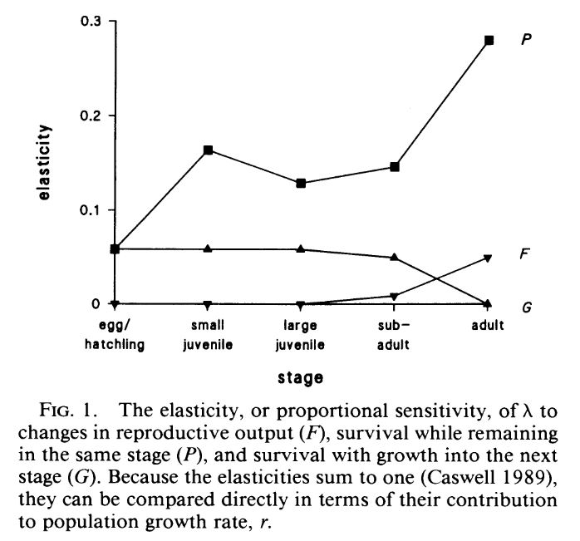
Probability of survival
TEDs
Effect on population growth rate
Fecundity
Nest protection
Probability of growing to the next stage
Notes:
By calculating the elasticity of each vital

Slide 16
Multistate models
Used to estimate transition probabilities among different physical sites or biological states
Look similar to matrix models, but individuals can move back and forth between states
Breeder/non-breeder status
Disease status
Movement among study areas
Very flexible and applicable to a range of situations

Slide 17





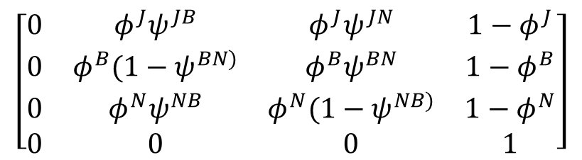


Example – breeding/non-breeding status
Breeding adult
$${1−φ}^{B}$$
$$ψ^{JB}$$
Juvenile
$${1−φ}^{J}$$
Dead
$$ψ^{BN}$$
$$ψ^{NB}$$
Non-breeding adult
$${1−φ}^{N}$$
$$ψ^{JN}$$
J B N D
J
B
N
D
$$\left[\begin{matrix}0 & φ^{J}ψ^{JB} & φ^{J}ψ^{JN} & 1−φ^{J} \\ 0 & φ^{B}(1−ψ^{BN)} & φ^{B}ψ^{BN} & 1−φ^{B} \\ 0 & φ^{N}ψ^{NB} & φ^{N}(1−ψ^{NB)} & 1−φ^{N} \\ 0 & 0 & 0 & 1\end{matrix}\right]$$

Slide 18
Extensions of multistate models
Range of applications, not just individual mark-recapture data
Used in both estimation and projection
Migratory connectivity
probability of moving among multiple breeding and wintering sites
Multistate occupancy analysis
change in occupancy state of sites (e.g. many, few, or none detected, detected with and without breeding activity, etc.)
Ecological succession
change in dominant land cover type over time

Slide 19
Integrated Population Models (IPMs)
Relatively new approach to combining all sources of demographic information into one analysis
Typically counts, mark-recapture, and some measure of fecundity
Pros:
More precise estimates of demographic rates
Can potentially estimate things you don’t have explicit data about (usually these things are hard to measure)
Immigration/emigration, juvenile survival
Can directly project population into the future while propagating all uncertainty
Cons:
More complicated analysis, requires more time/expertise to develop

Slide 20
Non-integrated analysis
Data input
Analysis
Output
Counts
N-mixture model
Abundance estimate
Mark-recapture
Survival analysis
Survival probability
Number of offspring/female
Poisson GLM
Average fecundity

Slide 21
Integrated analysis
Data input
IPM
Output
Counts
Abundance estimate
N-mixture model
Mark-recapture
Survival probability
Survival analysis
Number of offspring/female
Average fecundity
Poisson GLM

Slide 22

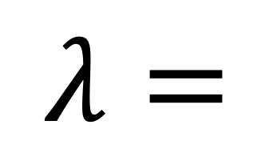
Change in population size
births
-
=
+
immigration
deaths
emigration
-
$$λ$$
$$λ=$$

Slide 23
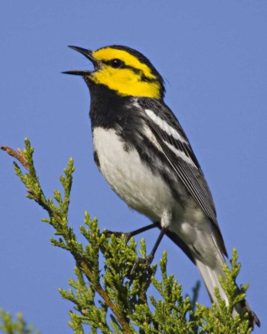
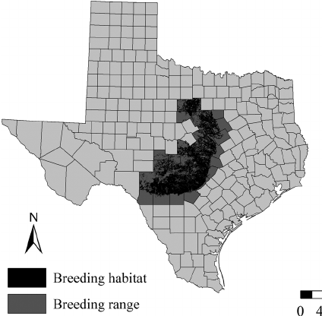
Do I need to use an IPM?
Core assumption = all data are a product of the same underlying population processes
Most useful when:
Individual analyses of different data sources give competing results
You want to estimate a demographic parameter without data (e.g. immigration rate)

