Slide 1
Day 2 - Introduction
SSA 200

Slide 2
Data models yesterday…
We reviewed some methods for analyzing data:
Descriptive
Occupancy
Count data, etc.
Focused on estimating population parameters and ecological relationships
Also estimated observation uncertainties (e.g., detection) and environmental variation

Slide 3
Today…
Making predictions for the future!
Use results of previous data analysis (yesterday’s focus)
Accounting for demographic and environmental Stochasticity
Accounting for “parametric uncertainty”

Slide 4


All models are wrong, but some models are useful – G. Box

Slide 5
Projection models are focused on
Creating useful predictions
Do not require all system details
Decision context dependent
As simple as possible to be useful

Slide 6
Projection modeling platforms
Rely on repeated execution codes/functions to project over time and replicate the projection
Programs:
MS Excel
Netica
RAMAS, Vortex, PopTools
R, MatLab, SAS, Python, etc.

Slide 7
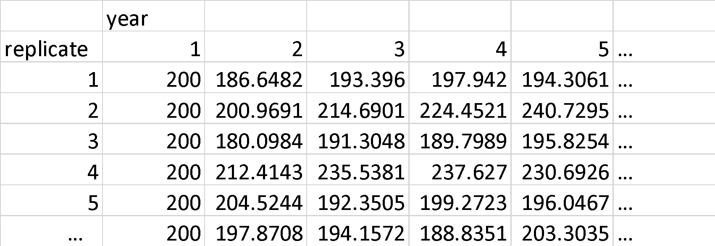
Time projections and replications
Repeat a set of instructions (function) over a number of years
Replicate that process multiples of times
estimate variability in predictions

Slide 8
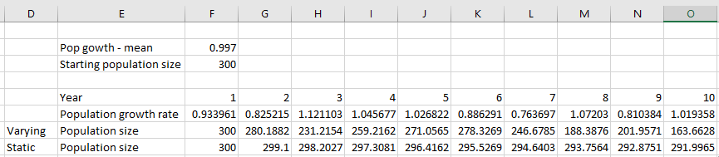
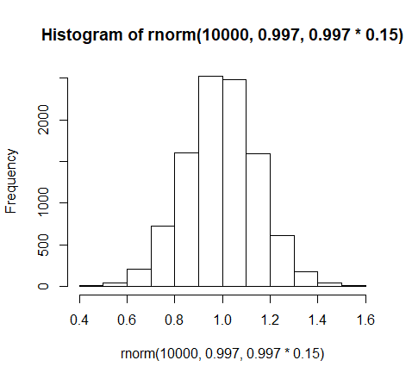
Variation over time
Population growth model where population growth varies by time

Slide 9
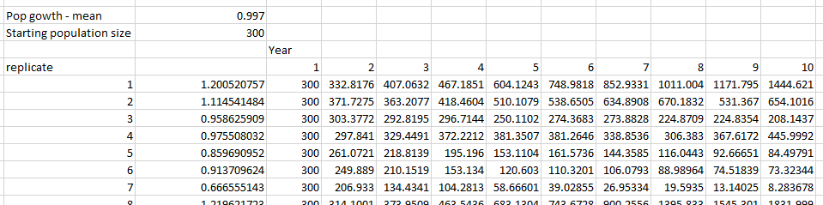
Parametric and temporal variability

Slide 10
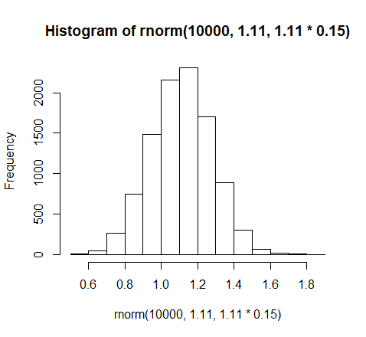
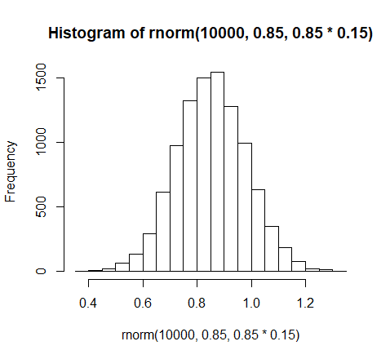
Parametric and temporal variability

Slide 11
Parametric and temporal variability

Slide 12
Projection models for today
Occupancy / site persistence models
Multi-state occupancy models
λ growth models and Poisson projection models
Demographic/matrix projection models
Key issues
Conceptual → quantitative
Linking population parameters to environmental variables
Environmental stochasticity and parametric uncertainty
Sensitivity analyses

Slide 13
Questions?

