Slide 1
Demographic projections with matrix population models
SSA 200

Slide 2
Applications to SSAs
Output useful metrics on future resiliency and redundancy
Future abundance, extinction probability, population growth rate
Use understanding of species’ life history to predict future condition of the populations and characterize uncertainties
Can be useful when little monitoring data exists (e.g., occupancy, current abundance) but we know a lot about species’ life history from the literature and/or captive populations
Notes:
Uses for matrix population models
Assessing extinction risk of single population
Comparing relative risk of two or more populations
Analyzing and synthesizing monitoring data
Identifying key life stages or demographic processes for management
Determining reserve size required to gain desired level of protection
Determine how many individuals to release to establish a new population
Setting limits on harvest or take
Deciding how many populations are needed to protect a species from regional or global extinction

Slide 3
Lecture outline
Building a matrix model
Accounting for uncertainty and stochasticity
Implementing future scenarios
Not just for demographic matrix models!

Slide 4
Lecture outline
Building a matrix model
Accounting for uncertainty and stochasticity
Implementing future scenarios

Slide 5
Building the demographic matrix model
Draw a life cycle diagram to understand key ages/stages that should be included
Young of the year
Juveniles
Adults

Slide 6
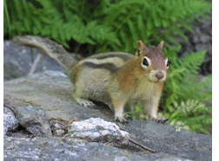
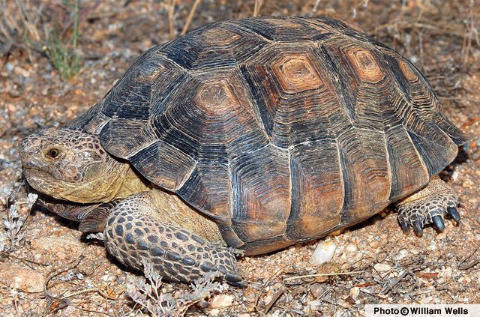
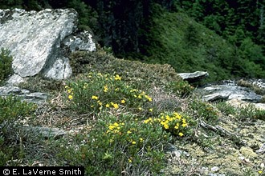
Structuring the life cycle model
Age classes (Leslie Matrix)
Equal time intervals & all individuals advance at next time
Short lived species with age-specific data
Stage classes (Lefkovitch Matrix)
Unequal time intervals
Population divided by developmental stage or size
Difficult to age individuals but can get length, height, etc.
Juvenile, subadult
Seeds, dormancy, small plants, large plants
Notes:
Leslie Matrices (P.H. Leslie 1945)
Age class specific matrix model → Golden-mantled ground squirrel (Callospermophilus lateralis)
Hostetler et al. 2012. Stochastic Population dynamics of a montane dwelling squirrel. Plos One 7(3) e34379.
Lefkovitch Matrix (L.P. Lefkovitch 1965)
Stage class matrix models
Sonoran Desert Tortoise (Gopherus morafkai)
McGowan et al. 2017. Incorporating population viability models into species status assessment and listing decisions under the U.S. Endangered Species Act. Global Ecology and Conservation 12:119-130.
Mountain Golden Heather (Hudsonia montana)
Morris and Doak 2002. Quantitative Conservation Biology: Theory and practice of population viability analysis.
SEE ALSO – Program R, ‘popbio’ package for details on model and code with tutorials on MGH

Slide 7
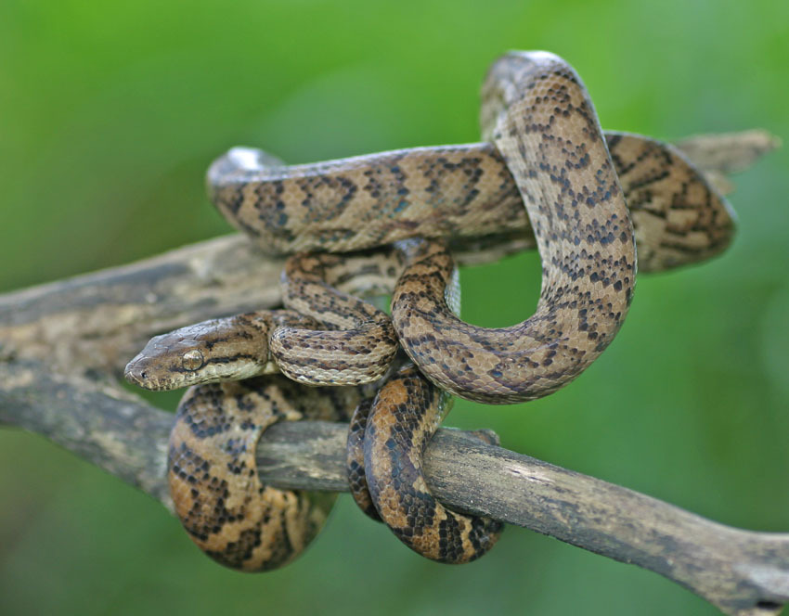
Puerto Rican boa
SSA in prep

Slide 8

Young
(<60 cm)
Juvenile
(60-90 cm)
Sub-adult
(90-110 cm)
Adult
(>110 cm)
Notes:
Arrows represent transitions in a one year time step

Slide 9
Building the model
Draw a life cycle diagram
Estimate vital rates (e.g., stage-specific survival probability, fecundity)

Slide 10
A number for each arrow
Data analysis
Fecundity
Number of offspring/female -> Poisson GLM
Successful breeding (yes/no) -> Binomial GLM
Annual survival/mortality
Radio telemetry -> known-fate models
Individual CMR -> Cormack-Jolly-Seber (CJS) models
Proportion of marked plants alive next year
Literature review
Expert judgement
Y
J
S
A

Slide 11





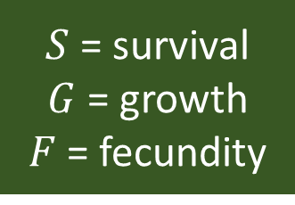




$S$ = survival
$G$ = growth
$F$ = fecundity
$$F^{A}∗S^{Y}$$
$$F^{S}∗S^{Y}$$
Young
(<60 cm)
Juvenile
(60-90 cm)
Sub-adult
(90-110 cm)
Adult
(>110 cm)
$$S^{Y}∗G^{Y}$$
$$S^{J}∗G^{J}$$
$$S^{S}∗G^{S}$$
$$S^{Y}∗(1−G^{Y})$$
$$S^{J}∗(1−G^{J})$$
$$S^{S}∗(1−G^{S})$$
$$S^{A}$$
Vital rates:
Annual survival of each stage (S)
Annual growth probability for each stage (G)
Annual fecundity for each stage (F)

Slide 12









$$4.5∗0.3$$
$$1∗0.3$$
Young
(<60 cm)
$$0.3∗0.67$$
Juvenile
(60-90 cm)
$$0.9∗0.5$$
Sub-adult
(90-110 cm)
$$0.72∗0.25$$
Adult
(>110 cm)
$$0.3∗(1−0.67)$$
$$0.9∗(1−0.5)$$
$$0.72∗(1−0.25)$$
$$0.9$$
Demographic rates were estimated by the expert team or drawn from the literature

Slide 13
Building the model
Draw a life cycle diagram
Estimate vital rates
Construct the population matrix and use it to project the population into the future

Slide 14
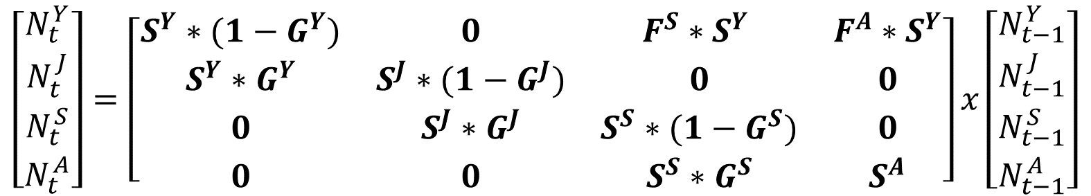
$S$ = survival
$G$ = growth
$F$ = fecundity
$$F^{A}∗S^{Y}$$
$$F^{S}∗S^{Y}$$
Young
(<60 cm)
Juvenile
(60-90 cm)
Sub-adult
(90-110 cm)
Adult
(>110 cm)
$$S^{Y}∗G^{Y}$$
$$S^{J}∗G^{J}$$
$$S^{S}∗G^{S}$$
$$S^{Y}∗(1−G^{Y})$$
$$S^{J}∗(1−G^{J})$$
$$S^{S}∗(1−G^{S})$$
$$S^{A}$$
$$\left[\begin{matrix}N_{t}^{Y} \\ N_{t}^{J} \\ N_{t}^{S} \\ N_{t}^{A}\end{matrix}\right]=\left[\begin{matrix}S^{Y}∗(1−G^{Y}) & 0 & F^{S}∗S^{Y} & F^{A}∗S^{Y} \\ S^{Y}∗G^{Y} & S^{J}∗(1−G^{J}) & 0 & 0 \\ 0 & S^{J}∗G^{J} & S^{S}∗(1−G^{S}) & 0 \\ 0 & 0 & S^{S}∗G^{S} & S^{A}\end{matrix}\right]x\left[\begin{matrix}N_{t−1}^{Y} \\ N_{t−1}^{J} \\ N_{t−1}^{S} \\ N_{t−1}^{A}\end{matrix}\right]$$

Slide 15
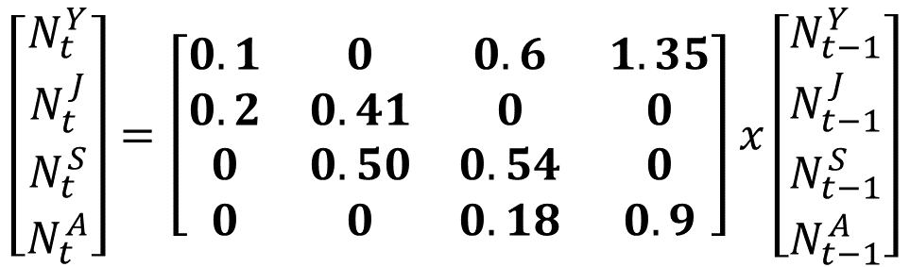


$S$ = survival
$G$ = growth
$F$ = fecundity
$$4.5∗0.3$$
$$2∗0.3$$
Young
(<60 cm)
$$0.3∗0.67$$
Juvenile
(60-90 cm)
$$0.9∗0.55$$
Sub-adult
(90-110 cm)
$$0.72∗0.25$$
Adult
(>110 cm)
$$0.3∗(1−0.67)$$
$$0.9∗(1−0.5)$$
$$0.72∗(1−0.25)$$
$$0.9$$
$$\left[\begin{matrix}N_{t}^{Y} \\ N_{t}^{J} \\ N_{t}^{S} \\ N_{t}^{A}\end{matrix}\right]=\left[\begin{matrix}0.1 & 0 & 0.6 & 1.35 \\ 0.2 & 0.41 & 0 & 0 \\ 0 & 0.50 & 0.54 & 0 \\ 0 & 0 & 0.18 & 0.9\end{matrix}\right]x\left[\begin{matrix}N_{t−1}^{Y} \\ N_{t−1}^{J} \\ N_{t−1}^{S} \\ N_{t−1}^{A}\end{matrix}\right]$$

Slide 16
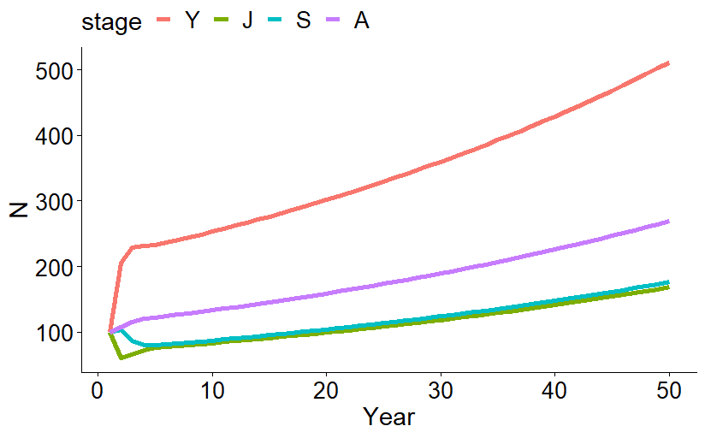
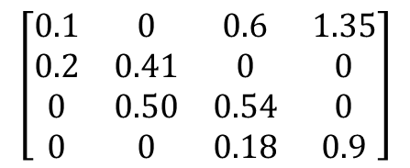
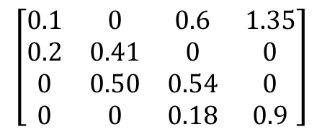
Year 1
Stage | N
Y | 100
J | 100
S | 100
A | 100
Total | 400
Year 2
Stage | N
Y | 205
J | 61
S | 104
A | 108
Total | 478
Year 3
Stage | N
Y | 229
J | 66
S | 87
A | 116
Total | 498
$$\left[\begin{matrix}0.1 & 0 & 0.6 & 1.35 \\ 0.2 & 0.41 & 0 & 0 \\ 0 & 0.50 & 0.54 & 0 \\ 0 & 0 & 0.18 & 0.9\end{matrix}\right]$$
$$\left[\begin{matrix}0.1 & 0 & 0.6 & 1.35 \\ 0.2 & 0.41 & 0 & 0 \\ 0 & 0.50 & 0.54 & 0 \\ 0 & 0 & 0.18 & 0.9\end{matrix}\right]$$
This is a deterministic projection--every time we run this model we would get the exact same output

Slide 17
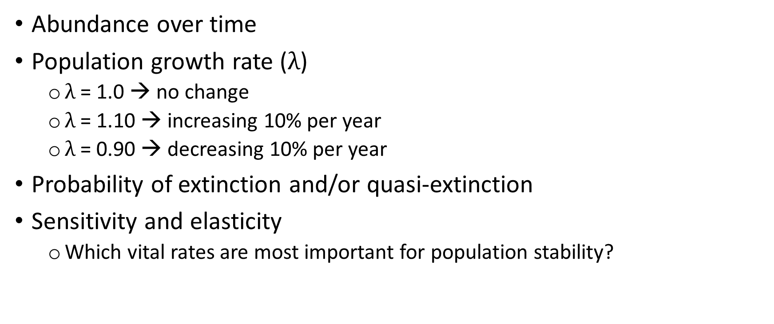
Matrix projection outputs
Abundance over time
Population growth rate ($λ$)
$λ$ = 1.0 → no change
$λ$ = 1.10 → increasing 10% per year
$λ$ = 0.90 → decreasing 10% per year
Probability of extinction and/or quasi-extinction
Sensitivity and elasticity
Which vital rates are most important for population stability?
Population Resiliency
Notes:
All of these outputs represent metrics useful for evaluating population resiliency
You can choose to use any combination (or all) of these metrics for presenting population resiliency

Slide 18
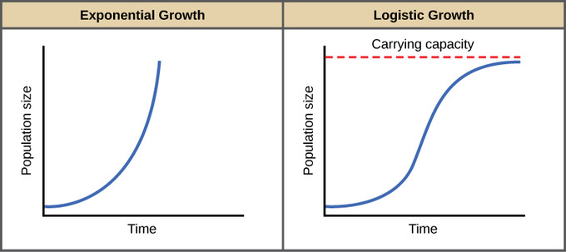
Density dependence
Most (all?) wildlife populations cannot grow exponentially forever
Allowing for exponential growth could lead to overestimating future abundance or population growth rate
Functional forms of density dependence poorly understood for most species

Slide 19
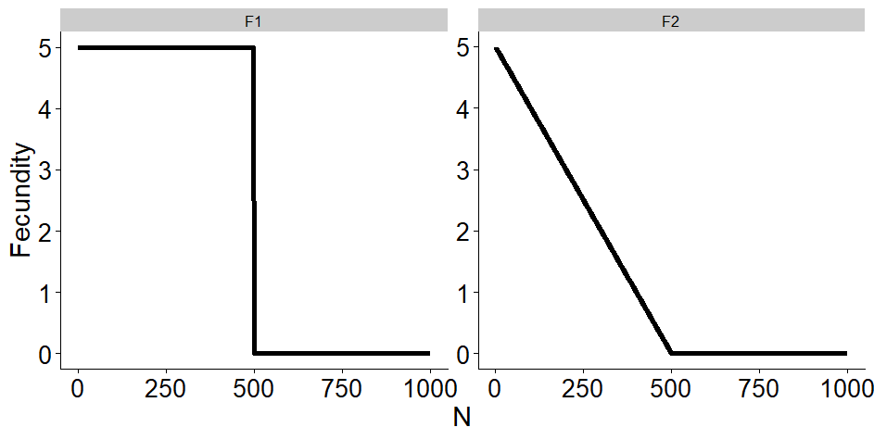
Modeling density dependence
Common approach: define a carrying capacity as a population ceiling, set a rule for how vital rates are affected by population size
If the population exceeds the carrying capacity, fecundity is equal to zero
OR, as the population approaches some ceiling threshold, fecundity gets smaller and smaller
Notes:
Modeling density dependence can be difficult because there is generally a large amount of uncertainty in its effects.
We can model it using two relatively simple approaches
Place a limit or threshold on the size of one or more classes, at which point the density dependent parameters is set equal to zero
Incorporate density dependent functions (similar to that in the previous figure) where as population size increases towards a threshold the density dependent parameter decreases

Slide 20
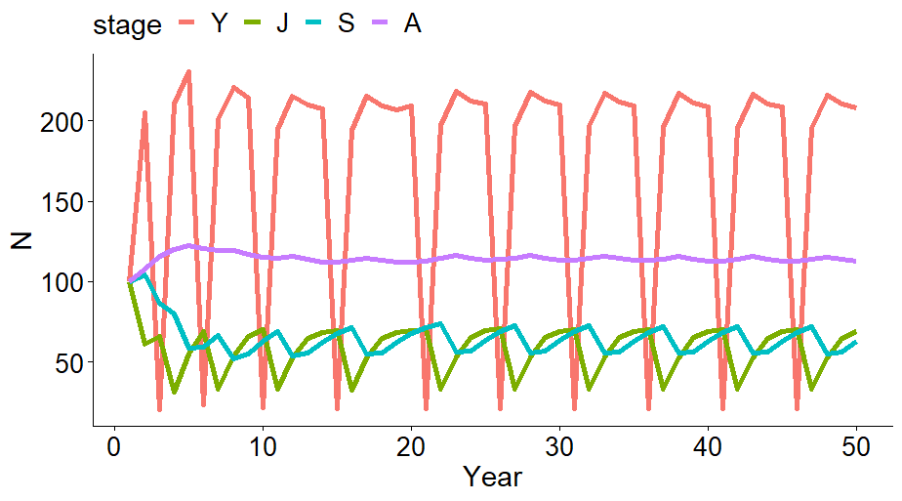
Density independent growth
Density dependent growth, K = 450
If total population size exceeded K, fecundity was set equal to 0

Slide 21
Lecture outline
Building a matrix model
Accounting for uncertainty and stochasticity
Implementing future scenarios

Slide 22
Accounting for uncertainty
Observational uncertainty
Environmental stochasticity
Demographic stochasticity
Failing to account for uncertainty and stochasticity can lead to overly precise projections (we would underestimate our level of uncertainty about the future state of the system)
Incorporate uncertainty via replicated projections

Slide 23
Observational uncertainty/parametric uncertainty
We cannot perfectly observe wildlife populations, and therefore we cannot perfectly measure vital rates
Vital rates are estimated with associated standard errors/confidence interval
Estimates of parametric uncertainty:
output of data analysis
should be reported in the literature where vital rates were presented
can be derived from expert elicitation

Slide 24
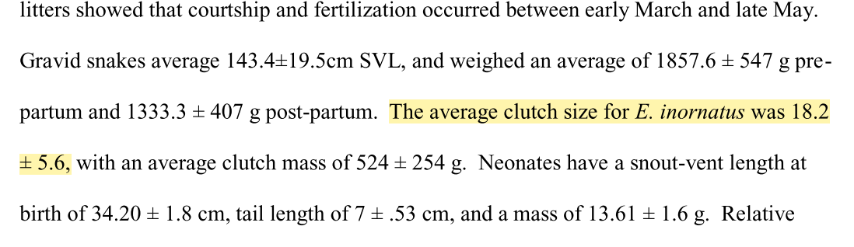
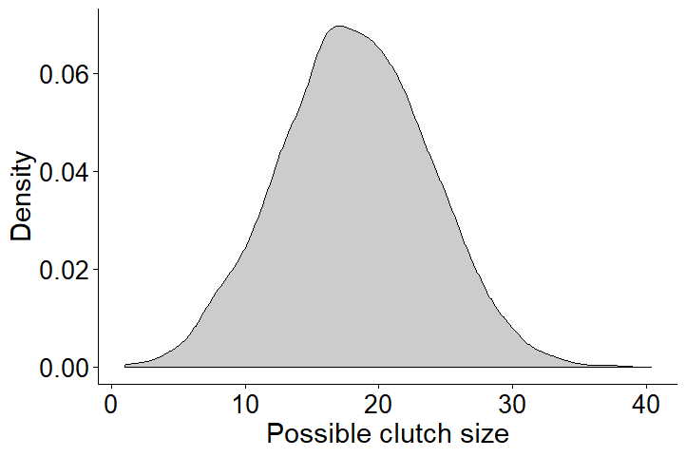
from Puente-Rolon (2012) (dissertation on reproductive ecology of Puerto Rican boa):
Clutch size = 18.2 ± 5.6

Slide 25
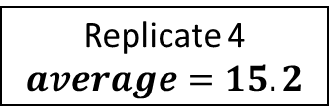

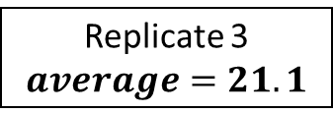
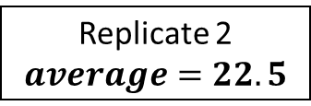

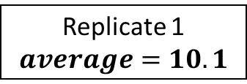
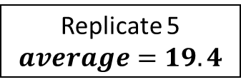
$$average=18.2$$
$$SD=5.6$$
Parametric uncertainty – uncertainty about the true average value
Draw a different average value for each replicate
Replicate 1
$$average=10.1$$
Replicate 2
$$average=22.5$$
Replicate 3
$$average=21.1$$
Replicate 4
$$average=15.2$$
Randomly draw one value per replicate
Replicate 5
$$average=19.4$$

Slide 26
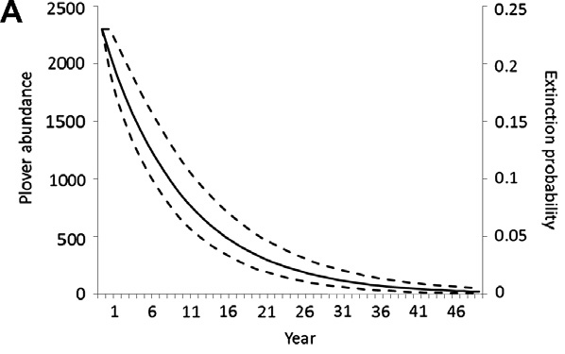
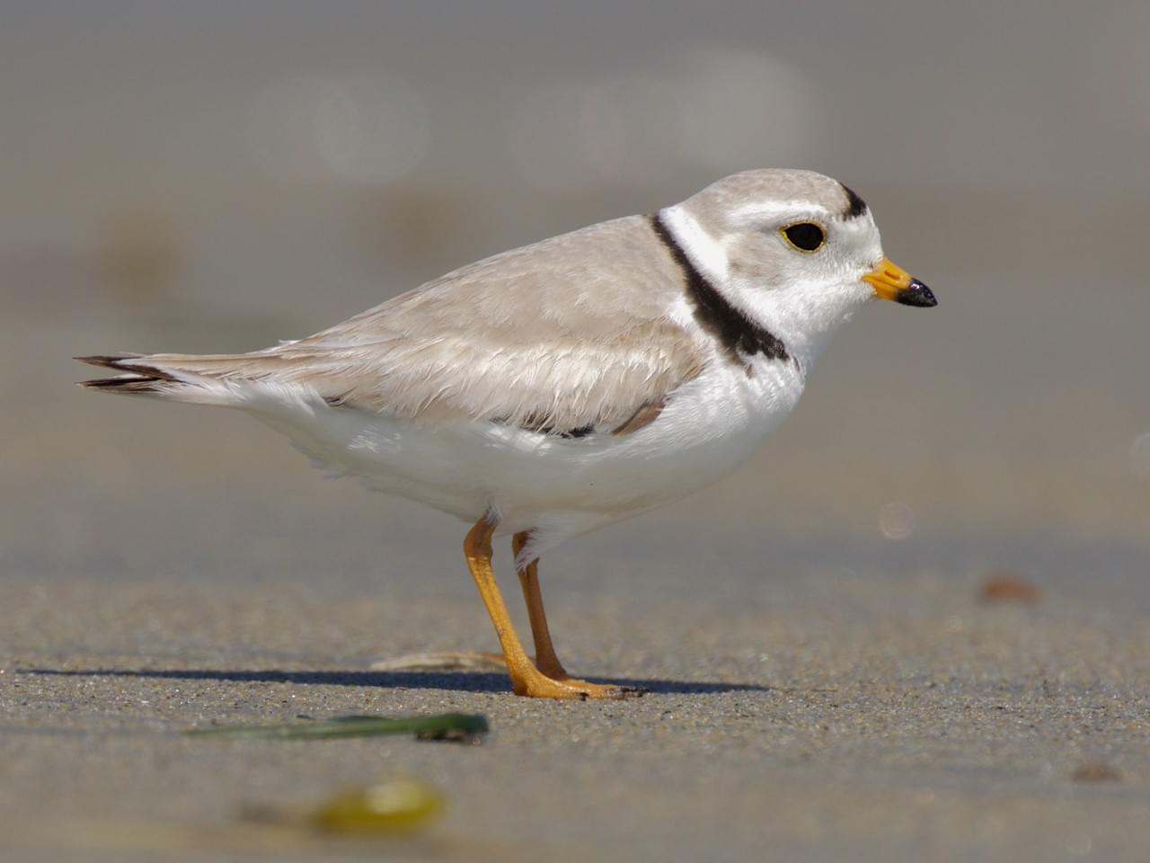
Projection without parametric uncertainty
Gates Dupont, Macaulay Library
McGowan, C. P., M. C. Runge, and M. a. Larson. 2011. Incorporating parametric uncertainty into population viability analysis models. Biological Conservation 144:1400–1408.
Notes:
In this figure, we have projected abundance of Plovers for 50 years and assumed that there was no sampling variance in the population size. This means we assume we know the population growth rate (or underlying demographic rates) perfectly. Therefore, when we project forward extinction probability is zero because at 50 years we are certain there is 1 or 2 individuals left in the population.
But that should sound terrifying to most of us…therefore,

Slide 27
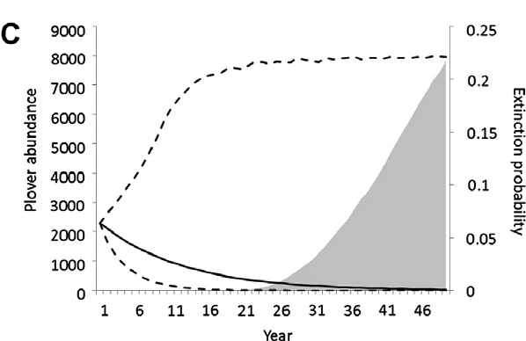
Projection with parametric uncertainty
Gates Dupont, Macaulay Library
McGowan, C. P., M. C. Runge, and M. a. Larson. 2011. Incorporating parametric uncertainty into population viability analysis models. Biological Conservation 144:1400–1408.
Notes:
We project the population including sampling variance and thus parametric uncertainty. Here we see that the probability of extinction (shaded gray) increases over time and confidence intervals increase representing more variability in predicted abundance. We want to represent this uncertainty!

Slide 28
Parametric uncertainty can be included for any input variable
Vital rates
Initial population size
Carrying capacity
Effects of stressors
etc

Slide 29
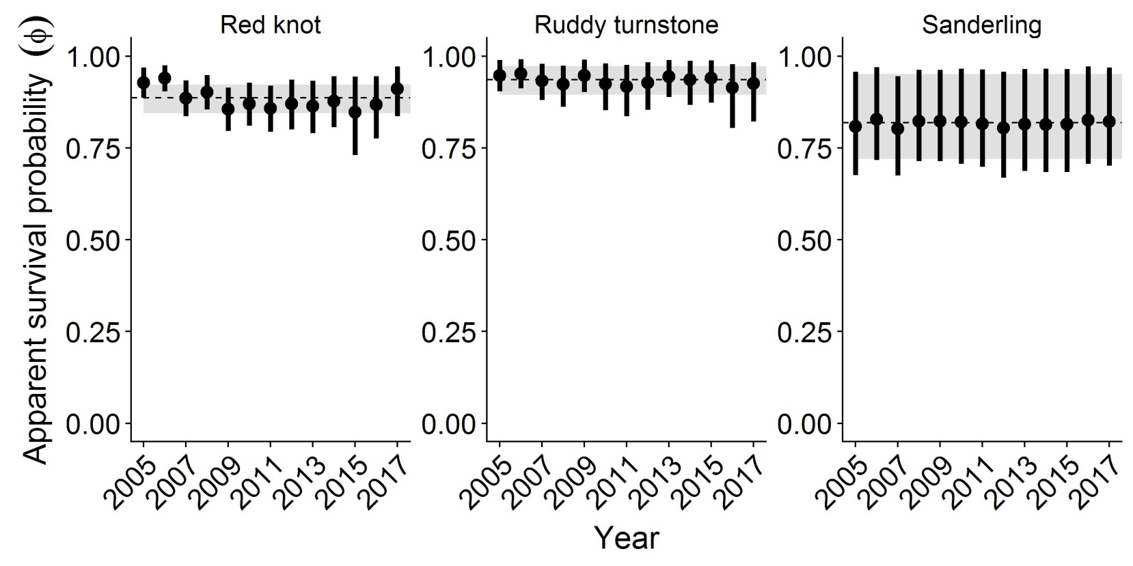

Environmental stochasticity
Realized demographic rates in a given year usually vary stochastically based on random variation in the environment
Estimating environmental stochasticity (process variation):
Analysis of long-term monitoring data (primary analysis or literature)
Expert elicitation
Assume that all demographic rates vary within some percent of the average among years
Year

Slide 30
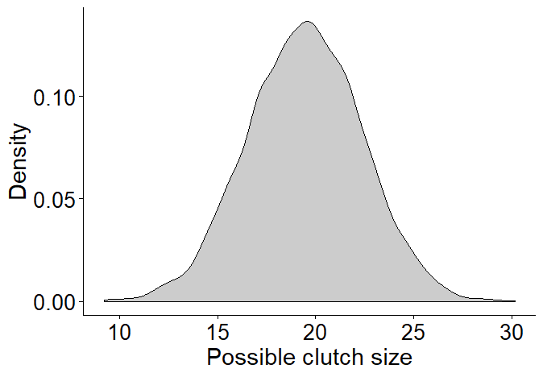
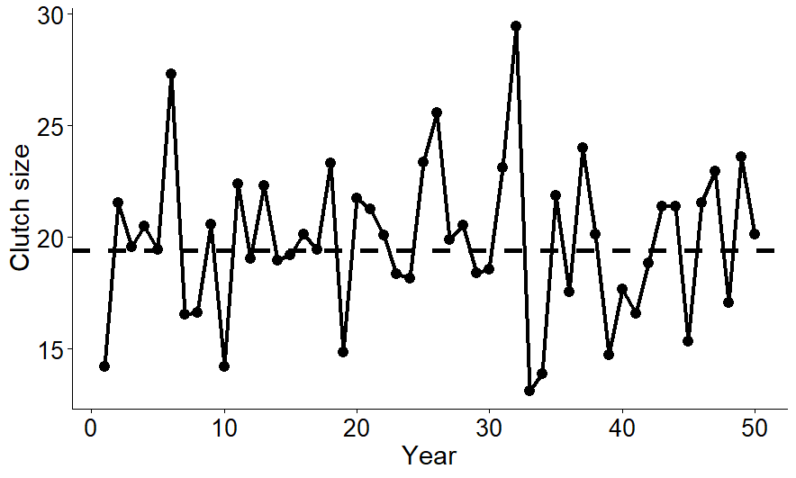
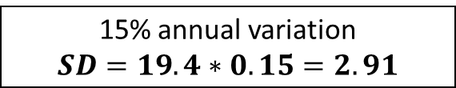
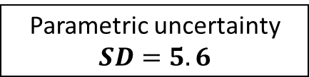
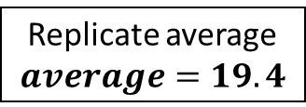
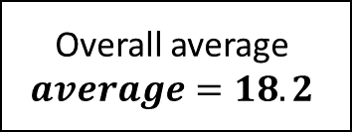
Overall average
$$average=18.2$$
Parametric uncertainty
$$SD=5.6$$
Replicate average
$$average=19.4$$
15% annual variation
$$SD=19.4∗0.15=2.91$$
Randomly draw one value per replicate
Randomly draw one value per year
Year-specific values
Parametric uncertainty – uncertainty about the true average value
Environmental stochasticity – random variation in realized rates from year to year

Slide 31
Demographic stochasticity
Animals live or die as whole animals - not as fractions
Without demographic stochasticity: If average survival probability = 0.8, 6 individuals * 0.8 = 4.8 individuals at the next time step
Demographic stochasticity refers to the random variation among individuals as to who lives or dies (or grows or reproduces) in a given year
With demographic stochasticity: Use Binomial distribution to determine who survives with probability = 0.8 for each “coin flip”
Especially important to consider for small populations
Notes:
Demographic stochasticity – chance independent events of individual survival and reproduction causing random fluctuations in population growth rate because birth and death of each individual is a discrete and probabilistic event.
Particularly important in small populations!
Typically get ignored in larger populations
Without accounting for demographic stochasticity (i.e. using a beta distribution or something else) the mean survival probability of 0.8 multiplied by a number of individuals will likely give you a fraction of individuals at the next time step.
In larger populations this tends to balance out
Modeling demographic stochasticity
Binomial distribution for survival
Poisson for fecundity
The number of individuals at the following time step will be a whole number
This sampling variation can result in numbers lower than expected from the mean (3 w/ ds, 4.8 without)
In small populations population growth rate will be lower than if it were not accounted for and extinction risk will increase

Slide 32
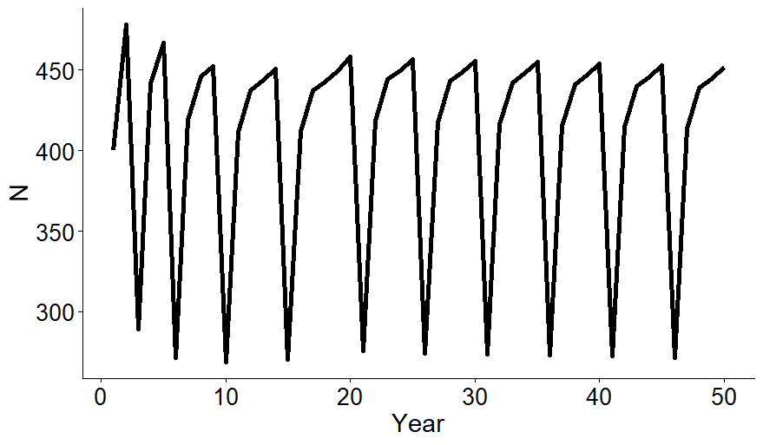
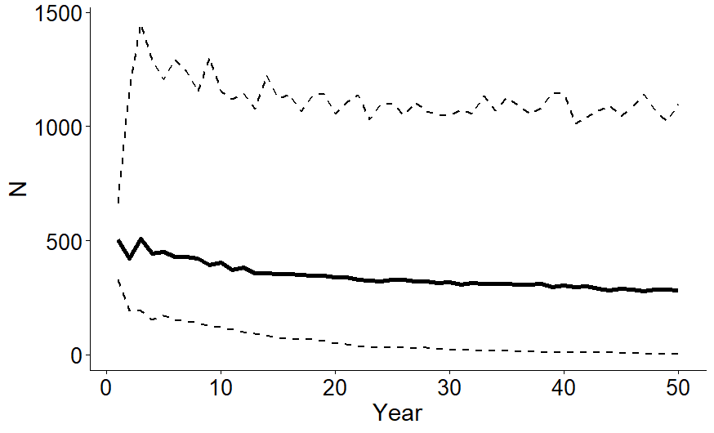
Stochastic projection with parametric uncertainty, environmental stochasticity, and demographic stochasticity (1000 reps)
Deterministic projection

Slide 33
Break?

Slide 34
Lecture outline
Building a matrix model
Accounting for uncertainty and stochasticity
Implementing future scenarios

Slide 35
Implementing future scenarios
Simpler
Use sensitivity analysis to inform how the population will respond to future conditions
Determine how environmental stressors and management actions will influence vital rates (arrows in the life cycle diagram), project the population under a few discrete scenarios
Use triple-loop replication to project the population under a range of possible conditions, evaluate the importance of stressors using GLM
More complex

Slide 36
Implementing future scenarios
Use sensitivity analysis to inform how the population will respond to future conditions

Slide 37

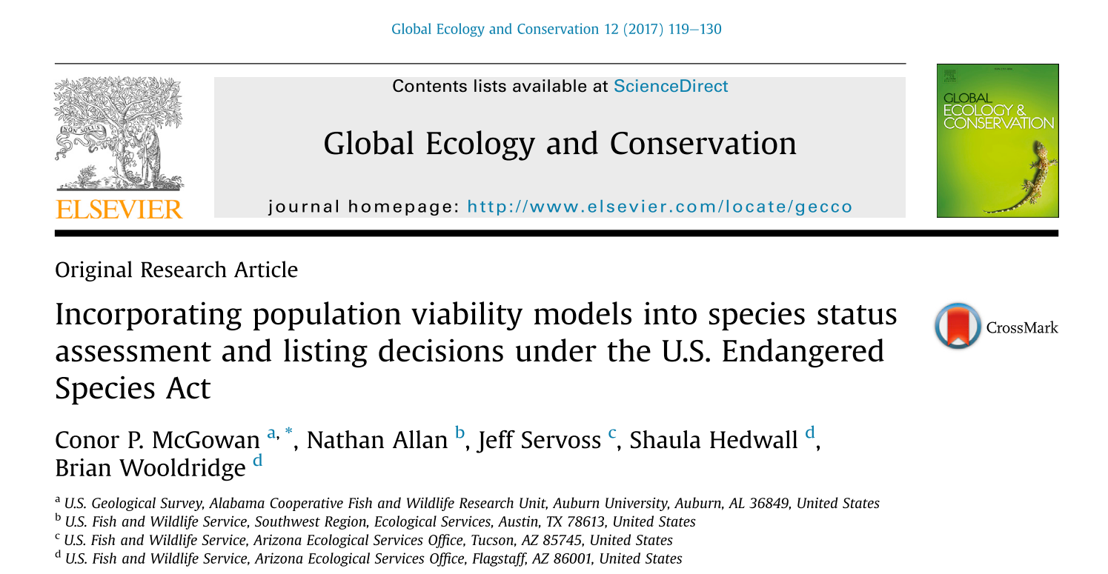
Sonoran desert tortoise

Slide 38


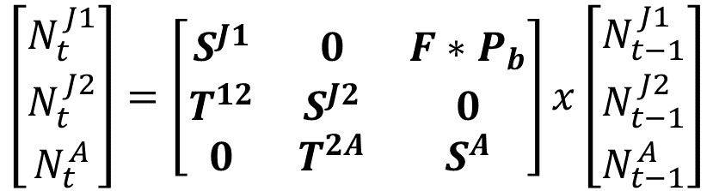





Sonoran desert tortoise life cycle model
$$F∗P_{b}$$
Young juveniles
Older juveniles
Adults
$$T^{12}$$
$$T^{2A}$$
$$S^{J1}$$
$$S^{J2}$$
$$S^{A}$$
$$\left[\begin{matrix}N_{t}^{J1} \\ N_{t}^{J2} \\ N_{t}^{A}\end{matrix}\right]=\left[\begin{matrix}S^{J1} & 0 & F∗P_{b} \\ T^{12} & S^{J2} & 0 \\ 0 & T^{2A} & S^{A}\end{matrix}\right]x\left[\begin{matrix}N_{t−1}^{J1} \\ N_{t−1}^{J2} \\ N_{t−1}^{A}\end{matrix}\right]$$

Slide 39
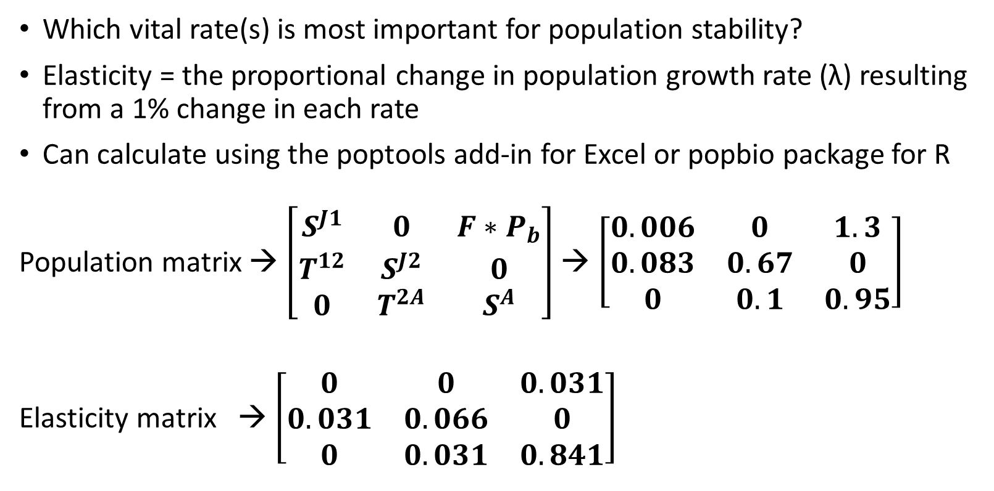
Sensitivity analysis
Which vital rate(s) is most important for population stability?
Elasticity = the proportional change in population growth rate (λ) resulting from a 1% change in each rate
Can calculate using the poptools add-in for Excel or popbio package for R
Population matrix → $\left[\begin{matrix}S^{J1} & 0 & F∗P_{b} \\ T^{12} & S^{J2} & 0 \\ 0 & T^{2A} & S^{A}\end{matrix}\right]$→ $\left[\begin{matrix}0.006 & 0 & 1.3 \\ 0.083 & 0.67 & 0 \\ 0 & 0.1 & 0.95\end{matrix}\right]$
Elasticity matrix → $\left[\begin{matrix}0 & 0 & 0.031 \\ 0.031 & 0.066 & 0 \\ 0 & 0.031 & 0.841\end{matrix}\right]$
Position with the greatest value corresponds to the vital rate that has the strongest effect on λ
1% change in adult survival will result in a 84.1% change in λ
Notes:
Note the changes in the matrix elements from F and S to little a’s
This is common practice in matrix models and generalizes the vital rates that go into a matrix
Remember, another way to represent a matrix is with a capital A, so the elements within A can be represented by little a’s
You can ignore the specifics of the equations for sensitivity and elasticity, but I want you to recognize that they are different
That is because sensitivity is the rate of change in population growth with respect to a change in any element of the matrix
Whereas, elasticity estimates the effect of a proportional change in demographic rates on population growth
* Elasticity is more useful because you can directly compare the effect of a 10% change in survival and a 10% change in fecundity even though they are traditionally on different scales (i.e. survival is between 0 and 1, and fecundity is between 0 and infinity).

Slide 40
Using elasticities to assess future conditions
Using sensitivity and/or elasticity output (example)
Results indicate population growth is most sensitive to adult survival
Conceptual modeling and lit review suggest that adult survival is negatively affected by drought frequency
Climate projections indicate that drought frequency will increase over next 50 years
What can we expect given this information?
Adult survival will likely decrease
Population growth will likely decrease
If climate predictions are accurate, future resiliency will decrease
Notes:
Emphasize simplicity of this “projection”
This is more of a qualitative assessment using quantitative information
BUT, we can model these scenarios and quantitatively determine the population resiliency to increased drought frequency!

Slide 41
Implementing future scenarios
Use sensitivity analysis to inform how the population will respond to future conditions
Determine how environmental stressors and management actions will influence vital rates (arrows in the life cycle diagram), project the population under a few discrete scenarios

Slide 42
Key threats = drought and habitat loss
Young juveniles
Older juveniles
Adults
Drought
Negative effect on survival of all stages
Habitat loss
Reduced carrying capacity

Slide 43
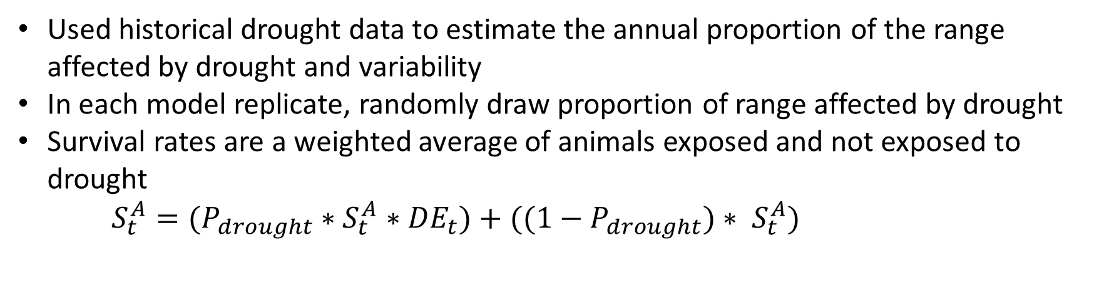
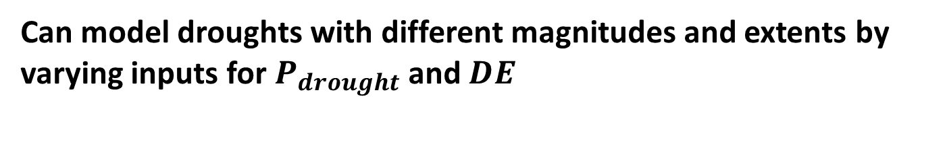
Modeling drought
Used historical drought data to estimate the annual proportion of the range affected by drought and variability
In each model replicate, randomly draw proportion of range affected by drought
Survival rates are a weighted average of animals exposed and not exposed to drought
$S_{t}^{A}=(P_{drought}∗$ $S_{t}^{A}∗{DE}_{t})+((1−P_{drought})∗ S_{t}^{A})$
Exposed to drought
Not exposed to drought
Proportion of range exposed to drought
Drought effect:
1% - 20% reduction in survival
Can model droughts with different magnitudes and extents by varying inputs for $P_{drought}$ and $DE$

Slide 44
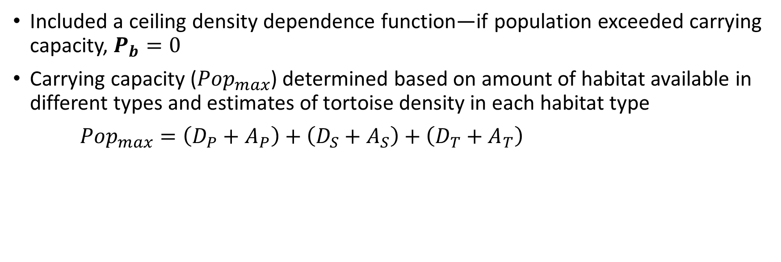
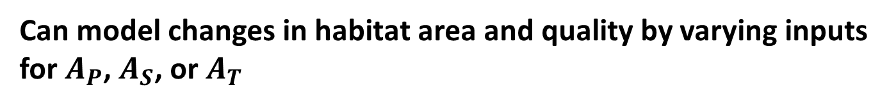
Modeling habitat loss
Included a ceiling density dependence function—if population exceeded carrying capacity, $P_{b}=0$
Carrying capacity (${Pop}_{max}$) determined based on amount of habitat available in different types and estimates of tortoise density in each habitat type
${Pop}_{max}=\left(D_{P}+A_{P}\right)+$ $\left(D_{S}+A_{S}\right)+\left(D_{T}+A_{T}\right)$
Density in primary habitat (17.1 per km²)
Area of primary habitat (km²)
Can model changes in habitat area and quality by varying inputs for $A_{P}$, $A_{S}$, or $A_{T}$
Notes:
Habitat types bases on land management, proximity to urban areas, invasive vegetation, and fire risk

Slide 45
Choosing future scenarios
Use the conceptual model and sensitivity analysis to guide scenarios
What ecological factors affect the most sensitive parameters?
Design scenarios to explore the expected range of future variation in important covariates
Young juveniles
Older juveniles
Adults

Slide 46
Choosing future scenarios
Identify key stressors and define relationships between stressors and demographic rates
Develop a few discrete scenarios, run with different model inputs and compare results
Scenario | Drought extent | Drought severity | Habitat area | Habitat quality
1
2
3
4

Slide 47

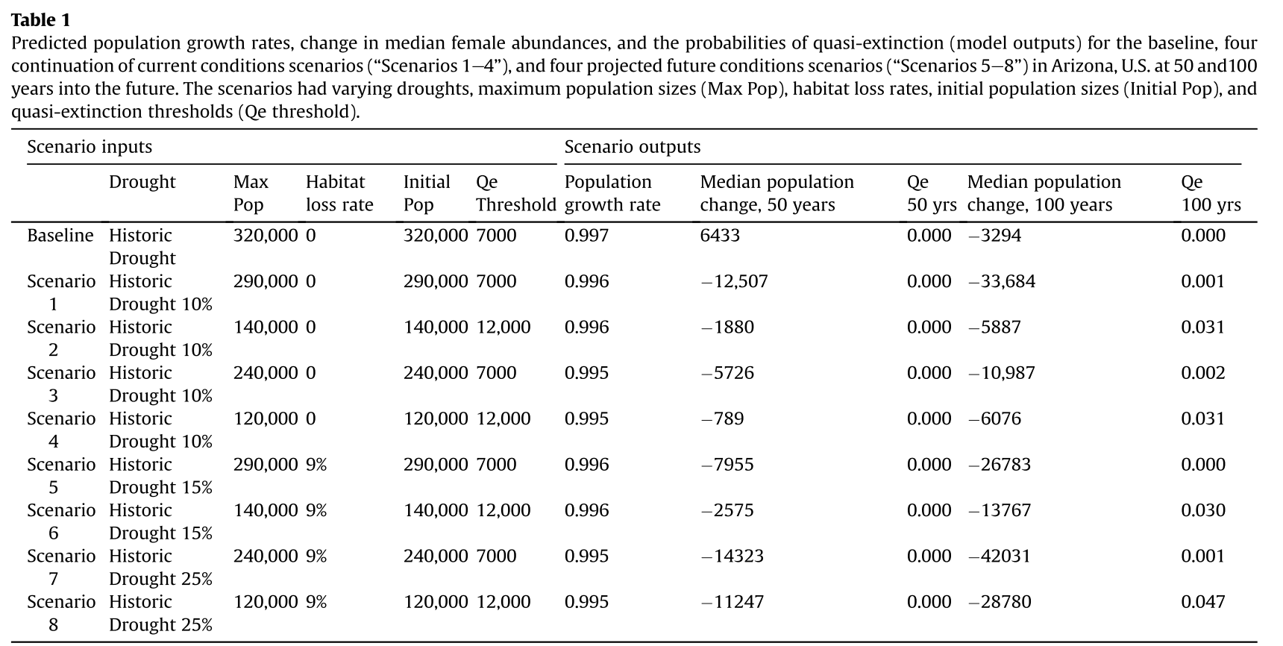

Slide 48
Implementing future scenarios
Use sensitivity analysis to inform how the population will respond to future conditions
Determine how environmental stressors and management actions will influence vital rates (arrows in the life cycle diagram), project the population under a few discrete scenarios
Use triple-loop replication to project the population under a range of possible conditions, evaluate the importance of stressors using GLM

Slide 49
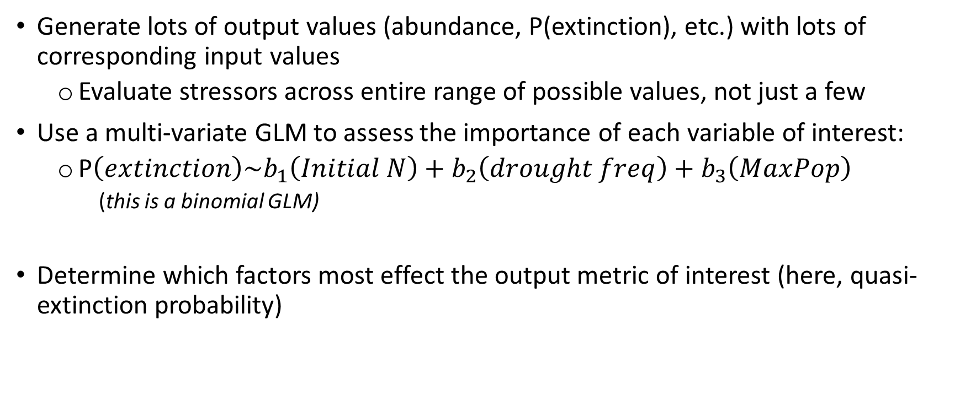
Evaluate range of future scenarios using GLMs
Generate lots of output values (abundance, P(extinction), etc.) with lots of corresponding input values
Evaluate stressors across entire range of possible values, not just a few
Use a multi-variate GLM to assess the importance of each variable of interest:
P$\left(extinction\right)\sim b_{1}\left(Initial N\right)+b_{2}\left(drought freq\right)+b_{3}\left(MaxPop\right)$
(this is a binomial GLM)
Determine which factors most effect the output metric of interest (here, quasi-extinction probability)

Slide 50
Draw scenario values
Draw average demographic rates (parametric uncertainty)
Draw annual demographic rates (environmental stochasticity)
1000 values
1000 reps
200 yrs
Model outputs

Slide 51
GLM output
MDR = mean drought rate
NAI = Initial Number of adults
MaxPop = habitat based maximum population size
𝑃(𝑄𝑒100) =‒ 5.602 + (18.42 𝑥 𝑀𝐷𝑅) ‒ (5.363𝑒 ‒ 6𝑥 𝑁𝐴𝐼) ‒ (1.797𝑒 ‒ 6𝑥 𝑀𝑎𝑥𝑃𝑜𝑝)
Drought exposure has a large, positive effect on quasi-extinction probability
Notes:
McGowan et al. 2017. Global Ecology and Conservation.

Slide 52
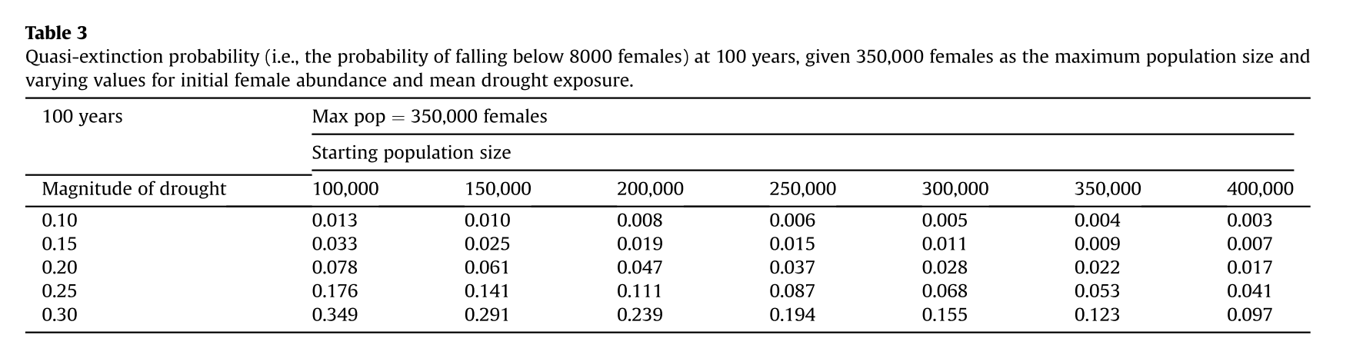
GLM output
Notes:
McGowan et al. 2017. Global Ecology and Conservation.

Slide 53
Review
Matrix population models use species life history to make predictions about future population size
Useful when we know a good amount about the basic ecology but don’t have a lot of historic/current monitoring data
Outputs can be used to assess current and future resiliency (population growth rate, quasi-extinction probability, etc.)
Important to include sources of uncertainty/stochasticity to capture all uncertainties and avoid overly-precise projections
Scenarios built on knowledge of how stressors influence specific demographic rates
Notes:
Population metrics
Sensitivity/elasticity (importance) of vital rates to population growth
Population growth rate
Extinction or quasi-extinction probability
Future population size
Sources of uncertainty
Demographic stochasticity
Parametric uncertainty
Environmental stochasticity
How to incorporate uncertainty (model parameters with statistical distributions)
Demographic stochasticity → model survival with binomial distribution
Parametric uncertainty →
Environmental stochasticity →

Slide 54
Questions

