Slide 1
Activity 3

Slide 2
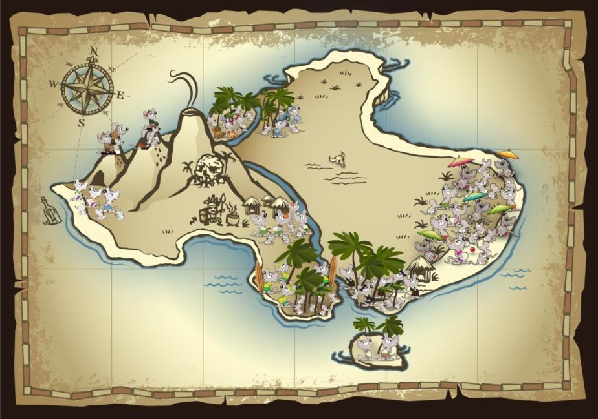


$$\left[\begin{matrix}T^{EE} & T^{LE} & T^{HE} \\ T^{EL} & T^{LL} & T^{HL} \\ T^{EH} & T^{LH} & T^{HH}\end{matrix}\right]$$

Slide 3



Multistate model for Island Mice
Population | Ecotype
Beach Bums | Coastal
Cannibal Cove | Coastal
Castaways | Coastal
Message in a Bottle | Coastal
Darlost’s Dome | Mountain
Misty Mountain | Mountain
Skull Mountain | Mountain
Dead Man Dunes | Paradise palms
Realm of Spirits | Paradise palms
Snowmelt Thicket | Paradise palms
Treasure Grove | Paradise palms
Low abundance: mice are present but at low numbers, declining or unstable population
High abundance: mice are consistently present, stable or increasing population
Locally extirpated: no mice present

Slide 4
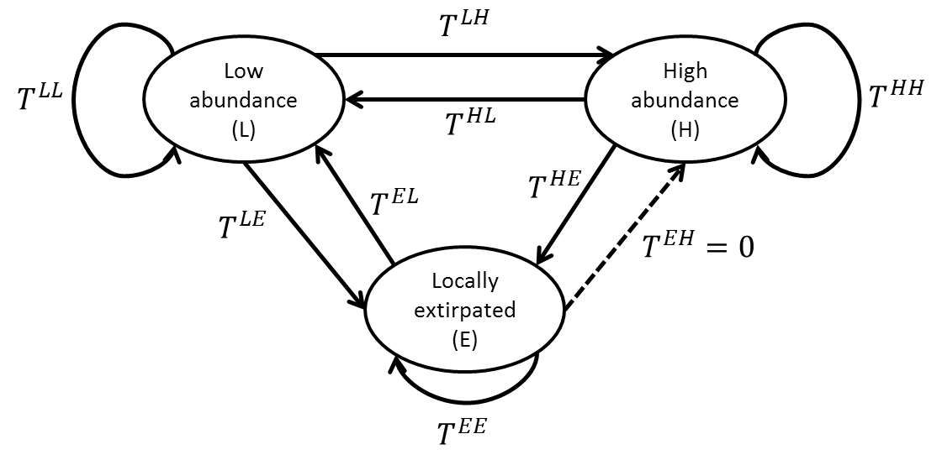

Slide 5
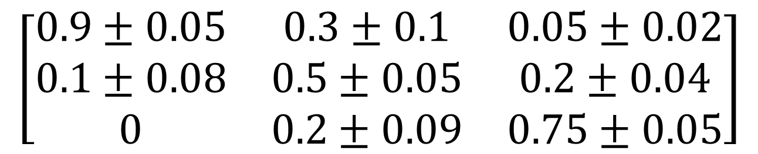
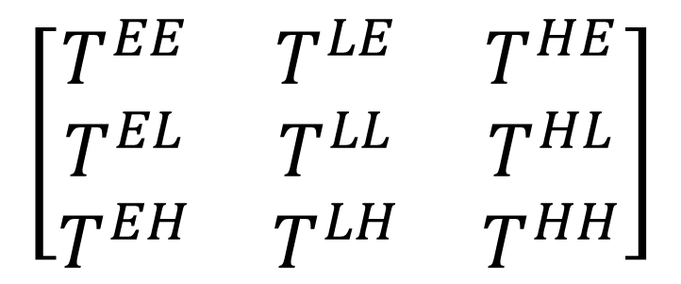
Pr(low → low)
If we didn’t have sufficient data to estimate these, how else could we determine what these values should be?
$$\left[\begin{matrix}T^{EE} & T^{LE} & T^{HE} \\ T^{EL} & T^{LL} & T^{HL} \\ T^{EH} & T^{LH} & T^{HH}\end{matrix}\right]$$
Pr(high → extirpated)
Pr(extirpated → low)
$$\left[\begin{matrix}0.9±0.05 & 0.3±0.1 & 0.05±0.02 \\ 0.1±0.08 & 0.5±0.05 & 0.2±0.04 \\ 0 & 0.2±0.09 & 0.75±0.05\end{matrix}\right]$$

Slide 6
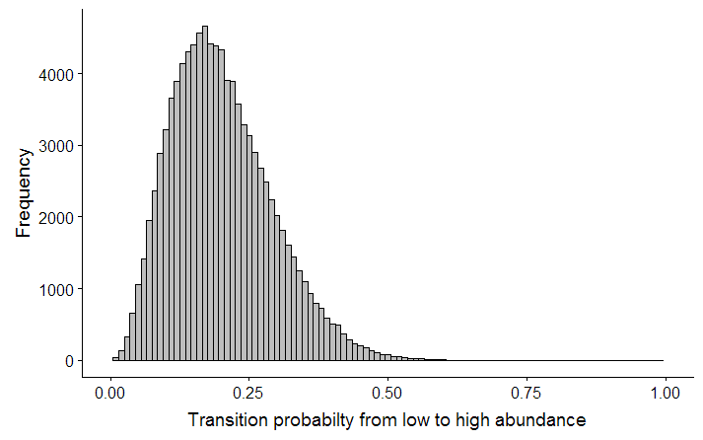
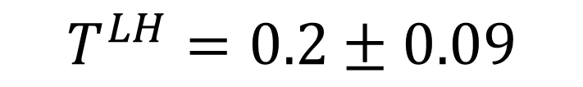

$$T^{LH}=0.2±0.09$$
Estimate $±$ SE
Parametric uncertainty
We’re uncertain about the true value of this transition probability

Slide 7
Population | Ecotype | Current state
Beach Bums | Coastal | H
Cannibal Cove | Coastal | H
Castaways | Coastal | L
Message in a Bottle | Coastal | H
Darlost’s Dome | Mountain | L
Misty Mountain | Mountain | L
Skull Mountain | Mountain | E
Dead Man Dunes | Paradise palms | L
Realm of Spirits | Paradise palms | H
Snowmelt Thicket | Paradise palms | L
Treasure Grove | Paradise palms | L

Slide 8



Example: Beach Bums
Current state
(Year 0)
Year 1
H
$$0.75±0.05$$
H
$$0.2±0.04$$
L
$$0.05±0.02$$
E

Slide 9
Example: Beach Bums
Current state
(Year 0)
Year 1
Year 2
H
H
H
L
E

Slide 10
Example: Beach Bums
Current state
(Year 0)
Year 1
Year 2
Year 3
H
H
H
L
L
E
Automate this process using a computer program (Excel, R)
Do this for all populations for 15 years
Repeat this process 1000 times
Keep track of population state at each time step for each replicate

Slide 11
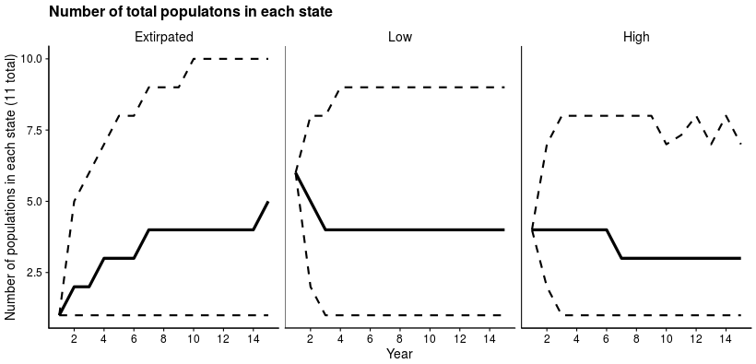
Solid line = median
Dashed lines = 95% confidence

Slide 12
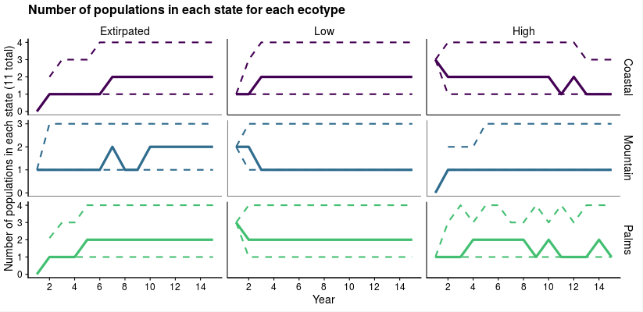

Slide 13
Baseline conditions
In 8% of the replications, all Coastal populations ended in the Extirpated state
Ecotype | Extinction probability
Coastal | 0.08
Mountain | 0.16
Paradise Palms | 0.08
Overall | 0.02
In 2% of the replications, all Island Mouse populations ended in the Extirpated state

Slide 14
Baseline conditions
In 61% of the replications, at least one Coastal population ended in the high abundance state
Ecotype | Prob. of at least one high abundance
Coastal | 0.61
Mountain | 0.52
Paradise Palms | 0.63
Overall | 0.83
In 83% of the replications, at least one population from any ecotype ended in the high abundance state

Slide 15
Ecotype | Extinction probability
Coastal | 0.08
Mountain | 0.16
Paradise Palms | 0.08
Overall | 0.02
Notes:
1. What is the most likely outcome for Island Mice in 15 years? What is the most likely outcome for each ecoregion?
2. Why is there uncertainty about the number of populations that will end in each state?
3. How would you characterize the expected resiliency, redundancy, and representation of this species?

Slide 16








What if conditions change?
$$T^{LH}$$
Low abundance (L)
High abundance (H)
$$T^{LL}$$
$$T^{HH}$$
$$T^{HL}$$
$$T^{HE}$$
$$T^{EL}$$
$$T^{LE}$$
Locally extirpated (E)
$$T^{EE}$$
Line weight is proportional to transition probability
Notes:
Three transition probabilities were found to be strongly associated with ambient noise level. $T^{HL}$, $T^{HE}$, and $T^{LE}$ all increased as ambient noise level increased (β = 1.5 ± 0.03, p = 0.001).
Two transition probabilities were found to be strongly associated with annual temperature range. $T^{HH}$ and $T^{LH}$ both decreased as temperature range increased (β = -1.8 ± 0.41, p = 0.0023).

Slide 17
















What if conditions change?
$$T^{LH}$$
Increased ambient noise
Low abundance (L)
High abundance (H)
$$T^{LL}$$
$$T^{HH}$$
$$T^{HL}$$
$$T^{LH}$$
$$T^{HE}$$
Low abundance (L)
High abundance (H)
$$T^{EL}$$
$$T^{LL}$$
$$T^{HH}$$
$$T^{LE}$$
$$T^{HL}$$
Locally extirpated (E)
$$T^{EL}$$
$$T^{HE}$$
$$T^{LE}$$
Locally extirpated (E)
$$T^{EE}$$
Baseline conditions
$$T^{EE}$$
Line weight is proportional to transition probability
Notes:
Three transition probabilities were found to be strongly associated with ambient noise level. $T^{HL}$, $T^{HE}$, and $T^{LE}$ all increased as ambient noise level increased (β = 1.5 ± 0.03, p = 0.001).
Two transition probabilities were found to be strongly associated with annual temperature range. $T^{HH}$ and $T^{LH}$ both decreased as temperature range increased (β = -1.8 ± 0.41, p = 0.0023).

Slide 18








What if conditions change?
$$T^{LH}$$
Increased annual temp. range
Low abundance (L)
High abundance (H)
$$T^{LL}$$
$$T^{HH}$$
$$T^{HL}$$
$$T^{LH}$$
Low abundance (L)
High abundance (H)
$$T^{EL}$$
$$T^{HE}$$
$$T^{LL}$$
$$T^{HH}$$
$$T^{LE}$$
$$T^{HL}$$
Locally extirpated (E)
$$T^{HE}$$
$$T^{EL}$$
$$T^{LE}$$
Locally extirpated (E)
$$T^{EE}$$
Baseline conditions
$$T^{EE}$$
Line weight is proportional to transition probability
Notes:
Three transition probabilities were found to be strongly associated with ambient noise level. $T^{HL}$, $T^{HE}$, and $T^{LE}$ all increased as ambient noise level increased (β = 1.5 ± 0.03, p = 0.001).
Two transition probabilities were found to be strongly associated with annual temperature range. $T^{HH}$ and $T^{LH}$ both decreased as temperature range increased (β = -1.8 ± 0.41, p = 0.0023).

Slide 19
Develop three scenarios:
Best case
Worst case
Most likely
Implement your scenarios:
http://ssa200.shinyapps.io/mouse-multistate
Condition | Best Case | Worst Case | Most Likely
Ambient noise level
Temperature range

Slide 20
Potential future scenarios
Scenario 1 – Status quo: No change in ambient noise level or annual temperature range
Scenario 2 – Climate change only: Climate change leads to an increase in average annual temperature range of 10°C, but management efforts to restrict development leads to no change in the ambient noise level.
Scenario 3 – Climate change and noise increase: Climate change leads to an increase in average annual temperature range of 10 °C, and further development leads to an increase in ambient noise level of 40 decibels.

Slide 21
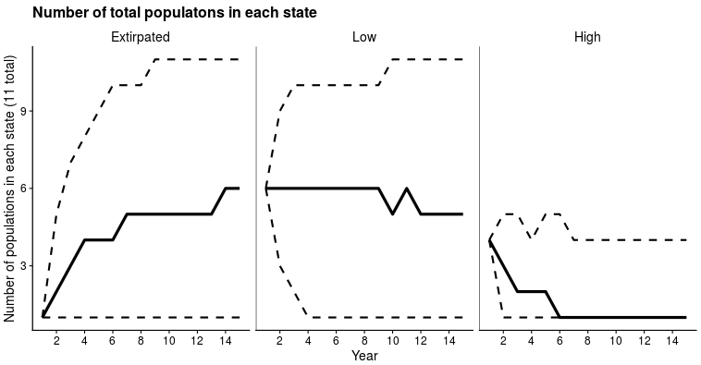
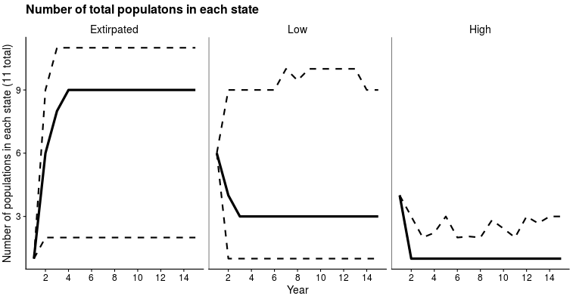
Scenario 1
Scenario 2
Scenario 3

Slide 22
Group | Extinction probability
 | Status quo | Climate change | Climate change and noise increase
Coastal | 0.08 | 0.17 | 0.46
Mountain | 0.16 | 0.24 | 0.50
Paradise Palms | 0.08 | 0.16 | 0.45
Overall | 0.02 | 0.07 | 0.22

