Slide 1
Activity 2

Slide 2
Interpreting Model Outputs
Evaluating support for competing models using AIC
Interpreting regression model outputs
Using model outputs to make predictions

Slide 3
Parameter(predictor variables)
Relative support for each model (Relative to the model with the lowest AIC)
If ΔAIC > 2 then top model has the most support
Model weight – another way to assess relative support
Model | AIC | ΔAIC | Np | w_{i}
S(time) p(.) | 684 | 0 | 5 | 0.98
S(.) p(.) | 693 | 9 | 2 | 0.01
S(time) p(time) | 698 | 14 | 10 | 0.01
S(time + sex) p(time) | 710 | 26 | 12 | 0
Usually listed in decreasing order
Number of parameters
(sometimes called k)
AIC is a relative measure of support only!
One model will always have the lowest AIC
Doesn’t necessarily mean it is a good model!

Slide 4
Part 1 – Evaluating competing models
Data:
Study conducted to measure breeding success in Beach Bums, Dead Man’s Dunes, and Misty Mountain populations
Over 5 years, mouse nests are surveyed and the number of offspring per female is counted
Pitfall traps at each site also measure invertebrate abundance
Model:
Poisson GLM to estimate the number of offspring per female as a function of several potential covariates
Developed a model set, fit each model, and ranked using AIC
Notes:
A study is conducted to measure breeding success in the Beach Bums, Dead Man’s Dunes, and Misty Mountain populations. Over the course of five years, mouse nests are surveyed throughout breeding to estimate the number of offspring produced per female. Pitfall traps are also placed at each study population to estimate invertebrate abundance.
We used a Poisson generalized linear model (Poisson GLM) to estimate the number of offspring produced per female as a function of several potential covariates. We fit several different models and used AIC model selection to rank models. Goodness-of-fit testing of the global model indicated adequate model fit. The results of that process were:

Slide 5
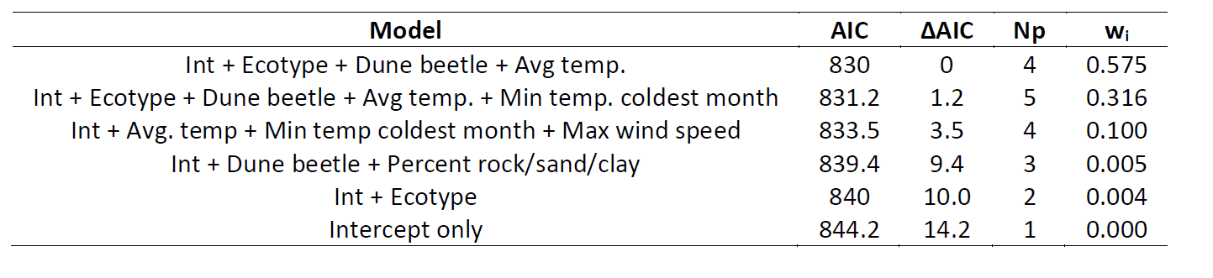
Notes:
Why did we use a Poisson GLM? (Why not a normal linear regression?)
2. Did one model receive more support than all others? If so, which one? If not, explain your answer.
3. In a sentence or two, interpret the model weights for the top-ranked model(s).
4. What are the key ecological predictors of breeding success for Island Mice?

Slide 6
Part 2 – Regression coefficients
Data:
Transect surveys conducted at randomly-selected points across Darlost’s Island
Vegetation surveys also conducted at survey points
Recorded presence/absence of Jack’s sparrows and pirate rats
Model:
N-mixture models used to estimate mouse abundance while accounting for imperfect detection

Slide 7
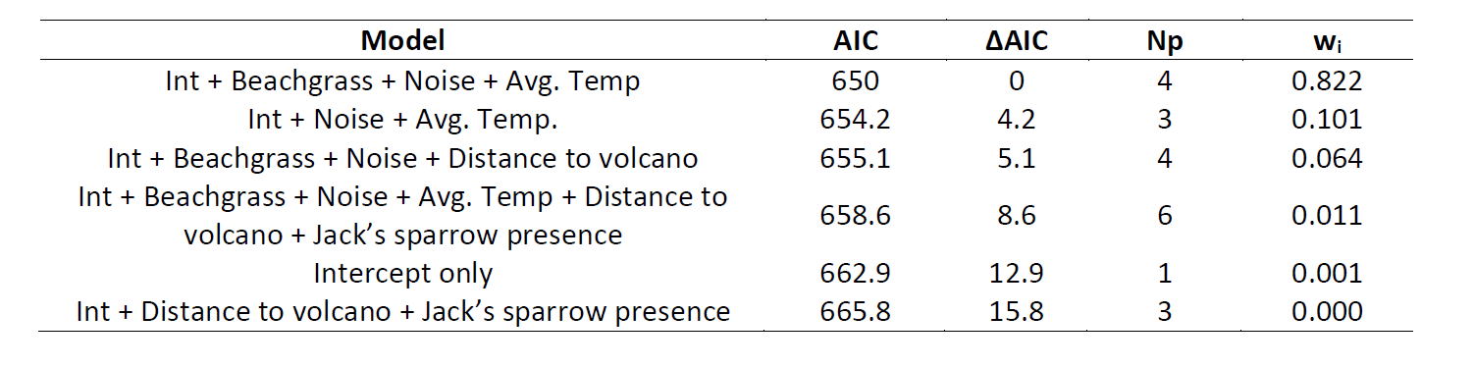
All candidate models

Slide 8
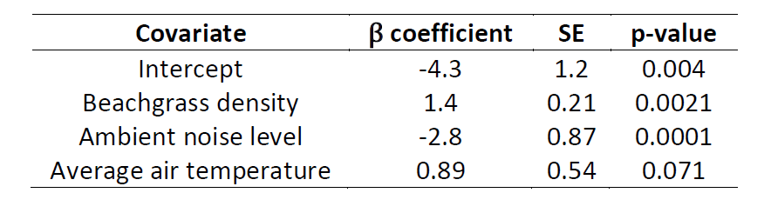
Results of the top-ranked model
Magnitude and direction of the effect
Statistical significance of the relationship
Precision/uncertainty in the estimate of β

Slide 9
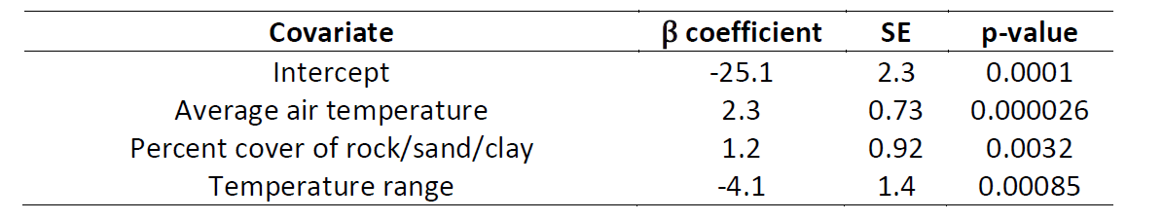
Part 3 – Making predictions
Island Mouse Recovery Team wants to assess the suitability of other nearby islands for possible translocations.
Used occurrence data to build a model to predict occurrence probability based on ecological covariates
Top-ranked model:

Slide 10
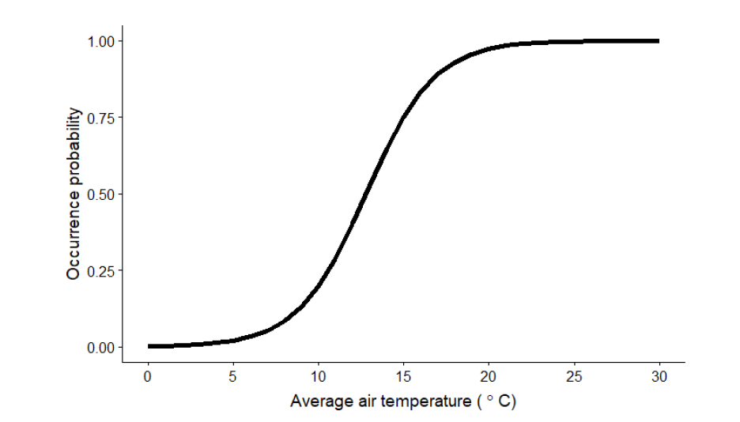
Average air temperature is a strong predictor of occurrence

Slide 11
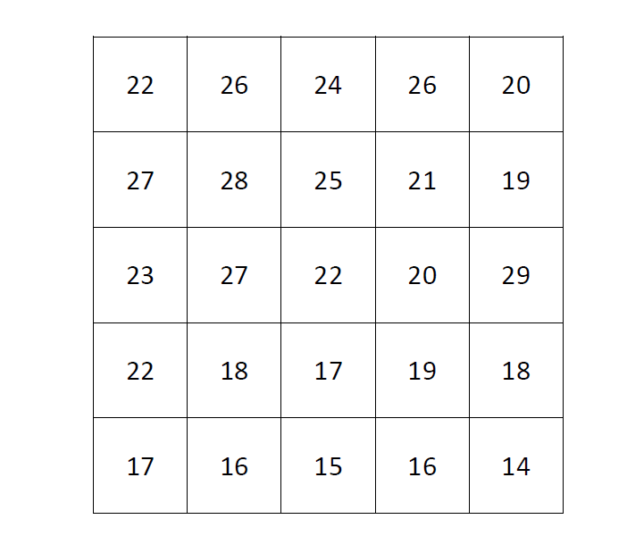
Based on average air temperature alone, predict occurrence of Island Mice

Slide 12
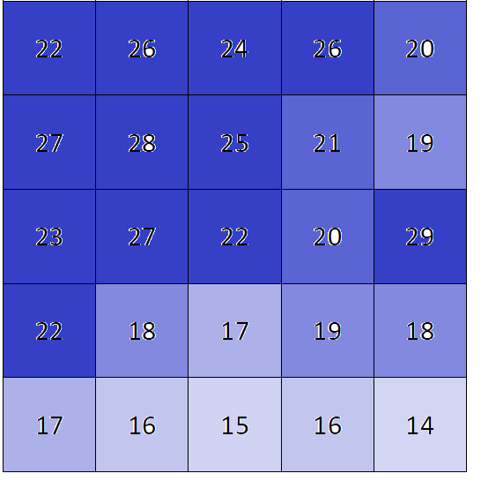

Slide 13
Evaluating potential translocation sites
use information about the new sites and the estimated relationships with occurrence to estimate the predicted probability of occurrence at each new site
Use web app: https://ssa200.shinyapps.io/logit-calculator
plug in the values for each covariate to get the probability of occurrence at that site.

Slide 14
Potential translocation sites
Site A: Wallace Rock
Average air temperature = 23.5 °C
Percent rock/sand/clay cover = 30%
Temperature range = 15 °C
Site B: Humboldt’s Atoll
Average air temperature = 20.7 °C
Percent rock/sand/clay cover = 50.5%
Temperature range = 19.7 °C
Site C: Attenborough Key
Average air temperature = 22 °C
Percent rock/sand/clay cover = 25%
Temperature range = 12 °C
Site D: Isle Lyell
Average air temperature = 25 °C
Percent rock/sand/clay cover = 5%
Temperature range = 9 °C

