Slide 1
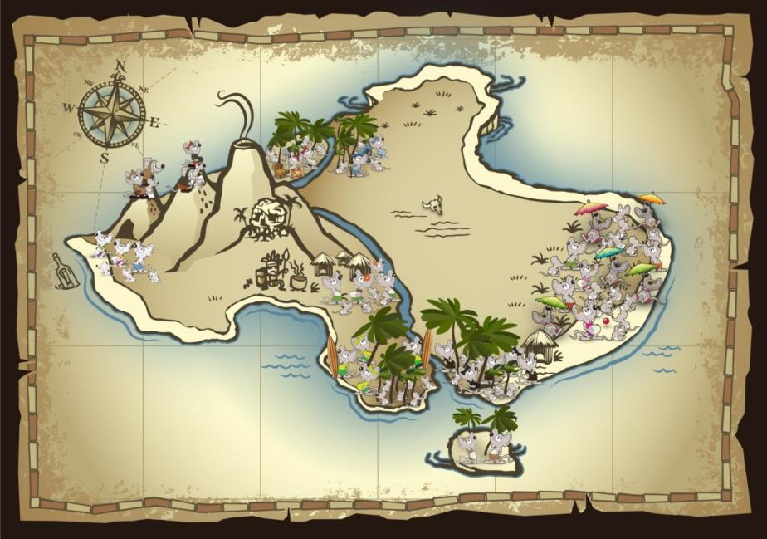


$$\left[\begin{matrix}T^{EE} & T^{LE} & T^{HE} \\ T^{EL} & T^{LL} & T^{HL} \\ T^{EH} & T^{LH} & T^{HH}\end{matrix}\right]$$

Slide 2



Multistate model for Island Mice
Population | Ecotype
Beach Bums | Coastal
Cannibal Cove | Coastal
Castaways | Coastal
Message in a Bottle | Coastal
Darlost’s Dome | Mountain
Misty Mountain | Mountain
Skull Mountain | Mountain
Dead Man Dunes | Paradise palms
Realm of Spirits | Paradise palms
Snowmelt Thicket | Paradise palms
Treasure Grove | Paradise palms
Low abundance: mice are present but at low numbers, declining or unstable population
High abundance: mice are consistently present, stable or increasing population
Locally extirpated: no mice present

Slide 3
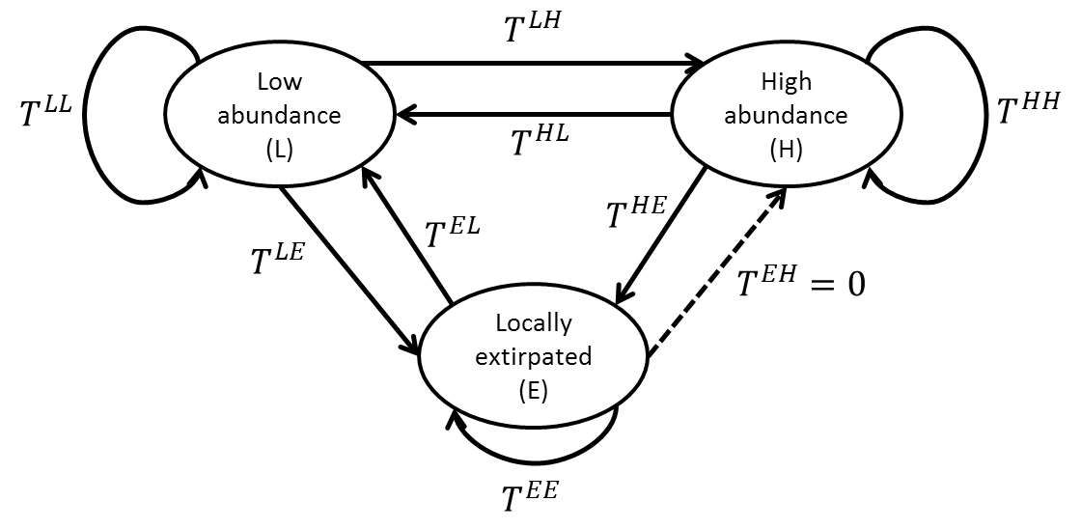

Slide 4
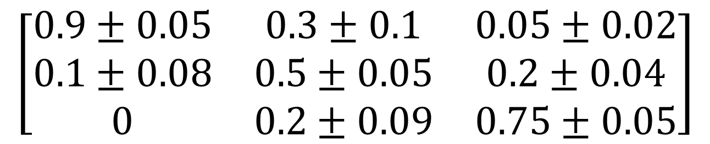
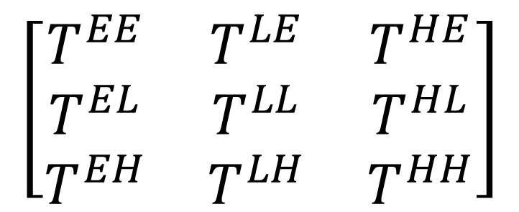
$$\left[\begin{matrix}T^{EE} & T^{LE} & T^{HE} \\ T^{EL} & T^{LL} & T^{HL} \\ T^{EH} & T^{LH} & T^{HH}\end{matrix}\right]$$
$$\left[\begin{matrix}0.9±0.05 & 0.3±0.1 & 0.05±0.02 \\ 0.1±0.08 & 0.5±0.05 & 0.2±0.04 \\ 0 & 0.2±0.09 & 0.75±0.05\end{matrix}\right]$$

Slide 5
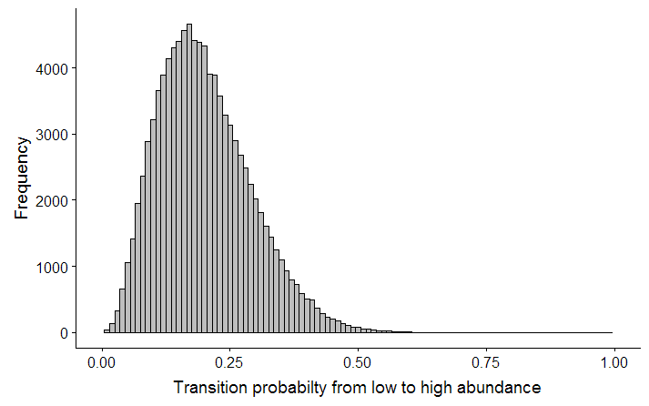


$$T^{LH}=0.2±0.09$$
Estimate $±$ SE
Parametric uncertainty

Slide 6
Population | Ecotype | Current state
Beach Bums | Coastal | H
Cannibal Cove | Coastal | H
Castaways | Coastal | L
Message in a Bottle | Coastal | H
Darlost’s Dome | Mountain | L
Misty Mountain | Mountain | L
Skull Mountain | Mountain | E
Dead Man Dunes | Paradise palms | L
Realm of Spirits | Paradise palms | H
Snowmelt Thicket | Paradise palms | L
Treasure Grove | Paradise palms | L
Project 15 years
Replicated 1000 times

Slide 7
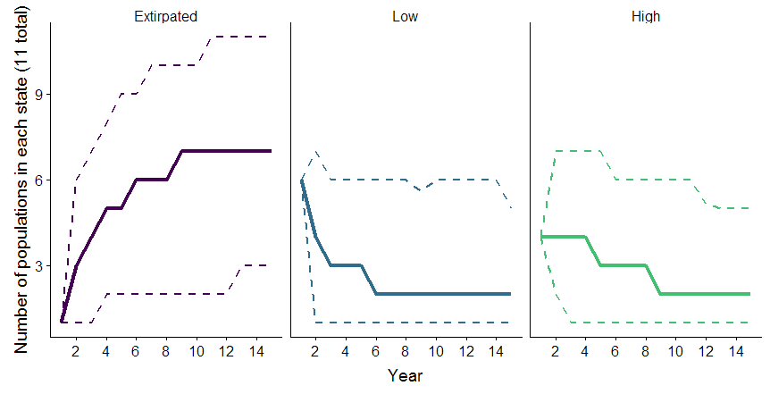
Solid line = median
Dashed lines = 95% confidence

Slide 8
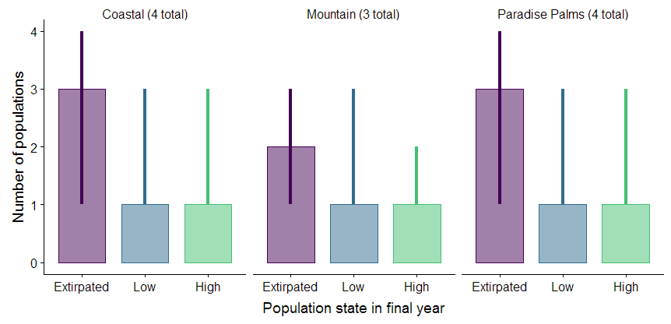

Slide 9
Baseline conditions
In 20% of the replications, all Coastal populations ended in the Extirpated state
Group | Extinction probability
Coastal | 0.21
Mountain | 0.37
Paradise Palms | 0.24
Overall | 0.05
In 5% of the replications, all Island Mouse populations ended in the Extirpated state

Slide 10
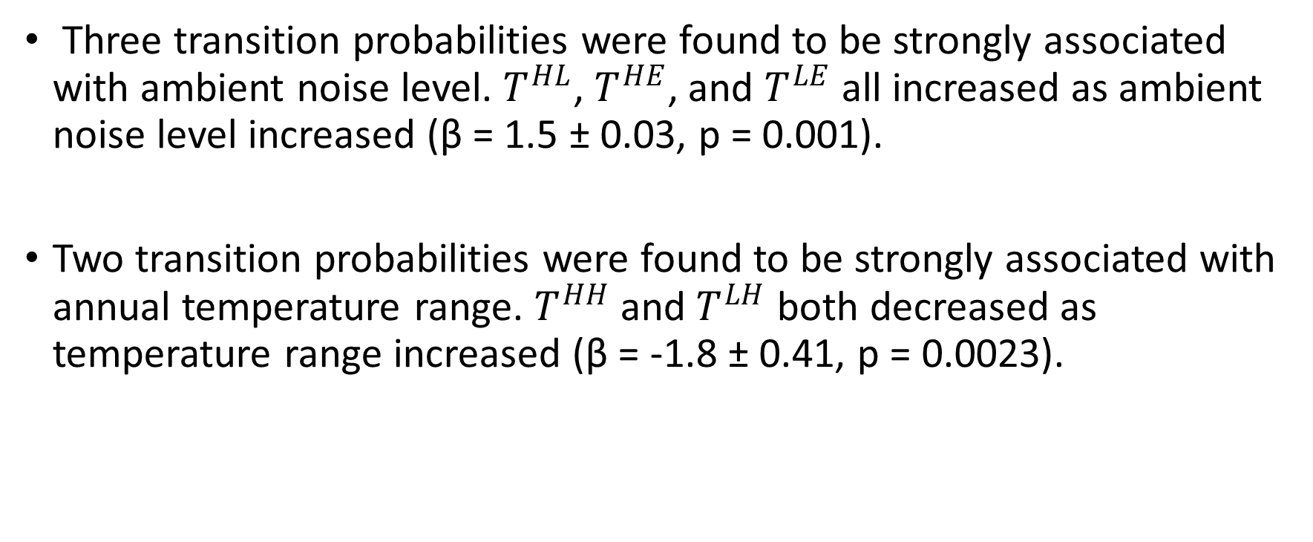
What if conditions change?
Three transition probabilities were found to be strongly associated with ambient noise level. $T^{HL}$, $T^{HE}$, and $T^{LE}$ all increased as ambient noise level increased (β = 1.5 ± 0.03, p = 0.001).
Two transition probabilities were found to be strongly associated with annual temperature range. $T^{HH}$ and $T^{LH}$ both decreased as temperature range increased (β = -1.8 ± 0.41, p = 0.0023).

Slide 11
Develop three scenarios:
Best case
Worst case
Most likely
Implement your scenarios:
http://ssa200.shinyapps.io/mouse-multistate
Scenario | Description | Change in ambient noise level (db) | Change in annual temperature range (°C)

Slide 12
Potential future scenarios
Scenario 1 – Status quo: No change in ambient noise level or annual temperature range
Scenario 2 – Noise reduction: Climate change leads to an increase in average annual temperature range of 0.5 °C, but management efforts to restrict development leads to a decrease in ambient noise level of 2 decibels.
Scenario 3 – Noise increase: Climate change leads to an increase in average annual temperature range of 0.5 °C, and further development leads to an increase in ambient noise level of 2 decibels.

Slide 13
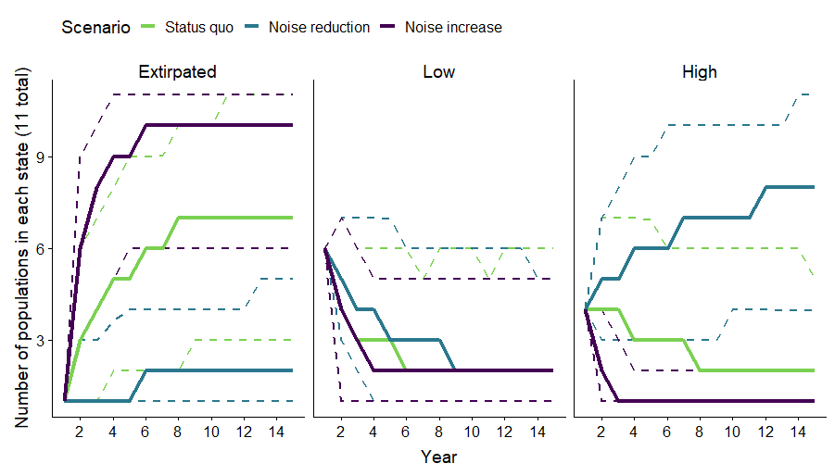

Slide 14
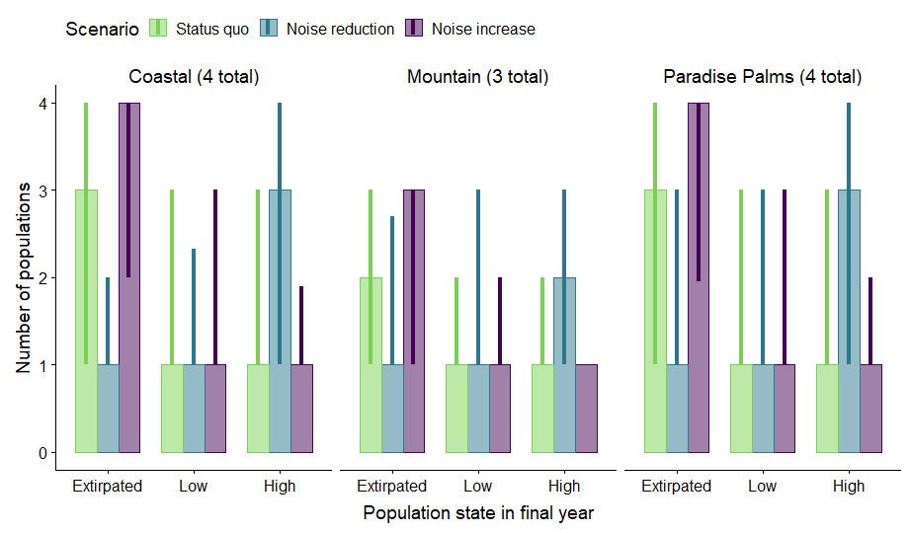

Slide 15
 | Extinction probability under each scenario
 | Status quo | Noise reduction & climate change | Noise increase & climate change
Coastal | 0.21 | 0.00 | 0.57
Mountain | 0.37 | 0.014 | 0.67
Paradise Palms | 0.24 | 0.001 | 0.58
Overall | 0.05 | 0.00 | 0.29

