Slide 1

Turquoise skipper

Slide 2
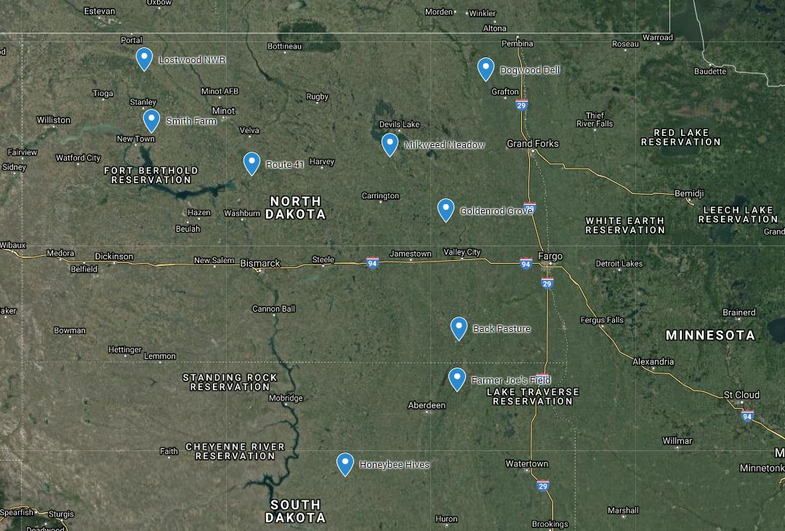

Slide 3
Demographic info in the literature
single generation per year
survive the winter as dormant eggs
overwinter survival of eggs is quite high (>90%) in the absence of early spring fires
females can lay up to 200 eggs in a single season
many caterpillars (>80%) die before pupating into adults

Slide 4
Three data sources available
Lostwood National Wildlife Refuge
presence/absence data at a number sites over 6 years
recorded some information on habitat features and weather at the time of surveys
Nature Conservancy
three times per season, counted individuals observed on several transects at three different properties from 1999 until 2009
No information about the habitat or other covariates (may be available from National Land Cover Data Base or NOAA weather data archives)
BLM
spanned 2 decades in the 1980s and 90s
several sites throughout the range
Various observers recorded the place, time, date and description of the number of butterflies
No other covariate information was provided

Slide 5
