Slide 1
Activity 1

Slide 2
Developing candidate model sets
Goal: find the model that best explains the data using the fewest number of parameters
hopefully identify the most important ecological drivers of species persistence
Null model (“dot model”) has no covariates included
If this model is top-ranked → none of the covariates we included are strong predictors
Still tells us something about the system
“All subsets” approach = include all possible combinations of all covariates
Not good science – models should represent a priori hypotheses
May result in top-ranked models that aren’t biologically meaningful and/or not useful for projections
Notes:
The Island Mouse (Zapus islandsonious) is a species that lives on Darlost's Island. There are 10 current populations, although historically they occurred at 11 sites across the island. As you covered in SSA 100, the mice are adapted to the unique ecology of Darlost’s Island. Their primary food source is dune beetles, which are found across the small island. They also rely on beach grass that grows along the coasts to build their nests and create shelter from the sun and cold winters. They require warm spring temperatures for successful breeding, and in years with exceptionally cold trade winds there is increased winter mortality. They are also very sensitive to noise, and loud noises can lead to depressed breeding activity and, in extreme cases, death from cardiac arrest. There are also several stressors on the island that influence their population dynamics. The two main predators of Island mice are Jack’s sparrow, which are found across the island, and the pirate rat, which are only found along the coasts. Darlost’s fire is a disease that causes mange and can be fatal, and toxic gas plumes from the island’s volcanoes can also be deadly. This conceptual diagram summarizes the key species needs (green boxes) and threats (red boxes) and how they influence breeding and survival.
Using

Slide 3
Avoiding collinearity
Collinearity occurs when two or more covariates are correlated
Notes:
if we are interested in predicting grizzly bear occurrence, we may want to test a model that includes the presence of a water source or the presence of fish at a given site. Since the presence of fish is highly correlated with the presence of water, those covariates could be collinear, and we may not want to include both in the same model. The presence of fish implies the presence of water, and may be closer to the real ecological reason why bears occur near water. However, if data about fish presence isn’t available, including water in the model can be a good proxy.

Slide 4


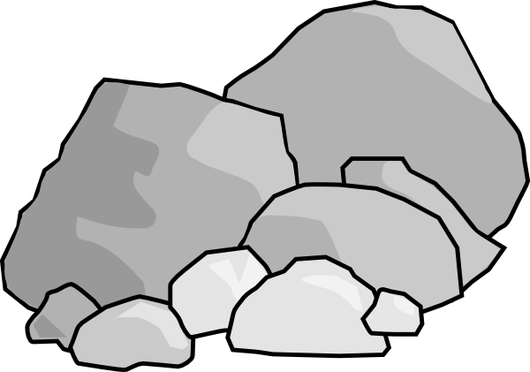


Notes:
if we are interested in predicting grizzly bear occurrence, we may want to test a model that includes the presence of a water source or the presence of fish at a given site. Since the presence of fish is highly correlated with the presence of water, those covariates could be collinear, and we may not want to include both in the same model. The presence of fish implies the presence of water, and may be closer to the real ecological reason why bears occur near water. However, if data about fish presence isn’t available, including water in the model can be a good proxy.

Slide 5
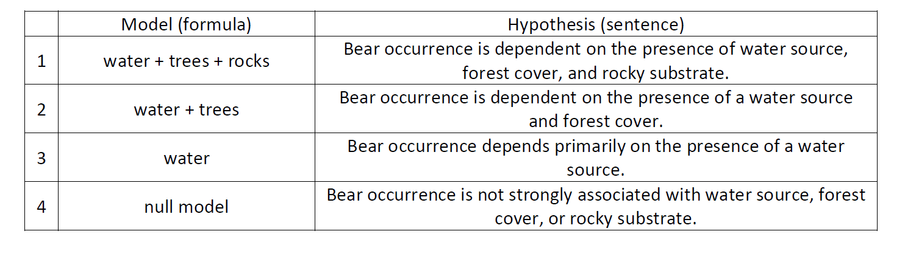

Slide 6
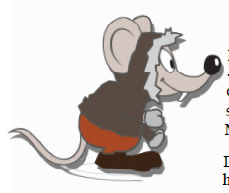
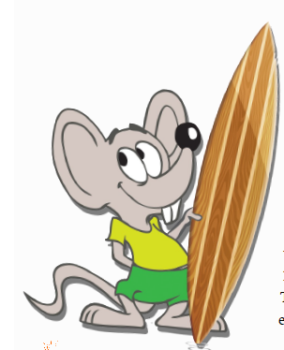
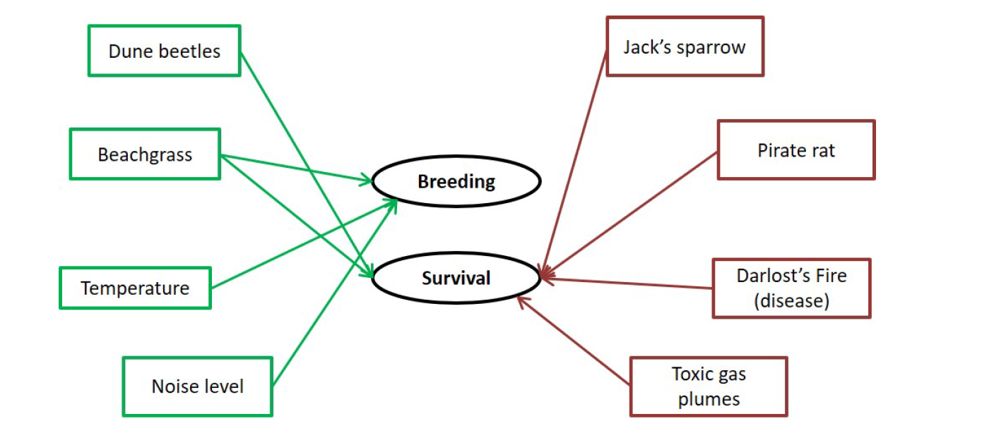


Slide 7
Part 1 – Predictors of mouse occurrence
Modeling approach: species distribution model using occurrence records from across Darlost’s Island
Using the data sources listed in your handout, develop a set of candidate models to predict occurrence of Island mice
Carefully consider the data sources available and how they may or may not be useful!
Response variable = probability of occurrence
Working alone or with your neighbors, develop a list of up to six possible candidate models

Slide 8
Model | Hypothesis
Temp. Annual Range | Island Mice like mild climates and so should prefer areas with less extreme warm and cold seasons.
Temp. Annual Range + % Cover Rock/sand/clay | Island Mice rely on beachgrass, which grows on sandy substrates, and prefer mild climates
% Cover rock/sand/clay | Sandy substrates (proxy for beachgrass) alone predicts mouse occurrence.
(.) | None of the above are strong predictors of occurrence.

Slide 9
Part 2 – Predictors of mouse abundance
Modeling approach: N-mixture model to estimate abundance while accounting for imperfect detection
Using the data sources listed in your handout, develop a set of candidate models to predict abundance of Island mice
Carefully consider the data sources available and how they may or may not be useful!
You have different data sources available than with the previous exercise
Response variable = site abundance
Working alone or with your neighbors, develop a list of up to six possible candidate models

Slide 10
Model | Hypothesis
Beachgrass + noise level | Island mouse abundance depends on beachgrass density and ambient noise level, which influence survival and reproduction.
Beachgrass + noise level + predators | Island mouse abundance depends on beachgrass density, noise level, and whether predators are present.
Beachgrass | Beachgrass density is the single best predictor of island mouse abundance.
(.) | None of the above are strong predictors of abundance.

Slide 11
Part 3 – Predictors of breeding output
Modeling approach: Poisson GLM to estimate the number of offspring per female
Using the data sources listed in your handout, develop a set of candidate models to predict breeding output of Island mice
Carefully consider the data sources available and how they may or may not be useful!
You have different data sources available than with the previous exercises
Response variable = number of offspring per female
Working alone or with your neighbors, develop a list of up to six possible candidate models

Slide 12
Model | Hypothesis
Average air temp. + dune beetles | Island mouse breeding output depends on warm temperatures and high dune beetle abundance.
Average air temp. + dune beetles + female age | Island mouse breeding output depends on temperature and dune beetle abundance, but older females have smaller litters.
Dune beetles | Dune beetle abundance is the single best predictor of breeding output.
(.) | None of the above are strong predictors of breeding output.

Slide 13
Review and recap
How similar or different were your model sets for occurrence, abundance, and breeding success?
Were you able to capture all important ecological relationships with the data available? If not, how did you deal with it?

