Slide 1
Descriptive data
SSA 200

Slide 2
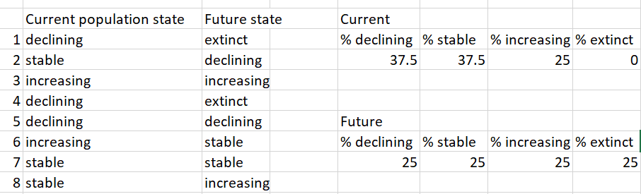
Looking back
Introduction to SSA course has content on how to conduct descriptive SSA analysis
Use descriptive data to assess the current redundancy and resiliency

Slide 3
A more quantitative approach…?
Convert descriptors into categories or “states”
Words describing high abundance are grouped together; words describing moderate abundance are grouped together…etc.
“many”, “abundant”, “Plethora”… → same category
“some”, “several”, “moderate”… → same category
“Few”, “not abundant”, “scant”…→ same category

Slide 4
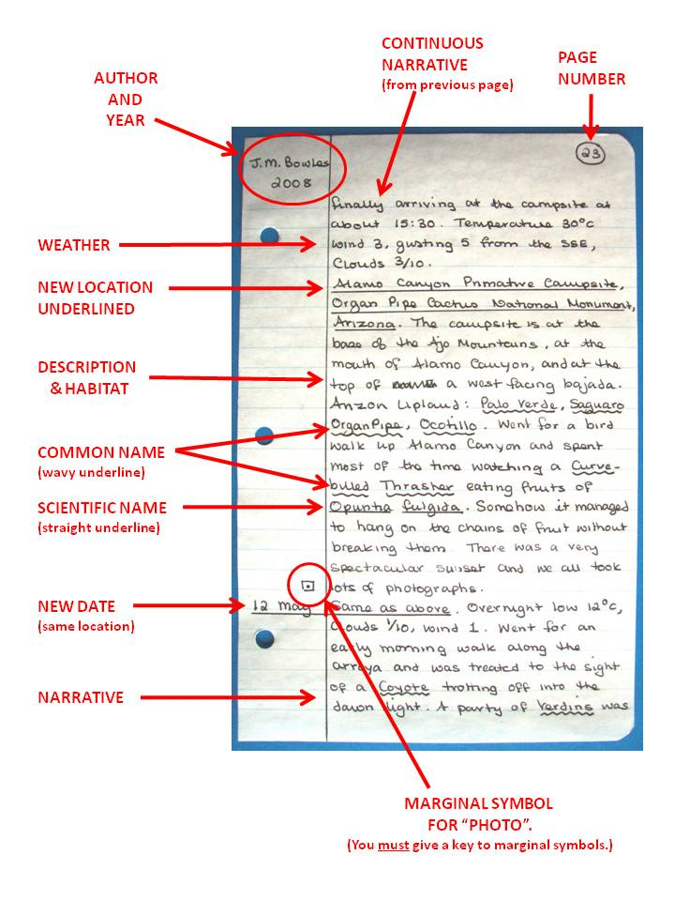
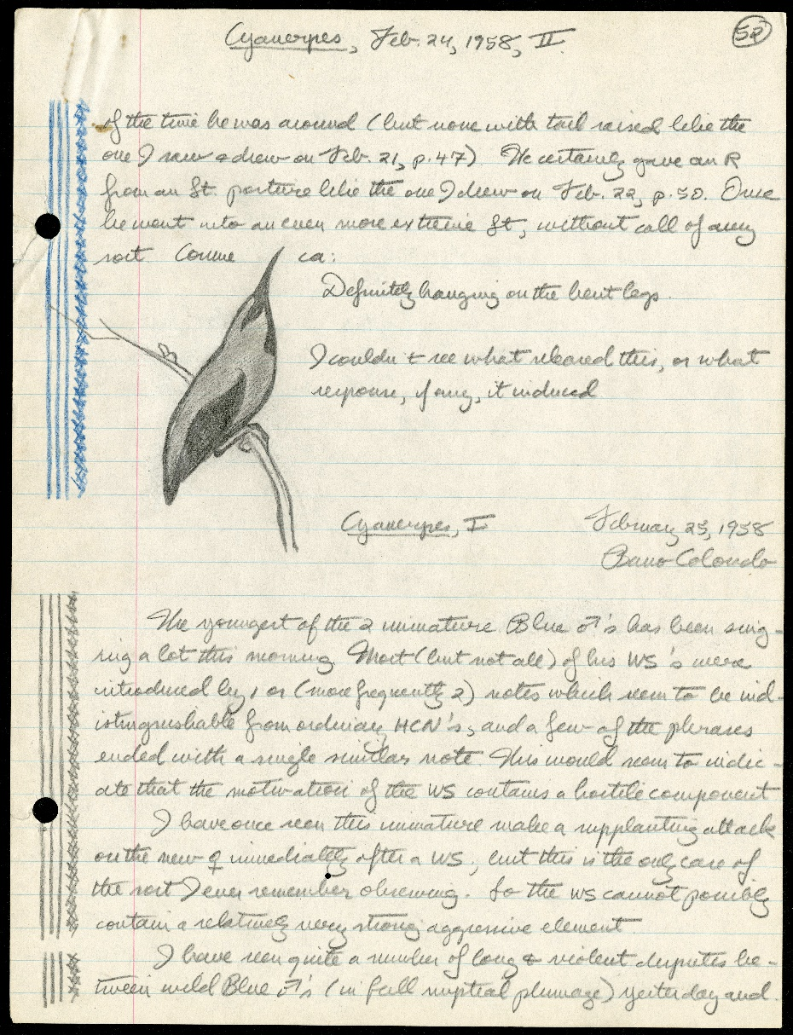

Field notes or similar data sources
Notes:
You can convert this.

Slide 5
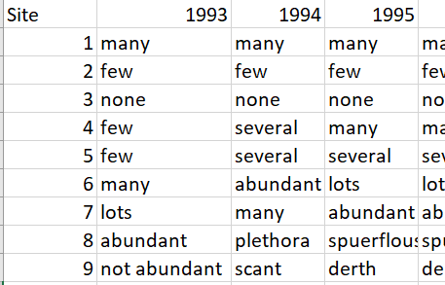
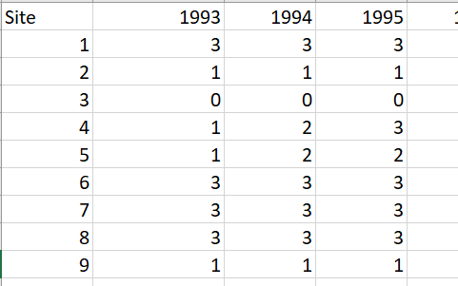
“data” conversion

Slide 6
Example – pulling from field notes
Descriptive accounts of what was observed

Slide 7
Example – how did the sites change?
Descriptive accounts of what was observed
Moving from ‘few’ to ‘several’ at site 4
is called a “state transition”

Slide 8
Probability of transitions
What is the probability of moving from category 1 to 2 or 1 to 3 or 1 to 0?
6 total state 1 transitions
1->1 happened 4 times
1->2 happened 2 times
1->3 happened 0 times
1->0 happened 0 times

Slide 9
Linking state transitions to the environment
Develop an assessment of species needs by linking status transitions to environmental variables
What environmental factors affect state transitions?
How do we estimate or quantify any potential relationships?

Slide 10
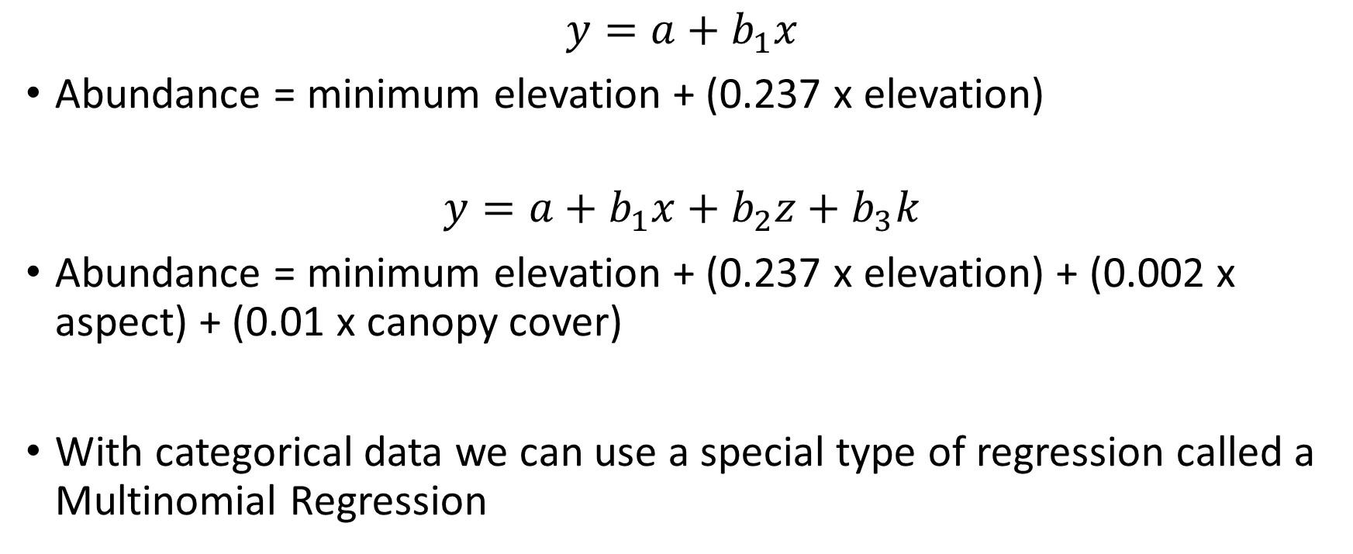
Regression modeling
$$y=a+b_{1}x$$
Abundance = minimum elevation + (0.237 x elevation)
$$y=a+b_{1}x+b_{2}z+b_{3}k$$
Abundance = minimum elevation + (0.237 x elevation) + (0.002 x aspect) + (0.01 x canopy cover)
With categorical data we can use a special type of regression called a Multinomial Regression
Notes:
The regression model asks the question: does the species need certain elevations? Canopy cover? Etc.?

Slide 12
Expert elicitation data
In the absence of good quantitative data, an expert elicitation might be warranted
Use expert knowledge as the basis for establishing what a species needs
Crafting questions to assess functional relationships
E.g., asking for probability of y occurring at three or more values of x
Using variation among experts to “estimate” uncertainty and variability

Slide 13
Elicited conceptual model to establish species needs
Stream length
Population abundance
Adult survival
Resliiency
Stream connectivity
Juvenile survival
Exotic predators
Productivity

Slide 14
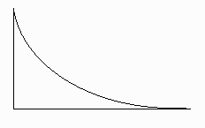
What is the stream length?
Stream Length
Change?
A stream may change length over time
If the stream does not change length, there is no effect of this parameter on occupancy.
No
Yes
If the stream does change length, there will be an effect on the probability of occupancy.
Effect on
P occupancy
We think the relationship between stream length and occupancy probability is curvilinear, a negative exponential relationship. The longer a stream is, the less it effects occupancy.
Stream Length

Slide 15
Headwater chub stream length and extinction risk

