Slide 1


SSA 200 Quantitative Tools for SSA
Oct 23-24, 2018
Houston, TX
Lectures, activities, and additional supplementary materials are available online at: annamtucker.github.io/ssa-200
Conor P. McGowan
Anna M. Tucker
Nicole F. Angeli
Kylee Dunham

Slide 2

Linear regression
$$y=a+bx$$
Parameter | Estimate | SE | t | p-value
Intercept | -0.22 | 1.29 | -0.169 | 0.866
b | 2.07 | 0.0978 | 21.16 | < 0.0001
General linear model – response variable (y) has a Normal distribution
Generalized linear model – response variable (y) has some other distribution
Logistic regression – Binomial distribution
Poisson regression – Poisson distribution

Slide 3
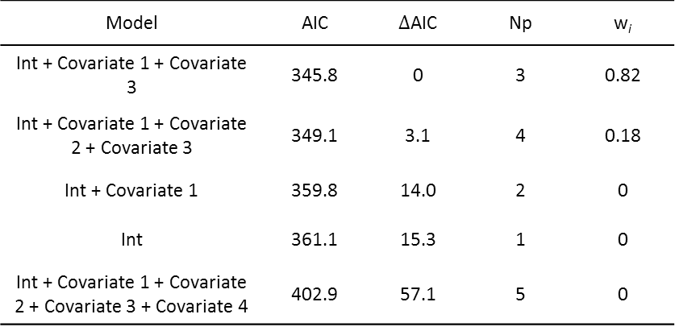
Interpreting model outputs
Parameter | Estimate | SE | p-value
Intercept | -0.22 | 1.29 | 0.866
Covariate 1 | 2.07 | 0.0978 | < 0.0001
Covariate 2 | -4.1 | 2.31 | 0.062
Covariate 3 | 0.00287 | 0.00013 | 0.0021
Covariate 4 | -0.278 | 0.145 | 0.835
Model | AIC | $∆$AIC | Np | w_{i}
Int + Covariate 1 + Covariate 3 | 345.8 | 0 | 3 | 0.82
Int + Covariate 1 + Covariate 2 + Covariate 3 | 349.1 | 3.1 | 4 | 0.18
Int + Covariate 1 | 359.8 | 14.0 | 2 | 0
Int | 361.1 | 15.3 | 1 | 0
Int + Covariate 1 + Covariate 2 + Covariate 3 + Covariate 4 | 402.9 | 57.1 | 5 | 0

Slide 4
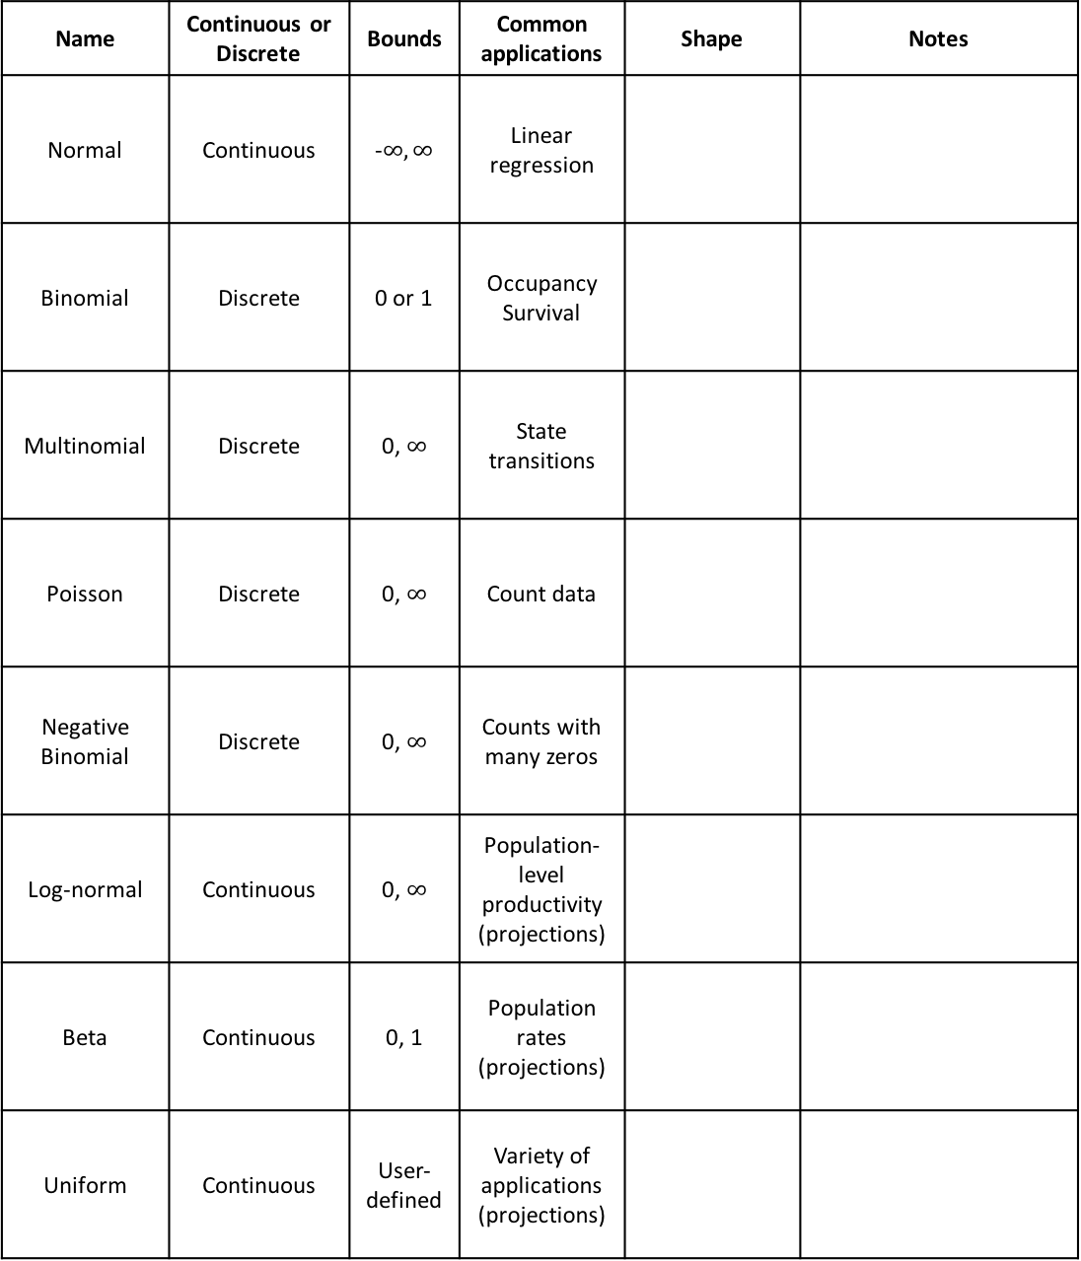
Statistical distributions
Name | Continuous or Discrete | Bounds | Common applications | Shape | Notes
Normal | Continuous | -$∞, ∞$ | Linear regression
Binomial | Discrete | 0 or 1 | Occupancy Survival
Multinomial | Discrete | 0, $∞$ | State transitions
Poisson | Discrete | 0, $∞$ | Count data
Negative Binomial | Discrete | 0, $∞$ | Counts with many zeros
Log-normal | Continuous | 0, $∞$ | Population-level productivity (projections)
Beta | Continuous | 0, 1 | Population rates (projections)
Uniform | Continuous | User-defined | Variety of applications (projections)

Slide 5
Types of uncertainty
Partial controllability – We are unable to control the exact management actions taken in a system.
Examples:
Setting management goals – we may intend to fully restore a habitat, but may not be able to implement the exact management goals due to other logistical constraints
Observational uncertainty – We are unable to perfectly observe the state of natural systems.
Examples:
Count data – in almost all cases, we cannot count every individual present at a specific location, but instead assume there is some probability of detecting individuals
Environmental variation – Stochastic environmental fluctuations mean that conditions typically vary randomly from year to year.
Examples:
Predicting effects of temperature – we may estimate a relationship between temperature and survival probability that we can use to predict survival under future temperature conditions, but temperature will likely vary in a stochastic way from year to year.
Ecological uncertainty – We have an imperfect understanding of how ecological systems work.
Examples:
Metapopulation dynamics – we think a set of populations function as a metapopulation, but have not conducted studies to explicitly estimate immigration among sites, and therefore we are unsure to what extent immigration plays a role in measured population growth rate at each site.

Slide 6
Key terms
Covariate
Parameter
Distribution
Response/dependent variable
Predictor/independent variable
Detection probability
AIC
Intercept
Null model
Global model
Population closure

Slide 7
Data analysis roadmap
What kind of data do you have?
Descriptive or categorical
Presence-type data
Counts
Demographic data
Follow the color of your data type!
How was it collected?
Opportunistic
(e.g. citizen science, historical records, museum specimens)
Designed survey
(e.g. transects, repeated counts, mark-recapture)
State transition model
State transition model
Are there repeated measurements within a closed period?
Species distribution model OR paired points analysis
No
Logistic regression
Yes
Poisson regression (counts)
Multinomial regression
Occupancy model
Abundance estimation
N-mixture model
Poisson regression (fecundity)
Survival analysis (mark-recapture)
This roadmap is to serve as a general guide and is not an exhaustive list of all analysis options. Also, always check the specific assumptions of your planned modeling approach!

