Slide 1
Analysis of presence-type data
SSA 200 – Day 1 – Lecture 3

Slide 2
Presence only vs. Presence-absence data
Example 1: A National Park office often gets reports from people who have seen wolverines in the park. They keep track of the locations and dates of these sightings.
Example 2: A researcher conducts point counts for birds in the same forest plot every month from May – July each year. During point counts they make an effort to detect and record every species within the survey window.
Example 3: A natural history museum has plant specimens that contain information about the location and date of collection.
Example 4: iNaturalist has over 29,000 recorded observations of Monarch butterflies from across their range dating back to 2009.
Presence only
Presence-absence
Presence only
Presence only

Slide 3
Presence only data

Slide 4
Example data sources
Presence-only data
Information about where/when a species was detected but NOT where/when it was looked for but not found
Opportunistic reporting by the public
Some eBird checklists (*complete checklists = presence-absence data)
Historical records (e.g. museum specimens, field notes)

Slide 5
Example questions
Presence-only data
Where is this species found? (Representation)
What ecological factors best predict it’s occurrence? (stressors/ecological needs)
Where will this species likely occur in the future? (Resiliency)
Predicted occurrence in areas without data
Climate change scenarios
Change in land use

Slide 6
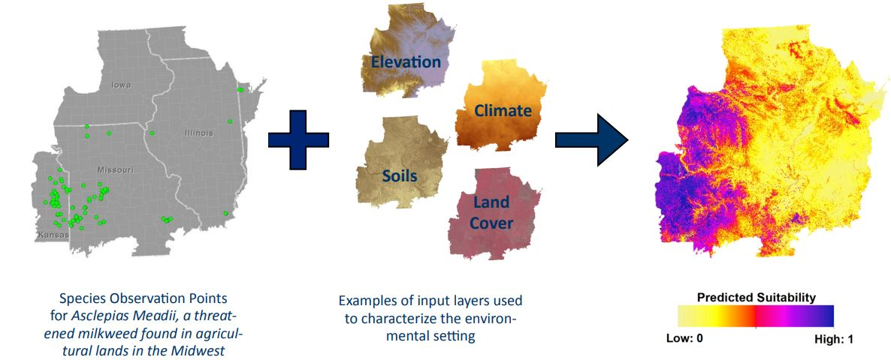
Common analysis approaches
Presence-only data
Species Distribution Modeling
MaxEnt
BIOCLIM
Notes:
Aka ecological niche modeling

Slide 7
Example
Presence-only data
Species distribution modeling
Seeking a good SDM example from the literature, preferably that
Deals with a rare/endangered species
Makes predictions
Has nice maps
Any suggestions?
Notes:
Example from the literature

Slide 8
Considerations and caveats
Presence-only data
Species distribution modeling
Temptation for overfitting
The number of terms in the model should not exceed the number of observations
Consider ecologically-relevant environmental variables to include
Potential observation bias
Be careful with extrapolation
Notes:
Interpreting outputs using literature example

Slide 9
Overfitting
Presence-only data
Species distribution modeling
Simpler
Worse fit
More useful
More complex
Best fit
Less useful
Notes:
Not sure if this idea will be covered in Intro materials?

Slide 10

Overfitting
Presence-only data
Species distribution modeling
Notes:
Not sure if this idea will be covered in Intro materials?

Slide 11
Considerations and caveats
Presence-only data
Species distribution modeling
Temptation for overfitting
The number of terms in the model should not exceed the number of observations
Consider ecologically-relevant environmental variables to include
Potential observation bias
Notes:
Interpreting outputs using literature example

Slide 12
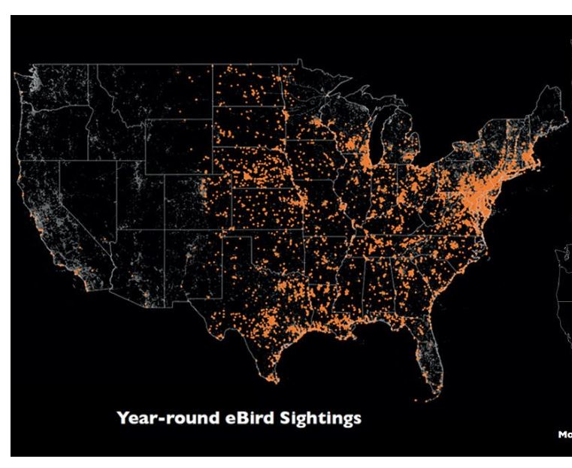
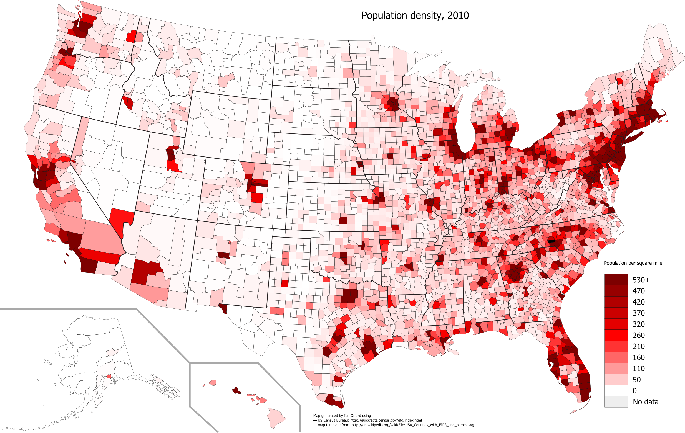

Observation bias?
Presence-only data
Species distribution modeling
Population density, 2010 US Census
Notes:
Ebird sightings of orchard oriole

Slide 13
Considerations and caveats
Presence-only data
Species distribution modeling
Temptation for overfitting
The number of terms in the model should not exceed the number of observations
Consider ecologically-relevant environmental variables to include
Potential observation bias
Be careful with extrapolation
Notes:
Interpreting outputs using literature example

Slide 14
Common analysis approaches
Presence-only data
Species Distribution Modeling/Ecological Niche Modeling
MaxEnt
BIOCLIM
Paired points
Notes:
Difficult to parse apart observation/detection probability from true occurrence probability

Slide 15
Paired points/pseudoabsences
Presence-only data
Paired points analysis
Pick random points from the background around your observations
Points where the species could have been reported, but wasn’t
Several methods to generate “pseudoabsences”
Entire range/study area
Within some specified distance of each observation
Constrained by environmental variables

Slide 16
Logistic regression
Presence-only data
Paired points analysis
A type of generalized linear model where the y variable is drawn from the Binomial distribution
Response variable consists of 1s and 0s (“successes” and “failures”)
Forms the basis for many more complex models
Occupancy analysis
Survival analysis
Resource selection

Slide 17
Example
Presence-only data
Paired points analysis
Paired points example from literature
Notes:
Difficult to parse apart observation/detection probability from true occurrence probability

Slide 18
Model outputs and considerations
Presence-only data
Paired points analysis

Slide 19
Common analysis approaches
Presence-only data
Broader spatial scale of data
Species Distribution Modeling/Ecological Niche Modeling
Paired points
Many others!
Local spatial scale
Notes:
Difficult to parse apart observation/detection probability from true occurrence probability

Slide 20
Presence-absence data

Slide 21
Example data sources
Presence-absence data
Information about where/when a species was detected AND where/when it was looked for but not found
Transect surveys
Point counts
Any other systematic survey effort
Complete eBird checklists

Slide 22
Example research questions
Presence-absence data
What habitat characteristics are associated with species presence? (ecological needs)
What is the distribution of a species in a given area? (Representation, Redundancy)
How has that distribution shifted over time? (e.g. due to habitat loss, invasive species, etc.)
What is the extent of the species range?
To what extent does this species co-occur with other species?
Species interactions, exclusion, etc.
How many species are found in this area?
Notes:
Difficult to parse apart observation/detection probability from true occurrence probability

Slide 23
Common analysis approaches
Presence-absence data
Logistic regression

Slide 24
Common analysis approaches
Presence-absence data
Logistic regression
Site-occupancy models

Slide 25
When is occupancy analysis appropriate?
Presence-absence data
Site-occupancy models
Presence/absence data
Multiple sites
Repeated visits in a closed period
Assume that true occupancy of a given site does not change between visits
Need to be collected within a short enough time-frame for this to be reasonable—depends on species of interest
Notes:
Multiple sites not necessary for the analysis, but needed to estimate effect of ecological covariates.

Slide 26
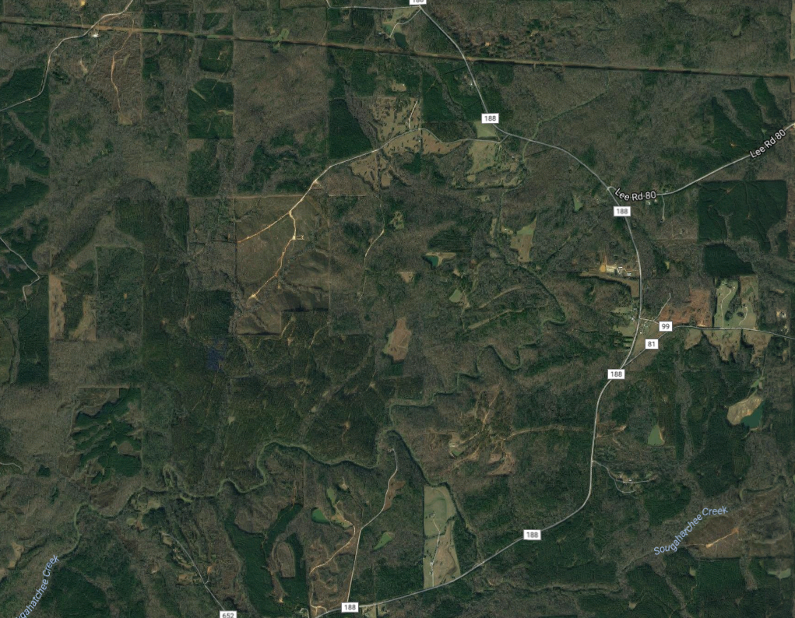
Sampling design
Presence-absence data
Site-occupancy models
Replication is key
Spatial – multiple, randomly selected sites or sampling units within the area of interest
Temporal – repeated visits to each site
Visit 1
Visit 2
Visit 3
Notes:
Difficult to parse apart observation/detection probability from true occurrence probability

Slide 27
Data wrangling
Presence-absence data
Site-occupancy models
Site | Date | Species detected?
A | 6/27/2006 | Yes
B | 6/28/2006 | Yes
C | 6/25/2006 | No
A | 7/3/2006 | No
B | 7/5/2006 | Yes
C | 7/2/2006 | No
A | 7/12/2006 | Yes
B | 7/11/2006 | Yes
C | 7/13/2006 | Yes
Site | Visit 1 | Visit 2 | Visit 3
A | 1 | 0 | 1
B
C
Site | Visit 1 | Visit 2 | Visit 3
A | 1 | 0 | 1
B | 1 | 1 | 1
C
Site | Visit 1 | Visit 2 | Visit 3
A | 1 | 0 | 1
B | 1 | 1 | 1
C | 0 | 0 | 1
Site | Visit 1 | Visit 2 | Visit 3
A
B
C
Notes:
Difficult to parse apart observation/detection probability from true occurrence probability

Slide 28
Presence-absence data
Site-occupancy models
Species is present
Species is not present
Detected
Not detected
Detected
Not detected
Notes:
Potential of underestimating occupancy is this is not taken into account

Slide 29
Assumptions
Presence-absence data
Site-occupancy models
Sites are closed to changes in occupancy between sampling occasions
Appropriate duration between surveys
Detection process is independent at each site
Appropriate distance between sites
Both detection probability and occupancy probability are constant across all sites OR explained by covariates
For example, if we think rainfall influences our ability to detect the species, then rainfall should be included in the model

Slide 30
Model parameters
Presence-absence data
Site-occupancy models
ψ_{i} = probability that site i is occupied
p_{i,t} = probability of detecting the species in site i at time t, given that the species is present
* Check text and captions for notation definitions within each paper – not always consistent!

Slide 31



Presence-absence data
Site-occupancy models
Is the species present?
Was it detected?
1
1
Occupancy probability (ψ)
Detection probability (p)
0
0

Slide 32
Model outputs
Presence-absence data
Site-occupancy models
Occupancy probability
Odds
Notes:
Difficult to parse apart observation/detection probability from true occurrence probability

Slide 33
What influences occupancy probability?
Presence-absence data
Site-occupancy models
Potential stressors and threats included as covariates
Site characteristics (e.g. land cover)
Weather (rainfall, temperature)
Distance to other occupied sites
… etc. …
Effect of covariates often expressed as odds

Slide 34
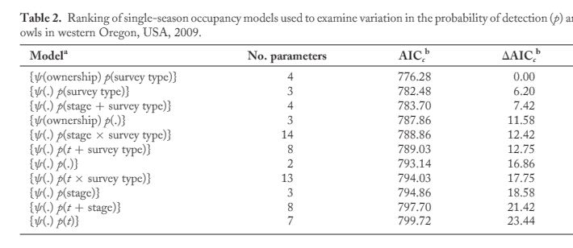
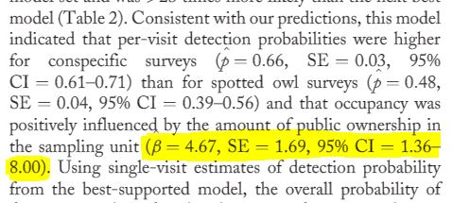
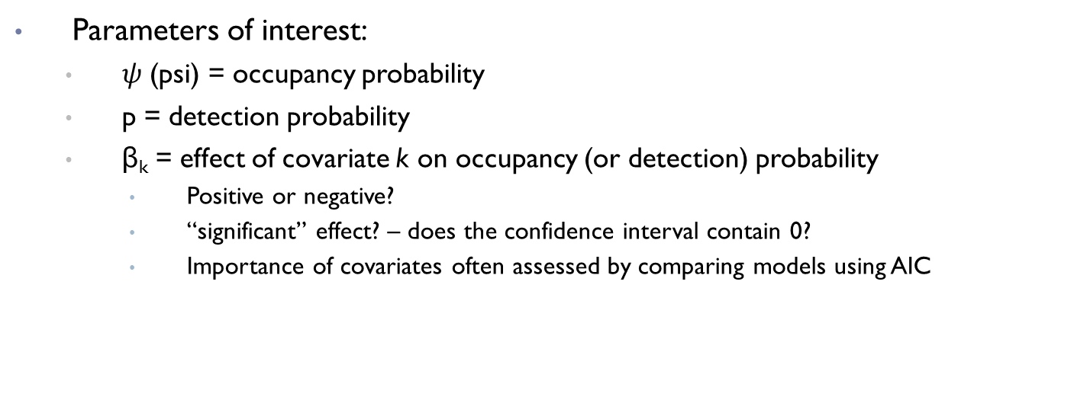
Interpreting model outputs
Presence-absence data
Site-occupancy models
Parameters of interest:
$ψ$ (psi) = occupancy probability
p = detection probability
β_{k} = effect of covariate k on occupancy (or detection) probability
Positive or negative?
“significant” effect? – does the confidence interval contain 0?
Importance of covariates often assessed by comparing models using AIC
Wiens et al 2011

Slide 35
Example
Presence-absence data
Site-occupancy models
Occupancy example
Notes:
Difficult to parse apart observation/detection probability from true occurrence probability

Slide 36
Why estimate occupancy?
Presence-absence data
Site-occupancy models
Abundance can tell you more about species status, site use, and ecology
More difficult to collect abundance data (time, money) and therefore often limited in spatial and/or temporal scope
Presence/absence data is typically:
Less intensive to collect
Cheaper
Covers larger area/time scale
Can be more practical depending on objectives

Slide 37
Common analysis approaches
Presence-absence data
Dynamic occupancy models
Logistic regression
Site-occupancy models
Dynamic occupancy models
Notes:
Difficult to parse apart observation/detection probability from true occurrence probability

Slide 38
Dynamic occupancy models
Presence-absence data
Dynamic occupancy models
Estimate change in occupancy over time (colonization and extinction)
1
P
1
0
P
E
1
E
0
C
1
1 - C
0
Time 1
Time 2
Time 3

Slide 39
Common analysis approaches
Presence-absence data
Logistic regression – lacking spatial and/or temporal replication
Site-occupancy models – single year, several sites
Dynamic occupancy models – several years, several sites
Account for imperfect detection
Assume detection is perfect
Notes:
Difficult to parse apart observation/detection probability from true occurrence probability

Slide 40
Do I have true absences in my data?
Presence only
Presence-absence
Spatial coverage?
Replicated surveys?
Yes
Number of years?
Rangewide
Local
No
few
lots
Species distribution model
Paired points or similar
Logistic regression
Site occupancy model
Dynamic occupancy model
Always check specific model assumptions!

