Slide 1
SSA 200 Quantitative Tools for SSA
Oct 23-24, 2018
Houston, TX

Slide 2

Linear regression
$$y=a+bx$$
Parameter | Estimate | SE | t | p-value
Intercept | -0.22 | 1.29 | -0.169 | 0.866
b | 2.07 | 0.0978 | 21.16 | < 0.0001
General linear model – response variable (y) has a Normal distribution
Generalized linear model – response variable (y) has some other distribution
Logistic regression – Binomial distribution
Poisson regression – Poisson distribution

Slide 3
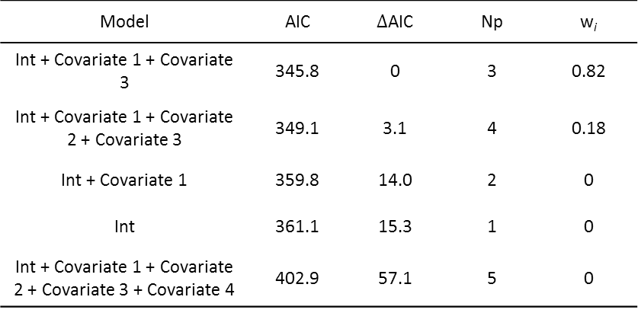
Interpreting model outputs
Parameter | Estimate | SE | p-value
Intercept | -0.22 | 1.29 | 0.866
Covariate 1 | 2.07 | 0.0978 | < 0.0001
Covariate 2 | -4.1 | 2.31 | 0.062
Covariate 3 | 0.00287 | 0.00013 | 0.0021
Covariate 4 | -0.278 | 0.145 | 0.835
Model | AIC | $∆$AIC | Np | w_{i}
Int + Covariate 1 + Covariate 3 | 345.8 | 0 | 3 | 0.82
Int + Covariate 1 + Covariate 2 + Covariate 3 | 349.1 | 3.1 | 4 | 0.18
Int + Covariate 1 | 359.8 | 14.0 | 2 | 0
Int | 361.1 | 15.3 | 1 | 0
Int + Covariate 1 + Covariate 2 + Covariate 3 + Covariate 4 | 402.9 | 57.1 | 5 | 0

Slide 4
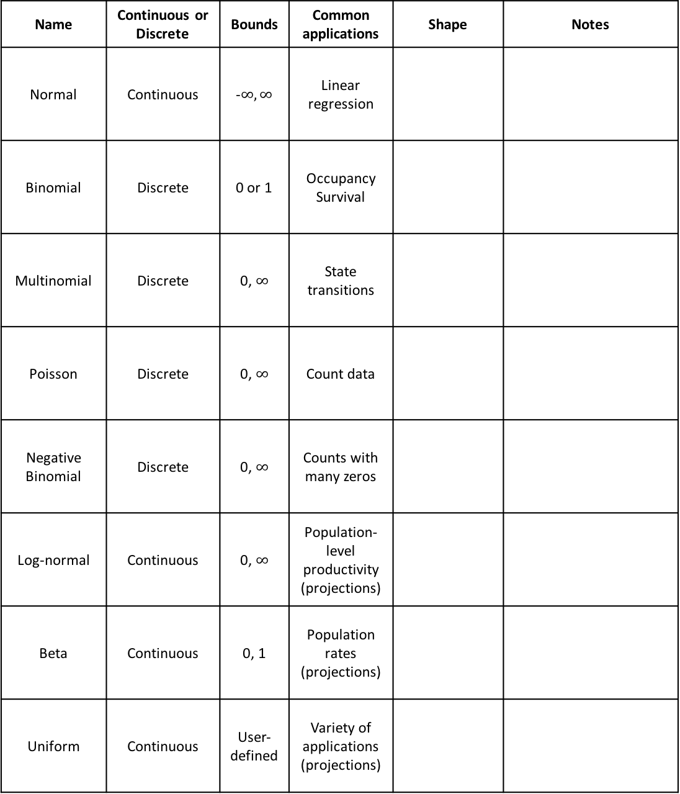
Statistical distributions
Name | Continuous or Discrete | Bounds | Common applications | Shape | Notes
Normal | Continuous | -$∞, ∞$ | Linear regression
Binomial | Discrete | 0 or 1 | Occupancy Survival
Multinomial | Discrete | 0, $∞$ | State transitions
Poisson | Discrete | 0, $∞$ | Count data
Negative Binomial | Discrete | 0, $∞$ | Counts with many zeros
Log-normal | Continuous | 0, $∞$ | Population-level productivity (projections)
Beta | Continuous | 0, 1 | Population rates (projections)
Uniform | Continuous | User-defined | Variety of applications (projections)

Slide 5
What kind of data do you have?
Descriptive or categorical
Presence-type data
Counts
Demographic data
Follow the color of your data type!
How was it collected?
Opportunistic
(e.g. citizen science, historical records, museum specimens)
Survey
(e.g. transects, repeated counts, mark-recapture)
State transition model
State transition model
Repeated visits within a closed period?
No
Species distribution model OR paired points analysis
Yes
Logistic regression
Multinomial regression
Occupancy model
Abundance estimation
Poisson regression (counts)
Poisson regression (fecundity)
N-mixture model
Survival analysis (mark-recapture)
This roadmap is to serve as a general guide and is not an exhaustive list of all analysis options. Also, always check the specific assumptions of your planned modeling approach!

Slide 6
How was the data collected?
Opportunistic
(e.g. citizen science, historical records, museum specimens)
Survey
(e.g. transects, repeated counts, mark-recapture)
What kind of data do you have?
Repeated visits within a closed period?
Descriptive or categorical
Counts
Yes
No
Presence-type data
What kind of data do you have?
State transition model
State transition model
Descriptive or categorical
Counts
Species distribution model OR paired points analysis
Multinomial regression
Presence-type data
What kind of data do you have?
Poisson regression
Presence-absence
Counts
Logistic regression
Occupancy model
N-mixture model
This roadmap is to serve as a general guide and is not an exhaustive list of all analysis options. Also, always check the specific assumptions of your planned modeling approach!

Slide 7
Accounting for observation uncertainty
Why account for observation uncertainty?
Assumptions needed to estimate detection probability:
True site occupancy/abundance does not change between surveys
Detection probability is the same for all sites and surveys OR explained by model covariates (e.g. weather conditions)
Perfect detection | Imperfect detection
Logistic regression | Site-occupancy model
Poisson regression | N-mixture model

Slide 8
Glossary
Covariate
Parameter
Distribution
Response/dependent variable
Predictor/independent variable
Detection probability
AIC
Intercept
Null model
Global model

Slide 9
Quantifying the three R’s
Redundancy
Resiliency
Representation

