Slide 1

Descriptive “data”
What can we do?
Quantitative Tools for SSA

Slide 2
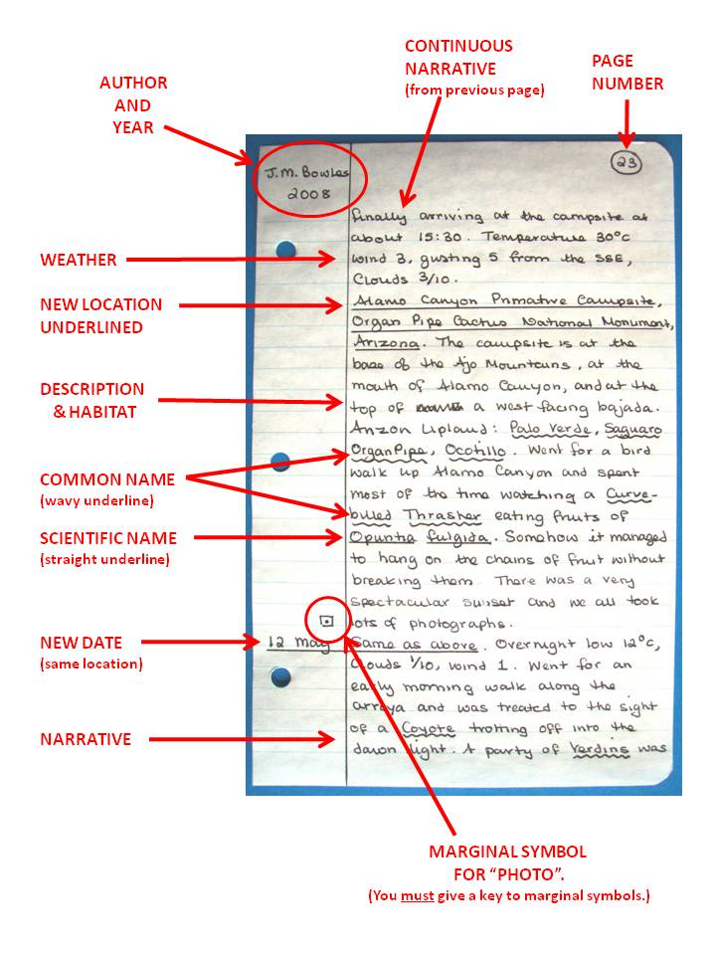
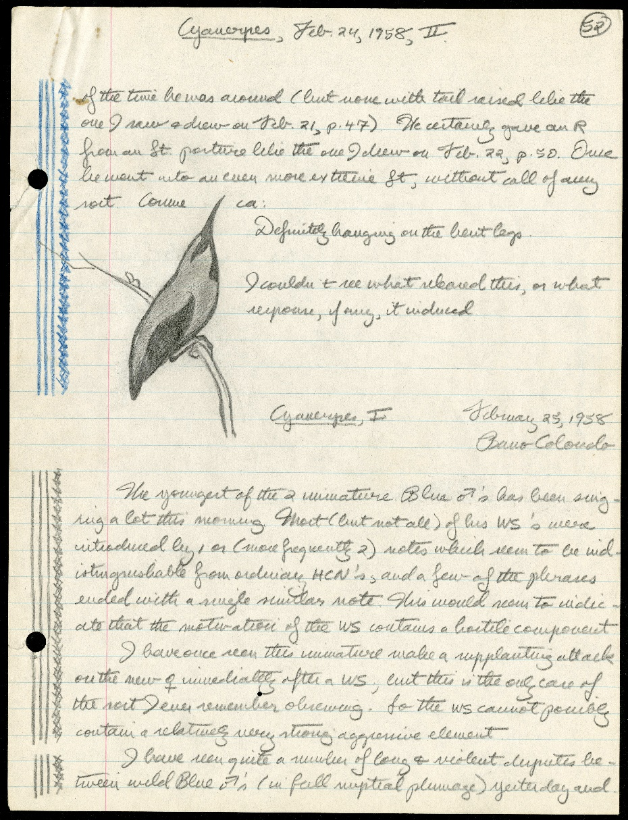
Field notes or similar data sources
Quantitative Tools for SSA

Slide 3
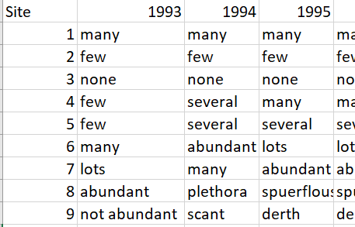
What are descriptive data?
Descriptive accounts of what was observed
Quantitative Tools for SSA

Slide 4
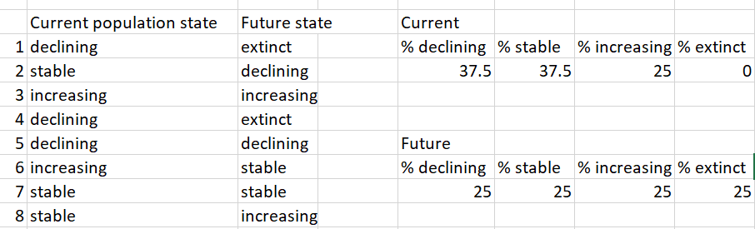
Looking back
Introduction to SSA course has some content on how to conduct a descriptive SSA analysis
Use descriptive data to assess the current redundancy and resiliency
Quantitative Tools for SSA

Slide 5
A more quantitative approach…?
Convert descriptors in to categories or “states”
Words describing high abundance are grouped together; words describing moderate abundance are grouped together…etc.
“many”, “abundant”, “Plethora”… → same category
“some”, “several”, “moderate”… → same category
“Few”, “not abundant”, “scant”…→ same catagory
Quantitative Tools for SSA

Slide 6
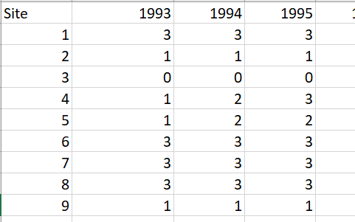
“data” conversion
Quantitative Tools for SSA

Slide 7
Probability of transitions
What is the probability of moving from category 1 to 2 or 1 to 3 or 1 to 0?
6 total state 1 transitions
1->1 happened 4 times
1->2 happened 2 times
1->3 happened 0 times
1->0 happened 0 times
Quantitative Tools for SSA

Slide 8
Linking state transitions to the environment
Develop an assessment of species needs by linking status transitions to environmental variables
What environmental factors affect state transitions?
How do we estimate or quantify any potential relationships?
Quantitative Tools for SSA

Slide 9
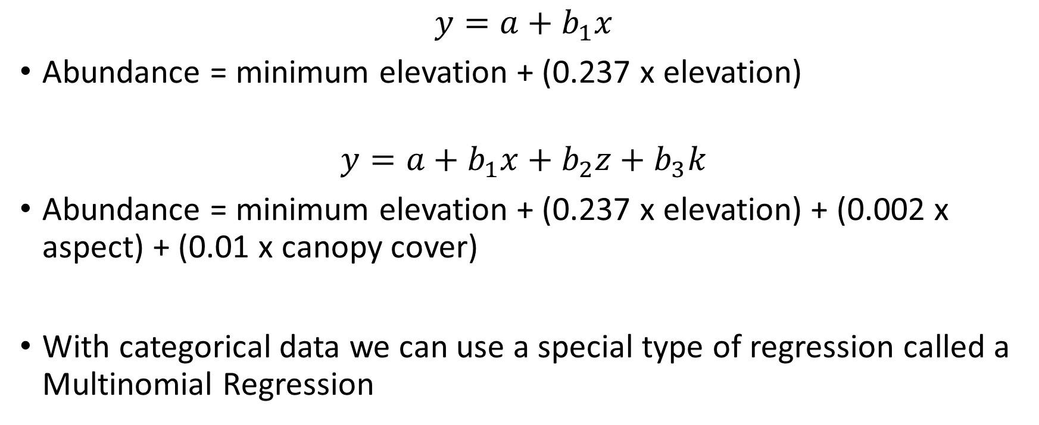
Regression modeling
$$y=a+b_{1}x$$
Abundance = minimum elevation + (0.237 x elevation)
$$y=a+b_{1}x+b_{2}z+b_{3}k$$
Abundance = minimum elevation + (0.237 x elevation) + (0.002 x aspect) + (0.01 x canopy cover)
With categorical data we can use a special type of regression called a Multinomial Regression
Quantitative Tools for SSA
Notes:
The regression model asks the question: does the species need certain elevations? Canopy cover? Etc.?

Slide 10
Quantitative Tools for SSA

Slide 11
Expert elicitation data
In the absence of good quantitative data expert elicitation might be warranted
Use expert knowledge as the basis for establishing what a species needs
Crafting questions to assess functional relationships
E.g., asking for probability of y occurring at three or more values of x
Using variation among experts to “estimate” uncertainty and variability
Quantitative Tools for SSA

Slide 12
Elicited conceptual model to establish species needs
Stream length
Population abundance
Adult survival
Resliiency
Stream connectivity
Juvenile survival
Exotic predators
Productivity
Quantitative Tools for SSA

Slide 13
Headwater chub steam length and extinction risk
Quantitative Tools for SSA

