Slide 1
Occupancy and multi-state occupancy projection models
SSA 200

Slide 2
Site occupancy projection
Year t
Year t +1
Site Occupied
?

Slide 3

Essentially a weighted coin flip

Slide 4


Probability of heads (1) = Occupancy probability (P)
1
0

Slide 5
P can be a function of environmental factors
Year t
Year t +1
Recolonize?
Site Occupied
?
These effects and relationships are estimated from data (i.e., the needs analysis) or elicited from experts
Invasive fish community affects P
Natural persistence probability (P, near 1)
Stream Length affects P
Round tail and Headwater Chub site occupancy model
Hydrology/flood frequency affects P

Slide 6
Multiple replicates
Year t
Year t +1
Year t
Year t +1
Year t
Year t +1
Site Occupied
?
Site Occupied
?
Site Occupied
?
Invasive fish community affects P
Invasive fish community affects P
Invasive fish community affects P
Natural persistence probability (P, near 1.0)
Natural persistence probability (P, near 1.0)
Natural persistence probability (P, near 1.0)
Stream Length affects P
Stream Length affects P
Stream Length affects P
Site 1, rep 1
Site 1, rep 2
Site 1, rep 3
Hydrology/flood frequency affects P
Hydrology/flood frequency affects P
Hydrology/flood frequency affects P
Year t
Year t +1
Year t
Year t +1
Year t
Year t +1
Site Occupied
?
Site Occupied
?
Site Occupied
?
Invasive fish community affects P
Invasive fish community affects P
Invasive fish community affects P
Natural persistence probability (P, near 1.0)
Natural persistence probability (P, near 1.0)
Natural persistence probability (P, near 1.0)
Stream Length affects P
Stream Length affects P
Stream Length affects P
Site 1, rep 4
Site 1, rep 5
Site 1, rep 6
Hydrology/flood frequency affects P
Hydrology/flood frequency affects P
Hydrology/flood frequency affects P

Slide 7
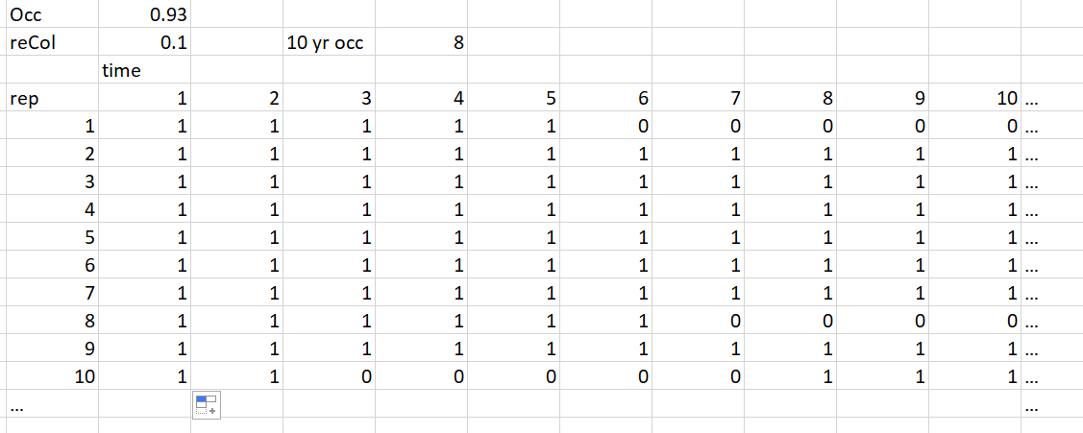
Spread sheet example
Persistence, near 1.0 – stream conditions (e.g., predators, length, etc.
Sum of replicates that are occupied at year 10

Slide 8
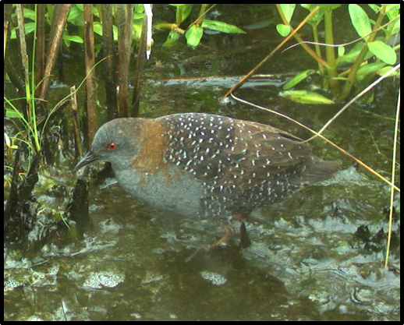
Eastern Black Rail species status assessment

Slide 9
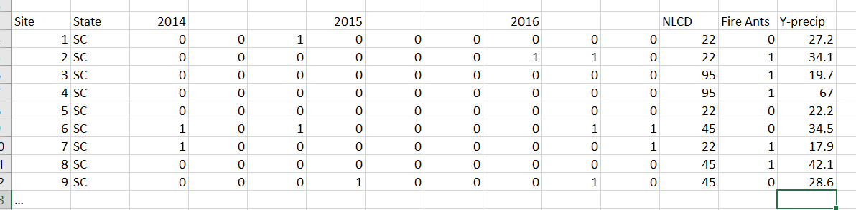
Available occupancy data:

Slide 10
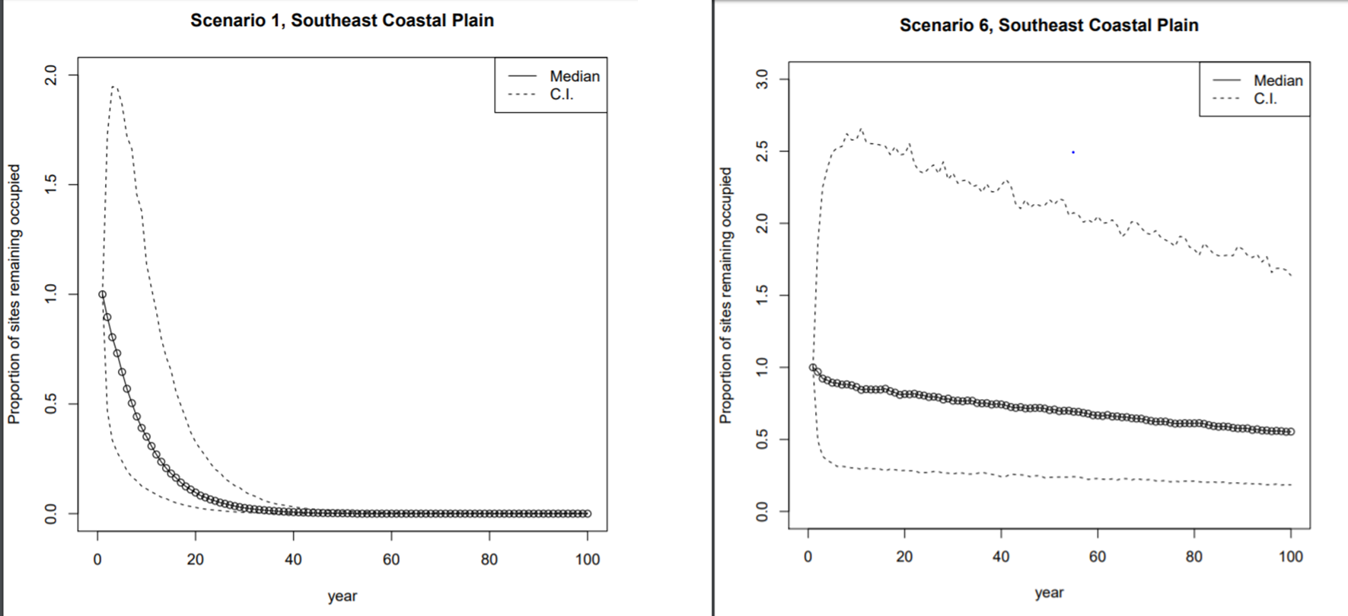
Eastern Black rail, proportion of sites occupied in the future

Slide 11

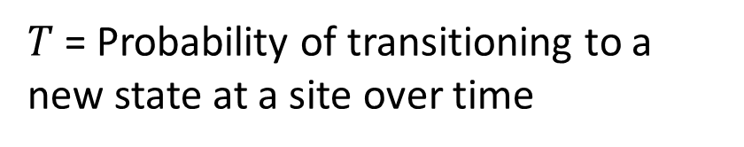
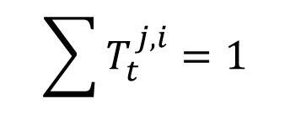


Multistate projection models
Year t +1
State 1?
Year t
$$T_{t}^{1,1}$$
Site in state 1
State 2?
$$\sum{T_{t}^{j,i}=1}$$
$$T_{t}^{2,1}$$
$$T_{t}^{E,1}$$
Extinct?
$T$= Probability of transitioning to a new state at a site over time

Slide 12


Multistate projection models
Year t +1
State 1?
Year t
$$T_{t}^{1,1}$$
Site in state 1
State 2?
$$\sum{T_{t}^{j,i}=1}$$
$$T_{t}^{1,2}$$
$$T_{t}^{1,E}$$
Extinct?
$T$= Probability of transitioning to a new state at a site over time

Slide 13
Multiple population states
Low abundance
Extirpated
High abundance

Slide 14






Multiple population states
Low abundance
$$T_{t}^{EL}$$
Extirpated
$$T_{t}^{LE}$$
$$T_{t}^{HL}$$
$$T_{t}^{LH}$$
High abundance
$$T_{t}^{HE}$$
$$T_{t}^{EH}$$

Slide 15
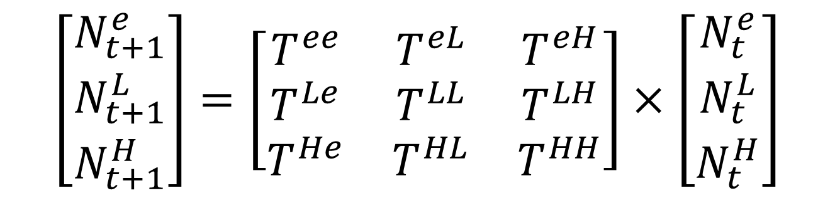
Matrix formulation
$$\left[\begin{matrix}N_{t+1}^{e} \\ N_{t+1}^{L} \\ N_{t+1}^{H}\end{matrix}\right]=\left[\begin{matrix}T^{ee} & T^{eL} & T^{eH} \\ T^{Le} & T^{LL} & T^{LH} \\ T^{He} & T^{HL} & T^{HH}\end{matrix}\right]×\left[\begin{matrix}N_{t}^{e} \\ N_{t}^{L} \\ N_{t}^{H}\end{matrix}\right]$$

Slide 16
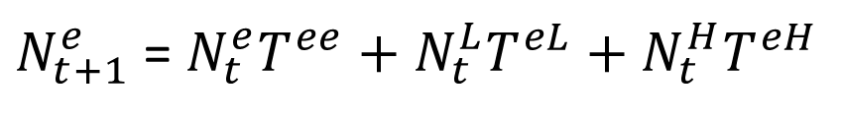
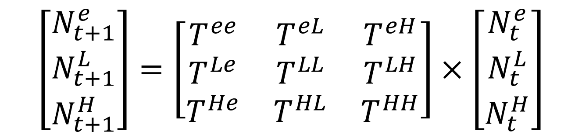
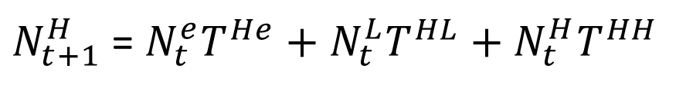
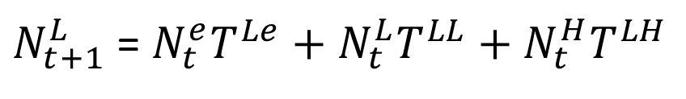
Matrix formulation
$$\left[\begin{matrix}N_{t+1}^{e} \\ N_{t+1}^{L} \\ N_{t+1}^{H}\end{matrix}\right]=\left[\begin{matrix}T^{ee} & T^{eL} & T^{eH} \\ T^{Le} & T^{LL} & T^{LH} \\ T^{He} & T^{HL} & T^{HH}\end{matrix}\right]×\left[\begin{matrix}N_{t}^{e} \\ N_{t}^{L} \\ N_{t}^{H}\end{matrix}\right]$$
$N_{t+1}^{e}$ = $N_{t}^{e}T^{ee}+N_{t}^{L}T^{eL}+N_{t}^{H}T^{eH}$
$N_{t+1}^{L}$ = $N_{t}^{e}T^{Le}+N_{t}^{L}T^{LL}+N_{t}^{H}T^{LH}$
$N_{t+1}^{H}$ = $N_{t}^{e}T^{He}+N_{t}^{L}T^{HL}+N_{t}^{H}T^{HH}$

Slide 17
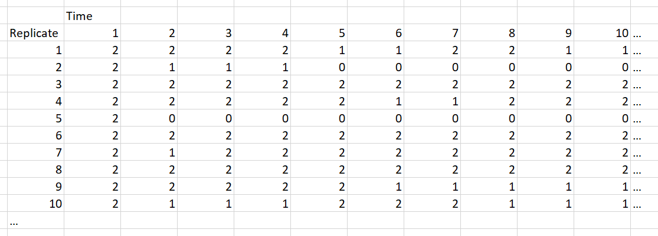
Example output

Slide 18
Modeling Headwater and Roundtail Chub resilience and redundancy

Slide 19
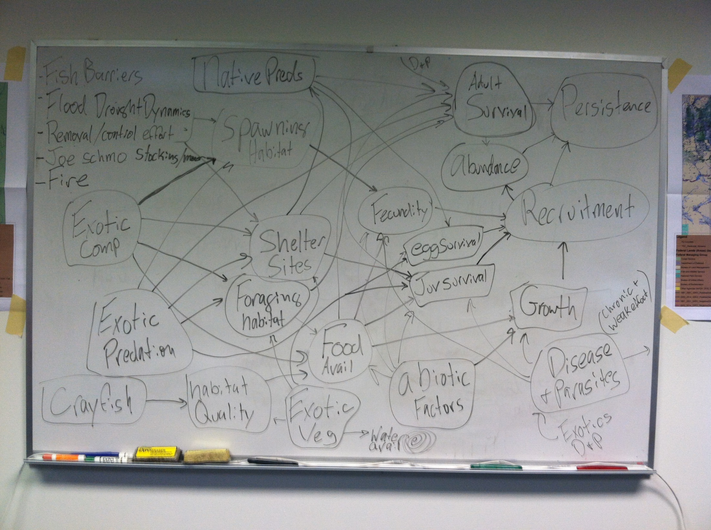

Slide 20
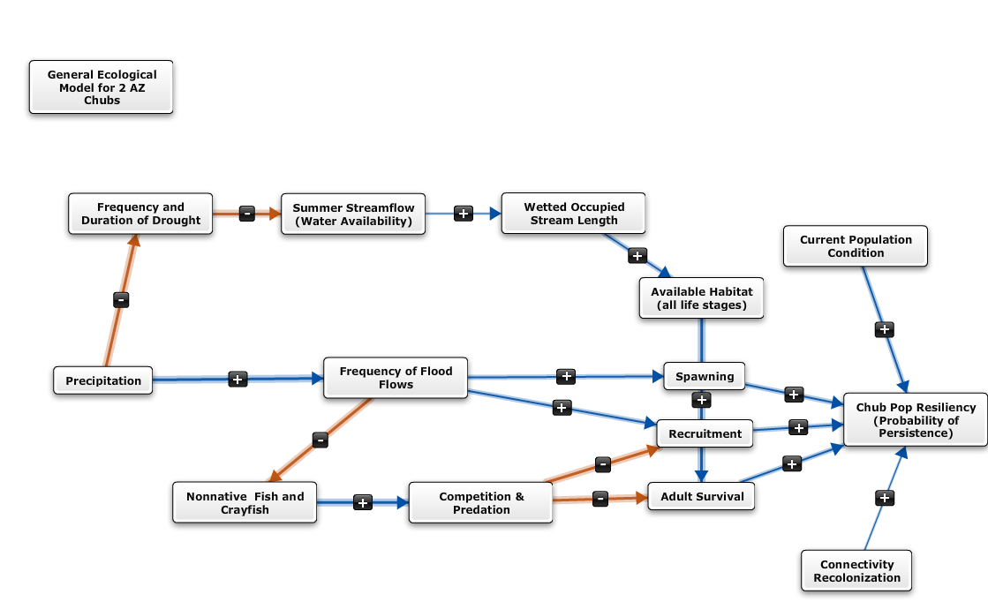
Chub Model Parameters
Model inputs

Slide 21
Environmental effects on probabilities
Year t
Year t +1
Site Occupied
?
Invasive fish community affects P
Natural persistence probability (P, near 1.0)
Stream Length affects P
Hydrology/flood frequency affects P

Slide 22
Conditional Logical functions
Link population parameters to environmental conditions by discrete logic function
“If average rainfall is less than x, then occupancy probability is y”
“if exotic community is equal to 2, then persistence probability is 0.93; if exotic community is equal to 3 then persistence probability is…”
Notes:
AMT – edit to give more specific example

Slide 23
Exotic Community
Change?
The exotic community may change from year to year
No
Yes
If there is no exotic community, there is no reduction in occupancy probability
Is there an exotic
community?
Yes
No
Level of exotic
community?
Different exotic communities affect occupancy differently
Final occupancy
probability
Here we apply the last reduction to the probability of chubs occupying a stream.

Slide 24
Continuous functions

Slide 25
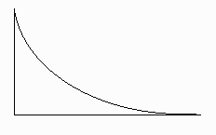
Stream Length
Change?
A stream may change length over time
If the stream does not change length, there is no effect of this parameter on occupancy.
No
Yes
If the stream does change length, there will be an effect on the probability of occupancy.
Effect on
P occupancy
The relationship between stream length and occupancy probability is curvilinear, a negative exponential relationship. The longer a stream is, the less it effects occupancy.
Stream Length

Slide 26
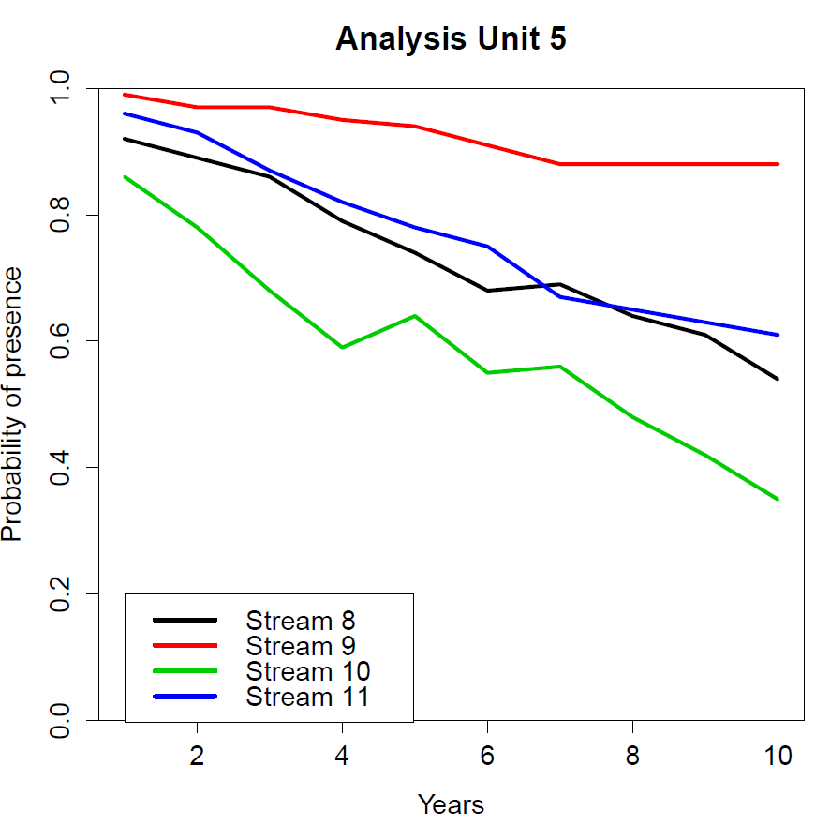
Model output

Slide 27
Measurement error
Simulation data assume perfect knowledge of the system
i.e., no partial observability/observation error in monitoring data
May be important to add observation error to output from the models
Recovery planning
Section 7 planning
Delisting decisions
Observed system response will not match predictions
This is the case no matter, but account for all uncertainties might be important

Slide 28
Modify model outputs
Randomized adjustments to model output data
Spread sheet example

Slide 29
Questions?

